Slide 1
Term Ordering for Non-Reachability of (Conditional) Rewriting
@IJCAR2022
YAMADA, Akihisa

Slide 2

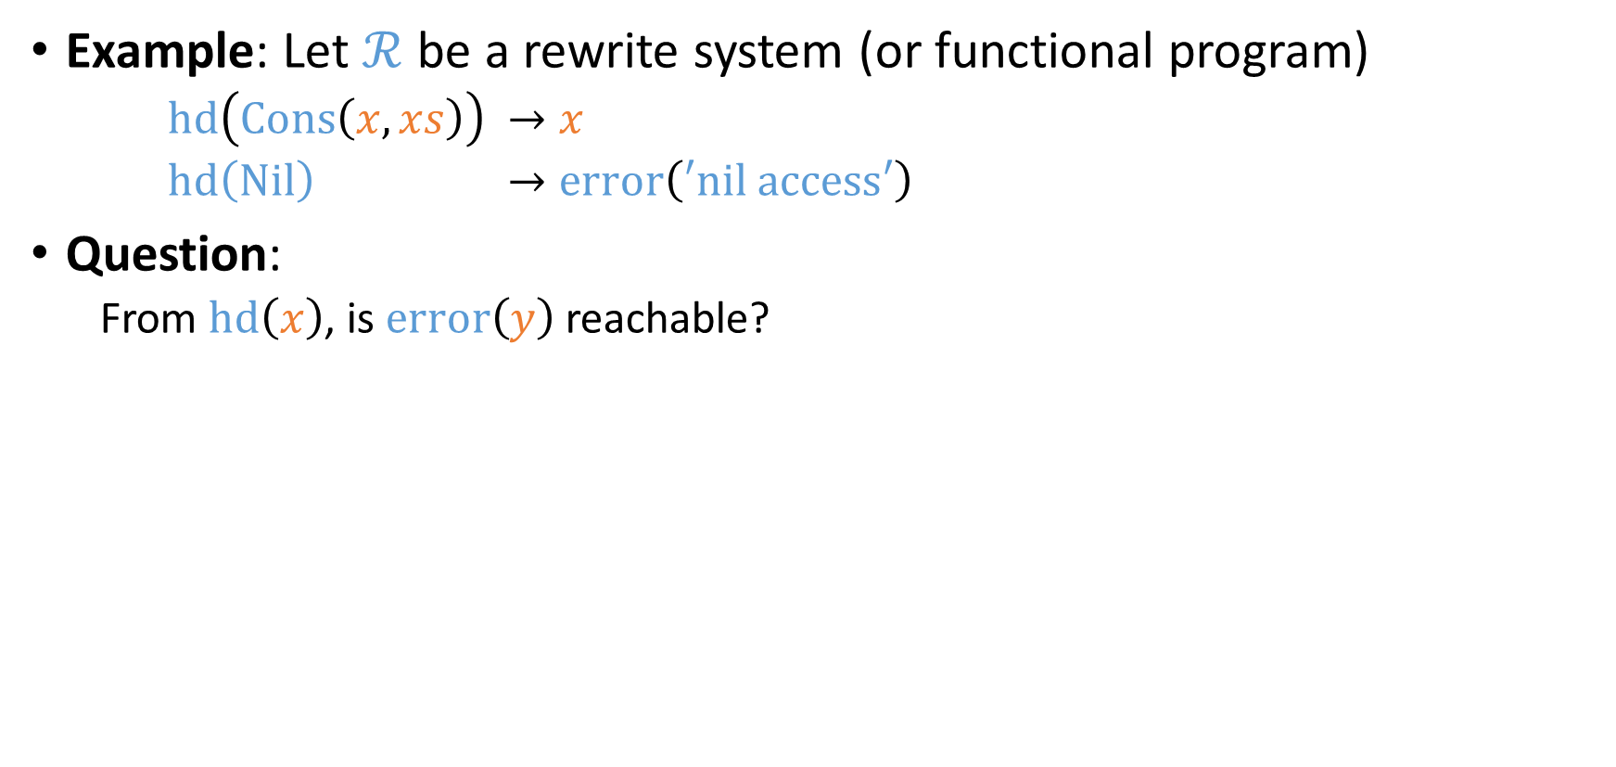

Reachability (in term rewriting)
Example: Let $ℛ$ be a rewrite system (or functional program)
$\text{hd}\left(\text{Cons}\left(x,xs\right)\right)$ $→x$
$\text{hd}\left(\text{Nil}\right)$ $→\text{error}\left(\text{′}\text{nil} \text{access}\text{′}\right)$
Question:
From $\text{hd}\left(x\right)$, is $\text{error}\left(y\right)$ reachable?
Classic answer:
NO! because $\text{hd}\left(x\right)↛_{ℛ}^{∗}\text{error}\left(y\right)$
Our answer:
SAT! solution $\left[x↦\text{Nil},y↦\text{′}\text{nil} \text{access}\text{′}\right]$
Definition: $s↠t$ is $ℛ$-satisfiable $:⟺$ $∃θ. sθ→_{ℛ}^{∗}tθ$

Slide 3
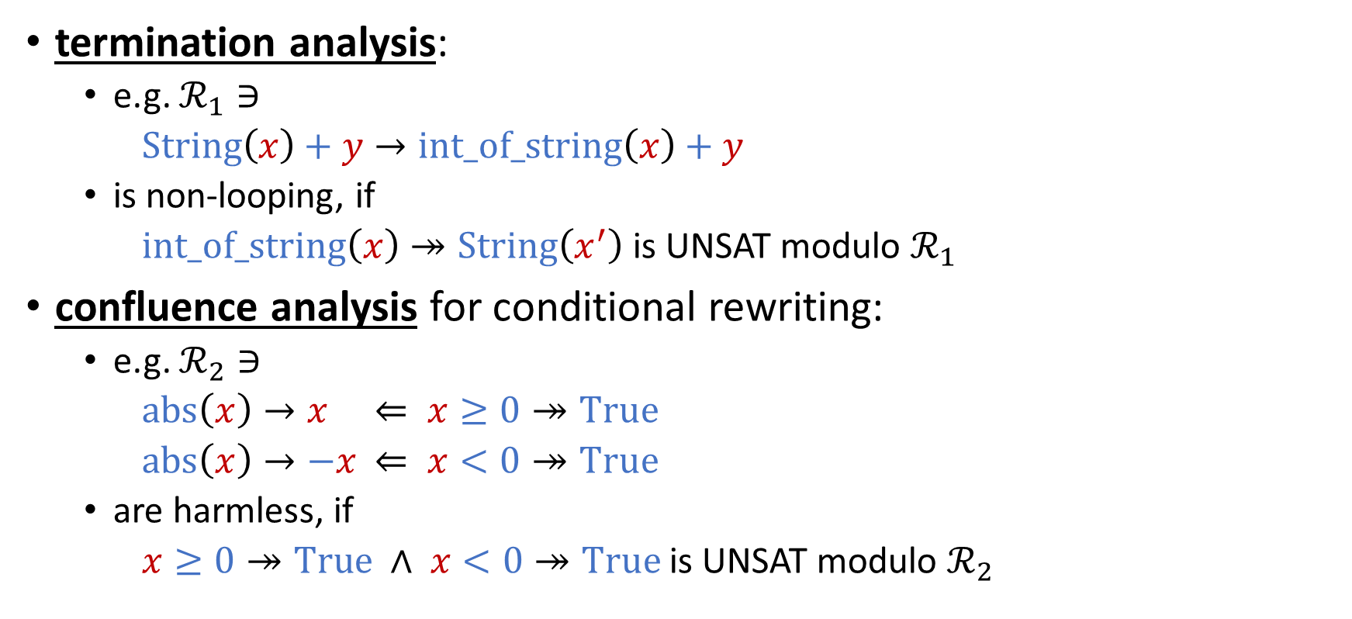
Our motivation stems from...
termination analysis:
e.g. $ℛ_{1}∋$
$\text{String}\left(x\right)+y→\text{int}\text{_}\text{of}\text{_}\text{string}\left(x\right)+y$
is non-looping, if
$\text{int}\text{_}\text{of}\text{_}\text{string}\left(x\right)↠\text{String}\left(x^{′}\right)$ is UNSAT modulo $ℛ_{1}$
confluence analysis for conditional rewriting:
e.g. $ℛ_{2}∋$
$\text{abs}\left(x\right)→x$ $⇐ x≥0↠\text{True}$
$\text{abs}\left(x\right)→−x$ $⇐ x<0↠\text{True}$
are harmless, if
$x≥0↠\text{True} ∧ x<0↠\text{True}$ is UNSAT modulo $ℛ_{2}$

Slide 4
Contribution 1: Rewrite pair

Slide 5
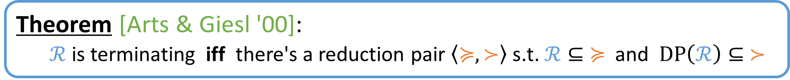

Reduction pair [Arts & Giesl '00, Hirokawa & Middeldorp '03, Yamada '21]
Definition: $\left(≽,≻\right)$ is a reduction pair if
$≽$ and $≻$ are closed under substitutions ($s≽t⟹sθ≽tθ$)
$≽$ is closed under contexts ($s≽t⟹C\left[s\right]≽C\left[t\right]$)
$≽$ is a quasi-order
$≻$ is well-founded
$≽⋅≻⋅≽ ⊆ ≻$
$≻ ⊆ ≽$
Theorem [Arts & Giesl '00]:
$ℛ$ is terminating iff there's a reduction pair $\left\langle ≽,≻\right\rangle$ s.t. $ℛ⊆ ≽$ and $DP\left(ℛ\right)⊆ ≻$
Many techniques exist for finding reduction pairs (for termination)

Slide 6
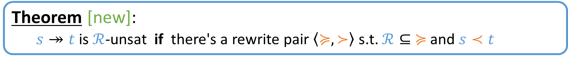
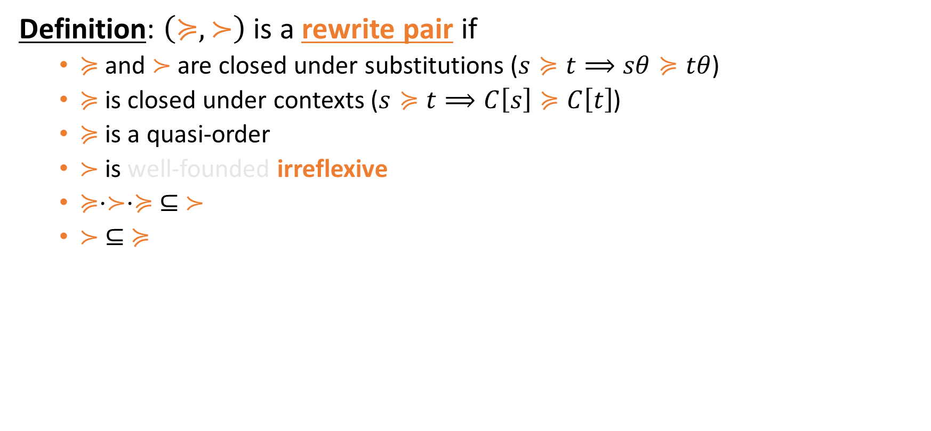
Rewrite pair [new]
Definition: $\left(≽,≻\right)$ is a rewrite pair if
$≽$ and $≻$ are closed under substitutions ($s≽t⟹sθ≽tθ$)
$≽$ is closed under contexts ($s≽t⟹C\left[s\right]≽C\left[t\right]$)
$≽$ is a quasi-order
$≻$ is well-founded irreflexive
$≽⋅≻⋅≽ ⊆ ≻$
$≻ ⊆ ≽$
rewrite order = reduction order[w.f. ↦ irrefl]
rewrite pair = reduction pair[w.f. ↦ irrefl]
Theorem [new]:
$s↠t$ is $ℛ$-unsat if there's a rewrite pair $\left\langle ≽,≻\right\rangle$ s.t. $ℛ⊆ ≽$ and $s≺t$

Slide 7

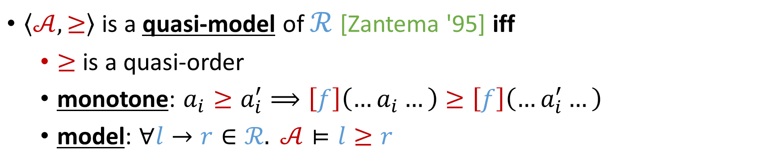
Interpretation method [Manna & Ness '70]
$ℱ$-algebra $𝒜=\left\langle A,\left[⋅\right]\right\rangle$ s.t. $\left[f\right] :A^{n}→A$ for $n$-ary $f∈ℱ$
$\left[s\right] :A^{V}→A$ $\left[x\right]α=α\left(x\right)$ $\left[f\left(s_{1},…,s_{n}\right)\right]α=\left[f\right]\left(\left[s_{1}\right]α,…,\left[s_{n}\right]α\right)$
$𝒜⊨s≥t$ $:⟺ ∀α :V→A. \left[s\right]α≥\left[t\right]α$
$\left\langle 𝒜,≥\right\rangle$ is a quasi-model of $ℛ$ [Zantema '95] iff
$≥$ is a quasi-order
monotone: $a_{i}≥a_{i}^{′}⟹\left[f\right]\left(…a_{i}…\right)≥\left[f\right]\left(…a_{i}^{′}…\right)$
model: $∀l→r∈ℛ. 𝒜⊨l≥r$
Corollary: $s↠t$ is $ℛ$-unsat if
$\left\langle 𝒜,≥\right\rangle$ is a quasi-model of $ℛ$, $\left\langle ≥,>\right\rangle$ is an order pair and $𝒜⊨s<t$

Slide 8
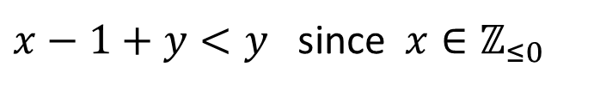

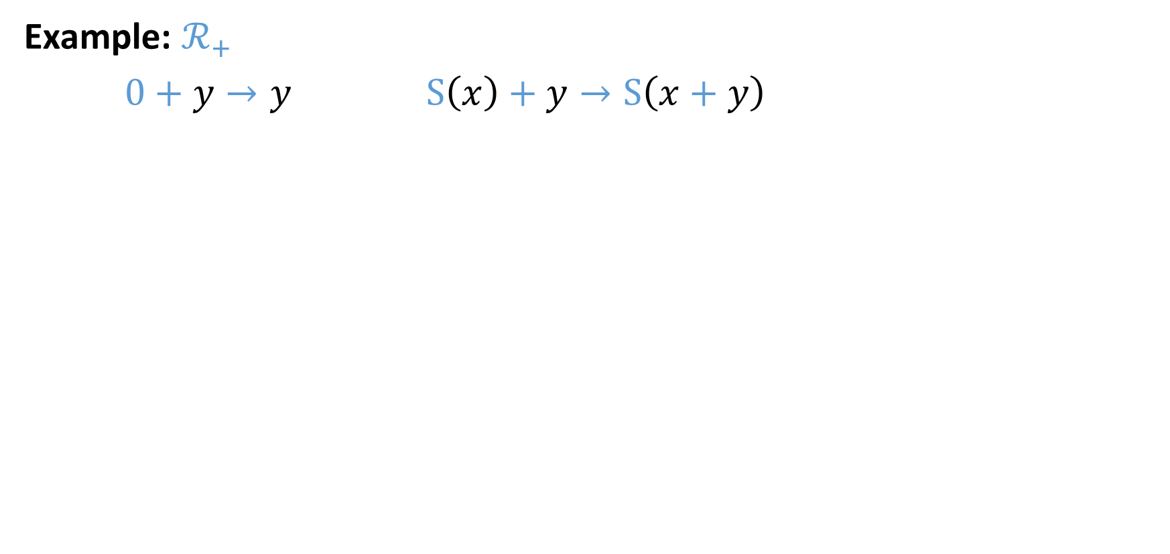
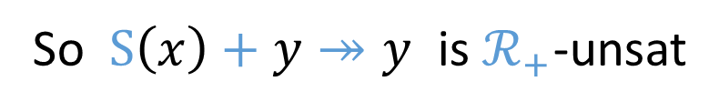

Interpretation method
Example: $ℛ_{+}$
$0+y→y$ $S\left(x\right)+y→S\left(x+y\right)$
Let $𝒜=\left\langle ℤ_{≤0},\left[⋅\right]\right\rangle$, $\left[0\right]=0$ $\left[S\right]\left(x\right)=x−1$ $x \left[+\right] y=x+y$
Then $\left\langle 𝒜,≥\right\rangle$ is a quasi-model of $ℛ_{+}$
$\left[0+y\right]≥\left[y\right]$ $\left[S\left(x\right)+y\right]≥\left[S\left(x+y\right)\right]$
$$0+y≥y$$
$$x−1+y≥x+y−1$$
So $S\left(x\right)+y↠y$ is $ℛ_{+}$-unsat
$x−1+y<y$ since $x∈ℤ_{≤0}$

Slide 9
Contribution 2: Co-rewrite pair

Slide 10
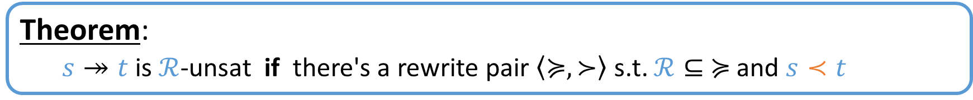
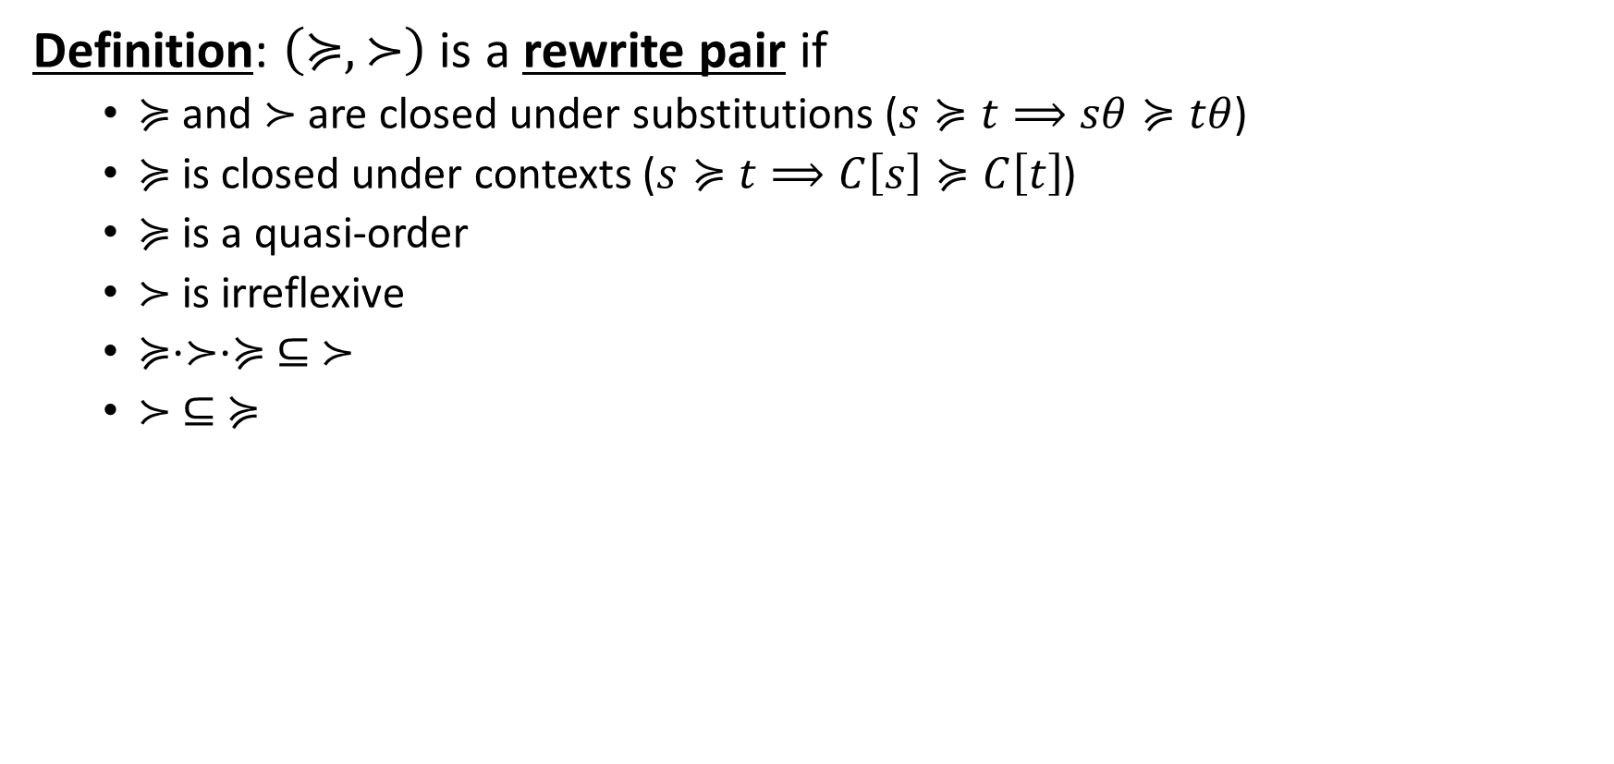
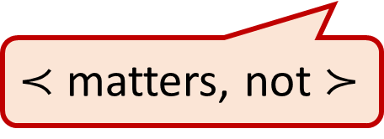
Rewrite pair (again)
Definition: $\left(≽,≻\right)$ is a rewrite pair if
$≽$ and $≻$ are closed under substitutions ($s≽t⟹sθ≽tθ$)
$≽$ is closed under contexts ($s≽t⟹C\left[s\right]≽C\left[t\right]$)
$≽$ is a quasi-order
$≻$ is irreflexive
$≽⋅≻⋅≽ ⊆ ≻$
$≻ ⊆ ≽$
Theorem:
$s↠t$ is $ℛ$-unsat if there's a rewrite pair $\left\langle ≽,≻\right\rangle$ s.t. $ℛ⊆ ≽$ and $s≺t$
$≺$ matters, not $≻$

Slide 11

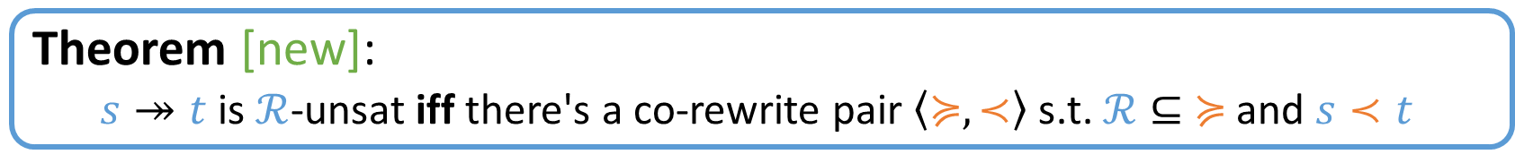
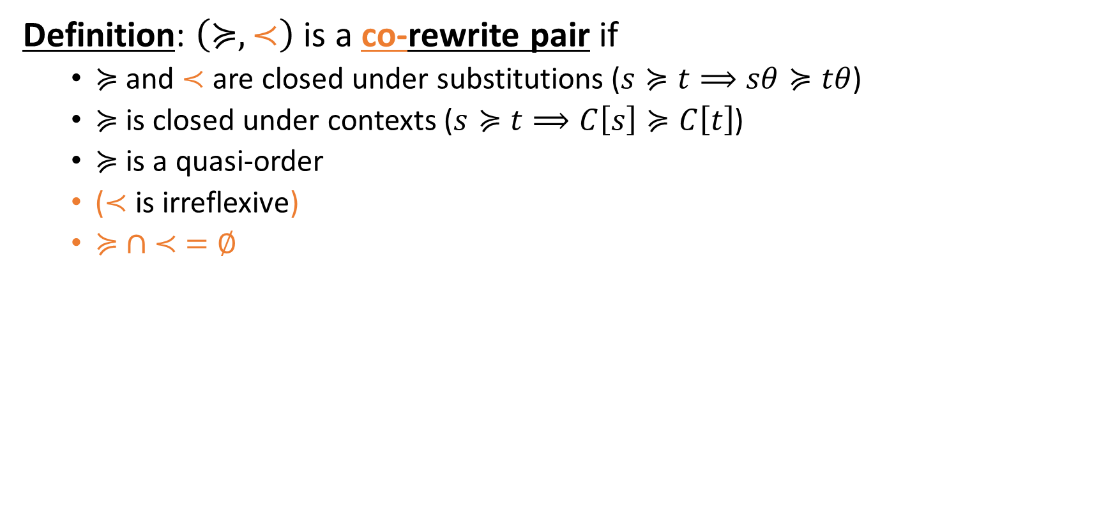
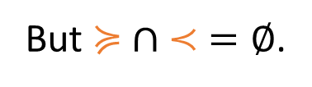


Co-rewrite pair
Definition: $\left(≽,≺\right)$ is a co-rewrite pair if
$≽$ and $≺$ are closed under substitutions ($s≽t⟹sθ≽tθ$)
$≽$ is closed under contexts ($s≽t⟹C\left[s\right]≽C\left[t\right]$)
$≽$ is a quasi-order
($≺$ is irreflexive)
$≽ ∩ ≺ =∅$
Theorem [new]:
$s↠t$ is $ℛ$-unsat iff there's a co-rewrite pair $\left\langle ≽,≺\right\rangle$ s.t. $ℛ⊆ ≽$ and $s≺t$
Proof
$\left(⇐\right)$ Suppose $sθ→_{ℛ}^{∗}tθ$. Then $sθ≽tθ$.
But $≽ ∩ ≺ =∅$.
Also $s≺t$.
Thus $sθ≺tθ$.
$\left(⇒\right)$ $\left\langle →_{ℛ}^{∗},≺\right\rangle$ is a co-rewrite pair, where: $s≺t⟺s↠t \text{is} ℛ$-$\text{unsat}$

Slide 12
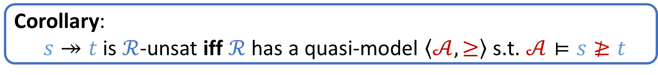

Co-rewrite pair
Definition: $\left(≽,≺\right)$ is a co-rewrite pair if
$≽$ and $≺$ are closed under substitutions ($s≽t⟹sθ≽tθ$)
$≽$ is closed under contexts ($s≽t⟹C\left[s\right]≽C\left[t\right]$)
$≽$ is a quasi-order
($≺$ is irreflexive)
$≽ ∩ ≺ =∅$
Theorem [new]:
$s↠t$ is $ℛ$-unsat iff there's a co-rewrite pair $\left\langle ≽,≺\right\rangle$ s.t. $ℛ⊆ ≽$ and $s≺t$
Corollary:
$s↠t$ is $ℛ$-unsat iff $ℛ$ has a quasi-model $\left\langle 𝒜,≥\right\rangle$ s.t. $𝒜⊨s≱t$
Proof: with $l≽r≔𝒜⊨l≥r$ and $l≺r≔𝒜⊨l≱r$

Slide 13
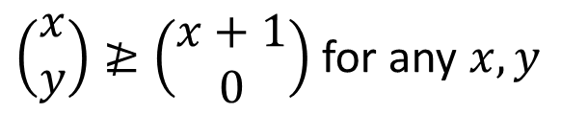
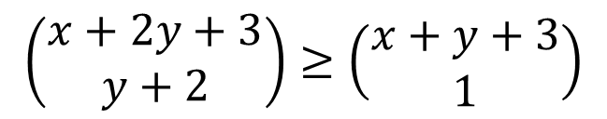
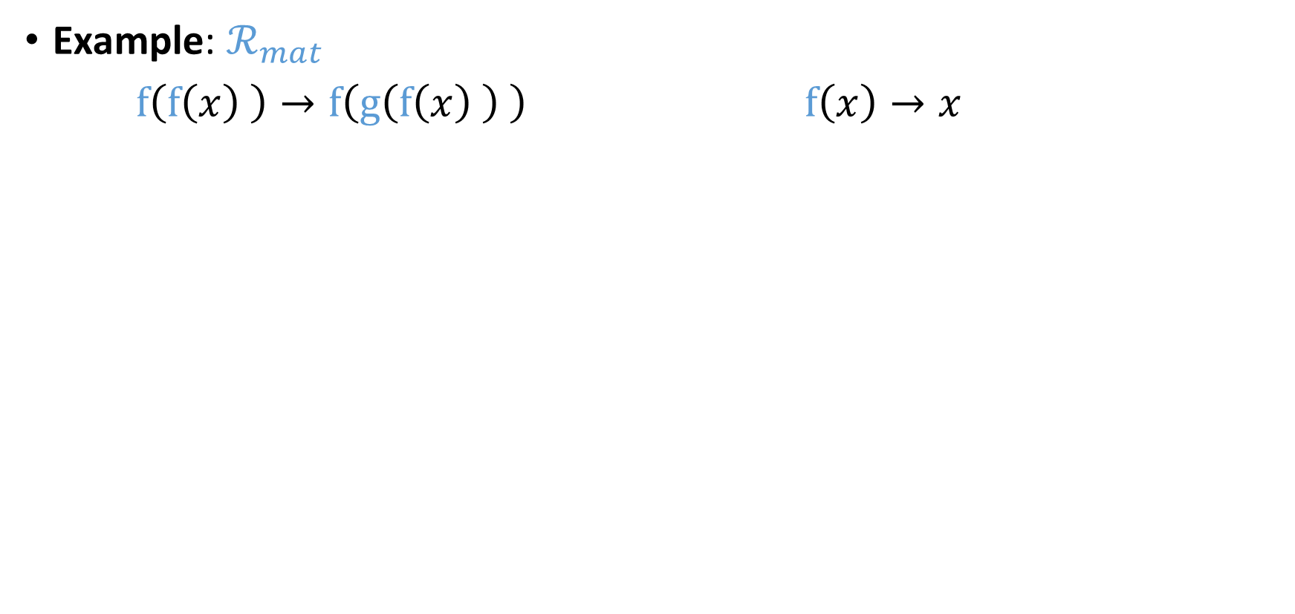


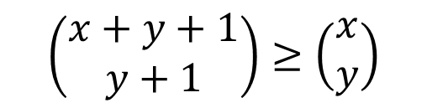
Matrix interpretations [Endrullis+'08]
Example: $ℛ_{mat}$
$f\left(f\left(x\right) \right)→f\left(g\left(f\left(x\right) \right) \right)$ $f\left(x\right)→x$
Define $𝒜=\left\langle ℕ^{2},\left[⋅\right]\right\rangle$ by $\left[f\right]\left(\begin{aligned}x \\ y\end{aligned}\right)=\left(\begin{aligned}x+y+1 \\ y+1\end{aligned}\right)$ $\left[g\right]\left(\begin{aligned}x \\ y\end{aligned}\right)=\left(\begin{aligned}x+1 \\ 0\end{aligned}\right)$
Then $\left\langle 𝒜,≥\right\rangle$ is a quasi-model of $ℛ_{mat}$
$f\left(f\left(\begin{aligned}x \\ y\end{aligned}\right) \right)≥f\left(g\left(f\left(\begin{aligned}x \\ y\end{aligned}\right) \right) \right)$ $f\left(\begin{aligned}x \\ y\end{aligned}\right)≥\left(\begin{aligned}x \\ y\end{aligned}\right)$
$$\left(\begin{aligned}x+2y+3 \\ y+2\end{aligned}\right)≥\left(\begin{aligned}x+y+3 \\ 1\end{aligned}\right)$$
$$\left(\begin{aligned}x+y+1 \\ y+1\end{aligned}\right)≥\left(\begin{aligned}x \\ y\end{aligned}\right)$$
So e.g. $x↠g\left(x\right)$ is $ℛ_{mat}$-unsat
$\left(\begin{aligned}x \\ y\end{aligned}\right)≱\left(\begin{aligned}x+1 \\ 0\end{aligned}\right)$ for any $x,y$
note $\left(\begin{aligned}x \\ y\end{aligned}\right)≮\left(\begin{aligned}x+1 \\ 0\end{aligned}\right)$ !

Slide 14
Contribution 3: WPO as rewrite pair

Slide 15
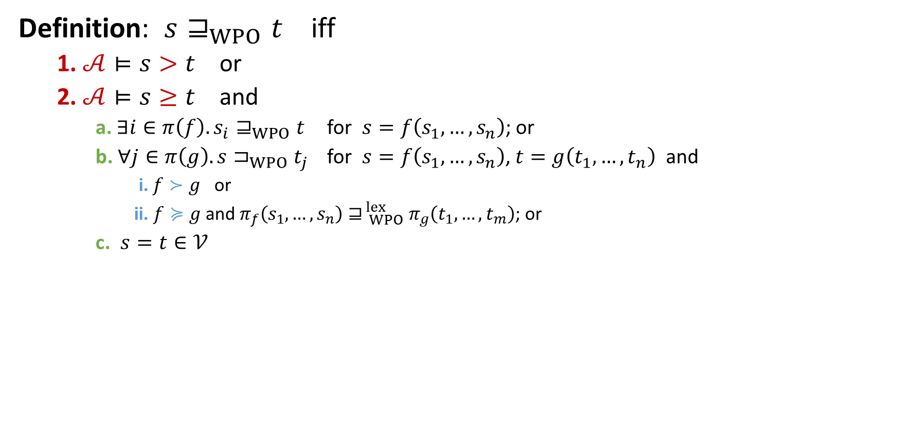
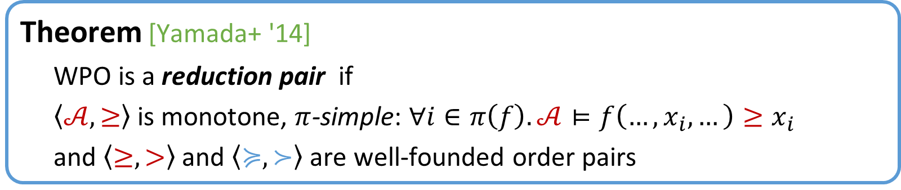
WPO = LPO + (G)KBO
Definition: $s⊒_{WPO}t$ iff
1. $𝒜⊨s>t$ or
2. $𝒜⊨s≥t$ and
a. $∃i∈π\left(f\right).s_{i}⊒_{WPO}t$ for $s=f\left(s_{1},…,s_{n}\right)$; or
b. $∀j∈π\left(g\right). s⊐_{WPO}t_{j}$ for $s=f\left(s_{1},…,s_{n}\right)$, $t=g\left(t_{1},…,t_{n}\right)$ and
i. $f≻g$ or
ii. $f≽g$ and $π_{f}\left(s_{1},…,s_{n}\right)⊒_{ WPO}^{ lex}π_{g}\left(t_{1},…,t_{m}\right)$; or
c. $s=t∈𝒱$
Theorem [Yamada+ '14]
WPO is a reduction pair if
$\left\langle 𝒜,≥\right\rangle$ is monotone, $π$-simple: $∀i∈π\left(f\right). 𝒜⊨f\left(…,x_{i},…\right)≥x_{i}$
and $\left\langle ≥,>\right\rangle$ and $\left\langle ≽,≻\right\rangle$ are well-founded order pairs

Slide 16
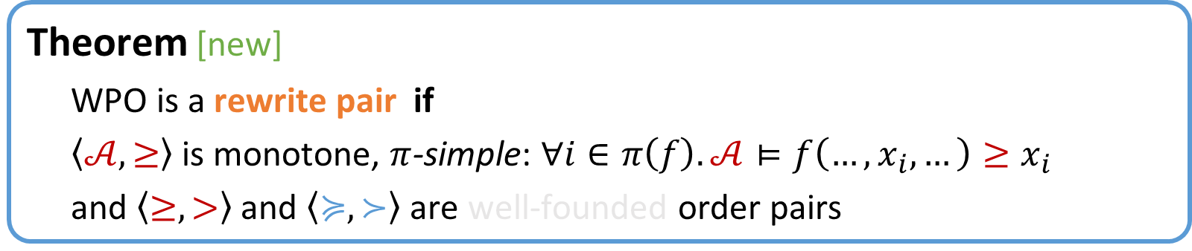
WPO = LPO + (G)KBO
Definition: $s⊒_{WPO}t$ iff
1. $𝒜⊨s>t$ or
2. $𝒜⊨s≥t$ and
a. $∃i∈π\left(f\right).s_{i}⊒_{WPO}t$ for $s=f\left(s_{1},…,s_{n}\right)$; or
b. $∀j∈π\left(g\right). s⊐_{WPO}t_{j}$ for $s=f\left(s_{1},…,s_{n}\right)$, $t=g\left(t_{1},…,t_{n}\right)$ and
i. $f≻g$ or
ii. $f≽g$ and $π_{f}\left(s_{1},…,s_{n}\right)⊒_{ WPO}^{ lex}π_{g}\left(t_{1},…,t_{m}\right)$; or
c. $s=t∈𝒱$
Theorem [new]
WPO is a rewrite pair if
$\left\langle 𝒜,≥\right\rangle$ is monotone, $π$-simple: $∀i∈π\left(f\right). 𝒜⊨f\left(…,x_{i},…\right)≥x_{i}$
and $\left\langle ≥,>\right\rangle$ and $\left\langle ≽,≻\right\rangle$ are well-founded order pairs

Slide 17
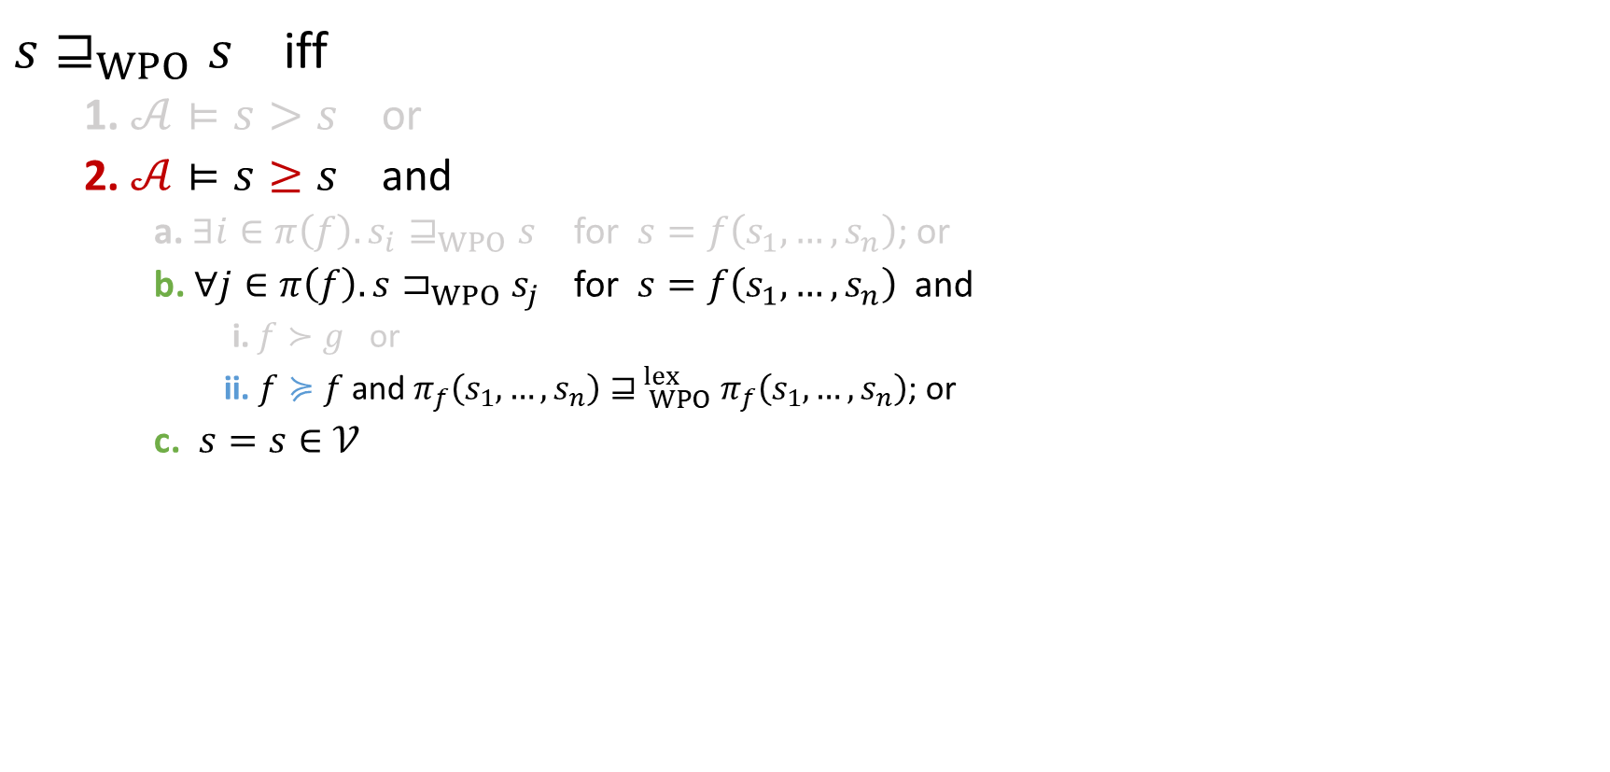



WPO is reflexive
$s⊒_{WPO}s$ iff
1. $𝒜⊨s>s$ or
2. $𝒜⊨s≥s$ and
a. $∃i∈π\left(f\right).s_{i}⊒_{WPO}s$ for $s=f\left(s_{1},…,s_{n}\right)$; or
b. $∀j∈π\left(f\right). s⊐_{WPO}s_{j}$ for $s=f\left(s_{1},…,s_{n}\right)$ and
i. $f≻g$ or
ii. $f≽f$ and $π_{f}\left(s_{1},…,s_{n}\right)⊒_{ WPO}^{ lex}π_{f}\left(s_{1},…,s_{n}\right)$; or
c. $s=s∈𝒱$
✔
?
✔
✔
Lemma: WPO is reflexive
and $∀i∈π\left(f\right). f(…s_{i}…)⊐_{WPO}s_{i}$
if $≥$ and $≽$ are reflexive
and $\left\langle 𝒜,≥\right\rangle$ is $π$-simple

Slide 18
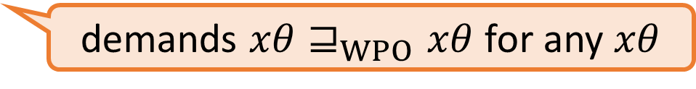
WPO is closed under substitution
✔
Definition: $s⊒_{WPO}t$ iff
1. $𝒜⊨s>t$ or
2. $𝒜⊨s≥t$ and
a. $∃i∈π\left(f\right).s_{i}⊒_{WPO}t$ for $s=f\left(s_{1},…,s_{n}\right)$; or
b. $∀j∈π\left(g\right). s⊐_{WPO}t_{j}$ for $s=f\left(s_{1},…,s_{n}\right)$, $t=g\left(t_{1},…,t_{n}\right)$ and
i. $f≻g$ or
ii. $f≽g$ and $π_{f}\left(s_{1},…,s_{n}\right)⊒_{ WPO}^{ lex}π_{g}\left(t_{1},…,t_{m}\right)$; or
c. $s=t∈𝒱$
demands $xθ⊒_{WPO}xθ$ for any $xθ$
Lemma: WPO is closed under substitution
if $≥$ and $≽$ are reflexive and $\left\langle 𝒜,≥\right\rangle$ is $π$-simple
No need to be order!

Slide 19
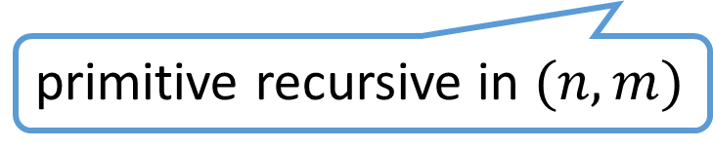


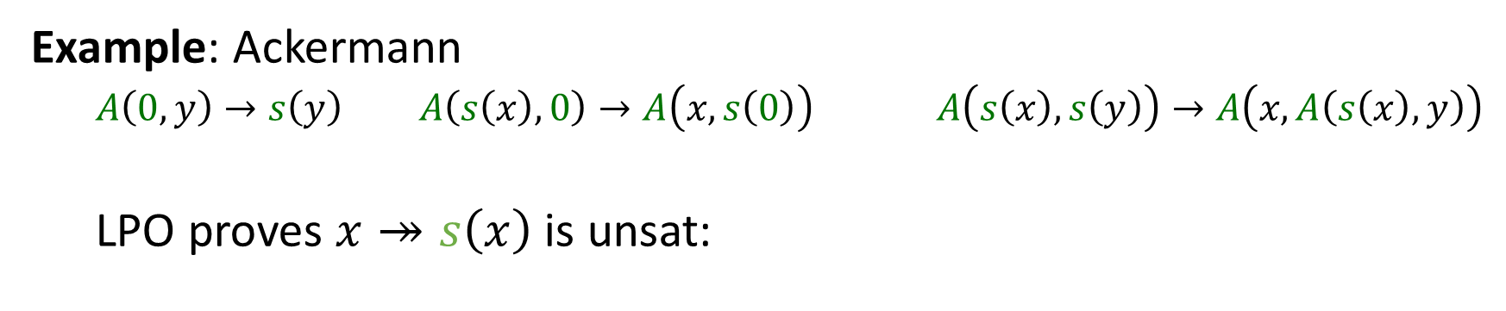

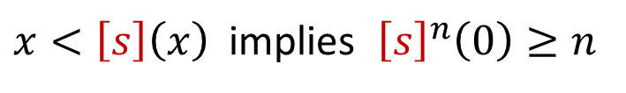

Why WPO (or LPO)?
Example: Ackermann
$A\left(0,y\right)→s\left(y\right)$ $A\left(s\left(x\right),0\right)→A\left(x,s\left(0\right)\right)$ $A\left(s\left(x\right),s\left(y\right)\right)→A\left(x,A\left(s\left(x\right),y\right)\right)$
LPO proves $x↠s\left(x\right)$ is unsat:
$$x≼_{LPO}s\left(x\right)$$
no primitive-recursive interpretation can:
$x<\left[s\right]\left(x\right)$ implies ${\left[s\right]}^{n}\left(0\right)≥n$
$$\left[A\right]\left({\left[s\right]}^{n}\left(0\right),{\left[s\right]}^{m}\left(0\right)\right)$$
$$≥{\left[s\right]}^{A\left(n,m\right)}\left(0\right)$$
$$≥A\left(n,m\right)$$
primitive recursive in $(n,m)$
no primitive-recursive bound

Slide 20
Contribution 3: WPO as co-rewrite pair

Slide 21

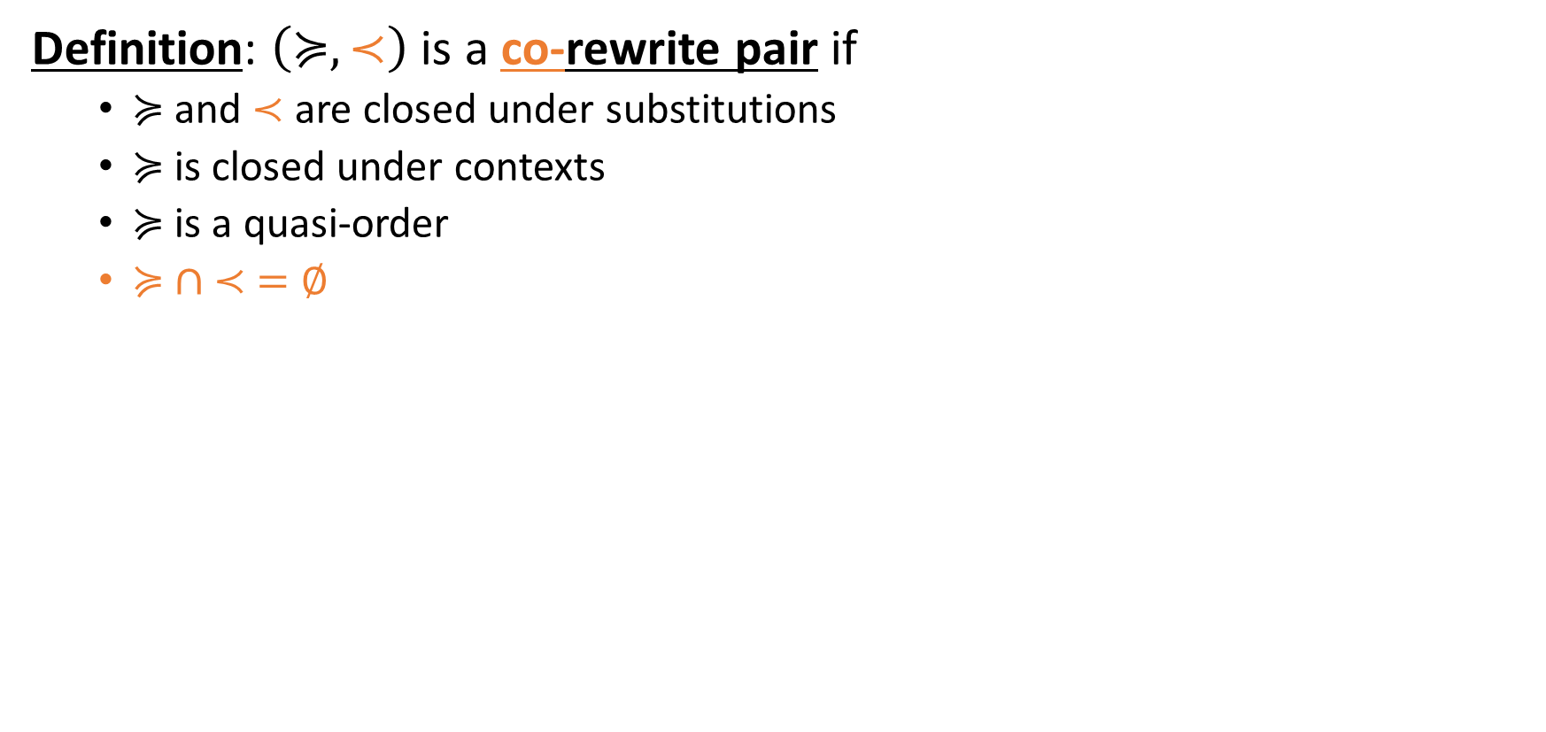
Co-rewrite pair (again)
Definition: $\left(≽,≺\right)$ is a co-rewrite pair if
$≽$ and $≺$ are closed under substitutions
$≽$ is closed under contexts
$≽$ is a quasi-order
$≽ ∩ ≺ =∅$
When $≽ = ≽_{WPO}$ what should $≺$ be?

Slide 22
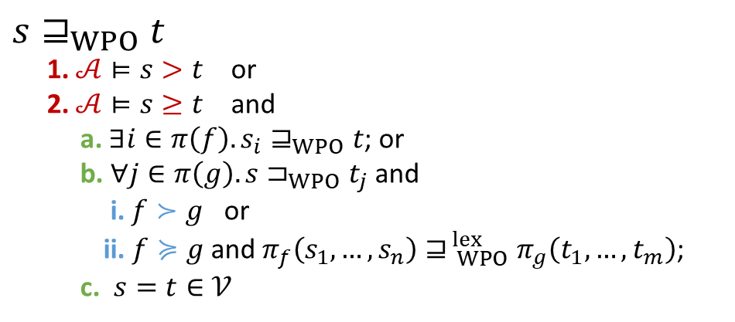
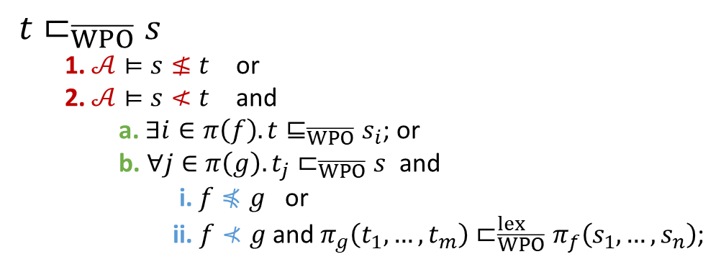
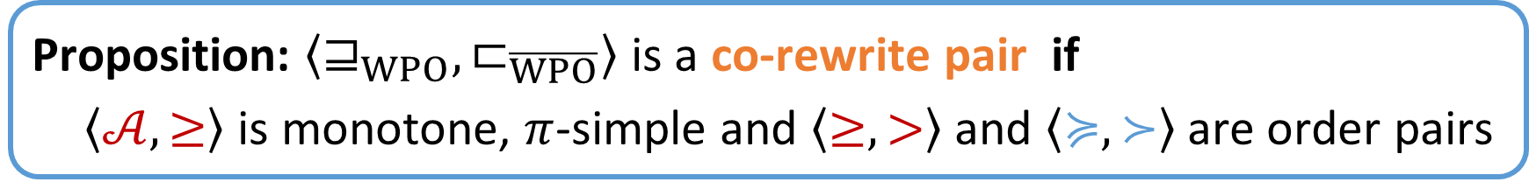
WPO as co-rewrite pair
$s⊒_{WPO}t$
1. $𝒜⊨s>t$ or
2. $𝒜⊨s≥t$ and
a. $∃i∈π\left(f\right).s_{i}⊒_{WPO}t$; or
b. $∀j∈π\left(g\right). s⊐_{WPO}t_{j}$ and
i. $f≻g$ or
ii. $f≽g$ and $π_{f}\left(s_{1},…,s_{n}\right)⊒_{ WPO}^{ lex}π_{g}\left(t_{1},…,t_{m}\right)$;
c. $s=t∈𝒱$
$t⊏_{\overline{WPO}}s$
1. $𝒜⊨s≰t$ or
2. $𝒜⊨s≮t$ and
a. $∃i∈π\left(f\right).t⊑_{\overline{WPO}}s_{i}$; or
b. $∀j∈π\left(g\right). t_{j}⊏_{\overline{WPO}}s$ and
i. $f⋠g$ or
ii. $f⊀g$ and $π_{g}\left(t_{1},…,t_{m}\right)⊏_{\overline{WPO}}^{lex}π_{f}\left(s_{1},…,s_{n}\right)$;
Proposition: $\left\langle ⊒_{WPO},⊏_{\overline{WPO}}\right\rangle$ is a co-rewrite pair if
$\left\langle 𝒜,≥\right\rangle$ is monotone, $π$-simple and $\left\langle ≥,>\right\rangle$ and $\left\langle ≽,≻\right\rangle$ are order pairs

Slide 23
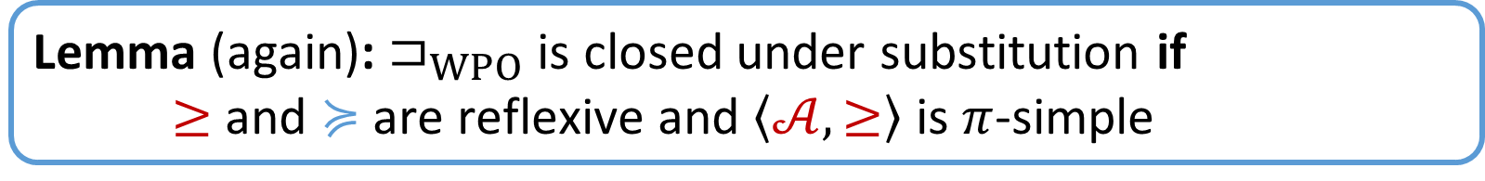
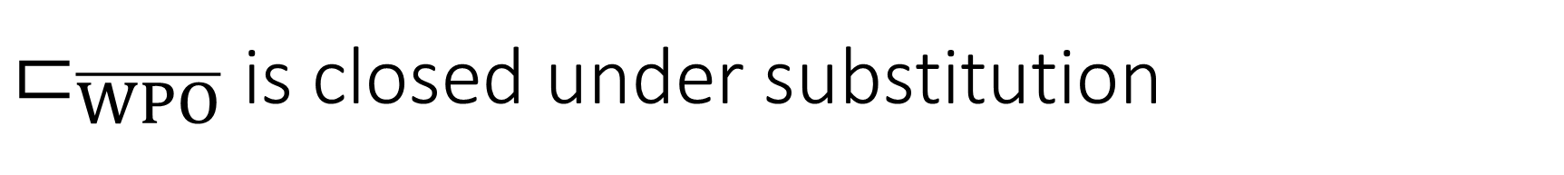

$⊏_{\overline{WPO}}$ is closed under substitution
Lemma (again): $⊐_{WPO}$ is closed under substitution if $≥$ and $≽$ are reflexive and $\left\langle 𝒜,≥\right\rangle$ is $π$-simple
Corollary: $⊏_{\overline{WPO}}$ is closed under substitution if $≮$ and $⊀$ are reflexive and $\left\langle 𝒜,≮\right\rangle$ is $π$-simple

Slide 24

$⊏_{\overline{WPO}}$ is closed under substitution
Lemma (again): $⊐_{WPO}$ is closed under substitution if $≥$ and $≽$ are reflexive and $\left\langle 𝒜,≥\right\rangle$ is $π$-simple
Corollary: $⊏_{\overline{WPO}}$ is closed under substitution if $>$ and $≻$ are irreflexive and $\left\langle 𝒜,≮\right\rangle$ is $π$-simple

Slide 25
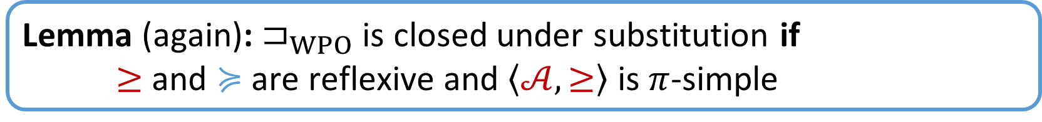

$⊏_{\overline{WPO}}$ is closed under substitution
Lemma (again): $⊐_{WPO}$ is closed under substitution if $≥$ and $≽$ are reflexive and $\left\langle 𝒜,≥\right\rangle$ is $π$-simple
Corollary: $⊏_{\overline{WPO}}$ is closed under substitution if $\left\langle ≥,>\right\rangle$ is an order pair, $≻$ is irreflexive and $\left\langle 𝒜,≥\right\rangle$ is $π$-simple

Slide 26

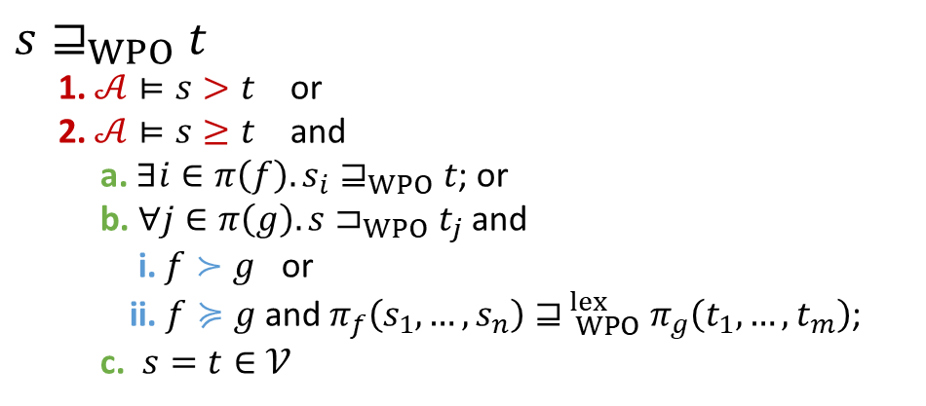

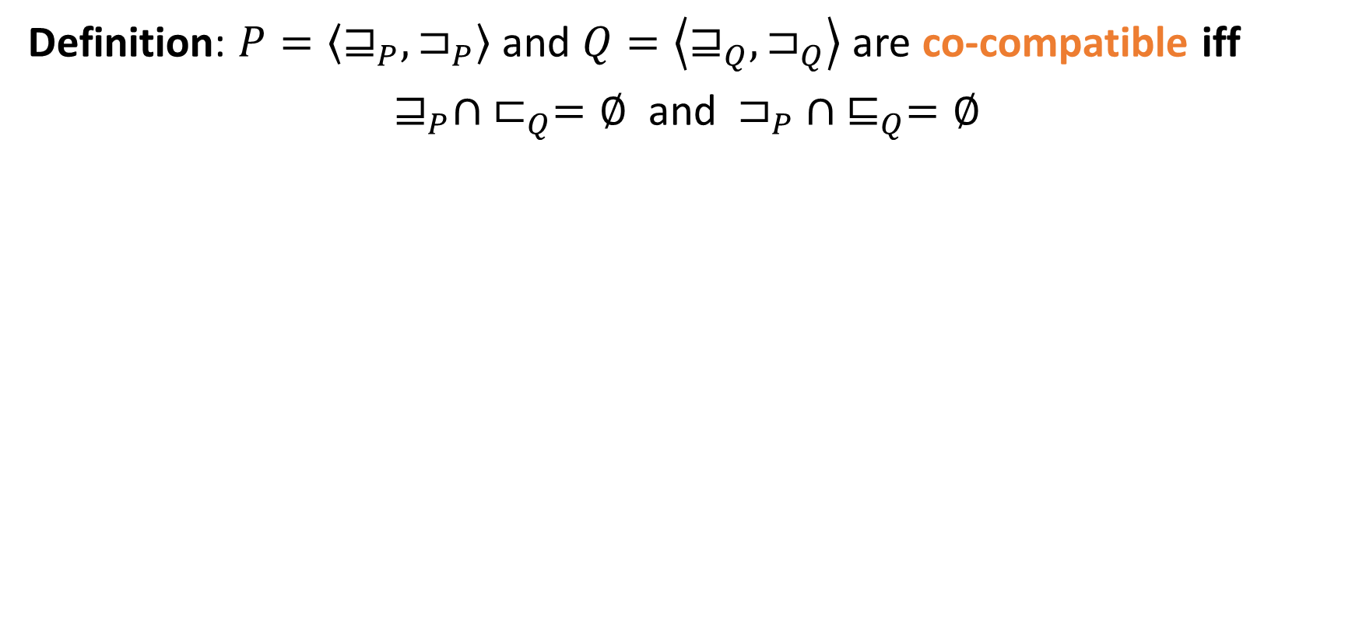
$⊒_{WPO} ∩ ⊏_{\overline{WPO}} =∅$ ?
Definition: $P=\left\langle ⊒_{P}, ⊐_{P}\right\rangle$ and $Q=\left\langle ⊒_{Q}, ⊐_{Q}\right\rangle$ are co-compatible iff
$⊒_{P}∩ ⊏_{Q}=∅$ and $⊐_{P} ∩ ⊑_{Q}=∅$
Proposition: WPO and $\overline{WPO}$ are co-compatible
$s⊒_{WPO}t$
1. $𝒜⊨s>t$ or
2. $𝒜⊨s≥t$ and
a. $∃i∈π\left(f\right).s_{i}⊒_{WPO}t$; or
b. $∀j∈π\left(g\right). s⊐_{WPO}t_{j}$ and
i. $f≻g$ or
ii. $f≽g$ and $π_{f}\left(s_{1},…,s_{n}\right)⊒_{ WPO}^{ lex}π_{g}\left(t_{1},…,t_{m}\right)$;
c. $s=t∈𝒱$
$t⊐_{\overline{WPO}}s$
1. $𝒜⊨t≰s$ or
2. $𝒜⊨t≮s$ and
a. $∃j∈π\left(g\right).t_{j}⊒_{\overline{WPO}}s$; or
b. $∀i∈π\left(f\right). t⊐_{\overline{WPO}}s_{i}$ and
i. $g⋠f$ or
ii. $g⊀f$ and $π_{g}\left(t_{1},…,t_{m}\right)⊐_{\overline{WPO}}^{lex}π_{f}\left(s_{1},…,s_{n}\right)$;

Slide 27
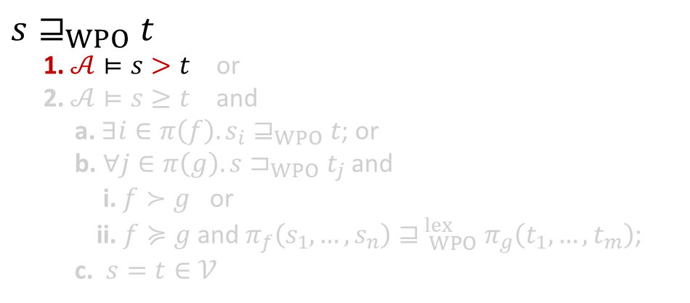
$⊒_{WPO} ∩ ⊏_{\overline{WPO}} =∅$ ?
Definition: $P=\left\langle ⊒_{P}, ⊐_{P}\right\rangle$ and $Q=\left\langle ⊒_{Q}, ⊐_{Q}\right\rangle$ are co-compatible iff
$⊒_{P}∩ ⊏_{Q}=∅$ and $⊐_{P} ∩ ⊑_{Q}=∅$
Proposition: WPO and $\overline{WPO}$ are co-compatible
$s⊒_{WPO}t$
1. $𝒜⊨s>t$ or
2. $𝒜⊨s≥t$ and
a. $∃i∈π\left(f\right).s_{i}⊒_{WPO}t$; or
b. $∀j∈π\left(g\right). s⊐_{WPO}t_{j}$ and
i. $f≻g$ or
ii. $f≽g$ and $π_{f}\left(s_{1},…,s_{n}\right)⊒_{ WPO}^{ lex}π_{g}\left(t_{1},…,t_{m}\right)$;
c. $s=t∈𝒱$
$t⊐_{\overline{WPO}}s$
1. $𝒜⊨t≰s$ or
2. $𝒜⊨t≮s$ and
a. $∃j∈π\left(g\right).t_{j}⊒_{\overline{WPO}}s$; or
b. $∀i∈π\left(f\right). t⊐_{\overline{WPO}}s_{i}$ and
i. $g⋠f$ or
ii. $g⊀f$ and $π_{g}\left(t_{1},…,t_{m}\right)⊐_{\overline{WPO}}^{lex}π_{f}\left(s_{1},…,s_{n}\right)$;

Slide 28
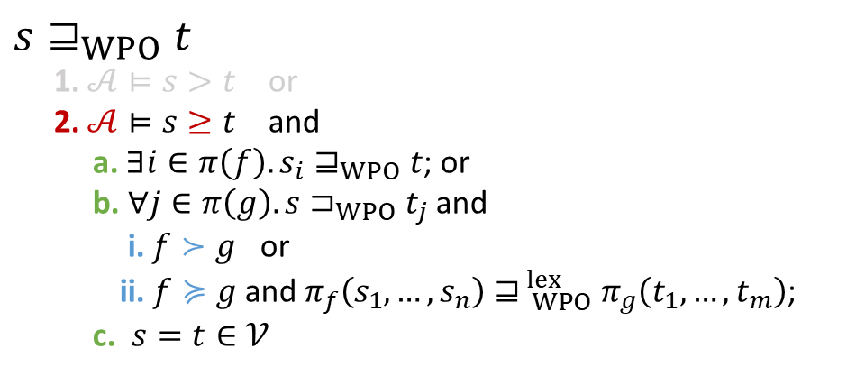
$⊒_{WPO} ∩ ⊏_{\overline{WPO}} =∅$ ?
Definition: $P=\left\langle ⊒_{P}, ⊐_{P}\right\rangle$ and $Q=\left\langle ⊒_{Q}, ⊐_{Q}\right\rangle$ are co-compatible iff
$⊒_{P}∩ ⊏_{Q}=∅$ and $⊐_{P} ∩ ⊑_{Q}=∅$
Proposition: WPO and $\overline{WPO}$ are co-compatible
$s⊒_{WPO}t$
1. $𝒜⊨s>t$ or
2. $𝒜⊨s≥t$ and
a. $∃i∈π\left(f\right).s_{i}⊒_{WPO}t$; or
b. $∀j∈π\left(g\right). s⊐_{WPO}t_{j}$ and
i. $f≻g$ or
ii. $f≽g$ and $π_{f}\left(s_{1},…,s_{n}\right)⊒_{ WPO}^{ lex}π_{g}\left(t_{1},…,t_{m}\right)$;
c. $s=t∈𝒱$
$t⊐_{\overline{WPO}}s$
1. $𝒜⊨t≰s$ or
2. $𝒜⊨t≮s$ and
a. $∃j∈π\left(g\right).t_{j}⊒_{\overline{WPO}}s$; or
b. $∀i∈π\left(f\right). t⊐_{\overline{WPO}}s_{i}$ and
i. $g⋠f$ or
ii. $g⊀f$ and $π_{g}\left(t_{1},…,t_{m}\right)⊐_{\overline{WPO}}^{lex}π_{f}\left(s_{1},…,s_{n}\right)$;

Slide 29

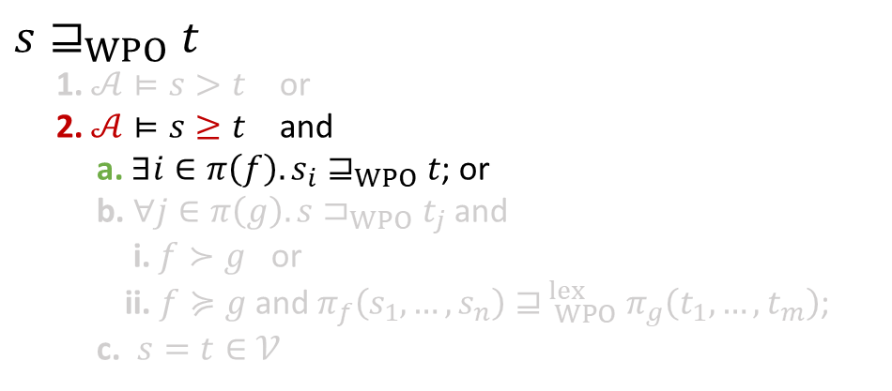

$⊒_{WPO} ∩ ⊏_{\overline{WPO}} =∅$ ?
Definition: $P=\left\langle ⊒_{P}, ⊐_{P}\right\rangle$ and $Q=\left\langle ⊒_{Q}, ⊐_{Q}\right\rangle$ are co-compatible iff
$⊒_{P}∩ ⊏_{Q}=∅$ and $⊐_{P} ∩ ⊑_{Q}=∅$
Proposition: WPO and $\overline{WPO}$ are co-compatible
$s⊒_{WPO}t$
1. $𝒜⊨s>t$ or
2. $𝒜⊨s≥t$ and
a. $∃i∈π\left(f\right).s_{i}⊒_{WPO}t$; or
b. $∀j∈π\left(g\right). s⊐_{WPO}t_{j}$ and
i. $f≻g$ or
ii. $f≽g$ and $π_{f}\left(s_{1},…,s_{n}\right)⊒_{ WPO}^{ lex}π_{g}\left(t_{1},…,t_{m}\right)$;
c. $s=t∈𝒱$
$t⊐_{\overline{WPO}}s$
1. $𝒜⊨t≰s$ or
2. $𝒜⊨t≮s$ and
a. $∃j∈π\left(g\right).t_{j}⊒_{\overline{WPO}}s$; or
b. $∀i∈π\left(f\right). t⊐_{\overline{WPO}}s_{i}$ and
i. $g⋠f$ or
ii. $g⊀f$ and $π_{g}\left(t_{1},…,t_{m}\right)⊐_{\overline{WPO}}^{lex}π_{f}\left(s_{1},…,s_{n}\right)$;
IH
$$s⊐_{WPO}s_{i}⊒_{WPO}t⊐_{WPO}t_{j}$$

Slide 30

$⊒_{WPO} ∩ ⊏_{\overline{WPO}} =∅$ ?
Definition: $P=\left\langle ⊒_{P}, ⊐_{P}\right\rangle$ and $Q=\left\langle ⊒_{Q}, ⊐_{Q}\right\rangle$ are co-compatible iff
$⊒_{P}∩ ⊏_{Q}=∅$ and $⊐_{P} ∩ ⊑_{Q}=∅$
Proposition: WPO and $\overline{WPO}$ are co-compatible
$s⊒_{WPO}t$
1. $𝒜⊨s>t$ or
2. $𝒜⊨s≥t$ and
a. $∃i∈π\left(f\right).s_{i}⊒_{WPO}t$; or
b. $∀j∈π\left(g\right). s⊐_{WPO}t_{j}$ and
i. $f≻g$ or
ii. $f≽g$ and $π_{f}\left(s_{1},…,s_{n}\right)⊒_{ WPO}^{ lex}π_{g}\left(t_{1},…,t_{m}\right)$;
c. $s=t∈𝒱$
$t⊐_{\overline{WPO}}s$
1. $𝒜⊨t≰s$ or
2. $𝒜⊨t≮s$ and
a. $∃j∈π\left(g\right).t_{j}⊒_{\overline{WPO}}s$; or
b. $∀i∈π\left(f\right). t⊐_{\overline{WPO}}s_{i}$ and
i. $g⋠f$ or
ii. $g⊀f$ and $π_{g}\left(t_{1},…,t_{m}\right)⊐_{\overline{WPO}}^{lex}π_{f}\left(s_{1},…,s_{n}\right)$;
IH

Slide 31
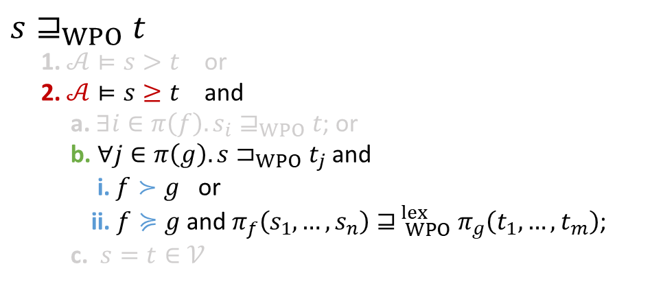
$⊒_{WPO} ∩ ⊏_{\overline{WPO}} =∅$ ?
Definition: $P=\left\langle ⊒_{P}, ⊐_{P}\right\rangle$ and $Q=\left\langle ⊒_{Q}, ⊐_{Q}\right\rangle$ are co-compatible iff
$⊒_{P}∩ ⊏_{Q}=∅$ and $⊐_{P} ∩ ⊑_{Q}=∅$
Proposition: WPO and $\overline{WPO}$ are co-compatible
$s⊒_{WPO}t$
1. $𝒜⊨s>t$ or
2. $𝒜⊨s≥t$ and
a. $∃i∈π\left(f\right).s_{i}⊒_{WPO}t$; or
b. $∀j∈π\left(g\right). s⊐_{WPO}t_{j}$ and
i. $f≻g$ or
ii. $f≽g$ and $π_{f}\left(s_{1},…,s_{n}\right)⊒_{ WPO}^{ lex}π_{g}\left(t_{1},…,t_{m}\right)$;
c. $s=t∈𝒱$
$t⊐_{\overline{WPO}}s$
1. $𝒜⊨t≰s$ or
2. $𝒜⊨t≮s$ and
a. $∃j∈π\left(g\right).t_{j}⊒_{\overline{WPO}}s$; or
b. $∀i∈π\left(f\right). t⊐_{\overline{WPO}}s_{i}$ and
i. $g⋠f$ or
ii. $g⊀f$ and $π_{g}\left(t_{1},…,t_{m}\right)⊐_{\overline{WPO}}^{lex}π_{f}\left(s_{1},…,s_{n}\right)$;
IH

Slide 32
$⊒_{WPO} ∩ ⊏_{\overline{WPO}} =∅$ ?
Definition: $P=\left\langle ⊒_{P}, ⊐_{P}\right\rangle$ and $Q=\left\langle ⊒_{Q}, ⊐_{Q}\right\rangle$ are co-compatible iff
$⊒_{P}∩ ⊏_{Q}=∅$ and $⊐_{P} ∩ ⊑_{Q}=∅$
Proposition: WPO and $\overline{WPO}$ are co-compatible
$s⊒_{WPO}t$
1. $𝒜⊨s>t$ or
2. $𝒜⊨s≥t$ and
a. $∃i∈π\left(f\right).s_{i}⊒_{WPO}t$; or
b. $∀j∈π\left(g\right). s⊐_{WPO}t_{j}$ and
i. $f≻g$ or
ii. $f≽g$ and $π_{f}\left(s_{1},…,s_{n}\right)⊒_{ WPO}^{ lex}π_{g}\left(t_{1},…,t_{m}\right)$;
c. $s=t∈𝒱$
$t⊐_{\overline{WPO}}s$
1. $𝒜⊨t≰s$ or
2. $𝒜⊨t≮s$ and
a. $∃j∈π\left(g\right).t_{j}⊒_{\overline{WPO}}s$; or
b. $∀i∈π\left(f\right). t⊐_{\overline{WPO}}s_{i}$ and
i. $g⋠f$ or
ii. $g⊀f$ and $π_{g}\left(t_{1},…,t_{m}\right)⊐_{\overline{WPO}}^{lex}π_{f}\left(s_{1},…,s_{n}\right)$;

Slide 33
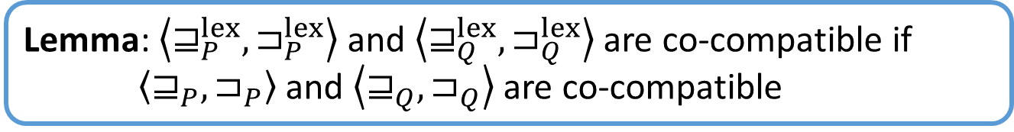
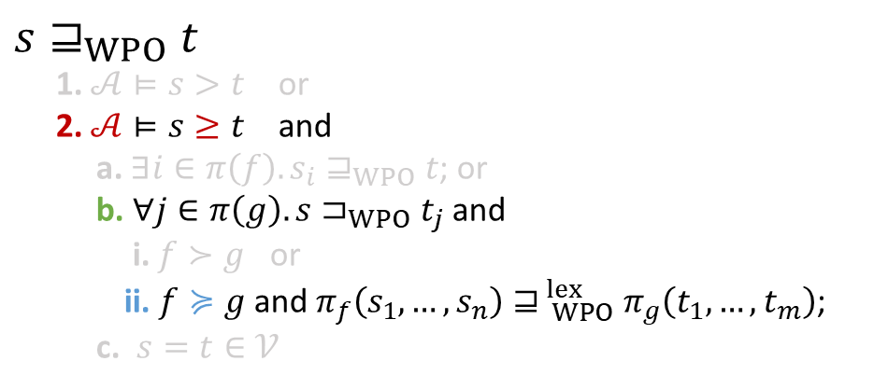

$⊒_{WPO} ∩ ⊏_{\overline{WPO}} =∅$ ?
Definition: $P=\left\langle ⊒_{P}, ⊐_{P}\right\rangle$ and $Q=\left\langle ⊒_{Q}, ⊐_{Q}\right\rangle$ are co-compatible iff
$⊒_{P}∩ ⊏_{Q}=∅$ and $⊐_{P} ∩ ⊑_{Q}=∅$
Proposition: WPO and $\overline{WPO}$ are co-compatible
$s⊒_{WPO}t$
1. $𝒜⊨s>t$ or
2. $𝒜⊨s≥t$ and
a. $∃i∈π\left(f\right).s_{i}⊒_{WPO}t$; or
b. $∀j∈π\left(g\right). s⊐_{WPO}t_{j}$ and
i. $f≻g$ or
ii. $f≽g$ and $π_{f}\left(s_{1},…,s_{n}\right)⊒_{ WPO}^{ lex}π_{g}\left(t_{1},…,t_{m}\right)$;
c. $s=t∈𝒱$
$t⊐_{\overline{WPO}}s$
1. $𝒜⊨t≰s$ or
2. $𝒜⊨t≮s$ and
a. $∃j∈π\left(g\right).t_{j}⊒_{\overline{WPO}}s$; or
b. $∀i∈π\left(f\right). t⊐_{\overline{WPO}}s_{i}$ and
i. $g⋠f$ or
ii. $g⊀f$ and $π_{g}\left(t_{1},…,t_{m}\right)⊐_{\overline{WPO}}^{lex}π_{f}\left(s_{1},…,s_{n}\right)$;
Lemma: $\left\langle ⊒_{P}^{lex}, ⊐_{P}^{lex}\right\rangle$ and $\left\langle ⊒_{Q}^{lex}, ⊐_{Q}^{lex}\right\rangle$ are co-compatible if $\left\langle ⊒_{P}, ⊐_{P}\right\rangle$ and $\left\langle ⊒_{Q}, ⊐_{Q}\right\rangle$ are co-compatible

Slide 34
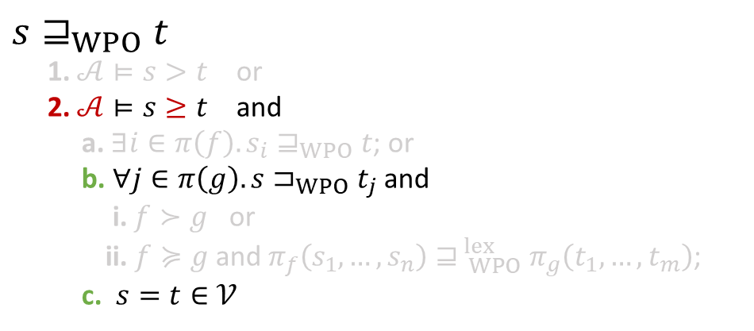
$⊒_{WPO} ∩ ⊏_{\overline{WPO}} =∅$ ?
Definition: $P=\left\langle ⊒_{P}, ⊐_{P}\right\rangle$ and $Q=\left\langle ⊒_{Q}, ⊐_{Q}\right\rangle$ are co-compatible iff
$⊒_{P}∩ ⊏_{Q}=∅$ and $⊐_{P} ∩ ⊑_{Q}=∅$
Proposition: WPO and $\overline{WPO}$ are co-compatible
$s⊒_{WPO}t$
1. $𝒜⊨s>t$ or
2. $𝒜⊨s≥t$ and
a. $∃i∈π\left(f\right).s_{i}⊒_{WPO}t$; or
b. $∀j∈π\left(g\right). s⊐_{WPO}t_{j}$ and
i. $f≻g$ or
ii. $f≽g$ and $π_{f}\left(s_{1},…,s_{n}\right)⊒_{ WPO}^{ lex}π_{g}\left(t_{1},…,t_{m}\right)$;
c. $s=t∈𝒱$
$t⊐_{\overline{WPO}}s$
1. $𝒜⊨t≰s$ or
2. $𝒜⊨t≮s$ and
a. $∃j∈π\left(g\right).t_{j}⊒_{\overline{WPO}}s$; or
b. $∀i∈π\left(f\right). t⊐_{\overline{WPO}}s_{i}$ and
i. $g⋠f$ or
ii. $g⊀f$ and $π_{g}\left(t_{1},…,t_{m}\right)⊐_{\overline{WPO}}^{lex}π_{f}\left(s_{1},…,s_{n}\right)$;

Slide 35
Contribution 5: Conditional rewriting

Slide 36
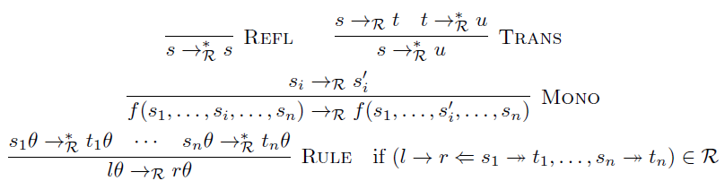
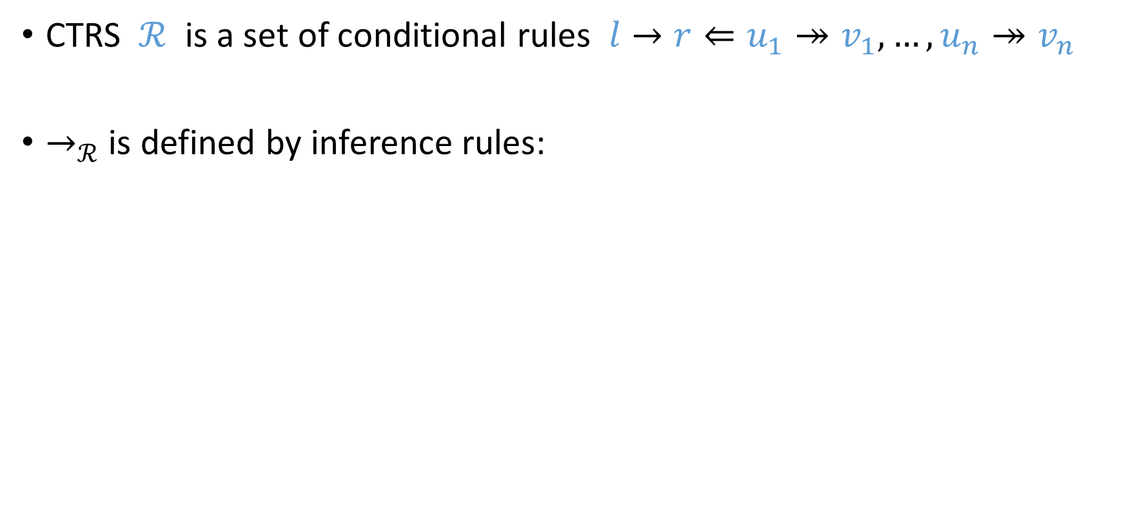
Conditional rewriting
CTRS $ℛ$ is a set of conditional rules $l→r⇐u_{1}↠v_{1},…,u_{n}↠v_{n}$
$→_{ℛ}$ is defined by inference rules:

Slide 37




Rewrite pair for CTRS?
Example:
$f\left(x\right)→x$ $g\left(x\right)→y⇐f\left(x\right)↠y$
Let $\left\langle ≽,≻\right\rangle$ be a rewrite pair s.t.
$f\left(x\right)≽x$ $g\left(x\right)≽y$ if $f\left(x\right)≽y$
Can we say $s≺t$ implies $s↠t$ is $ℛ$-unsat?
false
No! $g\left(x\right)≺_{LPO}f\left(x\right)$ with $g≺f$

Slide 38




Co-rewrite pair for CTRS
Example:
$f\left(x\right)→x$ $g\left(x\right)→y⇐f\left(x\right)↠y$
Let $\left\langle ≽,≺\right\rangle$ be a co-rewrite pair s.t.
$f\left(x\right)≽x$ $g\left(x\right)≽y$ if $f\left(x\right)≺y$
We can say $s≺t$ implies $s↠t$ is $ℛ$-unsat!
Proposition: $s↠t$ is $ℛ$-unsat if
$\left\langle ≽,≺\right\rangle$ is a rewrite pair s.t. $l≽r∨u_{1}≺v_{1}∨…∨u_{n}≺v_{n}$ for all $l→r⇐u_{1}↠v_{1},…,u_{n}↠v_{n}$
Works, but rather weak...

Slide 39








Model of CTRS
Definition: $\left\langle 𝒜,≥\right\rangle$ is a model of $ℛ$ iff
$𝒜⊨l≥r∨u_{1}≱v_{1}∨…∨u_{n}≱v_{n}$ for all $l→r⇐u_{1}↠v_{1},…,u_{n}↠v_{n}$
is a quasi-model if it is monotone and $≥$ is a quasi-order
Theorem: $s↠t$ is $ℛ$-unsat iff
$\left\langle 𝒜,≥\right\rangle$ is a quasi-model of $ℛ$ and $𝒜⊨s≱t$
Proof:
($⇐$) easy.
($⇒$)
$\left\langle 𝒯\left(F,V\right),→_{ℛ}^{∗}\right\rangle$ is a quasi-model of $ℛ$.
$$𝒯\left(F,V\right)⊨s→_{ℛ}^{∗}t$$
⟺ $sθ→_{ℛ}^{∗}tθ$ for any $θ :V→𝒯\left(F,V\right)$
⟺ $s↠t$ is $ℛ$-unsat

Slide 40



Formal WPO
Definition: $s⊒_{wpo}t ≔$
1. $s>t ∨$
2. $s≥t ∧$ (
a. $\left(∃i∈π\left(f\right).s_{i}⊒_{wpo}t\right)∨$
b. $\left(∀j∈π\left(g\right). s⊐_{wpo}t_{j}\right)∧$ (
i. $f≻g ∨$
ii. $f≽g ∧ π_{f}\left(s_{1},…,s_{n}\right)⊒_{wpo}^{lex}π_{g}\left(t_{1},…,t_{m}\right)$ ) )
Definition: $t⊒_{\overline{wpo}}s ≔$
1. $t≰s ∨$
2. $t≮s ∧$ (
a. $\left(∃j∈π\left(g\right).t_{j}⊒_{\overline{wpo}}s\right)∨$
b. $\left(∀i∈π\left(f\right). t⊐_{\overline{wpo}}s_{i}\right)∧$ (
i. $g⋠f ∨$
ii. $g⊀f ∧ π_{g}\left(t_{1},…,t_{m}\right)⊒_{\overline{wpo}}^{lex}π_{f}\left(s_{1},…,s_{n}\right)$ ) )
Lemma: $s⊒_{WPO\left(𝒜\right)}t$ if $𝒜⊨s⊒_{wpo}t$
$s⋣_{WPO\left(𝒜\right)}t$ if $𝒜⊨s⊏_{\overline{wpo}}t$ (not $𝒜⊨¬ s⊒_{wpo}t$!)

Slide 41
Experiments

Slide 42

Experiments
Implemented in NaTT
easy (in theory)
TRS → SMT (QF-LRA) solved by z3
CTRS
→ Farkas → QF-NRA ?
→ quantified LRA ?
Benchmark
Crafted ones
COPS/INF problems
for $s_{1}↠t_{1}∧…∧s_{n}↠t_{n}$ is transformed to $\#\left(s_{1},…,s_{n}\right)↠\#\left(t_{1},…,t_{n}\right)$
(z3) turns out faster

Slide 43

Experimental result

Slide 44
@ TACAS 2019
with Christian Sternagel

Slide 45

Reachability constraint satisfaction
Syntax
$$φ,ψ,…∷=s↠t∣⊤∣ ⊥ ∣φ∧ψ∣φ∨ψ∣φ⇒ψ∣¬φ∣∃x. φ∣∀x. φ$$
Semantics
substitution $σ$ satisfies $φ$ modulo rewrite system $ℛ$ $σ⊨_{ℛ}φ$
$σ⊨_{ℛ}s↠t$ if $sσ↠_{ℛ}tσ$
$σ⊨_{ℛ}∃x. φ$ if for some $t∈𝒯$, $σ\left[x↦t\right]⊨_{ℛ}φ$
and so on
$φ$ and $ψ$ are equivalent modulo $ℛ$: $φ≡_{ℛ}ψ$
for any $σ$, $σ⊨_{ℛ}φ⟺σ⊨_{ℛ}ψ$
One can think of more traditional semantics, with more notions.

Slide 46
Reasoning reachability

Slide 47

Constructors evaluate to constructors
Observation (folklore):
$\text{Cons}\left(s,ss\right)↠_{ℛ}\text{Cons}\left(t,ts\right)$ iff $s↠_{ℛ}t$ and $ss↠_{ℛ}ts$
$\text{Con}\text{s}\left(s,ss\right)↠_{ℛ}\text{Nil}$ never happen
... if $\text{Cons}$ is a constructor in $ℛ$ ($Cons\left(…\right)→…∉ℛ$)
In our language:
$\text{Cons}\left(s,ss\right)↠\text{Cons}\left(t,ts\right)≡_{ℛ}s↠t∧ss↠ts$
$\text{Cons}\left(s,ss\right)↠Nil≡_{ℛ} ⊥$
Proposition: If $f\left(…\right)→…∉ℛ$, then
$f\left(s_{1},…,s_{n}\right)↠f\left(t_{1},…,t_{n}\right) ≡_{ℛ} s_{1}↠t_{1}∧…∧s_{n}↠t_{n}$
$f\left(…\right)↠g\left(…\right)≡_{ℛ} ⊥$ if $f≠g$
decomposition

Slide 48

Constructors evaluate to constructors
Observation (folklore):
$\text{Cons}\left(s,ss\right)↠_{ℛ}\text{Cons}\left(t,ts\right)$ iff $s↠_{ℛ}t$ and $ss↠_{ℛ}ts$
$\text{Con}\text{s}\left(s,ss\right)↠_{ℛ}\text{Nil}$ never happen
... if $\text{Cons}$ is a constructor in $ℛ$ ($Cons\left(…\right)→…∉ℛ$)
In our language:
$\text{Cons}\left(s,ss\right)↠\text{Cons}\left(t,ts\right)≡_{ℛ}s↠t∧ss↠ts$
$\text{Cons}\left(s,ss\right)↠Nil≡_{ℛ} ⊥$
Proposition: If $f\left(…\right)→…∉ℛ$, then
$f\left(s_{1},…,s_{n}\right)↠g\left(t_{1},…,t_{m}\right) ≡_{ℛ}$
$f\left(s_{1},…,s_{n}\right)↠^{>ε}g\left(t_{1},…,t_{m}\right) ≔ \left\{\begin{aligned}&s_{1}↠t_{1}∧…∧s_{n}↠t_{n} &&\text{if} f=g \\ &⊥ &&if f≠g\end{aligned}\right.$

Slide 49

Look-ahead
$ℛ=\left\{ 0>x→\text{False}, s\left(x\right)>0→\text{True}\text{, }s\left(x\right)>s\left(y\right)→x>y \right\}$
Is $0>z↠\text{True}$ SAT modulo $ℛ$?

Slide 50

Look-ahead
$ℛ=\left\{ 0>x→\text{False}, s\left(x\right)>0→\text{True}\text{, }s\left(x\right)>s\left(y\right)→x>y \right\}$
Is $0>z↠\text{True}$ SAT?

Slide 51

Look-ahead
$ℛ=\left\{ 0>x→\text{False}, s\left(x\right)>0→\text{True}\text{, }s\left(x\right)>s\left(y\right)→x>y \right\}$
Is $0>z↠\text{True}$ SAT?

Slide 52

Look-ahead
$ℛ=\left\{ 0>x→\text{False}, s\left(x\right)>0→\text{True}\text{, }s\left(x\right)>s\left(y\right)→x>y \right\}$
Is $0>z↠\text{True}$ SAT?
Theorem: $f\left(s_{1},…,s_{n}\right)↠g\left(t_{1},…\right)≡_{ℛ}$
$f\left(s_{1},…,s_{n}\right)↠^{>ε}g\left(t_{1},…\right) ∨$
$$\bigvee_{\begin{aligned}f\left(l_{1},…\right)→r∈ℛ \\ of vars x_{1},…, x_{m}\end{aligned}}{∃x_{1},…,x_{m}. \left(s_{1}↠l_{1}∧…∧s_{n}↠l_{n} ∧ r↠g\left(t_{1},…\right)\right)}$$
Expansion can diverge

Slide 53

k-fold look-ahead
Definition: $f\left(s_{1},…,s_{n}\right)↠_{k}g\left(t_{1},…\right)≔$
$f\left(s_{1},…,s_{n}\right)↠_{k}^{>ε}g\left(t_{1},…\right) ∨$
$$\bigvee_{\begin{aligned}f\left(l_{1},…\right)→r∈ℛ \\ of vars x_{1},…, x_{m}\end{aligned}}{∃x_{1},…,x_{m}. \left(s_{1}↠_{k}l_{1}∧…∧ s_{n}↠_{k}l_{n} ∧ r↠_{k−1}g\left(t_{1},…\right)\right)}$$
Corollary: $f\left(…\right)↠g\left(…\right)≡_{ℛ}f\left(…\right)↠_{k}g\left(…\right)$

Slide 54
Evaluation for look-ahead
Implemented in the termination prover NaTT
Benchmark:
Origin:
Termination Problem Data Base (TPDB) ver.10.6, TRS Standard category
1498 TRSs
Preprocess:
Dependency graph method [Arts & Giesl '00], 1134k reachability problems
 | k=0 | k=1 | k=2 | k=3 | ... | k=8
UNSAT | 0 | 104,050 | 105,574 | 105,875 | ... | 105,993
time (s) | 33.96 | 38.98 | 38.13 | 39.15 | ... | 116.52
correspond to TCAP-unifiability [Giesl+'05]

Slide 55







Symbol transition graph
$ℛ=\left\{\begin{aligned}f\left(…\right)&→g\left(…\right) \\ g\left(…\right)&→c\left(…\right) \\ h\left(…\right)&→x\end{aligned}\right.$
$c\left(…\right)↠_{ℛ}t$ ⇒ $t$ must be $c\left(…\right)$
$g\left(…\right)↠_{ℛ}t$ ⇒ $t$ must be $g\left(…\right)$ or $c\left(…\right)$
$f\left(…\right)↠_{ℛ}t$ ⇒ $t$ must be $f\left(…\right)$ or $g\left(…\right)$ or $c\left(…\right)$
$$h$$
$$f$$
$$g$$
$$c$$
$h\left(…\right)↠_{ℛ}t$ ⇒ don't know
Symbol transition graph: $〈ℱ,↣_{ℛ}〉$ s.t. $f↣_{ℛ}g$ whenever
$f\left(…\right)→g\left(…\right)∈ℛ$ or $f\left(…\right)→x∈ℛ$.
Theorem:
If $¬ f↣_{ℛ}^{∗}g$ then $f\left(…\right)↠g\left(…\right)≡_{ℛ} ⊥$

Slide 56





Nonlinear-case
Example [Toyama'87]:
$ℛ=\left\{ f\left(0,1,x\right)→f\left(x,x,x\right) \right\}$
reduced to "$∃x,x^{′}. x↠0 ∧ x↠1 ∧ x↠x^{′}$" modulo $ℛ$
... UNSAT, since no term rewrites to both $0$ and $1$
Proposition:
If $f_{1},…,f_{n}$ has no common ancestor in $↣_{ℛ}$, then
$$x↠f_{1}\left(…\right)∧…∧x↠f_{n}\left(…\right) ≡_{ℛ} ⊥$$
$$f$$
$$0$$
$$1$$
?
$$↣_{ℛ}$$

Slide 57






Nonlinear-case
$$g$$
Example [Toyama'87]:
$ℛ^{′}=\left\{\begin{aligned} f\left(0,1,x\right)&→f\left(x,x,x\right) \\ \\ g\left(x,y\right)&→x \\ g\left(x,y\right)&→y\end{aligned} \right\}$
reduced to "$∃x,x^{′}. x↠0 ∧ x↠1 ∧ x↠x^{′}$" modulo $ℛ^{′}$
... Now SAT! solution $\left[x↦g\left(0,1\right),x^{′}↦g\left(0,1\right)\right]$
Proposition:
If $f_{1},…,f_{n}$ has no common ancestor in $↣_{ℛ}$, then
$$x↠f_{1}\left(…\right)∧…∧x↠f_{n}\left(…\right) ≡_{ℛ} ⊥$$
?
$$f$$
$$0$$
$$1$$
$$↣_{ℛ^{′}}$$

Slide 58
Evaluation for STG + look-ahead
Implemented in the termination prover NaTT
Benchmark:
1134k reachability problems over 1498 TRSs
Result:
correspond to TCAP-unifiability [Giesl+'05]
 |  | k=0 | k=1 | k=2 | k=3 | ... | k=8
None | UNSAT | 0 | 104,050 | 105,574 | 105,875 | ... | 105,993
 | time (s) | 33.96 | 38.98 | 38.13 | 39.15 | ... | 116.52
STG | UNSAT | 307,207 | 328,216 | 328,430 | 328,499 | ... | 328,636
 | time (s) | 38.50 | 42.71 | 42.72 | 43.00 | ... | 66.82

Slide 59
Impact in tool power
for termination of TRSs
implemented in NaTT [Yamada+ '14]
Benchmark: 1498 TRSs
for confluence of conditional TRSs
implemented in ConCon [T. Sternagel & Middeldorp '14]
Benchmark: 148 CTRSs from Confluence Problems database (COPS)
 | old | STG+LA
YES | 842 | 860
NO | 197 | 197
time (s) | 1216.1 | 1254.6
 | old | STG+LA
YES | 49 | 53
NO | 43 | 44
time (s) | 1764.58 | 2113.53

Slide 60
Future Work? Satisfiability Modulo Rewriting

Slide 61

How SAT solver works
Problem: $\left(¬x∨¬y\right)∧\left(x∨y\right)∧\left(¬y∨¬z\right)∧\left(x∨¬y∨z\right)$
Decision: Randomly/Heuristically decide a variable
$$x↦0$$
$$\left(¬0∨¬y\right)∧\left(0∨y\right)∧\left(¬y∨¬z\right)∧\left(0∨¬y∨z\right)$$

Slide 62

How SAT solver works
Problem: $\left(¬x∨¬y\right)∧\left(x∨y\right)∧\left(¬y∨¬z\right)∧\left(x∨¬y∨z\right)$
Decision: Randomly/Heuristically decide a variable
$$x↦0$$
$$\left(¬0∨¬y\right)∧\left(0∨y\right)∧\left(¬y∨¬z\right)∧\left(0∨¬y∨z\right)$$
Propagation: Some variables may be forced
$$y↦1$$
$$\left(¬0∨¬y\right)∧\left(0∨1\right)∧\left(¬1∨¬z\right)∧\left(0∨¬1∨z\right)$$

Slide 63

How SAT solver works
Problem: $\left(¬x∨¬y\right)∧\left(x∨y\right)∧\left(¬y∨¬z\right)∧\left(x∨¬y∨z\right)$
Decision: Randomly/Heuristically decide a variable
$$x↦0$$
$$\left(¬0∨¬y\right)∧\left(0∨y\right)∧\left(¬y∨¬z\right)∧\left(0∨¬y∨z\right)$$
Propagation: Some variables may be forced
$$y↦1$$
Conflict!
$$\left(¬0∨¬y\right)∧\left(0∨1\right)∧\left(¬1∨¬z\right)∧\left(0∨¬1∨z\right)$$
Analyze Conflict: What was wrong?
$x↦0$ was a wrong choice!

Slide 64

How SAT solver works
Learned clause
Problem: $\left(¬x∨¬y\right)∧\left(x∨y\right)∧\left(¬y∨¬z\right)∧\left(x∨¬y∨z\right)$
$$∧x$$
Decision: Randomly/Heuristically decide a variable
$$x↦0$$
$$\left(¬0∨¬y\right)∧\left(0∨y\right)∧\left(¬y∨¬z\right)∧\left(0∨¬y∨z\right)$$
Propagation: Some variables may be forced
$$y↦1$$
$$\left(¬0∨¬y\right)∧\left(0∨1\right)∧\left(¬1∨¬z\right)∧\left(0∨¬1∨z\right)$$
Analyze Conflict: What was wrong?
$x↦0$ was a wrong choice!

Slide 65






How SAT Modulo Theory (SMT) solver works
$$¬X∨¬Z$$
$$\left(¬X∨Y\right)∧$$
$$\left(X∨¬Y\right)∧$$
$$\left(Y∨Z\right)$$
$$\left(¬x>3∨y≥1\right)∧$$
$$\left(x>3∨¬y≥1\right)∧$$
$$\left(y≥1∨x<2\right)$$
SMT
SAT
$$X∧¬Y∧Z$$
Reject:
$$¬x>3∨¬x<2$$
$$x>3∧¬y≥1∧x<2$$
theory solver
e.g. Simplex

Slide 66




Satisfiability Modulo Rewriting?
$$\left(¬X∨Y\right)∧$$
$$\left(X∨¬Y\right)∧$$
$$\left(Y∨Z\right)$$
$$\left(¬f\left(x\right)→^{∗}a∨f\left(x\right)→^{∗}b\right)∧$$
$$\left(f\left(x\right)→^{∗}a∨¬f\left(x\right)→^{∗}b\right)∧$$
$$\left(f\left(x\right)→^{∗}b∨x→^{∗}c\right)$$
SMR
SAT
$$X∧¬Y∧Z$$
Needed:
$$x→^{∗}a∧¬x→^{∗}b$$
$$f\left(x\right)→^{∗}a∧¬f\left(x\right)→^{∗}b∧x→^{∗}c$$
TRS:
$$f\left(a\right)→a$$
$$f\left(b\right)→b$$
rewrite solver?

