Slide 1
CEIS150: Python Stock Tracking Final Project
Created by: Jeremy Duncan

Slide 2
Introduction
In this project I will be demonstrating fundamental concepts of Object Oriented Programming by creating a stock tracking program with Python.

Slide 3
Concepts Covered
Section 1: Software Environment Setup
Section 2: Classes
Section 3: menu-driven User interface
Section 4: Inheritance
Section 5: Creating Charts
Section 6: Saving data
Section 7: graphical user interface

Slide 4
SECTION 1
Software Environment Setup:
In section one of my project I am:
Installing the software environment for python.
installing the required plugins.
Loading the spyder IDE and testing functionality.

Slide 5
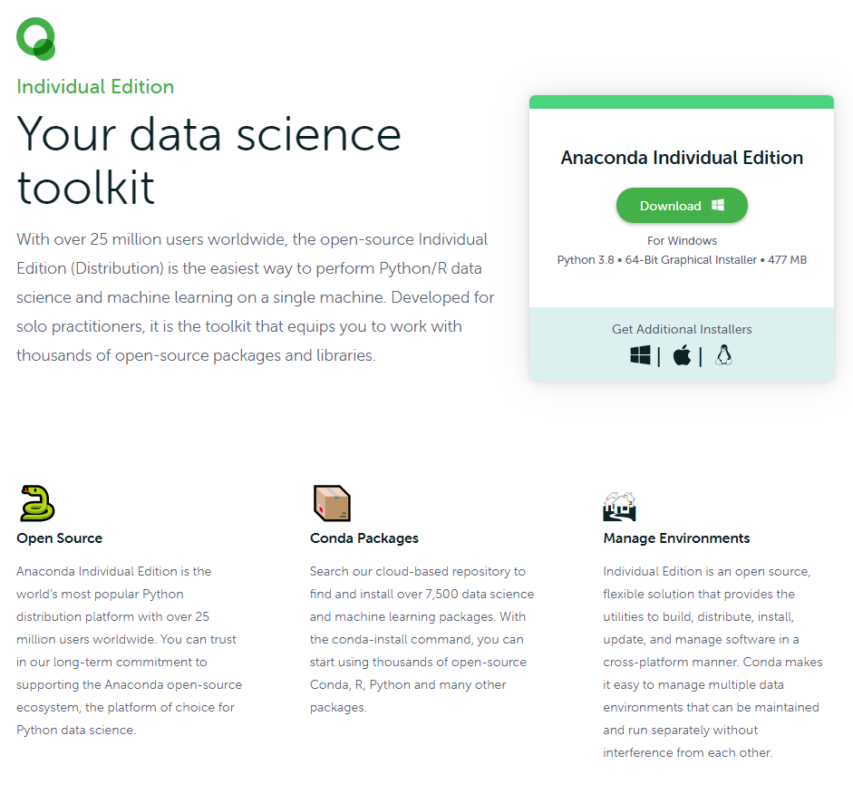
Section 1: Software Environment Setup
First, I download the Python toolkit Anaconda from www.anaconda.com.

Slide 6
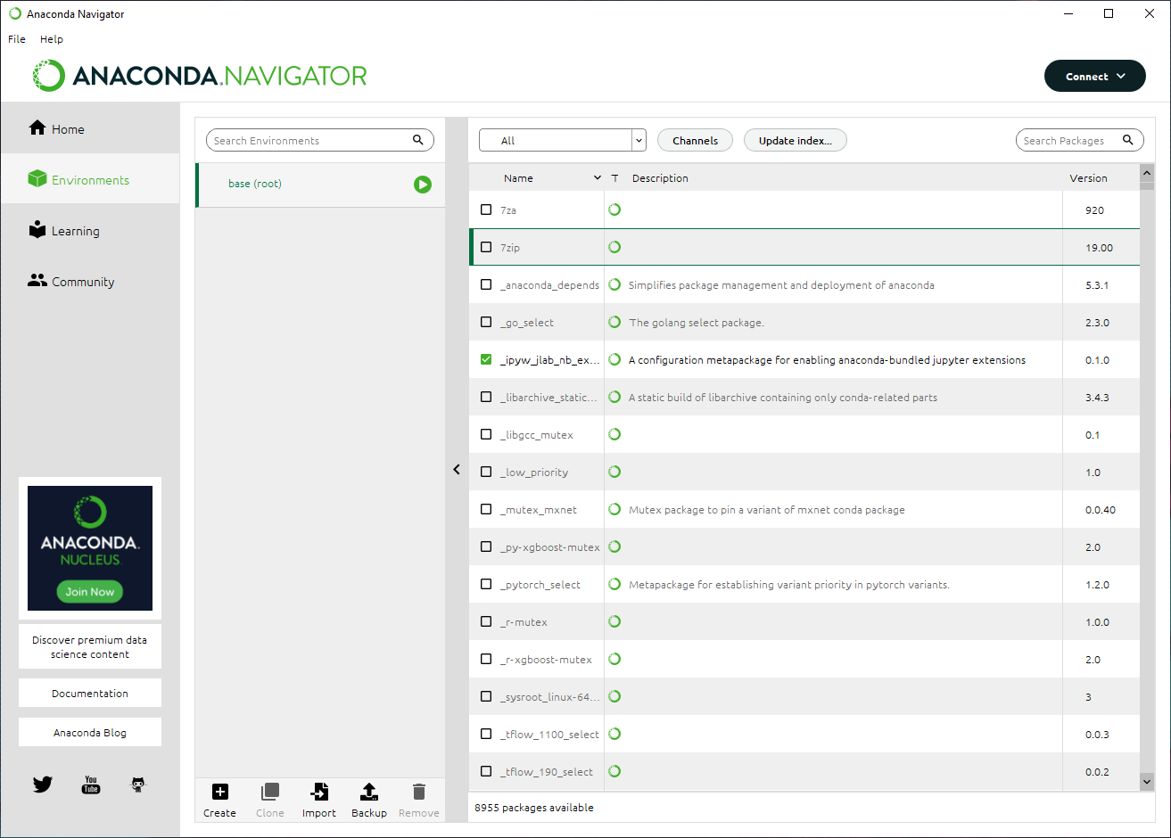
Section 1: Software Environment Setup
Once Anaconda is installed I run it, then update the index in the Environments section.
Next, I ensure matplotlib, pandas and git are installed in the environment.

Slide 7
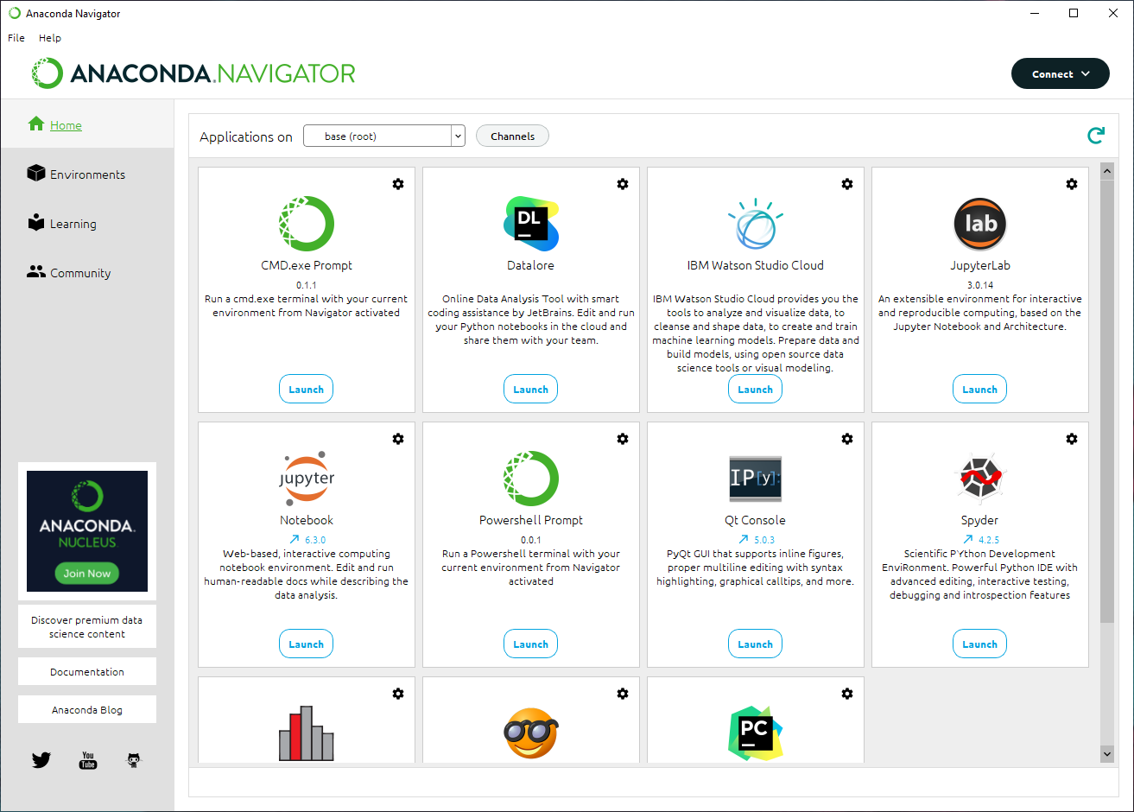
Section 1: Software Environment Setup
Next, I go to the Home section, and select Launch under Spyder.
Spyder is the IDE I will be using to create my program.

Slide 8
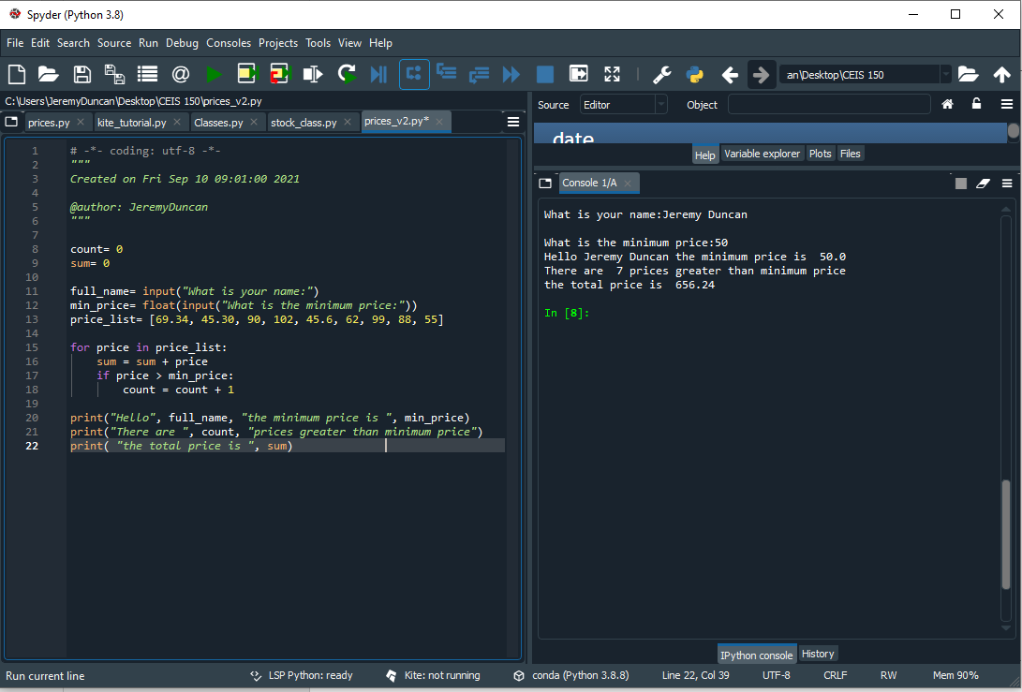
Section 1: Software Environment Setup
Once Spyder is running, I test the IDE by making a small program to run.

Slide 9
SECTION 2
Classes:
In section two of my project, I am:
Creating a visual diagram for my classes.
Creating the classes in python.
Testing my created class.

Slide 10
Section 2: Classes
The first step I take is creating a UML diagram to represent the classes and their variables, methods, and relationship to each other.
The two classes that I want to create are called Stock and DailyData.
Stock Class
DailyData Class

Slide 11
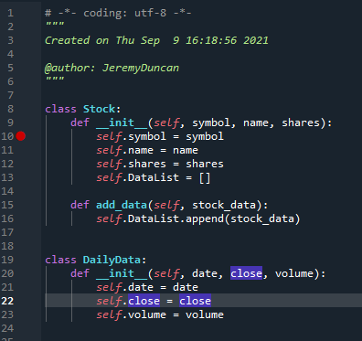
Section 2: Classes
Next, I create the Python code for the classes in Spyder.
I save this code as stock_class.py

Slide 12
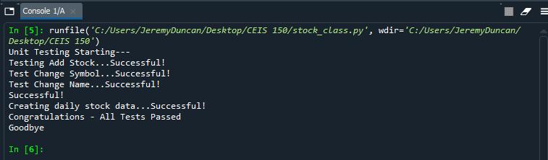
Section 2: Classes
The final step involved using a unit test to verify the classes and their methods work as intended.

Slide 13
SECTION 3
Menu-driven user interface:
In section three of my project I am:
Creating a menu-driven user interface for my program.
Testing the menu-driven interface.

Slide 14
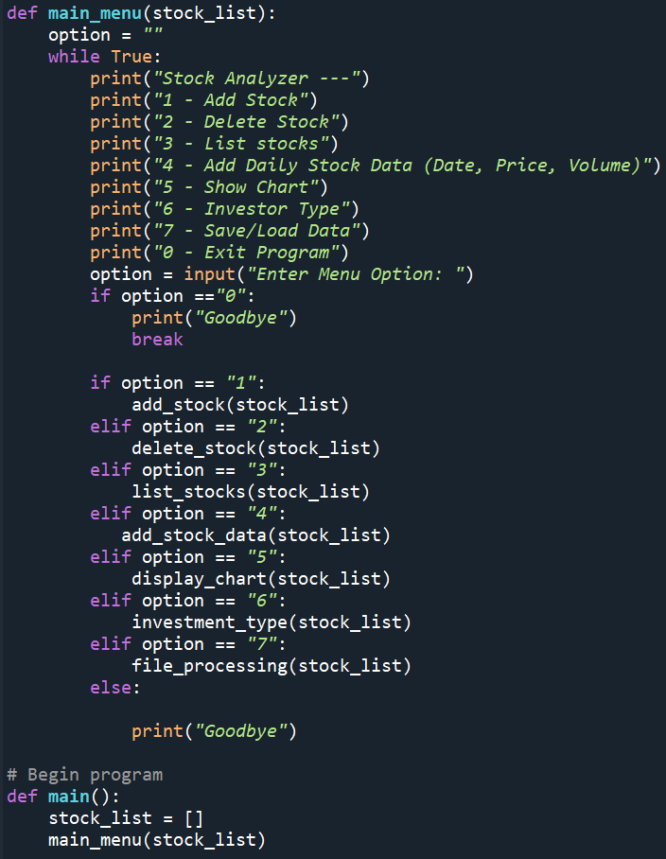
Section 3: Menu-Driven User Interface
To create my menu-driven interface, I create a new file called stock_menu.py.
Stock_menu.py will contain the code for my menu selection options.
The menu options that are in my code are:
Add Stock
Delete Stock
List Stocks
Add Daily Stock Data
Show Chart
Investor Type
Save/Load Data
Exit

Slide 15
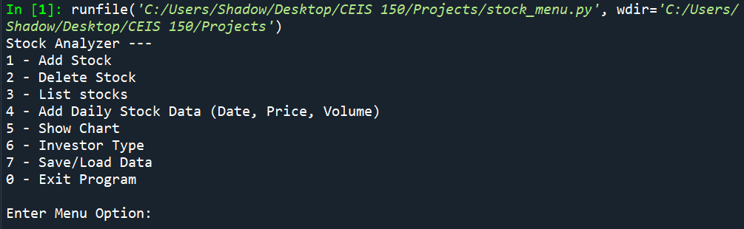
Section 3: Menu-Driven User Interface
Once my code is complete, I run it in the IDE to verify it displays as intended.

Slide 16
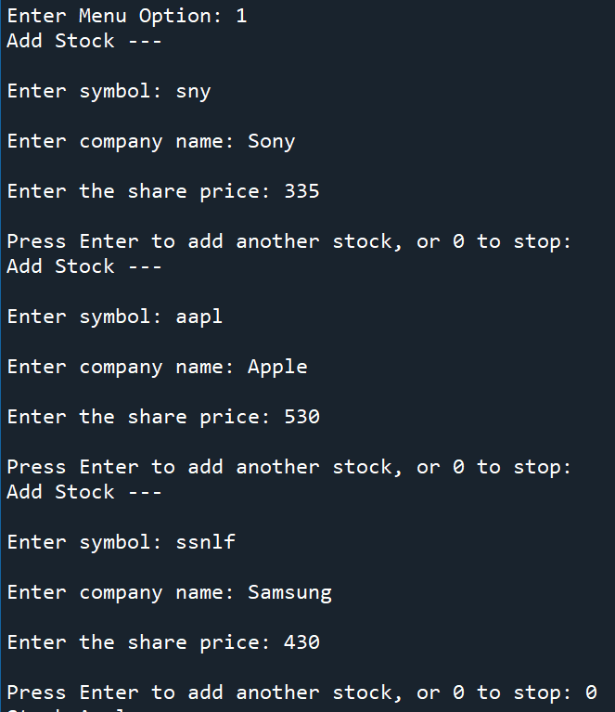
Section 3: Menu-Driven User Interface
Next, I test the functionality of the menu.
I selected the Add Stock menu option to add a few stock to verify it worked correctly.

Slide 17
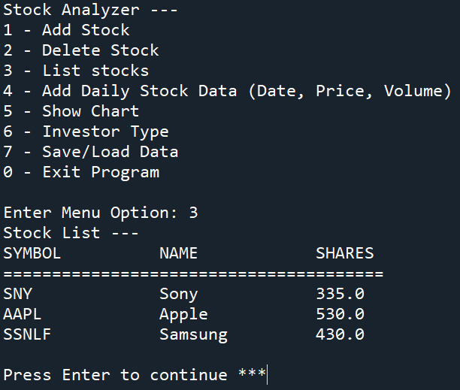
Section 3: Menu-Driven User Interface
I then verify the stock I entered from the previous menu option by selecting the List Stocks option.

Slide 18
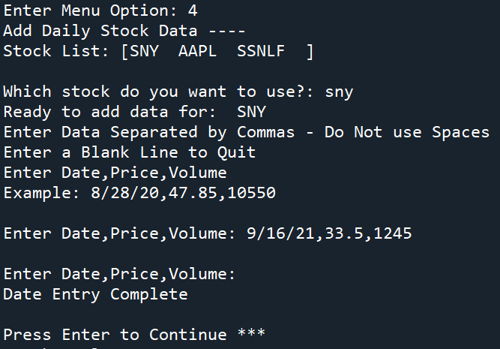
Section 3: Menu-Driven User Interface
The next menu option I test is the Add Daily Stock Data option.

Slide 19
SECTION 4
inheritance:
In section four of my project I am:
Implementing inheritance in my program.
Creating 3 classes with inheritance.
Testing the created classes.

Slide 20
Section 4: Inheritance
First, I create another diagram of the classes I will be using.
I want a Traditional and Robo class that will inherit variables balance and number from the Retirement_Account Class.
Retirement_Account Class
Traditional Class
Robo Class

Slide 21
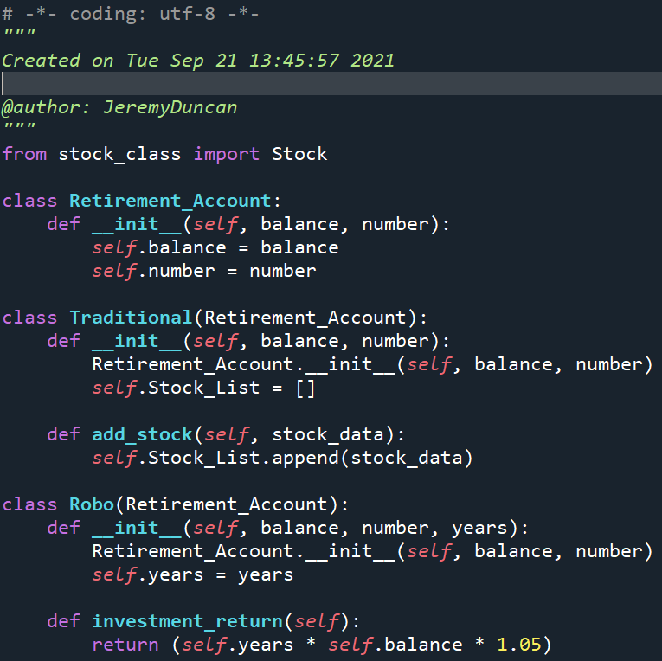
Section 4: Inheritance
Once I have the layout of the classes I want to use, I code them in Python and create a new file called account_class.py.

Slide 22
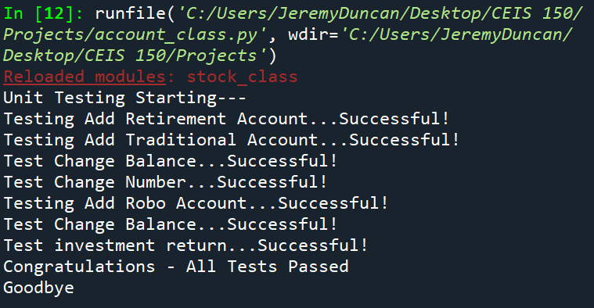
Section 4: Inheritance
The next step I use a unit test to verify the classes and their methods work as intended.

Slide 23
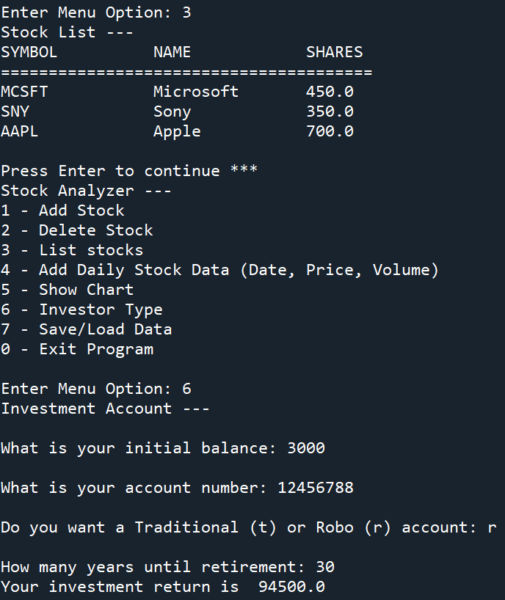
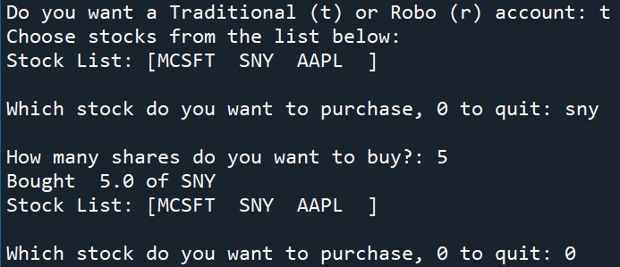
Section 4: Inheritance
I also verify the classes work correctly by testing them in the stock_menu.py program.
I select the Investor Type option to test the Retirement_Account, Traditional, and Robo classes.

Slide 24
SECTION 5
Creating charts:
In section five of my project, I am:
Using the python library matplotlib to create charts in my program.

Slide 25
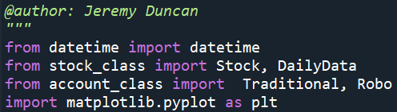
Section 5: Creating Charts
I start by opening stock_menu.py and typing import matplotlib.pyplot as plt at the top of my program.
This imports the pyblot class that is in the matplotlib library and creates an instance I can call on called plt.

Slide 26
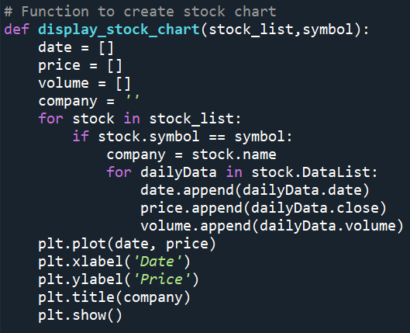
Section 5: Creating Charts
Next, I create a function called display_stock_chart() that will utilize the pyblot class from the matplotlib library to create my chart.
Instead of using pyblot in my code, I will be using plt since I used “as plt” in the import statement at the beginning of my code.

Slide 27
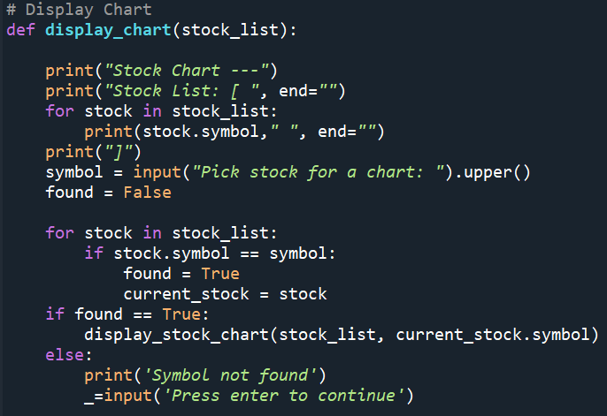
Section 5: Creating Charts
Next, I add the code that calls the display_stock_chart() function when the user selects the Stock Chart option in the menu of the program.
When the Stock Chart option is selected, it calls the display_chart() function, which asks for user inputs about what stock the user wants to display.
If the stock is found, it will call the display_stock_chart() function, and displays the chart.

Slide 28
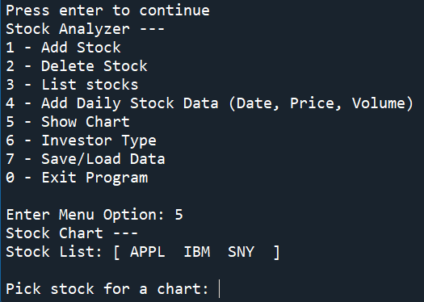
Section 5: Creating Charts
Now that I have the code complete for my chart functions, I test to make sure it works when I run the stock_menu.py program.
I select Show Chart for the test.

Slide 29
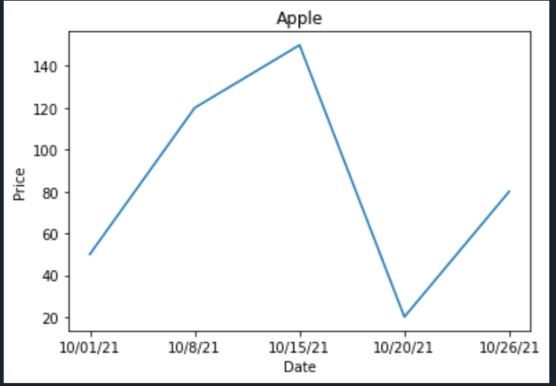
Section 5: Creating Charts
When I type APPL from the stock list, it generates a chart for Apple from the data that was made available.

Slide 30
SECTION 6
Saving data:
In section six of my project I am:
Using json to save and load data.
Using the CSV library to import data from yahoo! Finance.

Slide 31
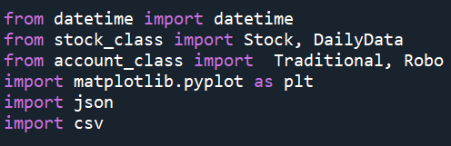
Section 6: Saving Data
In order to save and load data with JSON files, I need to import the json library into the top of my code.
I also need to add import the csv library into my code so I can load CSV files into my program as well.

Slide 32
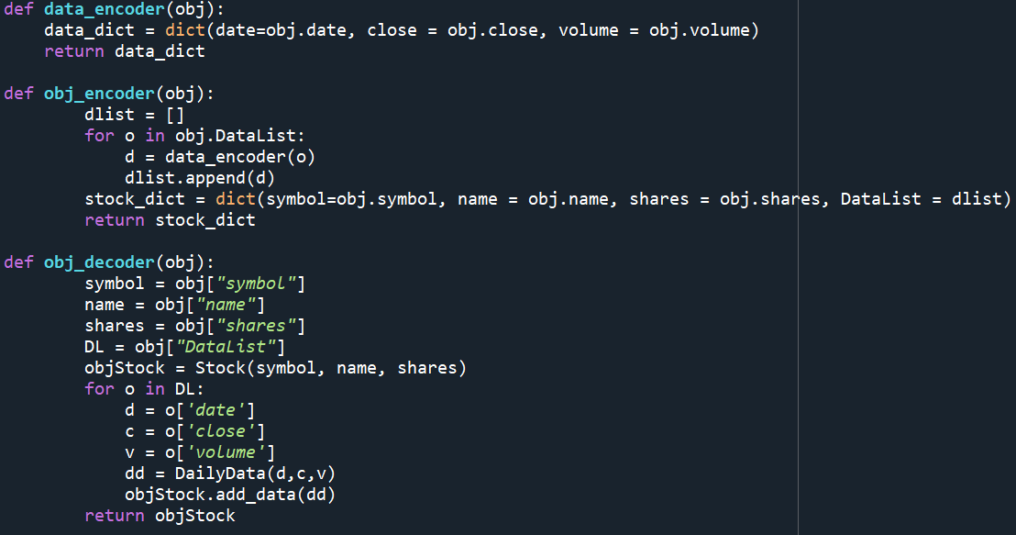
Section 6: Saving Data
Since JSON maps to Python dictionaries I need to add code that will encode my stock objects into a dictionary.
I also need to add code that will decode dictionaries into objects.
I create the functions data_encoder(), obj_encoder(), and obj_decoder() for this purpose.

Slide 33
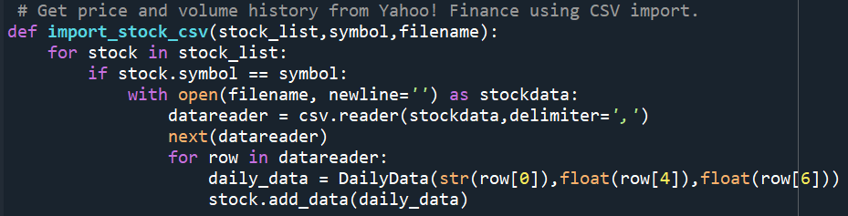
Section 6: Saving Data
I also need to create the code that allows my program to import CSV data.
I create the import_stock_csv() function for this task.

Slide 34
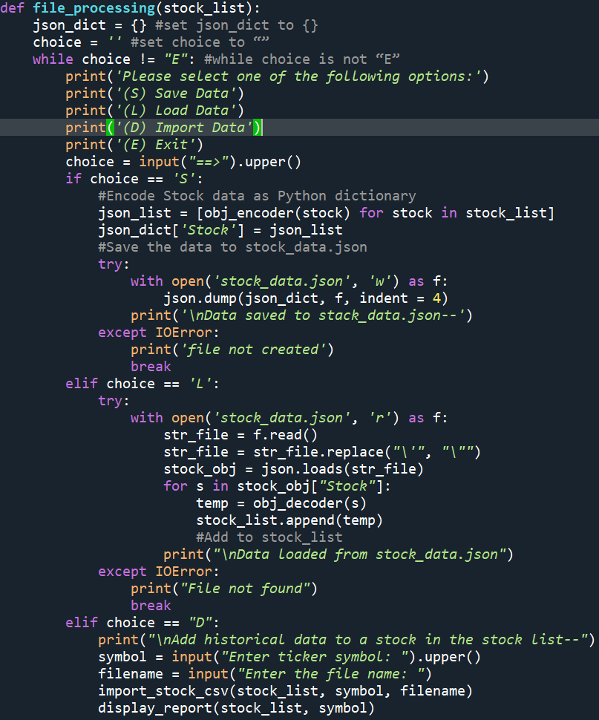
Section 6: Saving Data
Next, I need to add code that gives the user a way to select if they want to Save, Load, or Import Data.
I add the file_processing() function to make this happen.
file_processing() calls obj_encoder(), and obj_decoder() to process the Object and Dictionary data, which allows the program to save and load JSON files.
The function import_stock_csv() is called import CSV files as well.

Slide 35
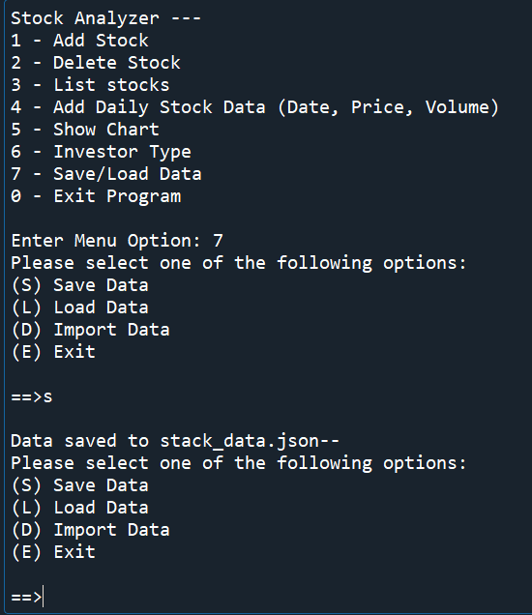
Section 6: Saving Data
Once I have the code complete, I test it to make sure everything works correctly.
I select Save/Load Data, then Save Data.
I should get the message “Data saved to stock_data.json” once successfully saved.

Slide 36
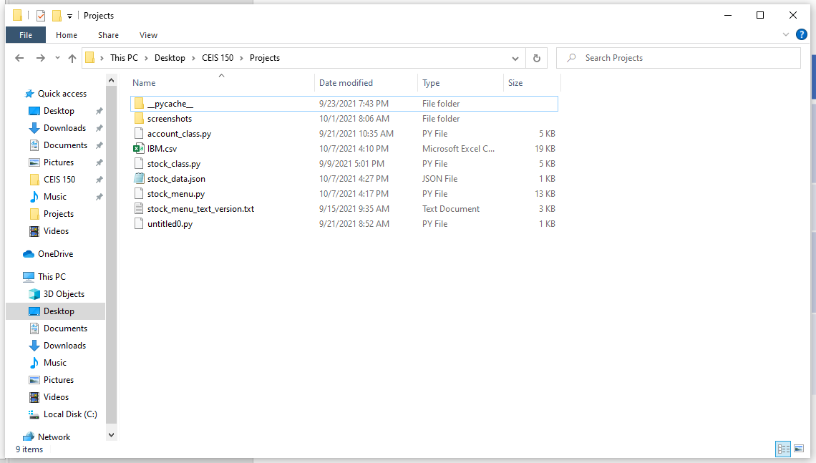
Section 6: Saving Data
I can also verify the data was saved by looking in my program directory and seeing stock_data.json.

Slide 37
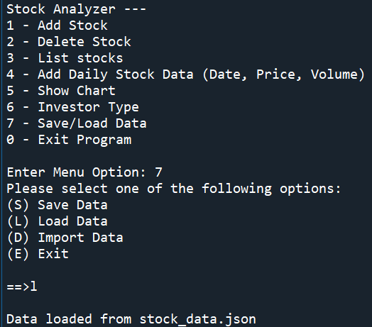
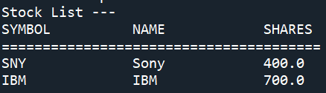
Section 6: Saving Data
Next, I want to make sure the data loads correctly.
I select Save/Load Data, then Load Data.
I should get the message “Data loaded from stock_data.json”.
I can verify the data loaded by selecting the List Stocks option in the main menu.
Loaded Data from stock_data.json

Slide 38
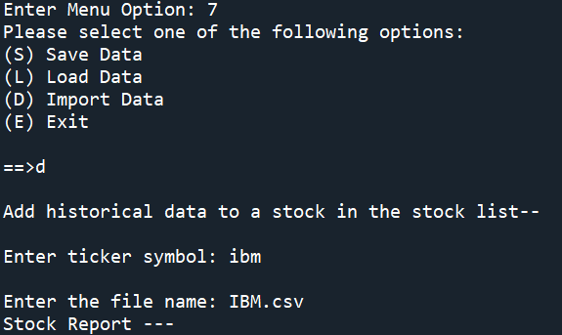
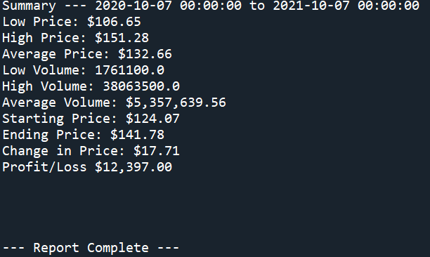
Section 6: Saving Data
Next, I want to verify I can import CSV data by selecting the Import Data option.
I enter the file name IBM.csv to import the IBM stock data from Yahoo! Finance.
If successful, I should see a summary of the data.

Slide 39
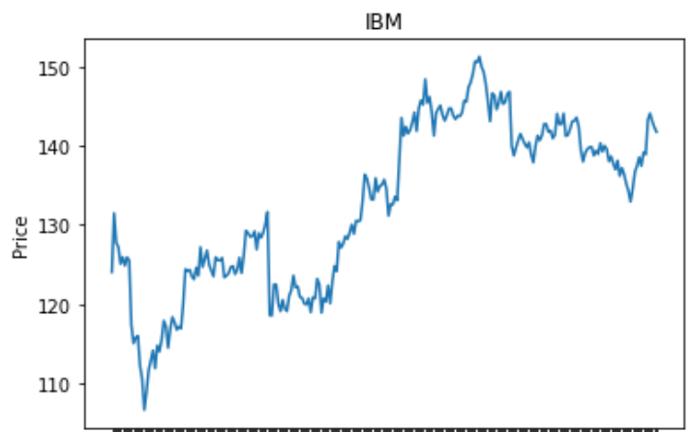
Section 6: Saving Data
I can display a chart of the CSV data in the Chart menu option as well to verify it worked correctly.

Slide 40
SECTION 7
Graphical User Interface:
In section seven of my project I am:
Creating a graphical user interface (GUI) by using the tkinter library.

Slide 41
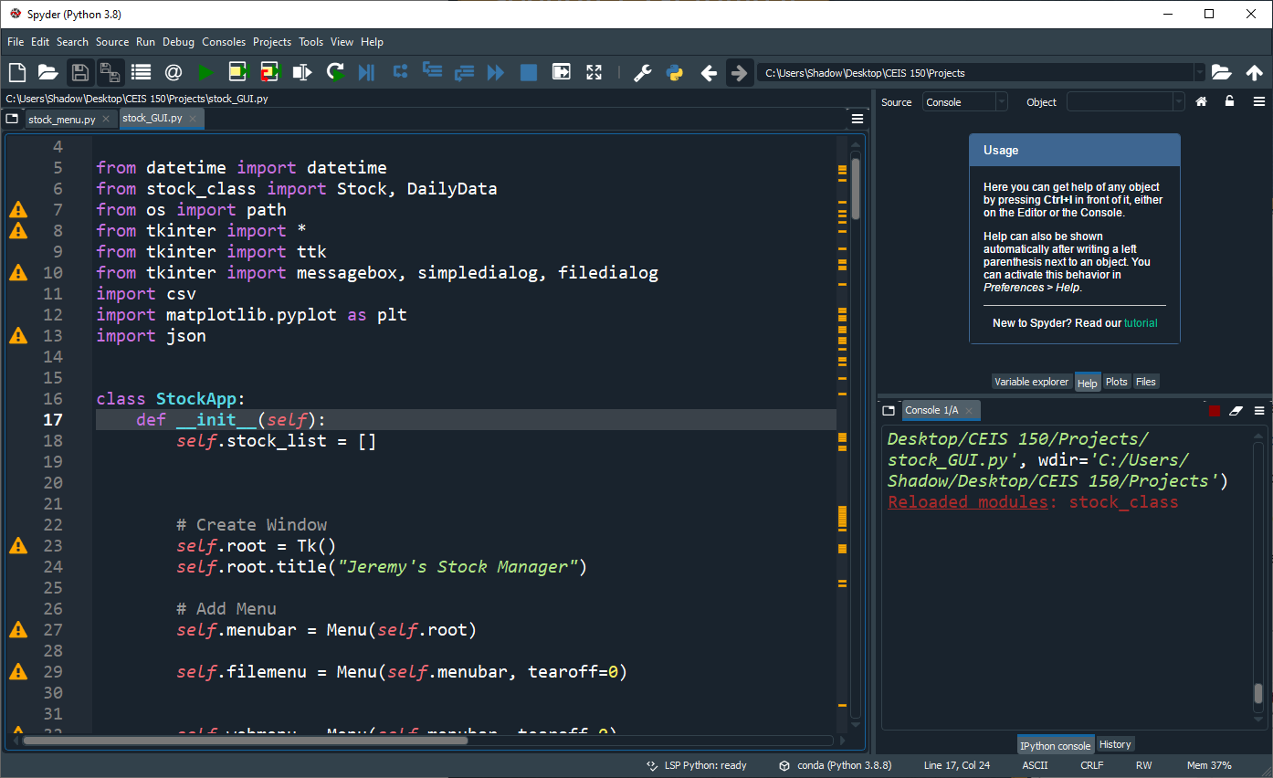
Section 7: Graphical User Interface
tkinter is a cross-platform library that will allow my GUI to work on Windows, Mac, or Linux
I create a new file called stock_gui.py to add the code for tkinter. This creates all the windows and tabs I will be using for the program I already created.

Slide 42
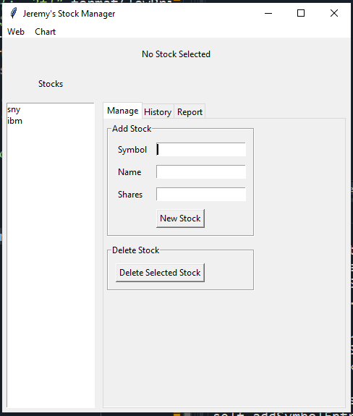
Section 7: Graphical User Interface
When the tkinter library and code is implemented, my program now has a more modern look that can be manipulate from the user with a mouse and keyboard.
In this example I added Sony and IBM stocks to test the functionality in the Manage tab.

Slide 43
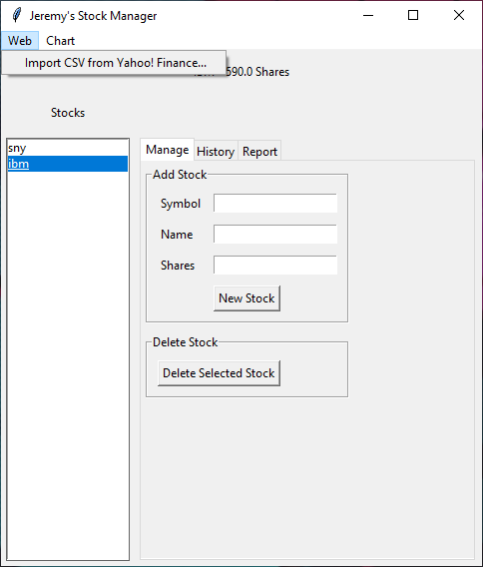
Section 7: Graphical User Interface
To test the import function, I select Web, then Import CSV from Yahoo! Finance.

Slide 44
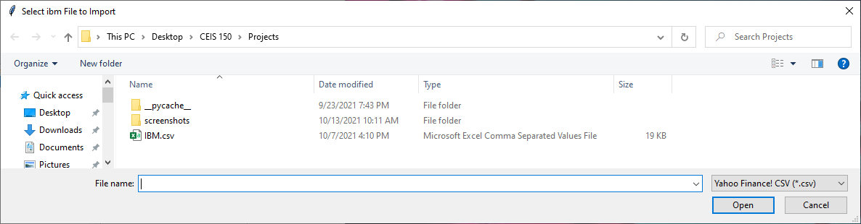
Section 7: Graphical User Interface
I then select the IBM.csv file I used earlier in my example.

Slide 45
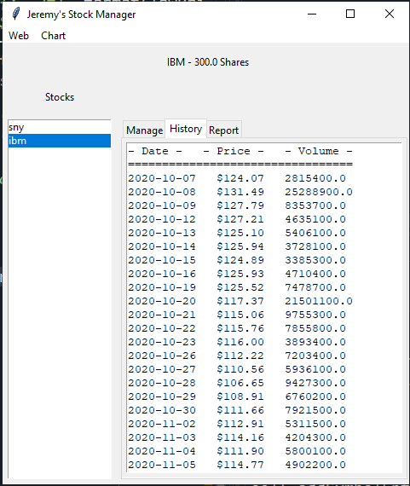
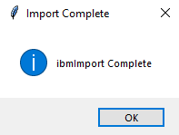
Section 7: Graphical User Interface
Once I load the IBM.csv file, I’m notified the Import was complete.
I can now view the loaded data in the history tab.

Slide 46
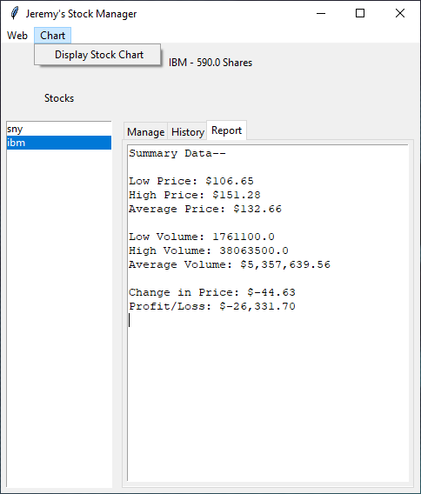
Section 7: Graphical User Interface
To display the chart of that imported data, I select Chart, then Display Stock Chart.

Slide 47
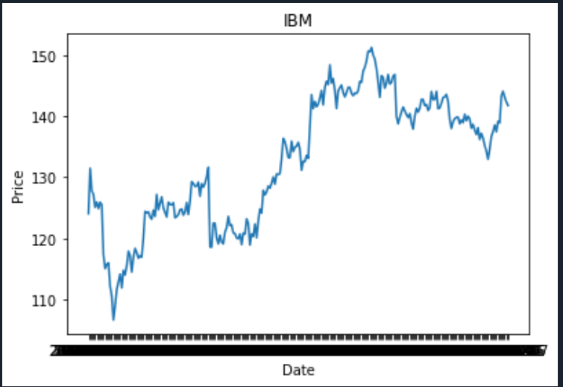
Section 7: Graphical User Interface
My imported data is now displayed on a chart.

Slide 48
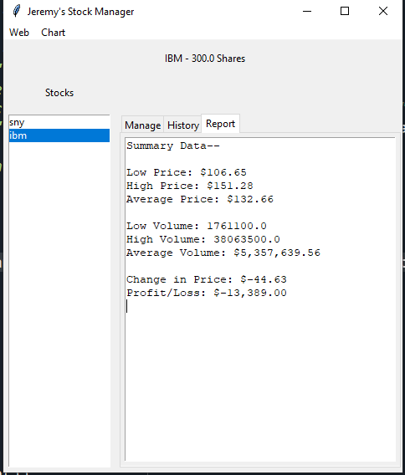
Section 7: Graphical User Interface
I can also see the financial report of my imported data by clicking on the Report tab.

Slide 49
Project CHallenges
One of the challenges I faced was doing this project entirely from an android operating system on my Samsung Galaxy Tab s7+.
I was able to overcome this obstacle by using a Virtual Machine (VM) service called shadow. This enabled me to run windows on my tablet, and ultimately install and run the required python ide and plugins.

Slide 50
Career Skills obtained
experience WITH Object oriented programming.
Experience creating applications in python.
Experience in creating UML CLASS diagrams.
Experience using python libraries.
Working in virtual environments.
Data analysis

Slide 51
Conclusion
While completing this project, I have learned that Python is a very versatile programming language. I am looking forward to expanding my knowledge and experience in the Python language in the future.

Slide 52
REFERENCES
https://www.python.org/
https://www.anaconda.com/
https://www.spyder-ide.org/
https://matplotlib.org/
https://pandas.pydata.org/
https://docs.python.org/3/library/json.html
https://docs.python.org/3/library/csv.html
https://docs.python.org/3/library/tkinter.html
https://shadow.tech/

