Slide 1
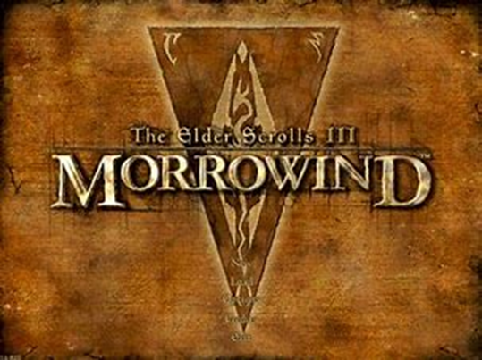
DIGIT400 T.E.S III Morrowind Librarium Project
Jeremy Fischer – Project Lead
Isaac Esterline – Website manager/CSS Stylist
Joel Watson – Schema Author and xml Markup

Slide 2
What’s the Project About?
Collection of “Morrowind Exclusive Books”
Simplification of complex lore
Organizing by people, factions, in-game items, and locations
Creating a Library of books that is easy to access and read

Slide 3
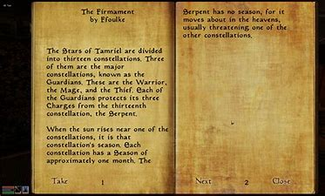

Slide 4
Problems with these books
Must acquire in-game
Language is confusing
Lore is incredibly complicated
None of the information is useful to the player besides for the background, is completely optional and takes away from the pace.

Slide 5
Website link
http://morrowind.newtfire.org/

