Slide 1


By Harisch Jeremy Joel, Lange Kimberly and YuTongzhou
CS490U: Blockchain & Cryptocurrency
Final Presentation / Demo
2018.12.15
Notes:
1

Slide 2










Slide 3
DEMO!
TrustCar – Final Presentation / Demo

Slide 4




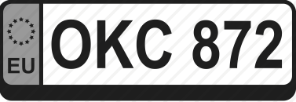
Smart Contract
struct car_struct
{
address addr; // Wallet's Address
string name; // Car’s Name
uint yearOfConstruction; // Year of Construction
string license_plate; // License Plate
string owner; // Car Owner
uint odometer; // Odometer
address place; // Garage of Construction
address item[] history; // Car’s History
}
struct item
{
uint date; // Date of Entry
string content; // Content of Entry
address garage; // Address of Garage
}
4

Slide 5
Smart Contract
struct garage_struct
{
address addr; // Wallet's Address
bool adm; // true => Admin
string name; // Name of Garage or Admin
uint yearOfConstruction; // Year of building Garage
string place; // Settlement of Garage
}
5

Slide 6
Smart Contract
In Smart Contract:
function sendHistory( address _car, string _content) public onlyGarage
{
item entry;
entry.date = now;
entry.garage = msg.sender;
entry.content = _content;
car_accounts[_car].history.push(entry);
}
In JavaScript:
// (after account was unlocked successfully)
A=document.getElementById("givenAddress").value;
B=document.getElementById("givenEntry").value.toString();
C=document.getElementById("login_addr").value.toString();
trustcar.sendHistory(A,B,{from:C, gas:500000});
6

Slide 7
Smart Contract
In Smart Contract:
function seeGarage( address _adr) public view
returns (bool admin, string garName, uint year, string location)
{
return(garage_accounts[_adr].adm, garage_accounts[_adr].name,
garage_accounts[_adr].yearOfConstruction, garage_accounts[_adr].place);
}
In JavaScript:
A=document.getElementById("givenAddress").value;
var result = trustcar.seeGarage.call(A);
TrustCar – Final Presentation / Demo
7

Slide 8
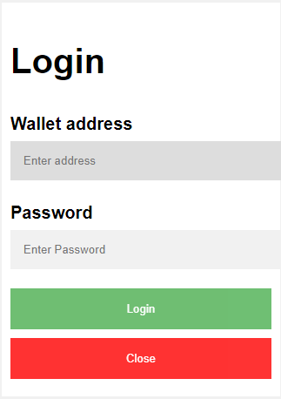
New Functionalities
Login Pop-Up
web3.personal.unlockAccount(…);
Create Accounts
web3.personal.newAccount(<passphrase>);
User Feedback
Success or Failure of Transaction

Slide 9
Error Handling
Input field empty
HTML form: required statement for input
Input (address) not valid
More/ less than 42 characters
Length of Ethereum address
No hexadecimal
Address not found
Check mappings
Transaction failed
if(addr.length != 42)
if(!isHex(addr))
function isHex(h){
var re = /[0-9A-Fa-f]{40}/g;
return re.test(h);
re.lastIndex = 0;
}

Slide 10
Evaluation
What we have done:
A fully functional smart contract
A user-friendly website with good error handing
Connection between them
What to do:
More functions to add after practical testing
Optimize the smart contract to save gas
…

Slide 11
Picture Sources
https://github.com/FortAwesome/Font-Awesome/issues/11479
https://www.vectorstock.com/royalty-free-vector/new-tag-icon-vector-13483800
https://de.wikipedia.org/wiki/Ethereum
https://thenounproject.com/term/admin/200080/
https://de.wikipedia.org/wiki/Datei:Car_with_Driver-Silhouette.svg
https://www.flaticon.com/free-icon/documentation_162807
https://www.iconfinder.com/icons/340588/car_check_fix_garage_gear_service_tool_icon
https://www.iconfinder.com/icons/2040837/auto_car_european_licence_number_plate_registration_icon
https://pngimage.net/counter-png-2/
https://www.freepik.com/free-icon/history_735420.htm
http://chittagongit.com/icon/name-tag-icon-21.html
10

