Slide 1
Kalman Filtering approach for a differential drive robot Robotics Project
Jeremy Hendrikse & Julius Ortstadt
ROBO5

Slide 2
Project overview and strategy

Slide 3
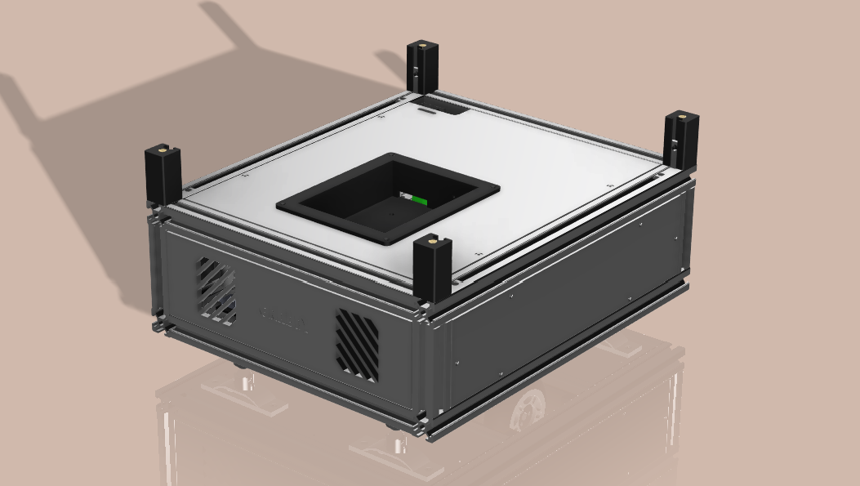
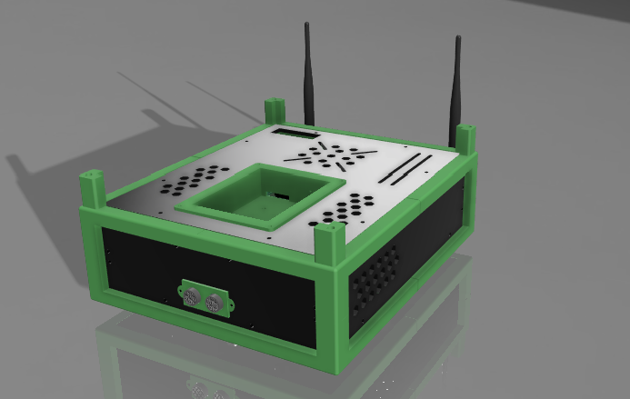
Grabby: a warehouse robot
Autonomous warehouse robot.
Differential drive propulsion method.
SLAM-based navigation.
Major improvements from V2 to V4 (ROS version, modular building approach, better sensors).
Grabby V4
Robot pose estimation using a Kalman Filter.
Estimation based on IMU and encoder data.
Used in the SLAM algorithm for localization and path planning.
Grabby V2

Slide 4
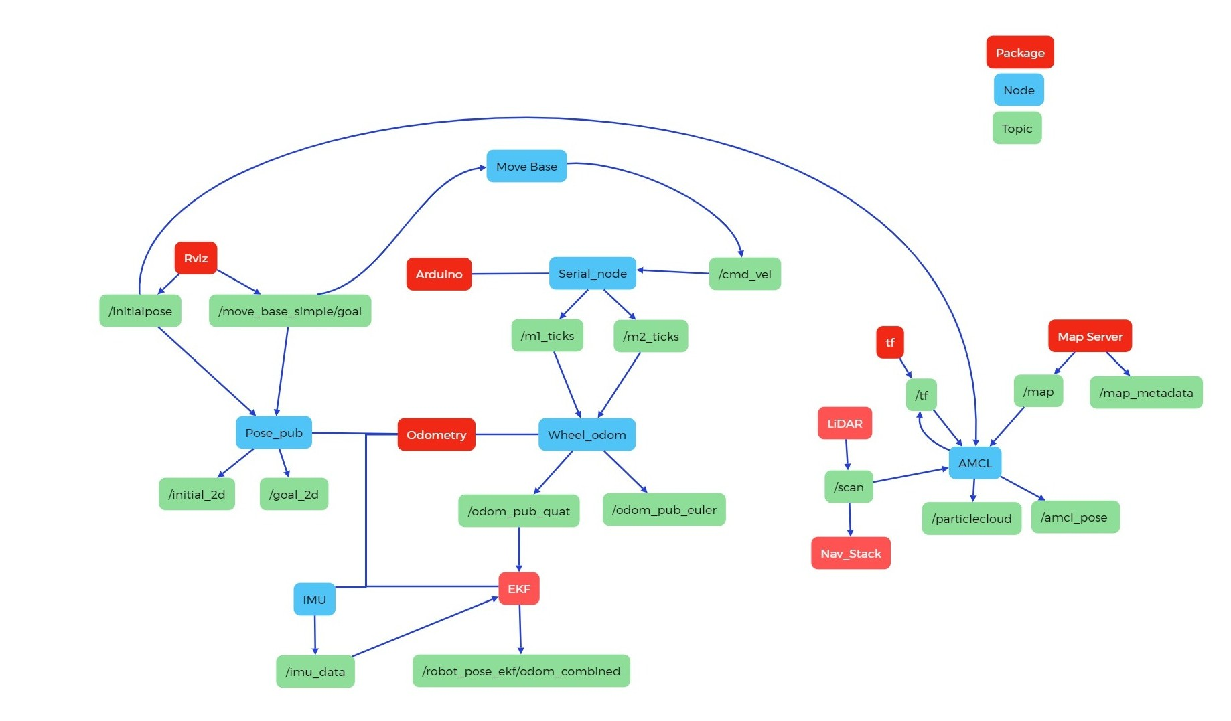
Problem statement

Slide 5
Problem statement
Relevant available sensors:
2D LiDAR
Motor encoders
Inertial Measurement Unit (IMU)
Algorithms:
ROS Navstack
AMCL (Advanced Monte Carlo Localization)
Google Cartographer
The SLAM algorithm needs a pose estimate of the robot.
There are two stages:
Stage 1: Estimate based on odometry
Stage 2: Estimate from stage 1 combined with LiDAR data
Potential error sources include:
Wheel slip
Sensor noise
IMU bias and drift

Slide 6
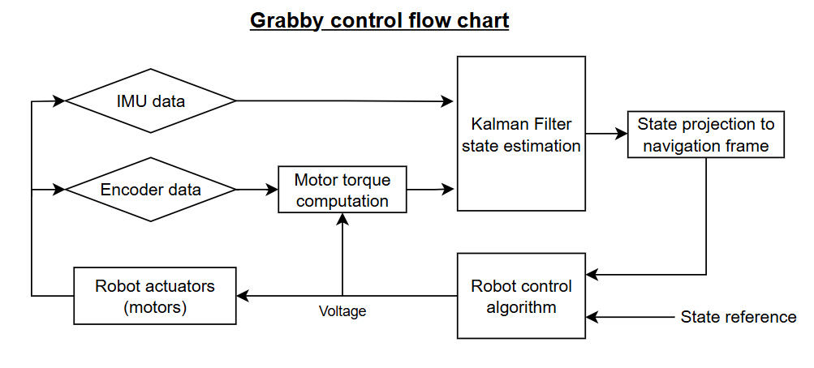
Robot control flow chart
The IMU data is used during the measurement update
The generated torque on each wheel is used as a system input during the prediction step

Slide 7
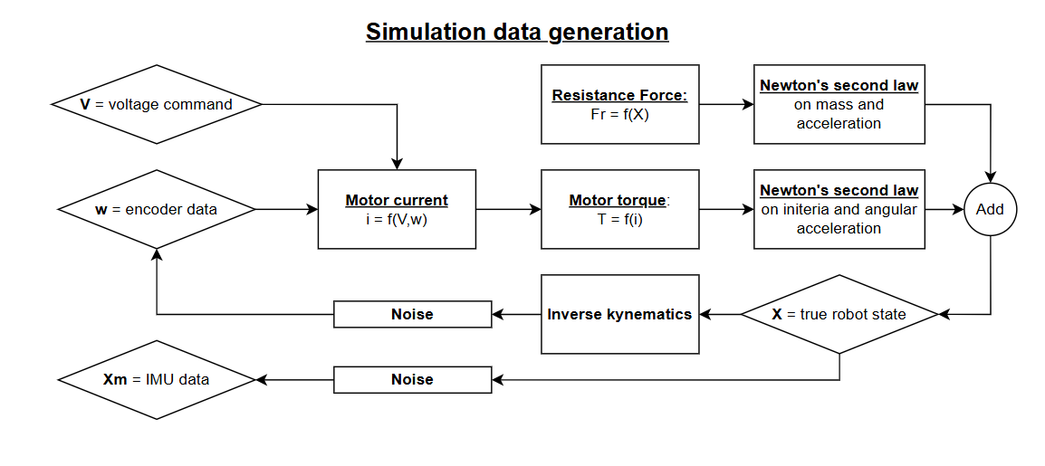
Data generation for simulation
To generate near real-world data
Full modeling of the system

Slide 8
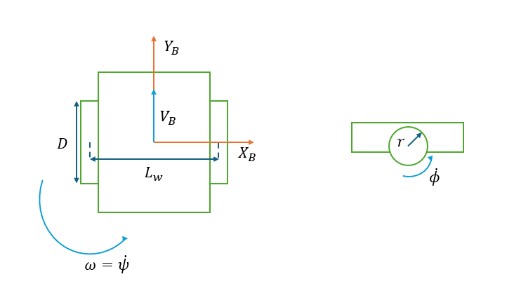
A model to describe the robot
Pose estimation requires:
Linear velocity
Heading (yaw angle)
Angular velocity (yaw rate)
Both dynamic and kinematic modelling of the robot

Slide 9
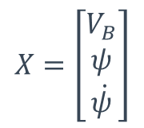
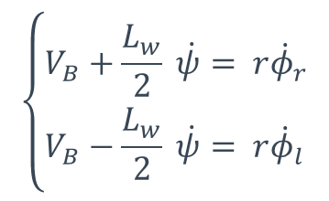
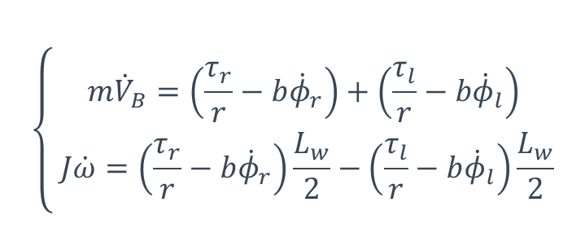
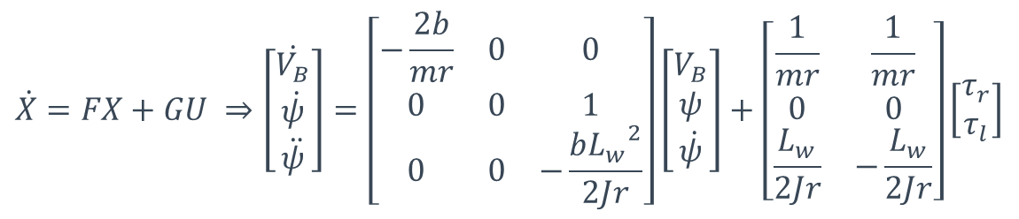
A model to describe the robot
Newton’s 2nd law of motion
Kinematic motion equations
$$\left\{\begin{aligned}m{\dot{V}}_{B}=\left(\frac{τ_{r}}{r}−b{\dot{φ}}_{r}\right)+\left(\frac{τ_{l}}{r}−b{\dot{φ}}_{l}\right) \\ J\dot{ω}=\left(\frac{τ_{r}}{r}−b{\dot{φ}}_{r}\right)\frac{L_{w}}{2}−\left(\frac{τ_{l}}{r}−b{\dot{φ}}_{l}\right)\frac{L_{w}}{2}\end{aligned}\right.$$
State vector
$$\left\{\begin{aligned}&V_{B}+\frac{L_{w}}{2} \dot{ψ}= r{\dot{φ}}_{r} \\ &V_{B}−\frac{L_{w}}{2} \dot{ψ}= r{\dot{φ}}_{l}\end{aligned}\right.$$
$$X=\left[\begin{aligned}V_{B} \\ ψ \\ \dot{ψ}\end{aligned}\right]$$
Continuous state-space model of the system
$$\dot{X}=FX+GU ⇒\left[\begin{aligned}\dot{V_{B}} \\ \dot{ψ} \\ \ddot{ψ}\end{aligned}\right]=\left[\begin{matrix}−\frac{2b}{mr} & 0 & 0 \\ 0 & 0 & 1 \\ 0 & 0 & −\frac{b{L_{w}}^{2}}{2Jr}\end{matrix}\right]\left[\begin{aligned}V_{B} \\ ψ \\ \dot{ψ}\end{aligned}\right]+\left[\begin{matrix}\frac{1}{mr} & \frac{1}{mr} \\ 0 & 0 \\ \frac{L_{w}}{2Jr} & −\frac{L_{w}}{2Jr}\end{matrix}\right]\left[\begin{matrix}τ_{r} \\ τ_{l}\end{matrix}\right]$$

Slide 10
Kalman Filter Implementation
Matlab code structure
Generating: Sensor data & true state reference
Filter initialization
Filter Loop: estimation of the state
Plot: State comparison & estimation error

Slide 11
Results and performance

Slide 12
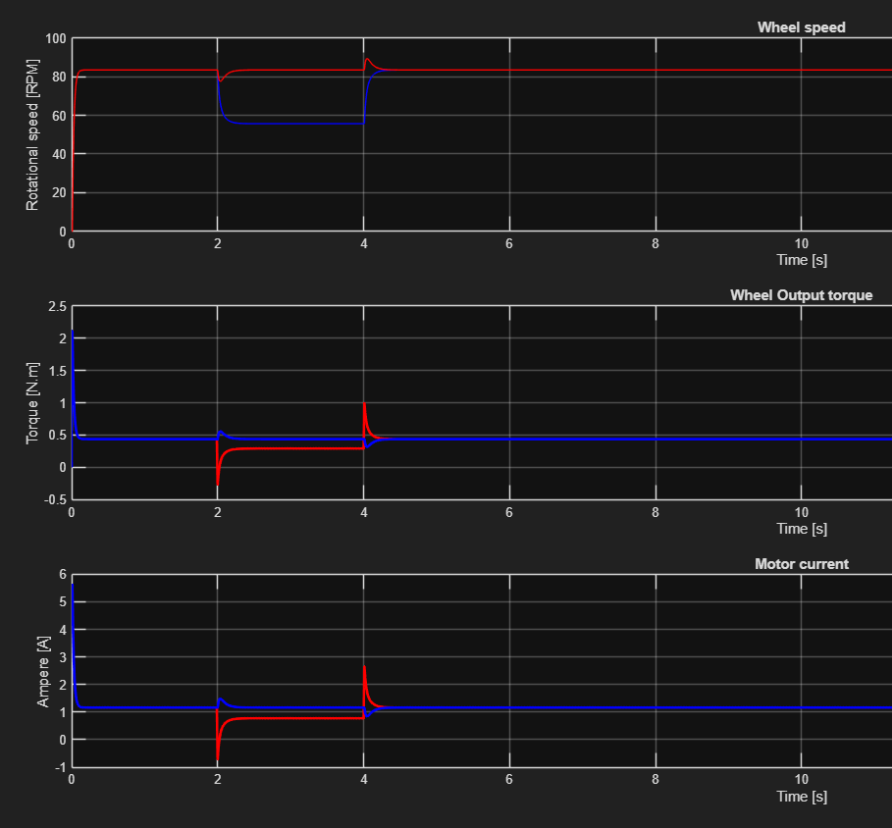
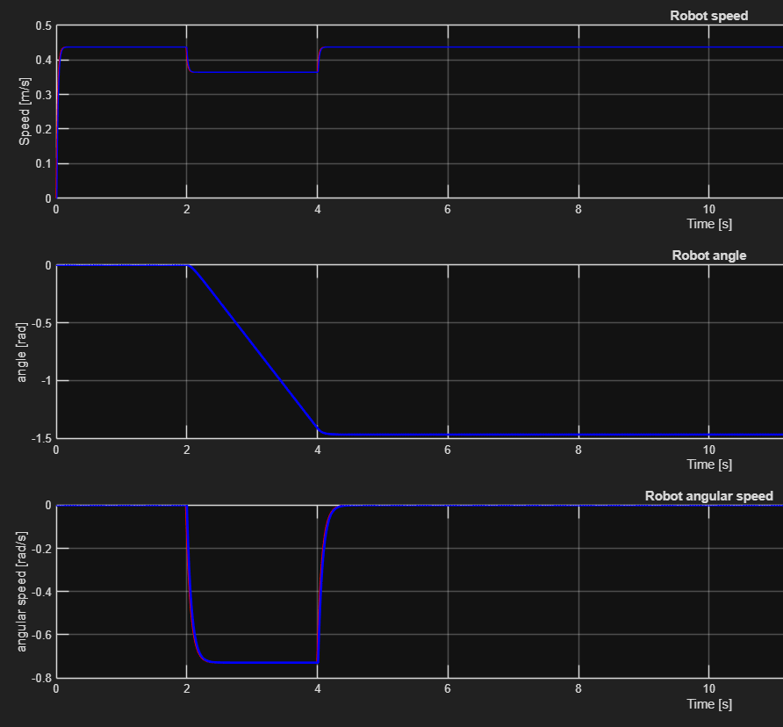


Results
Motor data generation
12V on both motors and slown down to 8V on the right motor (blue) between 2 and 4 seconds
True state
The computation of the true speed and yaw rate, enable the generation of motor data

Slide 13
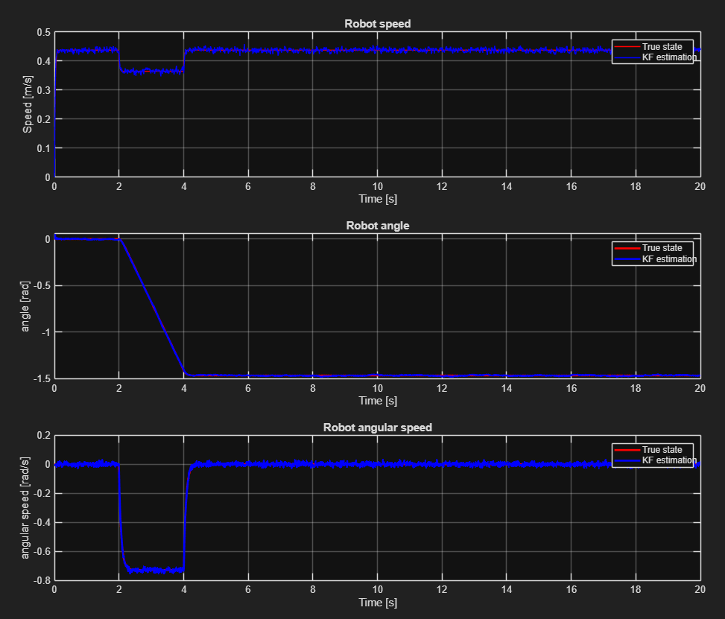
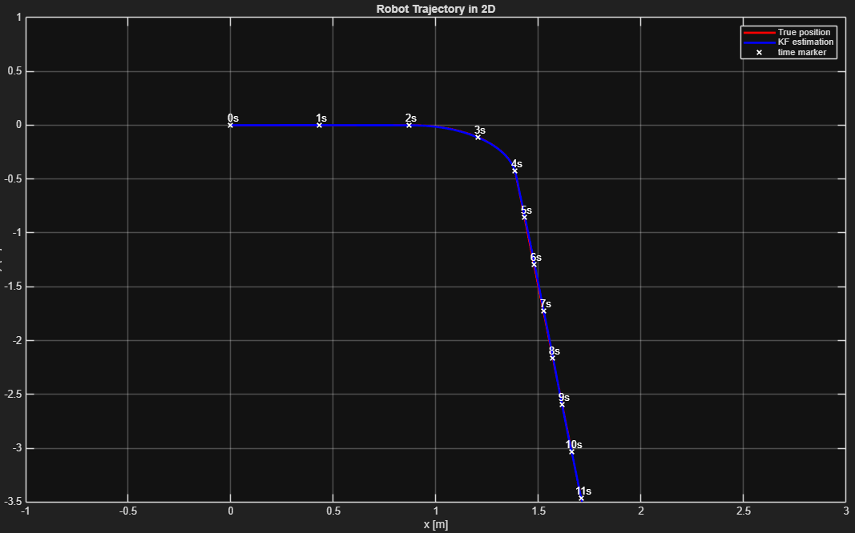
Results
Estimation
Add noise to the previously generated true states to simulate sensor data.
This data is used in the KF to compute the state estimate.
The state estimate is projected in the navigation frame to cross check the results.

Slide 14
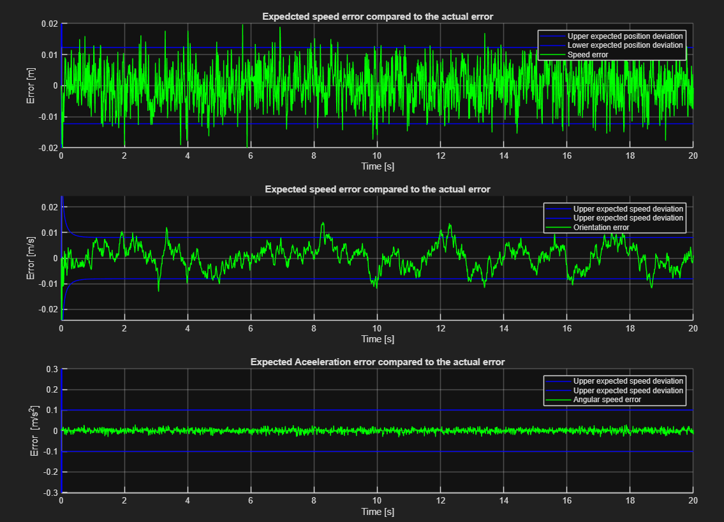
Results
Estimation errors
The expected error boundaries can be plotted by storing the square root of the estimation error covariance matrix P.
All three estimates of the state vector shod satisfying mean converging errors.

Slide 15
Future development and implementation

Slide 16
Improvements and implementation
The estimation capability is limited to the sensor precision and scope of the model.
The current filter doesn’t consider any non-linearity that can be introduced by the projection into the navigation frame.
This projection is handled by stage 2 in the navigation architecture.
The state vector can be expanded to also estimate the sensor biases for better compensation and modelling.

Slide 17
Thank you for your attention!
Do you have any questions?

Slide 18
A model to describe the robot
Project overview
Why would we need a KF
What do we have and what do we need ?
Robot control flow chart
Data generation for simulation
Explain the mathematical model
Kalman filter
Show the matrices and equations
Flaws of the filter
Future implementation and work

