Slide 1





LOAN ORIGINATION SYSTEM · PRODUCT INNOVATION
Making Doc Gen template configuration simple
Five solutions to turn a specialist-only task into a self-service workflow
[Presenter name] · [Team] · [Date]
Notes:
Open with the one-line problem: document generation works well once templates are configured, but configuring them is hard, slow and depends on a few specialists. The deck follows the storyline map: what we have, why it matters, where we are going and how we will get there.

Slide 2





THE STORYLINE
Five questions, six lenses, one story
1
2
3
4
5
What we have
Why it matters
Where we are going
How we will get there
What success looks like
What is our Doc Gen capability today?
Why is template setup painful for users and the business?
What does effortless configuration look like?
Which solutions, in which order?
How will we know it worked?
LENS
Product innovation
LENS
Business scenarios & use cases
LENS
Business impact
LENS
Value & benefits · Roadmap & prioritisation
LENS
Success metrics & outcomes
Doc Gen Innovation Roadmap
2
Notes:
This is the agenda. The five questions are the storyline. The six lenses from the product innovation framework sit inside them: product innovation, business scenarios and use cases, business impact, business value and benefits, roadmap and prioritisation, and success metrics.

Slide 3

01
What we have
What is our Doc Gen capability today, and where does the effort sit?
Lens · Product innovation

Slide 4













01 · WHAT WE HAVE
Doc Gen runs well, but setting it up does not
Doc Gen turns application data into ready-to-use credit documents such as offer letters, agreements and forms.
Data mapping
Template setup
Doc Gen engine
Credit docs
Map data to document tags
Build and manage templates
Compose and render documents
Offer letters, agreements, forms
DESIGN TIME
RUN TIME
The pain sits here
Already delivering
Hundreds of tags in a deep tree, hard to find
Single source of truth for documents
Field mapping and logic live in a separate FSD
Approved templates support compliance
Save errors are technical and cryptic
Faster turnaround, less manual effort
No view of which templates use a tag
Scales with business growth
Doc Gen Innovation Roadmap
4
Notes:
Doc Gen is the foundation of credit document automation and it works well at run time. The problem is design time: data mapping and template setup are where configurers struggle. Everything we propose targets those two steps, not the engine.

Slide 5
02
Why it matters
What do configurers struggle with, in real day-to-day scenarios?
Lens · Business scenarios & use cases

Slide 6




02 · WHY IT MATTERS
Four pain points we hear from configurers
PAIN POINT 1
PAIN POINT 2
Cryptic error messages
Tags are hard to find
Save fails with system errors users cannot act on
Manual scrolling through a deep tag tree
PAIN POINT 3
PAIN POINT 4
Mapping lives elsewhere
No view of tag usage
Opening the master FSD to check every tag
Unknown which templates a tag change affects
Doc Gen Innovation Roadmap
6
Notes:
Four recurring pain points from customer feedback. Each has its own slide next, with the actual system screen.

Slide 7

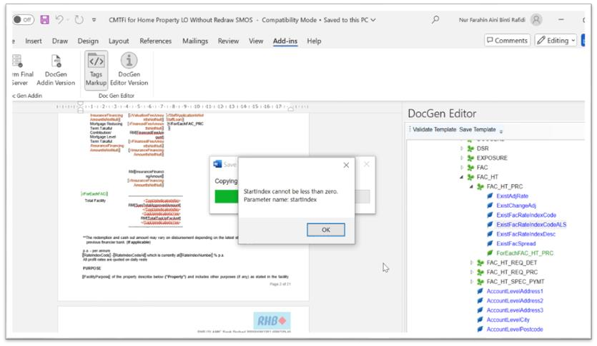
PAIN POINT 1 · CUSTOMER FEEDBACK
Users can’t act on technical error messages
CURRENT SCREEN
“I clicked Save Template, but it failed with this error. I do not understand what StartIndex cannot be less than zero means or how to fix it.”
Save Template fails with a raw system exception: no cause, no location, no fix.
Doc Gen Innovation Roadmap
7
Notes:
The error is a .NET exception surfaced straight to the user. It does not say which tag, which page or what to change, so users raise a ticket or try things by trial and error.

Slide 8
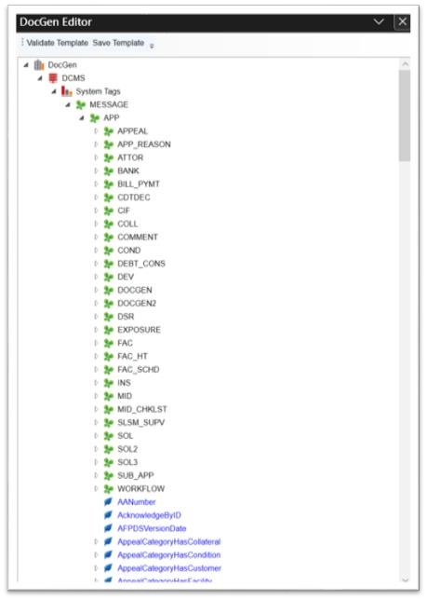
PAIN POINT 2 · CUSTOMER FEEDBACK
Finding a tag means scrolling a deep tree
CURRENT SCREEN
What goes wrong today
Tags sit 4–6 levels deep under folders like APP › FAC › FAC_HT
No search box: users expand folders one by one
“HeB, I’m unable to search for the XXX doc gen tags.”
Users must already know which folder a tag lives in
New configurers depend on senior staff
Doc Gen Innovation Roadmap
8
Notes:
The tag tree has no search, so locating a tag depends on knowing which folder it sits in. This is the biggest time sink for new configurers.

Slide 9
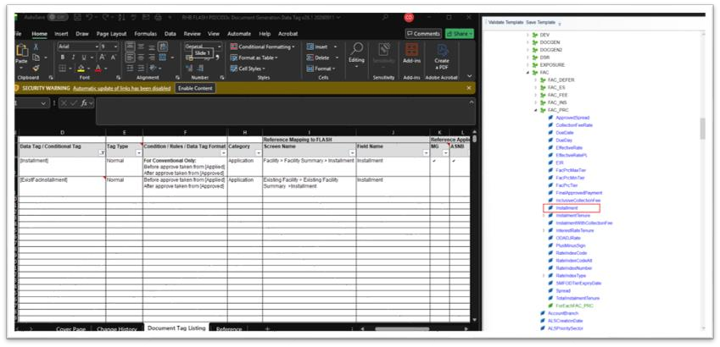
PAIN POINT 3 · CUSTOMER FEEDBACK
Every mapping check means opening the FSD
CURRENT SCREEN
“Aiya, need to open the master FSD to check the mapping again.”
Left: the FSD holds condition, screen and field
Right: the editor shows only the tag name
Doc Gen Innovation Roadmap
9
Notes:
For every tag, users switch to a separate Excel FSD to see which screen and field it maps to and what condition applies. The constant switching is slow and error-prone, and the FSD can drift from what is deployed.

Slide 10

PAIN POINT 4 · CUSTOMER FEEDBACK
No one can see which templates use a tag
SCENARIO
A change request updates the logic behind [Installment]. Which offer letters and agreements must be updated and re-tested?
Offer letter
[Installment]
Facility agreement
“[Add user quote]”
[n] more templates
Today: open each template and search by hand. Missed templates reach production with outdated logic.
Doc Gen Innovation Roadmap
10
Notes:
There is no reverse lookup from a tag to the templates that use it. Impact analysis for a change request is manual, slow and risky. Add a real user quote if you have one.

Slide 11
03
Where we are going
What does effortless template configuration look like, and what changes for the business?
Lens · Business impact

Slide 12






03 · THE FUTURE STATE
Self-service configuration, no specialist needed
Any trained configurer can build, check and change a template without a specialist or a second document.
TODAY
FUTURE STATE
BUSINESS IMPACT
Save fails with “StartIndex < 0”
Error says what, where and how to fix it
Risk reduction
Scroll the tag tree folder by folder
Type part of a name, find any tag in seconds
Productivity
Open the FSD for every tag
Mapping and logic shown inside the editor
Efficiency, accuracy
Guess which templates use a tag
Instant list of every template using it
Risk reduction
Build every template by hand
AI drafts the template, summary and preview
Time to market, CX
Doc Gen Innovation Roadmap
12
Notes:
This is the destination. Each row pairs one of today’s pain points with the future-state experience and the business impact it moves.

Slide 13
04
How we will get there
Five solutions, the value they bring, and the order we deliver them in
Lens · Business value & benefits · Roadmap & prioritisation

Slide 14






04 · HOW WE WILL GET THERE
Five solutions, each aimed at a pain point
SOLUTION 1 · PAIN POINT 1
SOLUTION 2 · PAIN POINT 2
Meaningful error messages
Wildcard tag search
SOLUTION 5 · ALL PAIN POINTS
What went wrong, where, and how to fix it
Find any tag by partial name in the editor
AI template builder with live preview
Drop a sample document and prompt
Get the raw template as a .zip
SOLUTION 3 · PAIN POINT 3
SOLUTION 4 · PAIN POINT 4
Built-in tag dictionary
Tag usage search engine
Get a summary PDF, mapping on hover
An info icon shows mapping and logic in place
See every template that uses a tag
Preview it with sample values
Doc Gen Innovation Roadmap
14
Notes:
Solutions 1 to 4 each fix one pain point directly. Solution 5 builds on them to automate template creation, and includes a preview of the generated template with sample values.

Slide 15



SOLUTION 1 · SOLVES PAIN POINT 1
Error messages that tell users how to fix it
TODAY
PROPOSED · ILLUSTRATIVE
Template not saved: 1 issue to fix
WHAT HAPPENED
A repeating section is opened but never closed.
WHERE
Page 2 · tag [ForEachFAC_HT_PRC]
HOW TO FIX
Add the matching end tag after the last row of the repeating table, then save again.
Raw system exception, no cause or location
Go to location
Copy details
Technical log ›
User can’t self-serve, so raises a ticket
Error code DG-[####] · system detail kept for IT support
Doc Gen Innovation Roadmap
15
Notes:
Translate technical exceptions into a catalogue of plain-language messages, each with what happened, where (page and tag) and how to fix it, plus a jump-to-location button. The raw exception is still logged for IT. The example cause is illustrative; confirm the real causes of the StartIndex error with the Doc Gen engine team. Start with the top 10 errors by ticket volume.

Slide 16




SOLUTION 2 · SOLVES PAIN POINT 2
Wildcard search finds any tag in seconds
TODAY
PROPOSED · ILLUSTRATIVE
DocGen Editor
Key features
*Rate*
Wildcards: * any text, ? one character
All
System tags
Data tags
Matches anywhere in the tree
[n] matches
ExistAdjRate
Full path shown for every result
APP › FAC_HT › FAC_HT_PRC
ExistFacRateIndexCode
Filter by tag type
APP › FAC_HT › FAC_HT_PRC
EffectiveRate
APP › FAC › FAC_PRC
Double-click to insert the tag
RateIndexNumber
APP › FAC › FAC_PRC
InterestRateTenure
Recent and favourite tags
APP › FAC › FAC_PRC
Doc Gen Innovation Roadmap
16
Notes:
A search box at the top of the DocGen Editor panel. Typing part of a name, with optional wildcards, filters the whole tree and shows each match with its full path, so users no longer need to know which folder a tag sits in. Tag names are taken from the current tag tree; paths are illustrative.

Slide 17



SOLUTION 3 · SOLVES PAIN POINT 3
A built-in tag dictionary, one click away
TODAY: TWO WINDOWS
PROPOSED · INFO ICON IN THE EDITOR
▾ FAC_PRC
[Installment]
EIR
TYPE · CATEGORY
Normal · Application
FacPrcTier
SCREEN
Installment
Facility › Facility Summary › Installment
RateIndexCode
FIELD
Installment
Spread
LOGIC
Conventional only. Before approval: from Applied. After approval: from Approved.
Switch to Excel for every tag
FSD may not match what is deployed
Content taken from the current FSD entry for [Installment].
APPLIES TO
MG, ASNB
Logic buried in long condition text
Used in [n] templates ›
Doc Gen Innovation Roadmap
17
Notes:
Each tag in the tree gets an info icon. Clicking it shows the tag’s dictionary entry: type, category, screen path, field, condition logic and the products it applies to, from the same data as the master FSD. The “Used in n templates” link connects to Solution 4. Maintain the dictionary as structured data, ideally generated from the FSD or system configuration, so it stays in sync.

Slide 18



SOLUTION 4 · SOLVES PAIN POINT 4
Search a tag, see every template using it
PROPOSED SCREEN · SAMPLE DATA
Doc Gen Console › Tag Usage Explorer
What it enables
Installment
Status: All
Impact analysis before a change request
Found in 5 templates · 11 occurrences
Export impact list
Exact regression test scope
Template | Count | Status
CMTFi Home Property LO Without Redraw SMOS | 3 | Active
Home Financing Letter of Offer | 2 | Active
Personal Financing-i Letter of Offer | 1 | Active
Hire Purchase Agreement | 1 | Draft
Term Financing Facility Agreement | 4 | Active
Clean-up of unused tags
Audit of regulatory fields
Indexed on every upload, so results are always current
Doc Gen Innovation Roadmap
18
Notes:
A reverse index from tag to template. Every time a template is uploaded to the Doc Gen console its tags are extracted and indexed. Searching a tag lists every template that uses it, how many times, and its status, and the list exports as the impact list for a change request. Template names and counts are sample data, except the first, taken from the current-system screenshot.

Slide 19






SOLUTION 5 · BUILDS ON SOLUTIONS 1–4
AI template builder: drop, prompt, preview
1 · INPUT
2 · AI BUILDS
3 · OUTPUTS
AI template builder
File 1 · Raw template
offer_letter_tpl.zip
Ready to upload to the Doc Gen console
Drag and drop a sample
1
Detects the variable text in the sample
offer_letter.docx
File 2 · Summary report
2
Matches each item to a tag using the tag dictionary
offer_letter_summary.pdf
Same layout as the template; hover a tag to see its screen mapping
PROMPT
3
Adds repeating sections and conditions
Preview
“Set this up as a home financing offer letter. Map customer, facility and pricing fields.”
Validates against Doc Gen rules
Sample values
4
The generated template filled in, before upload
5
Renders a preview with sample values
Configurer reviews the preview, then uploads the .zip
Doc Gen Innovation Roadmap
19
Notes:
The user drags in a sample document, for example a finished offer letter, and describes it in a prompt. The AI detects the variable text, matches each item to a Doc Gen tag using the tag dictionary from Solution 3, adds loops and conditions, validates the result, and renders a preview with sample values. It returns two files: the raw template as a .zip, ready to upload to the Doc Gen console, and a summary report PDF with the same layout as the template, where hovering over a tag shows its screen mapping. A human always reviews before upload.

Slide 20

SOLUTION 5 · WHAT THE USER GETS
A summary PDF that explains every tag, and a preview
FILE 2 · SUMMARY REPORT (PDF) · HOVER TO SEE MAPPING
PREVIEW WITH SAMPLE VALUES
LETTER OF OFFER
LETTER OF OFFER
[AccountLevelAddress1]
No. [__], Jalan [Sample]
[AccountLevelCity] [AccountLevelPostcode]
Kuala Lumpur 50450
Purpose: [FacilityPurpose]
Purpose: Purchase of residential property
Profit rate: [RateIndexCode] + [Spread]% p.a.
Profit rate: BFR – 2.50% p.a.
Tenure: [TotalInstallmentTenure] months
Tenure: 420 months
Monthly instalment: RM [Installment]
Monthly instalment: RM 2,350.00
[Installment]
Screen: Facility › Facility Summary › Installment
Field: Installment
Logic: Applied before approval, Approved after
Sample values only; no customer data.
Doc Gen Innovation Roadmap
20
Notes:
Left: the summary report is a PDF with the same layout as the raw template. Every Doc Gen tag is highlighted, and hovering over a tag shows its screen mapping, field and logic, so testers and approvers can read the template without the FSD. Right: the preview shows the generated template filled in with sample values, so the configurer can check the result before uploading the .zip. Tag names are from the current system; values are samples.

Slide 21

04 · BUSINESS VALUE & BENEFITS
What each solution is worth
SOLUTION
VALUE LENS
BENEFIT
1 · Error messages
Users fix errors themselves, fewer tickets
Risk reduction · Cost
2 · Wildcard search
Tags found in seconds, not minutes
Productivity
3 · Tag dictionary
No FSD switching, fewer mapping errors
Efficiency · Accuracy
4 · Tag usage engine
Complete impact analysis for every change
Risk reduction
5 · AI template builder
New templates in hours, checked by preview before upload
Time to market · CX
Strategic alignment: less dependence on specialists, faster product launches, stronger compliance trail.
Doc Gen Innovation Roadmap
21
Notes:
The value each solution brings, mapped to the business value lenses. Baselines for tickets, configuration time and mapping defects can be measured before Phase 1 to quantify these benefits.

Slide 22

04 · PRODUCT ROADMAP
Three phases, each building on the last
Phase 1 · Quick wins
Phase 2 · Foundation
Phase 3 · Intelligence
S1 · Error messages
S3 · Tag dictionary
S5 · AI template builder
Top 10 errors rewritten first
FSD turned into structured data
.zip template and summary PDF
S2 · Wildcard search
S4 · Tag usage engine
S5 · Sample-value preview
Search box in DocGen Editor
Templates indexed on upload
Check the generated template first
MILESTONE
Users self-fix common errors
MILESTONE
No more FSD look-ups
MILESTONE
First AI-built template live
Doc Gen Innovation Roadmap
22
Notes:
Phase 1 delivers visible relief quickly with contained UI changes. Phase 2 builds the data foundation: the tag dictionary as structured data and an index of tags per template. Phase 3 uses that foundation for the AI template builder, with a sample-value preview of each generated template, piloted on one template family first.

