Slide 1
Transcranial Magnetic Information: Influence of Surprise on Corticospinal Excitability
Jeremy Hogeveen
Centre for Cognitive Neuroscience
Wilfrid Laurier University

Slide 2
Outline
Intro to transcranial magnetic stimulation (TMS)
Notes:
Going over the fundamentals of TMS and outlining its use in cognitive neuroscience

Slide 3
Outline
Intro to transcranial magnetic stimulation (TMS)
Present model
Notes:
In which I will employ concepts from information theory (surprise and entropy) to attempt to model some neurophysiological data we’ve obtained using TMS

Slide 4
Outline
Intro to transcranial magnetic stimulation (TMS)
Present model
Conclusions
Notes:
In which I will try to briefly and cohesively summarize my conclusions after attempting to model this data

Slide 5
Transcranial Magnetic Stimulation (TMS)
Why use TMS?
Intro: TMS
Present Model
Conclusions
Notes:
In order to address this question I first need to make sure that everyone has a general idea of what TMS is, so…

Slide 6
Transcranial Magnetic Stimulation (TMS)
Why use TMS?
TMS is a non-invasive method of stimulating the brain and peripheral nervous system using induced currents (Barker & Freeston, 2007)
Intro: TMS
Present Model
Conclusions
Notes:
To many, the idea of neural stimulation may seem inherently invasive, hence the question: why use TMS in the first place?
- This question seems especially apt once we consider the plethora of brain imaging tools available to contemporary neuroscientists…

Slide 7
Why use TMS?
fMRI, PET, MEG & ERPs are hugely illuminating
Intro: TMS
Present Model
Conclusions
Notes:
Specifically, fMRI, PET, MEG and ERPs are all hugely illuminating tools, providing us with a means to open the laundry machine without turning it off, and we can now study the neural substrates of the various foci of cognitive neuroscience (i.e. Perception, attention, memory, action, imagery, language and consciousness) in awake, behaving humans

Slide 8
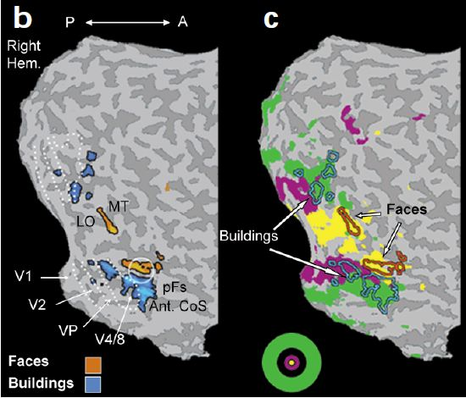
Why use TMS?
fMRI, PET, MEG & ERPs are hugely illuminating
Figure courtesy: Levy, I., et al., (2001).
Intro: TMS
Present Model
Conclusions
Notes:
For example, this impressive fMRI image has localized, within object-processing areas of the human ventral stream, subregions that are selectively engaged during the perception of buildings, or faces
Therefore, this study showed that discrete neuronal substrates underlie these two different object classes in the lateral occipital complex…

Slide 9
Why use TMS?
fMRI, PET, MEG & ERPs are hugely illuminating
But, what can we conclude from this?
Figure courtesy: Levy, I., et al., (2001).
Intro: TMS
Present Model
Conclusions
Notes:
In this image, we can say that regional cebebral blood flow (strongly associated with neural activity) has increased in these discrete subregions when subjects are perceiving faces or buildings
But, we cannot say that these region are essential for the perception of faces and buildings
It could be that these regions are associated with a particular task adopted by participants, or that those regions are involved in the inhibition of peripheral information,
Essentially, we need to triangulate multiple methods to establish a clearer causal relationship between a particular neuronal substrate and experimental condition…

Slide 10
Why use TMS?
Because it helps us elaborate on neuroimaging data to establish causal relationships between candidate neural substrates and behaviour
Intro: TMS
Present Model
Conclusions
Notes:
(let me restate that I am not saying one or the other between neuroimaging or stimulation, simply that a triangulation of multiple methodologies is essential)
Next, I will get into the nuts and bolts of TMS for those of you who are unfamiliar with it, and then how exactly it allows us to expand upon neuroimaging data to infer causal brain-behaviour relationships

Slide 11
TMS: Fundamentals
Based on Faraday’s electromagnetic induction
A pulse of electrical current flowing through a coil of wire generates a magnetic field
Pascual-Leone, Walsh, & Rothwell (2000).
Intro: TMS
Present Model
Conclusions

Slide 12
TMS: Fundamentals
Based on Faraday’s electromagnetic induction
A pulse of electrical current flowing through a coil of wire generates a magnetic field
If the magnitude of this field changes in time, it induces a secondary current in a nearby conductor
Pascual-Leone, Walsh, & Rothwell (2000).
Intro: TMS
Present Model
Conclusions

Slide 13
TMS: Fundamentals
Based on Faraday’s electromagnetic induction
A pulse of electrical current flowing through a coil of wire generates a magnetic field
If the magnitude of this field changes in time, it induces a secondary current in a nearby conductor
The rate of change of the field determines the size of the current induced
Pascual-Leone, Walsh, & Rothwell (2000).
Intro: TMS
Present Model
Conclusions
Notes:
In the case of TMS....

Slide 14
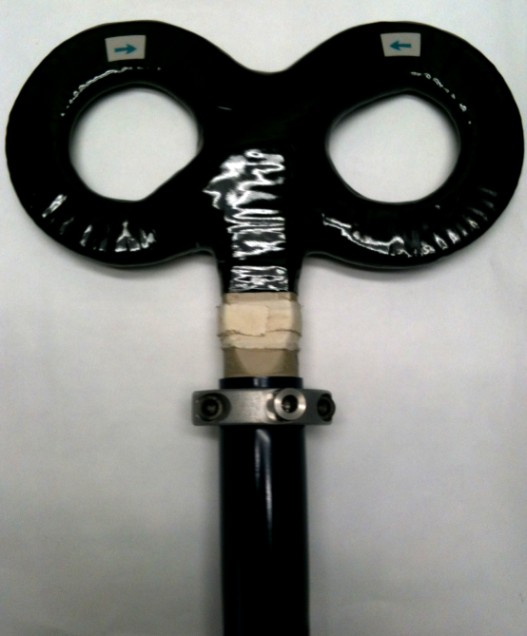
TMS: Fundamentals
Intro: TMS
Present Model
Conclusions
Notes:
The coil through which current is running is the stimulator, which is...

Slide 15
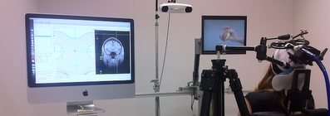
TMS: Fundamentals
Intro: TMS
Present Model
Conclusions
Notes:
...held against a participant’s head and...

Slide 16
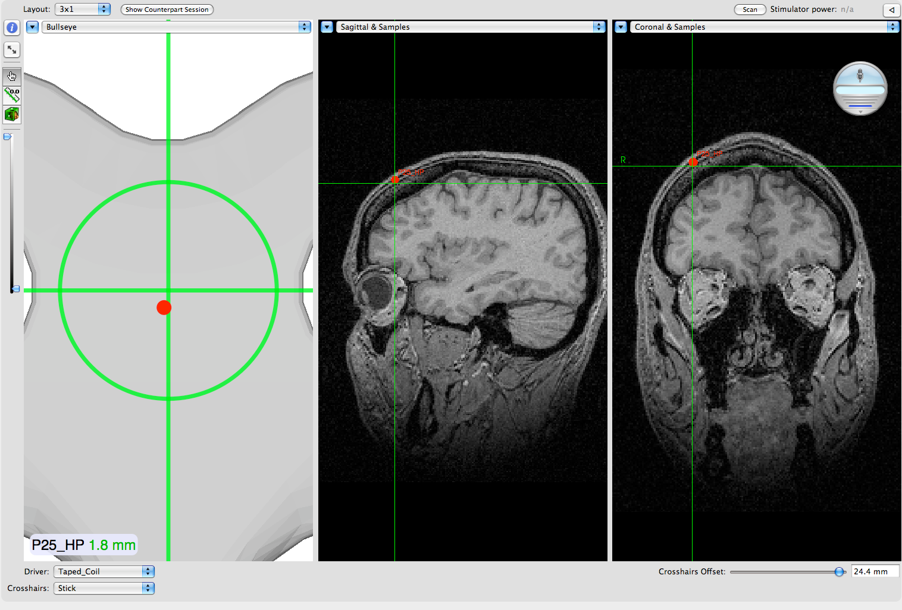
TMS: Fundamentals
Intro: TMS
Present Model
Conclusions
Notes:
...as a brief pulse of current passes through it, a magnetic field is generated that passes through the participants’ scalp and skull with negligible attenuation
- This induces a current in the subject’s brain, and this stimulates neural tissue
- What possible uses can this have for cognitive neuroscientists??

Slide 17
TMS: Uses
Neural Intervention
Intro: TMS
Present Model
Conclusions
Notes:
One possible use is neural intervention, and to illustrate what this means, lets reconsider the occipital face area that was previously shown...

Slide 18
TMS: Uses
Neural Intervention
Pitcher, Walsh, Yovel, & Duchaine (2007).
Figure courtesy: Levy, I., et al., (2001).
Intro: TMS
Present Model
Conclusions
Notes:
Using fMRI, remember there were specific subregions displaying increased regional cerebral blood flow when people observed houses or faces...
- Using a neural intervention paradigm...

Slide 19
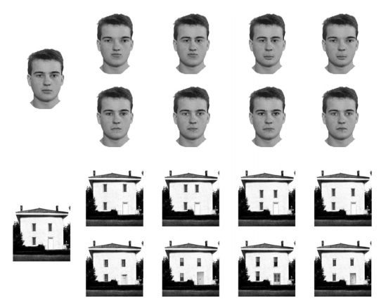
TMS: Uses
Neural Intervention
Pitcher, Walsh, Yovel, & Duchaine (2007).
Intro: TMS
Present Model
Conclusions
Notes:
... Pitcher and colleagues targeted the occipital face area before participants observed faces and houses, and had them perform a delayed match-to-sample task
- Specifically, they used a repetitive TMS paradigm, in which a train of TMS pulses are delivered and ongoing neuronal processing in the target region is disrupted

Slide 20
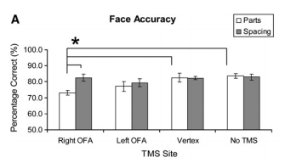
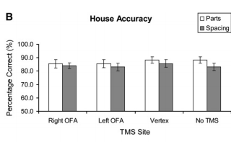
TMS: Uses
Neural Intervention
Pitcher, Walsh, Yovel, & Duchaine (2007).
Intro: TMS
Present Model
Conclusions
Notes:
... Showed that TMS to a right occipital face area disrupted accurate perception of aspects of the face stimuli, but had no effect on accurate perception of the house stimulus
- Here, TMS is disorganizing ongoing processing related to the features of the observed face, which is strong evidence that activity in this occipital face area is causally-related to accurate face perception

Slide 21
TMS: Uses
Neural Intervention
Here, TMS is disorganizing ongoing neural processing in a brain region, effectively disrupting a specific percept
Intro: TMS
Present Model
Conclusions
Notes:
This type of study typifies the use of TMS as a neural intervention, or virtual lesion, technique, but this is not what we will be discussing for the remainder of the talk,, instead we will be focussing on...

Slide 22
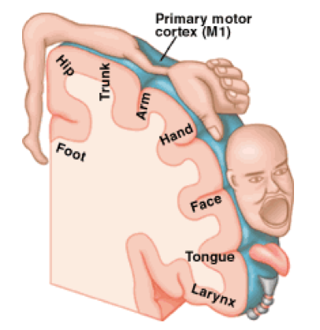
TMS: Uses
Motor corticospinal excitability
Intro: TMS
Present Model
Conclusions
Notes:
... The use of TMS to measure event-related changes in motor-corticospinal excitability, most of you should know a little about the motor homonculus
Basically the human primary motor cortex is organized as a map of the contralateral side of the body, and when we execute a voluntary action with a particular part of our body, a corresponding section of this “map” or homonculus underlies that movement

Slide 23
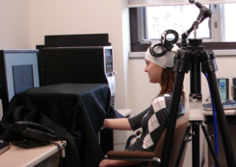
TMS: Uses
Motor corticospinal excitability
+
Intro: TMS
Present Model
Conclusions
Notes:
... In our experiments, we place the coil over the hand representation of M1...

Slide 24
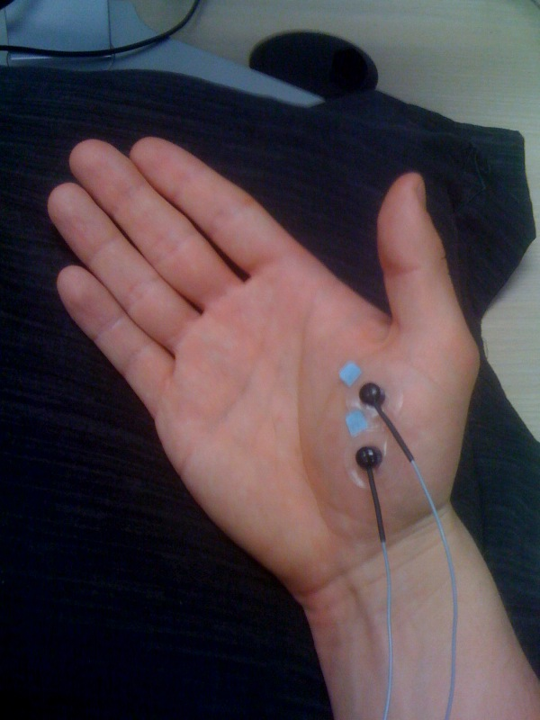
TMS: Uses
Motor corticospinal excitability
+
Intro: TMS
Present Model
Conclusions
Notes:
And record electromyographic activity by placing electrodes on a muscle in their hand (that is not her hand btw)

Slide 25
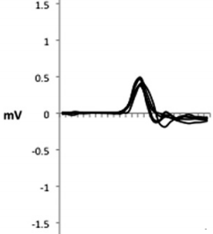
TMS: Uses
Motor corticospinal excitability
+
Intro: TMS
Present Model
Conclusions
Notes:
And deliver single TMS pulses, inducing a slight muscle contraction in their hand, which we record using electromyography (mention that the hand is passive)
In this depiction, the computer screen in front of participants displays an innocuous fixation cross, and the amplitude of the muscle contractions in this condition would give us a baseline measure of corticospinal excitability, however...

Slide 26
TMS: Uses
Motor corticospinal excitability
Aka MEP
+
Intro: TMS
Present Model
Conclusions
Notes:
I should note that I will likely be switching between motor evoked potential (or MEP) and corticospinal excitability in this talk… the MEP is simply our dependent measure to operationalize CSE, they are fairly interchangeable…

Slide 27
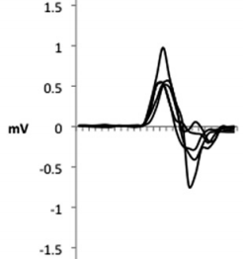
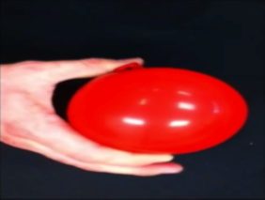
TMS: Uses
Motor corticospinal excitability
+
Intro: TMS
Present Model
Conclusions
Notes:
If we were to perform the same stimulation procedures whilst participants’ observe an event of interest (in this case another person executing a movement), then an increase in the average amplitude of those muscle contractions suggests that there is phasic motor corticospinal excitability that is caused by the on-screen event
In future slides, this muscle contraction will be referred to as a motor-evoked potential (MEP)

Slide 28
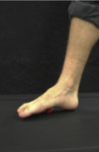
TMS: Uses
Motor corticospinal excitability
+
Intro: TMS
Present Model
Conclusions
Notes:
This enhanced CSE is muscle-specific, meaning that if we observed a foot performing the same action, MEPs recorded from a hand muscle would not be enhanced in the same fashion

Slide 29
TMS: Uses
Motor corticospinal excitability
Intro: TMS
Present Model
Conclusions
Notes:
People have argued that motor resonance, or the mirroring of others’ actions in an observer’s motor system, is the cortical mechanism underlying imitation
This type of motor-evoked potential data shows that motor cortical activity during action observation is muscle-specific, improving our ability to assert that covert motor resonance during passive action observation is substrate to overt motor replication during imitation
This intro was just to give you an idea of what we’ll be looking at, specifically motor-evoked potentials, now lets move on to how exactly we typically analyze motor-evoked potential datasets

Slide 30
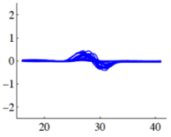
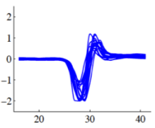
Motor-Evoked Potentials: Typical Analysis
Baseline
Experimental
Intro: TMS
Present Model
Conclusions

Slide 31
Motor-Evoked Potentials: Typical Analysis
Baseline
Experimental
Intro: TMS
Present Model
Conclusions
Notes:
Average of all observations during the baseline phase would give us one measure of baseline CSE (outliers removed from image and analysis)

Slide 32
Motor-Evoked Potentials: Typical Analysis
Baseline
Experimental
Intro: TMS
Present Model
Conclusions
Notes:
Average of all observations during the experimental block would give us one measure of event-related CSE (outliers removed from image and analysis)

Slide 33
Motor-Evoked Potentials: Typical Analysis
Baseline
Experimental
Intro: TMS
Present Model
Conclusions
Notes:
MEP facilitation ratios calculated for participants with the average P-P amplitude in the experimental phase divided by that of the baseline phase

Slide 34
Motor-Evoked Potentials: Typical Analysis
F(1,36) = 9.140, p = .005, η² = .20
Intro: TMS
Present Model
Conclusions
Notes:
We can then compare these MEP facilitation ratios between different experimental stimuli, and test them using traditional mean comparison techniques

Slide 35
Motor-Evoked Potentials: Within-Block Variability
Intro: TMS
Present Model
Conclusions
Notes:
Participant’s MEPs during the observation of the same stimulus over the course of a block display a lot of variability
Although we get rid of extreme values and test our hypotheses at the trial level to make sure that this variability does not wreck our traditional analysis, the reasons for this variability are quite poorly understood, and I decided to take this assignment as an excuse to try to figure out why that it

Slide 36
Possible Explanation?
Mars et al., (2008)
Investigated the computational processes underlying the P300 ERP component
Mars, Debener, Gladwin, Harrison, Haggard, Rothwell, & Bestmann (2008).
Intro: TMS
Present Model
Conclusions
Notes:
A recent paper by Mars and colleagues points to a potential solution to this problem…

Slide 37
Possible Explanation?
Mars et al., (2008)
Investigated the computational processes underlying the P300 ERP component
Found that degree of surprise associated with an event predicts trial-by-trial fluctuations in the P300
Mars, Debener, Gladwin, Harrison, Haggard, Rothwell, & Bestmann (2008).
Intro: TMS
Present Model
Conclusions
Notes:
Concluded that, computationally speaking, it may be efficient to focus processing resources on such surprising events, because these contain the most information to an observer

Slide 38
Do MEPs also vary as a function of surprise?
Intro: TMS
Present Model
Conclusions
Notes:
So, I decided to use the same mathematical principles to model surprise associated with the delivery of TMS pulses in an old dataset from our lab

Slide 39
Do MEPs also vary as a function of surprise?
Intro: TMS
Present Model
Conclusions
Notes:
Figure depicts the entire block containing the variable MEPs I displayed previously…
In order to reduce anticipation effects, we follow a convention from the literature whereby TMS pulses are delivered on only a small number of the total trials in a block (in this case there are 30 TMS pulses in a block of 75 trials, or 40% of total trials – i.e. when the line touches zero, there is no TMS delivered on that trial)
Therefore, there may be a high degree of surprise associated with MEP delivery, and this may help to account for some of the trial-by-trial fluctuations in MEP amplitudes

Slide 40
Quantifying Information
Shannon’s Information Theory
Shannon (1948).
Intro: TMS
Present Model
Conclusions
Notes:
So how do we quantify surprise?
The mars and colleagues paper, along with several other recent computational neuroscience papers, uses equations derived from Shannon’s Information Theory, originally devised to answer problems in signal processing, data compression and communication…

Slide 41
Quantifying Information
Shannon’s Information Theory
Uses principles from probability theory and statistics to formally quantify information
Shannon (1948).
Intro: TMS
Present Model
Conclusions
Notes:
Information Theory….

Slide 42
Quantifying Information
Shannon’s Information Theory
Computations can formally quantify the amount of information conveyed by a sensory event
e.g. Strange et al. (2005); Mars et al., (2008); Bestmann et al. (2008)
Intro: TMS
Present Model
Conclusions
Notes:
For neuroscientsts, the computations from information theory can be used to formally…

Slide 43
Quantifying Information
Surprise
Entropy
Intro: TMS
Present Model
Conclusions
Notes:
Relevant to the present model are the information quantities of surprise and entropy

Slide 44
Quantifying Information
Surprise: Refers to the improbability of a stimulus occurring
Intro: TMS
Present Model
Conclusions

Slide 45
Quantifying Information
Surprise: Refers to the improbability of a stimulus occurring
Imagine an ideal observer estimating probability of TMS event based on encountered trials…
Intro: TMS
Present Model
Conclusions
Notes:
The expression for this would be…

Slide 46

Quantifying Information
Surprise: Refers to the improbability of a stimulus occurring
Imagine an ideal observer estimating probability of TMS event based on encountered trials…
Intro: TMS
Present Model
Conclusions
Notes:
Where the little k is for a particular outcome, say the occurrence of TMS, and the large K is thus a vector at two levels of k (i.e. TMS or non-TMS)
The prior distribution before any outcomes have been observed assumes knowledge of TMS or no TMS trials
Therefore 1 in the numerator represents the prior knowledge of the occurrence of TMS
And K in the denominator represents the prior knowledge of both possible outcomes (i.e. TMS or no TMS)
Ni-1k in the numerator refers to the number of exposures to TMS at trial i-1
N in the denominator refers to the total number of trials experienced at trial i-1
Overall, we have the total number of occurrences of a TMS event, plus theTMS prior, in the numerator, divided by the total number of trials, plus the total prior, in the denominator

Slide 47

Quantifying Information
Surprise: Refers to the improbability of a stimulus occurring
Surprise quantifies the information conveyed by the occurrence of event x_{i}
Intro: TMS
Present Model
Conclusions
Notes:
Therefore, surprise represents the improbability (or negative log) of event xi at trial I and varies as a function of the computed probability from trial i-1

Slide 48
Quantifying Information
Intro: TMS
Present Model
Conclusions
Notes:
Here, surprise to TMS is plotted for a sample participant block..
Initially surprise is quite variable, but become more stable as the ideal observer learns the block-wise probabilities associated with TMS or non TMS trials

Slide 49
Quantifying Information
Entropy: Refers to the average surprise over all possible outcomes
Intro: TMS
Present Model
Conclusions

Slide 50

Quantifying Information
Entropy: Refers to the average surprise over all possible outcomes
Quantifies the ideal observer’s expected information based on encountered trials…
Intro: TMS
Present Model
Conclusions
Notes:
Notice that probabilities are updated as a function of the event at time I instead of i-1,
This is because, rather than representing an updated quantity of information after trial i-1, entropy reflects the average quantity of information before a trial occurs

Slide 51

Quantifying Information
Entropy: Refers to the average surprise over all possible outcomes
Quantifies the ideal observer’s expected information based on encountered trials…
Intro: TMS
Present Model
Conclusions
Notes:
Thus, entropy quantifies the expected or average surprise over all events up to, and including, trial I
Reflects the predictability of an outcome before it occurs

Slide 52
Quantifying Information
Intro: TMS
Present Model
Conclusions
Notes:
As would be predicted from the formula, entropy is much more stable than surprise, although it is generally high in the present data, since the overall uncertainty associated with a 60-40 TMS vs. non-TMS breakdown is large

Slide 53
Questions:
Explaining MEP variation:
Are within-block variations in the MEP just “random noise”?
Intro: TMS
Present Model
Conclusions
Notes:
To reiterate, We’re trying to see whether those random variations in MEP amplitudes are more likely the result of random noise, or..

Slide 54
Questions:
Explaining MEP variation:
Are within-block variations in the MEP just “random noise”?
Or, do they reflect knowledge of the probability of a TMS event?
Intro: TMS
Present Model
Conclusions
Notes:
As reflected in blockwise uncertainty, or entropy, and trial-by-trial improbability, or surprise

Slide 55

Nested Model Comparison
x_{1 (participant)}
x_{2 (condition)}
Error Variance
Intro: TMS
Present Model
Conclusions
Notes:
If we imagine this circle representing ALL MEP VARIANCE, which is adequately modeled by x1 (participant) and x2 (experimental condition)

Slide 56
Nested Model Comparison
x_{3 (surprise)}
x_{4 (entropy)}
x_{1 (participant)}
x_{2 (condition)}
Error Variance
Intro: TMS
Present Model
Conclusions
Notes:
Then, we add surprise and entropy as parameters in the model…

Slide 57
Nested Model Comparison
x_{3 (surprise)}
x_{4 (entropy)}
x_{1 (participant)}
x_{2 (condition)}
Error Variance
Intro: TMS
Present Model
Conclusions
Notes:
Then, we take the sum of squares for by the complete model, and…

Slide 58
Nested Model Comparison
x_{3 (surprise)}
x_{4 (entropy)}
x_{1 (participant)}
x_{2 (condition)}
Error Variance
Intro: TMS
Present Model
Conclusions
Notes:
Subtract the new parameters, therefore testing whether or not surprise and entropy contribute significantly to the model

Slide 59
Nested Model Comparison
 | Original Model vs. Ideal Observer Model
 | ANOVA
 | Source | df | Sum of Squares | Mean Square | F | Sig.
 | Original Model | 2 | 157.459 | 78.730 | 93.522 | p < .0001
 | Ideal Observer - Original Model | 2 | 14.907 | 7.454 | 8.854 | p = .0002
 | Error (Ideal Observer) | 1187 | 999.255 | 0.842
 | Total | 1191 | 1171.621
Intro: TMS
Present Model
Conclusions
Notes:
If we look at the light grey row here, the difference between the two models accounted for a significant amount of the variance in MEPs, however, only the surprise measure had a significant effect… So, lets take a look at the actual data …

Slide 60
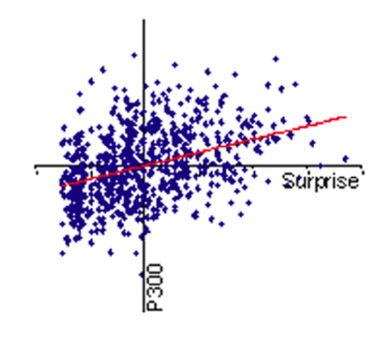
Ideal Observer Model
Figure courtesy Mars et al., 2008.
Intro: TMS
Present Model
Conclusions
Notes:
First let me point out that, In the Mars et al paper that I used as inspiration, there was a significant positive relationship between the P300 ERP component and surprise
Therefore, I did predict a positive relationship between CSE and surprise

Slide 61
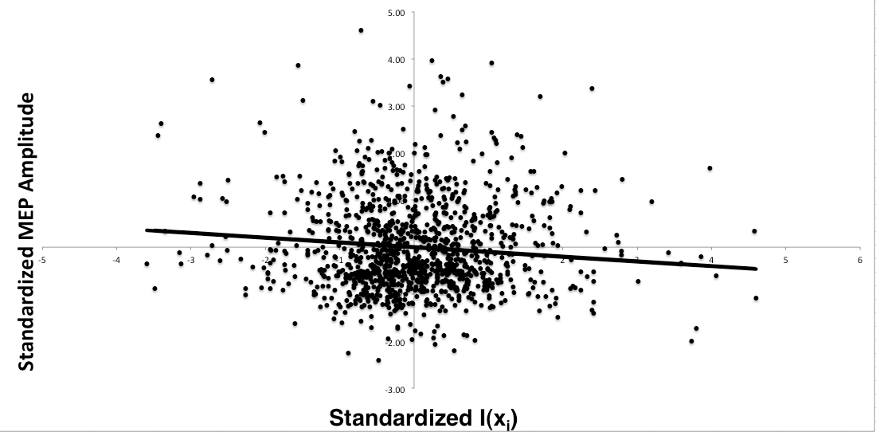
Ideal Observer Model
Intro: TMS
Present Model
Conclusions
Notes:
Here we have a similar figure constructed from the present data, with standardized MEP amplitudes plotted against standardized Surprise to a TMS event
However, CSE was generally lower when trials were preceded by surprising events, in fact…

Slide 62
Ideal Observer Model
Intro: TMS
Present Model
Conclusions
Notes:
On average, there’s a .382 mV decrease in MEP amplitudes predicted for every one bit increase in surprise
In clearer terms, trials preceded by a surprising TMS event are associated with a decrease in subsequent corticospinal excitability
I’ll return to what exactly I think this might mean in a few slides, but first let me ask another question…

Slide 63
Questions:
Explaining MEP variation:
Are participants “ideal”, or fast forgetters?
Intro: TMS
Present Model
Conclusions
Notes:
A second question I wanted to look @ was whether participants update probabilities in an optimal fashion, or whether they are fast forgetters

Slide 64
Questions:
Explaining MEP variation:
Are participants “ideal”, or fast forgetters?
N = n^{i-1} -> n^{i-4}
Intro: TMS
Present Model
Conclusions
Notes:
To test this, I performed the same iterative surprise and entropy calculations, based on a probability distribution that only reflected the previous four trials (the denominator in our probability calculation simply reflects the sum of the previous four events)
This updating rule would be suboptimal in theory, because actual TMS probability is constant throughout the experimental block

Slide 65
Nested Model Comparison
x_{1 (participant)}
x_{2 (condition)}
Error Variance
Intro: TMS
Present Model
Conclusions
Notes:
Again, we have our original model with Participant and condition as factors

Slide 66
Nested Model Comparison
x_{5 (Max forgetting surprise)}
x_{6 (Max forgetting entropy)}
x_{1 (participant)}
x_{2 (condition)}
Error Variance
Intro: TMS
Present Model
Conclusions
Notes:
Then, we add

Slide 67
Nested Model Comparison
x_{5 (Max forgetting surprise)}
x_{6 (Max forgetting entropy)}
x_{1 (participant)}
x_{2 (condition)}
Error Variance
Intro: TMS
Present Model
Conclusions
Notes:
Again, we subtract the new parameters from the complete model, and assess whether or not these fast forgetting surprise and entropic measures add anything to the model

Slide 68
Nested Model Comparison
 | Original Model vs. Maximal Forgetting Model
 | ANOVA
 | Source | df | Sum of Squares | Mean Square | F | Sig.
 | Original Model | 2 | 157.459 | 78.730 | 93.522 | p < .0001
 | Forgetting - Original Model | 2 | 7.586 | 3.793 | 4.473 | p = .0116
 | Error (Forgetful Observer) | 1187 | 1006.576 | 0.848
 | Total | 1191 | 1171.621
Intro: TMS
Present Model
Conclusions
Notes:
Very low significance level given the massive DF,

Slide 69
Maximal Forgetting Model
Intro: TMS
Present Model
Conclusions
Notes:
And if we look at the coefficient for predicting MEPs based on the maximal forgetting model, we see a smaller and less consistent effect than the ideal observer model…
therefore we can fairly certainly say that actual participants perform closer to ideal observer model than the maximal forgetting model

Slide 70
Therefore:
Are within-block variations in the MEP just “random noise”?
Trial-by-trial MEP variation can be modelled as a function of surprise
Intro: TMS
Present Model
Conclusions
Notes:
Interestingly, there is a counterintuitive relationship between CSE and surprise, with increased surprise on the previous trial being associated with a decrease in CSE on the subsequent trial, whereas the ERP literature provided me with the opposing prediction

Slide 71
Therefore:
Are within-block variations in the MEP just “random noise”?
Trial-by-trial MEP variation can be modelled as a function of surprise
Formal quantification of surprise provides a viable target for future exploration of the Motor-Evoked Potential
Intro: TMS
Present Model
Conclusions
Notes:
Participants seem to learn the probability of TMS vs. non-TMS to some degree over the course of a block, which is evidence that…

Slide 72
Therefore:
Are participants “ideal observers”?
The ideal observer model accommodated MEP variation better than maximal forgetting
Intro: TMS
Present Model
Conclusions

Slide 73
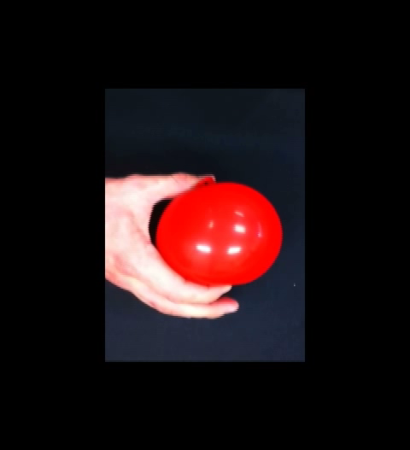
Problem:
TMS vs non-TMS trials was not the only possible probability for participants to learn…
Intro: TMS
Present Model: Redux
Conclusions
Notes:
TMS pulses were delivered at points of maximum flexion during any one of these movements…
Therefore, perhaps a computation of surprise associated with the probability of TMS at a specific onset would better accommodate MEP variability

Slide 74
Quantifying Information – Take 2
TMS onset asynchrony (SOA) was distributed in the following manner:
Intro: TMS
Present Model: Redux
Conclusions
Notes:
This distribution reflects the number of presentations of each video length

Slide 75

Quantifying Information – Take 2
K as a vector of size k x j, where
k represents the levels of TMS
j represents the possible SOAs…
Intro: TMS
Present Model: Redux
Conclusions
Notes:
We then compute surprise using the same formula…

Slide 76

Quantifying Information – Take 2
K as a vector of size k x j, where
k represents the levels of TMS
j represents the possible SOAs…
Intro: TMS
Present Model: Redux
Conclusions
Notes:
- Then use the probability of each TMS by SOA combination at time i-1 to model surprise at time i…

Slide 77
Quantifying Information – Take 2
Intro: TMS
Present Model: Redux
Conclusions
Notes:
Here, blue represents SOA 6, and the black line represents SOA 3,
TMS @ SOA 6 is much more surprising than TMS at SOA 3, therefore, based on the previous model, we may predict an increased effect on MEPs at these SOA’s..

Slide 78
Model Comparison – Take 2
Intro: TMS
Present Model: Redux
Conclusions
Notes:
We perform the same model comparison technique, this time assessing whether or not the parameters B3 … Bk,j (aka the surprise associated with each TMS by SOA combination)

Slide 79
Model Comparison – Take 2
 | Original Model vs. Ideal Observer (with SOA)
 | ANOVA
 | Source | df | Sum of Squares | Mean Square | F | Sig.
 | Original Model | 2 | 157.459 | 78.730 | 93.522 | p < .0001
 | Ideal with SOA - Original Model | 14 | 137.675 | 9.834 | 13.183 | p < .0001
 | Error (Ideal with SOA) | 1175 | 876.487 | 0.746
 | Total | 1191 | 1171.621
Intro: TMS
Present Model: Redux
Conclusions
Notes:
I believe the sum of squares from the original ideal observer model comparison was around 14, so therefore this SOA by TMS combined surprise model is accommodating a MUCH larger amount of MEP variation than our previous ideal observer model,
Now, to take a look at the results,,

Slide 80
Intro: TMS
Present Model: Redux
Conclusions
Notes:
First, recall the breakdown of TMS onset asynchronies, and the prediction that more unlikely TMS onset times should be associated with larger decreases in MEP amplitude…

Slide 81
Intro: TMS
Present Model: Redux
Conclusions
Notes:
There was a trend in that direction, with the betas corresponding to the latest TMS delivery times associated with the largest decrease in CSE
Although the significance at one of the most common SOA’s (3) kind of ruined my day…

Slide 82
Therefore:
Trial-by-trial MEP variation can be modelled as a function of surprise to the TMS event,
…and time of pulse onset
Intro: TMS
Present Model
Conclusions: Redux
Notes:
In fact, the time of onset seems to model the dataset better than surprise as a basic function of the presence or absence of a TMS pulse

Slide 83
Back to Reality
What does this tell us about event-related motor-evoked potentials?
Intro: TMS
Present Model
Conclusions: Redux

Slide 84
Back to Reality
What does this tell us about event-related motor-evoked potentials?
Baseline
Experimental
Intro: TMS
Present Model
Conclusions: Redux
Notes:
As a precaution, previous experiments we have carried out have matched TMS onset asynchrony and frequency between baseline and experimental conditions,
So, at a methodological level, this result justifies that caution
At a fundamental level, though, what does the decrease in CSE after a surprising event tell us about motor corticospinal excitability???

Slide 85
Back to Reality
What does this tell us about event-related motor-evoked potentials?
Covert motor preparation after a surprising event?
Intro: TMS
Present Model
Conclusions: Redux
Notes:
One possibility is that…

Slide 86
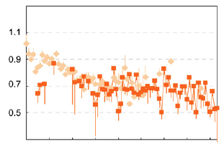
Back to Reality
What does this tell us about event-related motor-evoked potentials?
Covert motor preparation after a surprising event?
Figure courtesy Bestmann et al., 2008.
Intro: TMS
Present Model
Conclusions: Redux
Notes:
There is a period of CS inhibition immediately prior to action execution that has been shown to vary as a function of surprise present in a preceding stimulus event..
This figure displays a similar relationship between surprise and subsequent CSE during motor preparation that the present data shows during a passive task

Slide 87
Back to Reality
What does this tell us about event-related motor-evoked potentials?
Resource depletion following surprising event?
Intro: TMS
Present Model
Conclusions: Redux
Notes:
Perhaps there is a general resource depletion that follows the occurrence of a surprising event, and MEP inhibition is just one neurophysiological marker of that depletion
Because this was a post hoc analysis, and I did not actually design the experiment for the purposes of examining the effect of surprise on CSE, we cannot be sure, but there is definitely a chance that I will be taking this result under advisement during the design of future experiments

Slide 88
References
Barker, A. T., & Freeston, I. (2007). Transcranial magnetic stimulation. Scholarpedia, 2, 2936.
Bestmann, S., Harrison, L. M., Blankenburg, F., Mars, R. B., Haggard, P., Friston, K. J., & Rothwell, J. C. (2008). Influence of uncertainty and surprise on human corticospinal excitability during preparation for action. Current Biology, 18, 775-780.
Levy, I., Hasson, R., Avidan, G., Hendler, T., & Malach, R. (2001). Center-periphery organization of human object areas. Nature Neuroscience, 4, 533-539.
Mars, R. B., Debaner, S., Gladwin, T. E., Harrison, L. M., Haggard, P., Rothwell, J. C., & Bestmann, S. Trial-by-trial fluctuations in the event-related electroencephalogram reflect dynamic changes in the degree of surprise. Journal of Neuroscience, 28, 12539-12545.
Pascual-Leone, A., Walsh, V., & Rothwell, J. (2000). Transcranial magnetic stimulation in cognitive neuroscience - virtual lesion, chronometry, and functional connectivity. Current Opinion in Neurobiology, 10, 232-237.
Pitcher, D., Walsh, V., Yovel, G., & Duchene, B. (2007). TMS evidence for the involvement of the right occipital face area in early face processing. Current Biology, 17, 1568-1573.
Shannon, C. E. (1948). A mathematical theory of communication. The Bell System Technical Journal, 27, 379-423.
Strange, B. A., Duggins, A., Penny, W., Dolan, R. J., & Friston, K. J. (2005). Information theory, novelty, and hippocampal responses: Unpredicted or unpredictable? Neural Networks, 18, 225-230.

Slide 89
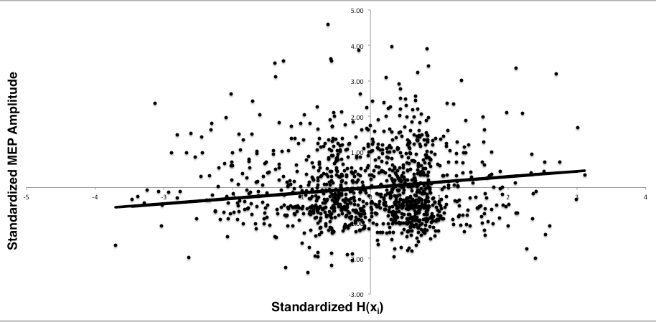
Ideal Observer Model
Intro: TMS
Present Model
Conclusions
Notes:
CSE was generally higher when overall uncertainty, or entropy, was high

Slide 90
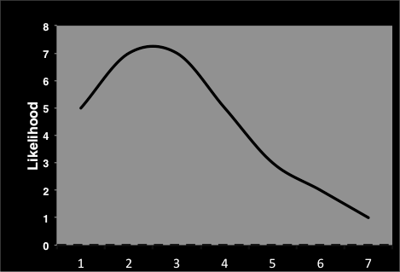
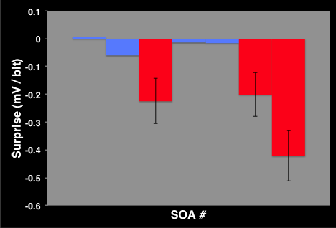
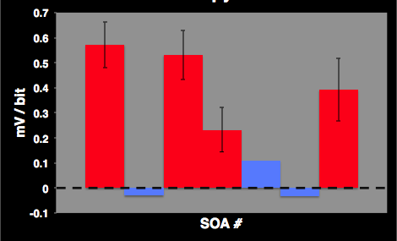
Ideal Observer Model – Take 2
Intro: TMS
Present Model: Redux
Conclusions
Notes:
- if we compare that to the coefficients for our model containing surprise associated with each TMS, SOA combination, we have an interesting trend…
Therefore, it seems as if the participants are (to a degree) learning the probabilities associated with TMS over the course of the block.. As well as the probabilities associated with each time of TMS delivery… the higher the improbability of a TMS pulse delivery timing, the (generally) lower the degree of CSE on the subsequent trial

