Slide 1
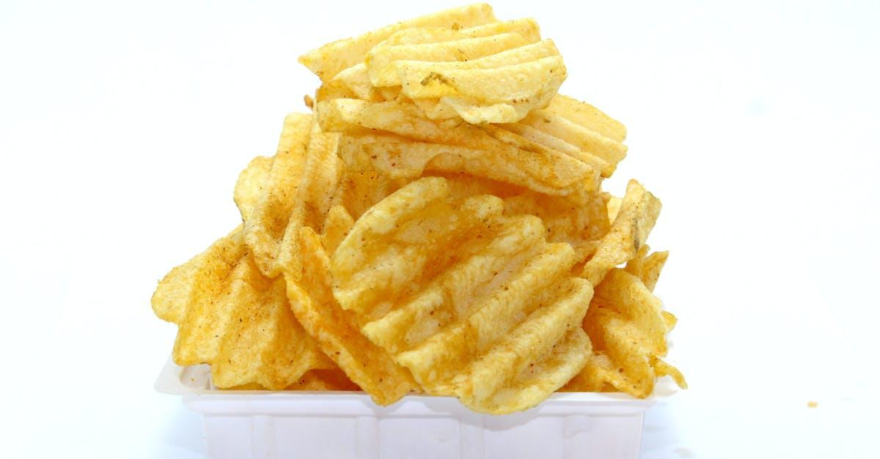
Integrated Circuits
MEMS
(Microelectromechanical systems)
Types of Chips
Silicon Photonics
CHIP is a very generic term in the market, but these can be sub-divided into different Families

Slide 2
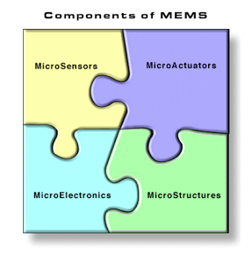
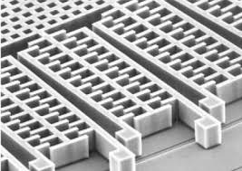
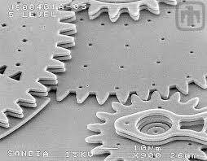
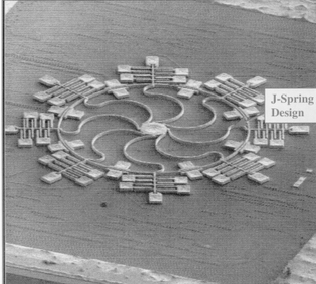
What are MEMS
(Micro/electro/mechanical/systems)
Think of MEMS devices as the interface between the digital realm and the analogue world.
The digital IC comprises of ‘1’s and ‘0’s, whilst the MEMS devices are sensors and actuators.
Accelerometer
Gears
Gyroscope

Slide 3
Process Modules In the Fab
Photolithography
Etching
Chemical Vapor Deposition (CVD)
Physical Vapor Deposition (PVD)
Chemical Mechanical Polishing (CMP)
Diffusion
Implantation
Cleaning
Yield Defect Density (YDD)
In-line Testing

Slide 4
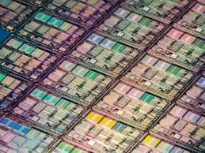
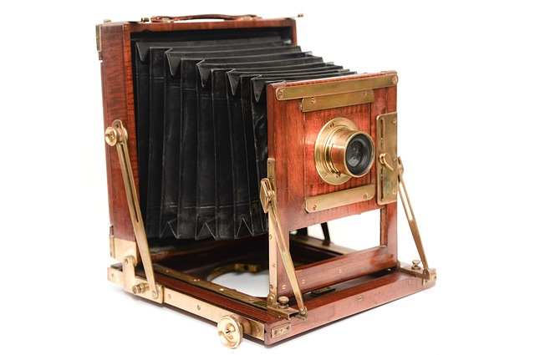
Photolithography

Slide 5
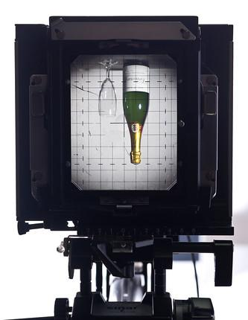
Photolithography
Reticles vs mask
Light sources
Photoresist
Process flow
Terminologies
Critical dimension (CD), overlay and inspection

Slide 6
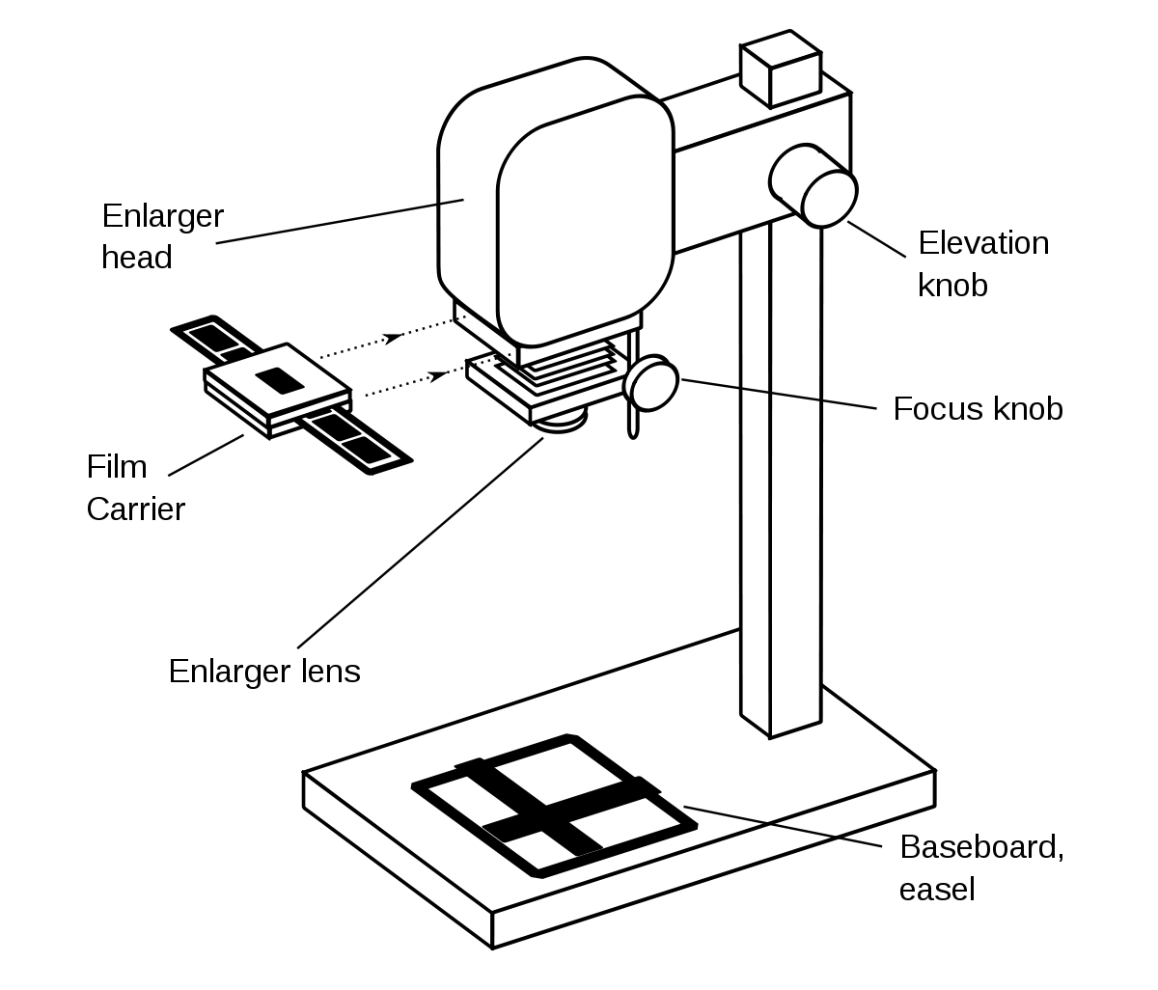
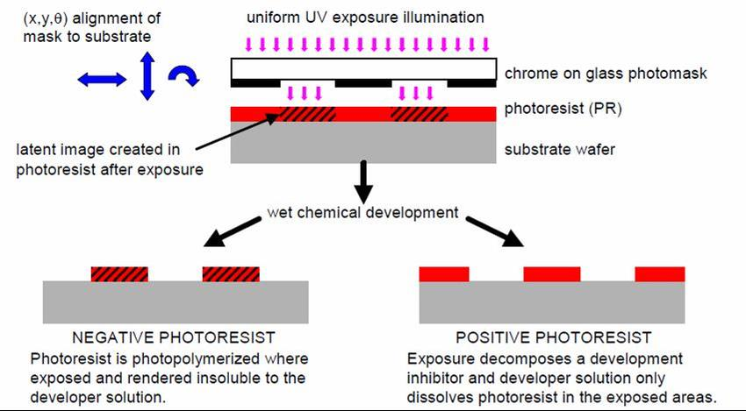
Comparison be between Photography and Photolithography

Slide 7
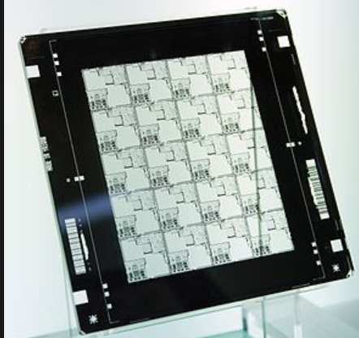
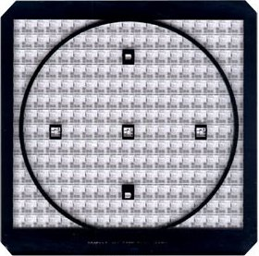
Reticle vs Photomask
Typically used in 1x Contact Aligners
These are used on Steppers or Scanners (5x or 4x)

Slide 8
Field vs Die
A key concept to introduce at this juncture: Exposure Field vs a Die
Based upon this reticle:
This has an exposure field of 4 x 5 (dies)
Each of the individual squares within is a complete DIE or upon dicing an IC chip.
Singular is called a DIE, multiple DICE.
Each of these are referred to as a DIE
Other features observed on the reticle are unique bar codes that identify the reticle, as well as ‘fudicle’ marks used for the alignment of the reticle to the wafer on the exposure tool.

Slide 9
Evolution of Exposure Systems
Contact printing
Proximity printing
Projection printing
Step and Repeat / Step and Scan
Layer of Water
The latest innovation is immersion lithography

Slide 10
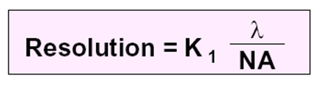
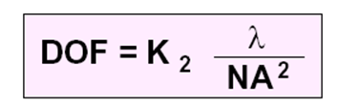
Constraints Faced in Photolithography
Key Factors of Consideration
Where k1 = process constant
λ = Wavelength of the illuminating light
NA= Numerical Aperture Of the Lens
Rayleigh criterion
DOF Depth of Focus
Where k2 = criteria for acceptable imaging and type of feature

Slide 11
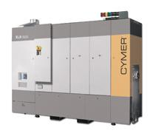
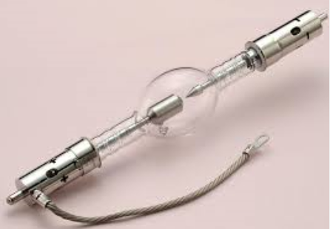
Exposure Wavelengths
1980-1990s
g-line – 436nm
h-line – 405nm
1990s-today
i-line – 365nm
DUV -- 248nm (KrF)
193nm (ArF)
Mercury Arc Lamp
Excimer Lasers
One of the key considerations pertains to the intensity of the different light sources used in the exposure, which will directly impact the choice of the photoresist chosen for the application.

Slide 12
Extreme Ultraviolet (EUV)
KrF and ArF did not contribute to radical changes in the wavelength for the exposure.
In the next leap forward, the industry has adopted EUV lithography, where the wavelength has dropped to 13.5nm.
With the application of RET and OPC techniques, the K1 factor can be reduced, thus providing for geometries of under 9nm can be fabricated in the industry.

Slide 13
EUV Laser Systems
The system consists of a 40 kW CO₂ laser, to create EUV radiation from a 30 µm droplet of tin.
This laser is able to provide a beam intensity of 250W for the exposure of the wafers.
A major shortcoming of this system is the power supply requirements to drive it: 1MW!

Slide 14
The 2 Families of Photoresist
UV Light
UV Light
Exposure
Reticle
Positive Photoresist
Negative Photoresist
Oxide
Oxide
Substrate
Substrate
Develop
Oxide
Oxide
Substrate
Substrate
Etch
Substrate
Substrate
Resist Strip
Substrate
Substrate
Positive Resist
Negative Resist

Slide 15
Photolithography Process Flow
Incoming
(film deposition / cleaning step)
Dehydration Bake
Soft-Bake
(PAB Bake)
Prime (HMDS)
Resist Coat
In the modern factories, these steps are performed in an integrated system.
Post Exposure Bake (PEB)
Hard-Bake
Develop
Exposure
Critical Dimension (CD)
Overlay
Inspection

Slide 16
Common Terminologies in Photolithography
Critical layers vs non-critical layers
Wavelengths
Exposure (E = Intensity x Time)
Reticle Transmission (RT)
ARC, BARC, TARC
Aspect Ratio
CD – critical dimensions
Pitch
Overlay
CAR – chemically amplified resist
PAB (post Apply Bake- soft-bake)
PED (post exposure delay)
Ghost Imaging

Slide 17
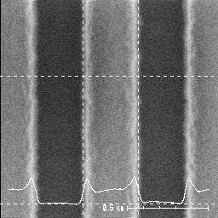
Critical Dimensions Measurements
Measurements made using the scanning electron microscope (SEM).
The tool can be utilized to monitor the line width or the spacing between the photoresist line.
Rudimentary assessments of the profile can be made. For a true understanding of the profiles, a cross-sectional image may be required.

Slide 18
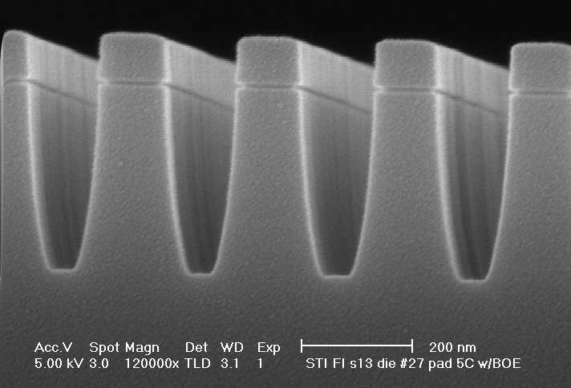
Comparison between XSEM and OCD
With the introduction of OCD, the next innovation of in-situ metrology is born

Slide 19
Overlay and Alignment
Overlay ≠ Alignment
A pattern may be said to be well aligned, but the overall overlay of the wafer can still be considered bad leading to wafer being scrapped.
Overlay refers to general pattern placement, whereas alignment refers to specific spots on the wafer (alignment marks or keys). Hence, alignment cannot fully guarantee that the overlay elsewhere upon the wafer meets the desired specifications
Let’s say the alignment specification is ± 0.1 μm, we can say the 2 layers are aligned.
However looking at the totality, the resultant overlay is out of the desired specifications.
For the IC’s of today, we are talking about 40+ mask Levels!

