Slide 1
15-446 Networked Systems Practicum
Lecture 10 – Security Intro

Slide 2
What is Security?
Managing a malicious adversary
Guaranteeing properties even if a malicious adversary tries to attack
Basic security properties
  Secrecy / confidentiality / privacy
  Authenticity / integrity
  Availability
Trust assumptions & security mechanisms & attacker model → security properties

Slide 3
Basic Security Analysis
What are we protecting?
Who is the adversary?
What are the security requirements?
What security approaches are effective?

Slide 4
What are we Protecting?
Enumerate assets and their value
Useful questions to ask
  What is the operating value, i.e., how much would we lose per day/hour/minute if the resource stopped?
  What is the replacement cost? How long would it take to replace it?

Slide 5
Who is the Adversary?
Identify potential attackers
Estimate attacker resources
  Time and money
Estimate number of attackers, probability of attack

Slide 6
What are the Security Requirements?
Enumerate security requirements
  Confidentiality
  Integrity
  Authenticity
  Availability
  Auditability
  Access control
  Privacy
  …

Slide 7
Approaches to Achieve Security
No security: Legal protection (deterrence)
  Innovative: patent attack, get protection through patent law
Build strong security defense
  Use cryptographic mechanisms
  Perimeter defense (firewall), VPN
Resilience to attack
  Multiple redundant systems (“hot spares”)
Detection and recovery (& offense ???)
  Intrusion detection system
  Redundancy, backups, etc.
  Counterstrike ??? (Legal issues?)

Slide 8
Basic Attacker Model
Attacker action
  Passive attacker: eavesdropping
  Active attacker: eavesdropping + data injection
Attacker sophistication
  Ranges from script kiddies to government-funded group of professionals
Attacker access
  External attacker: no knowledge of cryptographic information, no access to resources
  Internal attacker: complete knowledge of all cryptographic information, complete access
    Result of system compromise

Slide 9
Secrecy, Confidentiality, Privacy, Anonymity
Often considered synonymous, but are slightly different
Secrecy
  Keep data hidden from unintended receivers
  “Alice and Bob use encrypted communication links to achieve secrecy”
Confidentiality
  Keep someone else’s data secret
  “Trent encrypts all user information to keep their client’s information confidential in case of a file server compromise”
Privacy
  Keep data about a person secret
  “To protect Alice’s privacy, company XYZ did not disclose any personal information”

Slide 10
Secrecy, Confidentiality, Privacy, Anonymity
Anonymity
  Keep identity of a protocol participant secret
  “To hide her identity to the web server, Alice uses The Onion Router (TOR) to communicate”
Secrecy
Anonymity
Confidentiality
Privacy

Slide 11
Integrity, Authentication
Sometimes used interchangeably, but they have different connotations
Data integrity
  Ensure data is “correct” (i.e., correct syntax & unchanged)
  Prevents unauthorized or improper changes
  “Trent always verifies the integrity of his database after restoring a backup, to ensure that no incorrect records exist”
Entity authentication or identification
  Verify the identity of another protocol participant
  “Alice authenticates Bob each time they establish a secure connection”
Data authentication
  Ensure that data originates from claimed sender
  “For every message Bob sends, Alice authenticates it to ensure that it originates from Bob”
Notes:
Often “origin authentication”, “source authentication”, “origin integrity” are also used.

Slide 12
Difference between Integrity and Authentication
Integrity is often a property of local or stored data
  For example, we want to ensure integrity for a database stored on disk, which emphasizes that we want to prevent unauthorized changes
Integrity emphasizes that data has not been changed
Authentication used in network context, where entities communicate across a network
  Two communicating hosts want to achieve data authentication to ensure data was not changed by network
Authentication emphasizes that data was created by a specific sender
  Implies integrity, data unchanged in transit
  Implies that identity of sender is verified

Slide 13
Signature, Non-repudiation
Signature: non-repudiation of origin
  Binds data to an identity
  The signer cannot deny having created the signature
  “Alice’s signature provides non-repudiation, preventing her from denying receipt of the document”

Slide 14
Difference between
Authentication and Signature
Authentication enables the receiver to verify origin, but receiver cannot convince a third party of origin
Signature enables the receiver to verify origin, and receiver can convince third party of origin as well
Signature provides authentication

Slide 15
Other Properties
Authorization
  Allowing another entity to perform an action
Auditability
  Enable forensic activities after intrusions
  Prevent attacker from erasing or altering logging information
Availability
  Provide access to resource despite attacks
  Denial-of-Service (DoS) attacks attempt to prevent availability

Slide 16
Basic Approaches for Security
Prevention
  Attack prevention mechanisms used to prevent or complicate specific attacks
Detection and recovery
  Attack detection mechanism is in place, recovery phase initiated after attack detected
Resilience
  Despite undetected attacks, security property continues to hold
Deterrence
  Use of legal system to provide disincentive for attacks
How can these approaches be used to achieve secrecy, integrity, availability?

Slide 17
Cryptography As a Tool
Using cryptography securely is not simple
Designing cryptographic schemes correctly is near impossible.
Today we want to give you an idea of what can be done with cryptography.
Take a security course if you think you may use it in the future (e.g. 18-487)

Slide 18
Attacks Against Encryption
Schemes
Known ciphertext (ciphertext only)
  Attacker only has a copy of some ciphertext
Known plaintext
  Attacker obtains ciphertext and corresponding plaintext
Chosen plaintext
  Attacker can choose plaintext that is going to be encrypted and obtains ciphertext
Chosen ciphertext
  Attacker can choose ciphertext and obtains corresponding plaintext

Slide 19
Symmetric Encryption Primitives
Encryption key = decryption key
Encryption: E_{K}(plaintext) = ciphertext
Decryption: D_{K}(ciphertext) = plaintext
We write {plaintext}_{K} for E_{K}(plaintext)
Key
Key
Plaintext
Encrypt
Ciphertext
Decrypt
Plaintext

Slide 20
Substitution Ciphers
Caesar cipher: substitution cipher:
  A → D, B → E
Captain Midnight Secret Decoder rings:
  Shift variable by n: IBM → HAL, or :
    (letter + offset) mod 26
  Only 26 possible ways of secret coding.
Monoalphabetic cipher:
  Generalization, arbitrary mapping of one letter to another
  26!, approximately 4 × 10²⁶

Slide 21
Breaking a Substitution Cipher
Single letter frequency in English
Count letter frequency in ciphertext, start assigning potential candidate letters
Use language properties to eliminate or derive letter assignments
a | b | c | d | e | f | g | h | I | j | k | l | m
8 | 1.5 | 3 | 4 | 13 | 2 | 1.5 | 6 | 6.5 | .5 | .5 | 3.5 | 3
n | o | p | q | r | s | t | u | v | w | x | y | z
7 | 8 | 2 | .25 | 6.5 | 6 | 9 | 3 | 1 | 1.5 | .5 | 2 | .25

Slide 22
From Letters to Binary
Vernam (1918) uses binary, not letters
  ci = pi ⊕ ki
  pi - ith binary digit of plaintext
  ki - ith binary digit of key(stream)
  ci - ith binary digit of ciphertext
Plaintext
⊕
Keystream
=
Ciphertext

Slide 23
Vernam Cipher Encrypt
“Hi”
Plaintext
1101000 1101001
⊕⊕⊕⊕⊕⊕⊕ ⊕⊕⊕⊕⊕⊕⊕
Random OTP Key
1110100 1001101
“tM”
Cipher Text
0011100 0100100
“\x1c$”

Slide 24
Vernam Cipher Decrypt
“\x1c$”
Cipher Text
0011100 0100100
⊕⊕⊕⊕⊕⊕⊕ ⊕⊕⊕⊕⊕⊕⊕
Random OTP Key
1110100 1001101
“tM”
Plain Text
1101000 1101001
“Hi”

Slide 25
Symmetric Key: Confidentiality
One-time Pad (OTP) is secure but usually impractical
  Key is as long at the message
  Keys cannot be reused (why?)
In practice, two types of ciphers are used that require only constant key length:
Stream Ciphers:
Ex: RC4, A5
Block Ciphers:
Ex: DES, AES, Blowfish

Slide 26

Symmetric Key: Confidentiality
Stream Ciphers (ex: RC4)
Alice:
PRNG
Pseudo-Random stream of L bits
K _{A-B}
XOR
Message of Length L bits
=
Encrypted Ciphertext
Bob uses K_{A-B} as PRNG seed, and XORs encrypted text to get the message back (just like OTP).

Slide 27
Stream Cipher Vulnerabilities
Keystream reuse attack
  Enormous security vulnerability if same keystream used to encrypt two different messages
  c₁ = p₁ ⊕ k, c₂ = p₂ ⊕ k
  c₁ ⊕ c₂ = p₁ ⊕ p₂ (which is easy to analyze, because the unknown key is removed!)
  c₁ = p₁ ⊕ PRG( K, IV ), where IV = initialization vector, make sure IV is never used twice!
Ciphertext modification attack
  Alteration of ciphertext will alter corresponding values in plaintext after decryption
  Example, encrypt a single bit: c = p ⊕ k, for p=1, k=0, thus c=1
  If attacker changes c to 0 during transmission, decrypted value is changed to 0! p = c ⊕ k, if c=0, k=0, then p=0
  To defend, need to ensure authenticity of ciphertext

Slide 28
Permutation Ciphers
Simply permute input symbols
Example: Staff cipher
  Cut narrow strip of paper long enough to write message
  Wind it around a staff so that adjacent edges abut
  Write message horizontally down the shaft with a character on each wrapping
  Unwind to “encrypt”
S E C R E T 3
E R S E C 3 T

Slide 29
Permutation Variations
Write message letters on alternate rows, read off cipher by row
Plain = “I CAME I SAW I CONQUERED”
Plain: I A E S W C N U E
C M I A I O Q R D
Cipher: IAESW CNUE CMIAI OQRD
The old mirror trick, write the message backwards
Plain: I CAME I SAW I CONQUERED
Cipher: DEREU QNOCI WASIE MACI

Slide 30
Block Ciphers
Block cipher is a pseudo-random permutation (PRP), each key defines a one-to-one mapping
  Substitution cipher with large block size
Encrypt each block separately
Examples: DES, RC5, Rijndael / AES

Slide 31
Symmetric Key: Confidentiality
Block Ciphers (ex: AES)
Block 1
Block 2
Block 3
Block 4
(fixed block size, e.g. 128 bits)
Round #1
Round #2
Round #n
Alice:
K _{A-B}
Block 1
Block 2
Block 3
Block 4
Bob breaks the ciphertext into blocks, feeds it through decryption engine using K_{A-B} to recover the message.

Slide 32
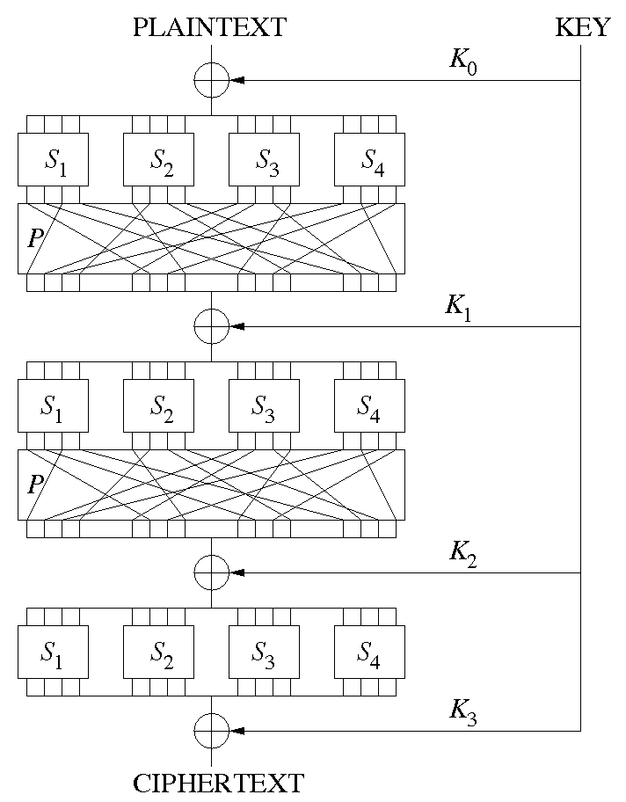
S-P Network (AES)

Slide 33
Symmetric Key: Integrity
Background: Hash Function Properties
  Consistent hash(X) always yields same result
  One-way given X, can’t find Y s.t. hash(Y) = X
  Collision resistant given hash(W) = Z, can’t find X such that hash(X) = Z
Hash Fn
Fixed Size
Hash
Message of arbitrary length

Slide 34
Cryptographic Hash Functions
Maps arbitrary-length input into finite length output
Properties of a secure hash function
  One-way: Given y = H(x), cannot find
  x’ s.t. H(x’) = y
  Weak collision resistance: Given x, cannot find x’ ≠ x s.t. H(x) = H(x’)
  Strong collision resistance: Cannot find x, x’ s.t. x’ ≠ x and H(x) = H(x’)

Slide 35
Attack Complexity: One-Wayness
Assume secure hash function with n-bit output
One-wayness: given output y, how many operations does it take to find any x,
such that H(x) = y?
  Assumption: best attack is random search
  For each trial x, probability that output is y is 2^{-n}
  P[find x after m trials]=1-(1-2^{-n})^{m}
  Rule of thumb: find x after 2^{n-1} trials on average

Slide 36
Attack Complexity: Weak Col Res
Weak collision resistance (or second pre-image collision resistance): given input x, how many operations does it take to find another x’ ≠ x, s.t. H(x) = H(x’)?
  Assumption: best attack is random search
  For each trial x’, probability that output is equal is 2^{-n}
  P[find x after m trials]=1-(1-2^{-n})^{m}
  Rule of thumb: find x’ after 2^{n-1} trials on average

Slide 37
Attack Complexity:
Strong Col Res.
Strong collision resistance: how many operations does it take to find x and x’, s.t. x’ ≠ x and H(x) = H(x’)?
  Assumption: best attack is random search
  Algorithm picks random x’, checks whether H(x’) matches any other output value previously seen
  P[find col after m trials]=
  1-(1-1/2^{n})(1-2/2^{n})(1-3/2^{n})…(1-(m+1)/2^{n})
  Rule of thumb: find collision after 2^{n/2} trials on average
    (1.17*2^{n/2} to be a bit more precise)

Slide 38
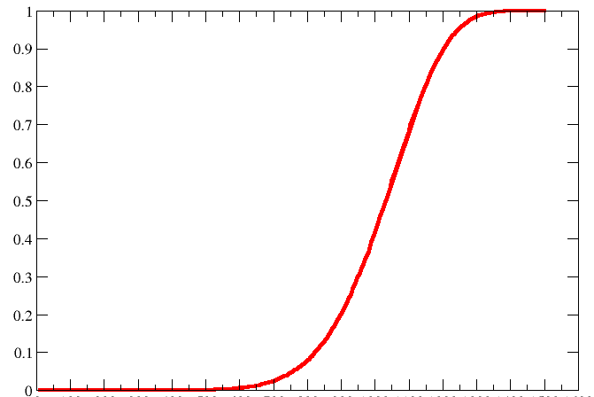
Birthday Paradox
How many people need to be in a room to have a probability > 50% that at least two people have the same birthday?
Answer: approximately 1.17*365^{1/2} ~ 22.4

Slide 39
Symmetric Key: Integrity
Hash Message Authentication Code (HMAC)
Step #1:
Alice creates MAC
Hash Fn
Message
MAC
K _{A-B}
Alice Transmits Message & MAC
Step #2
Step #3
Bob computes MAC with message and K_{A-B} to verify.
MAC
Message
Why is this secure? How do properties of a hash function help us?
Notes:
This is similar to a checksum, but secure. Why? Note: the message does not have to be encrypted, unless you also desire confidentiality.
Will the MAC always check out on the receiving end? Yes, b/c receiver has key, and HAS is consistent.
Can attacker substitute in another message? No, b/c of collision resistance of HASH
Can attacker recover the key, based on the message? No, b/c of one-way nature of HASH

Slide 40
Symmetric Key: Authentication
You already know how to do this!
(hint: think about how we showed integrity)
I am Bob
Hash Fn
A43FF234
Wrong!
K _{A-B}
Alice receives the hash, computes a hash with K_{A-B} , and she knows the sender is Bob

Slide 41



Symmetric Key: Authentication
What is Mallory overhears the hash sent by Bob, and then “replays” it later?
ISP D
ISP B
ISP C
ISP A
Hello, I’m
Bob. Here’s the hash to “prove” it
A43FF234

Slide 42

Symmetric Key: Authentication
A “Nonce”
  A random bitstring used only once. Alice sends nonce to Bob as a “challenge”. Bob Replies with “fresh” MAC result.
Nonce
Bob
Alice
Nonce
Hash
B4FE64
B4FE64
K _{A-B}
Performs same hash with K_{A-B} and compares results

Slide 43
Symmetric Key: Authentication
A “Nonce”
  A random bitstring used only once. Alice sends nonce to Bob as a “challenge”. Bob Replies with “fresh” MAC result.
Nonce
?!?!
Alice
Mallory
If Alice sends Mallory a nonce, she cannot compute the corresponding MAC without K _{A-B}

Slide 44
Symmetric Key Crypto Review
Confidentiality: Stream & Block Ciphers
Integrity: HMAC
Authentication: HMAC and Nonce
Questions??
Are we done? Not Really:
Number of keys scales as O(n²)
How to securely share keys in the first place?

Slide 45
Symmetric Key Distribution
How does Andrew do this?
Andrew Uses Kerberos, which relies on a Key Distribution Center (KDC) to establish shared symmetric keys.

Slide 46


Key Distribution Center (KDC)
Alice, Bob need shared symmetric key.
KDC: server shares different secret key with each registered user (many users)
Alice, Bob know own symmetric keys, K_{A-KDC} K_{B-KDC} , for communicating with KDC.
KDC
K_{A-KDC}
K_{P-KDC}
K_{X-KDC}
K_{P-KDC}
K_{B-KDC}
K_{Y-KDC}
K_{Z-KDC}
K_{A-KDC}
K_{B-KDC}

Slide 47
Key Distribution Center (KDC)
Q: How does KDC allow Bob, Alice to determine shared symmetric secret key to communicate with each other?
KDC generates R1
K_{A-KDC}(A,B)
Alice
knows R1
K_{A-KDC}(R1, K_{B-KDC}(A,R1) )
Bob knows to use R1 to communicate with Alice
K_{B-KDC}(A,R1)
Alice and Bob communicate: using R1 as
session key for shared symmetric encryption
Notes:
Downside:
KDC must always be online to communicate securely
KDC can give our session keys away (escrow)

Slide 48


Slide 49
Asymmetric Key Crypto:
Instead of shared keys, each person has a “key pair”
The keys are inverses, so:
K_{B}
Bob’s public key
Bob’s private key
K_{B}⁻¹
K_{B}⁻¹ (K_{B} (m)) = m
Notes:
Note: We are not going to go into the details of that K_{B}(m) means as far as computation. We will treat it as a black box function with these properties.

Slide 50
Asymmetric Key Crypto:
It is believed to be computationally unfeasible to derive K_{B}⁻¹ from K_{B} or to find any way to get M from K_{B}(M) other than using K_{B}⁻¹ .
=> K_{B} can safely be made public.
Note: We will not detail the computation that K_{B}(m) entails, but rather treat these functions as black boxes with the desired properties.
Notes:
Note: We are not going to go into the details of that K_{B}(m) means as far as computation. We will treat it as a black box function with these properties.

Slide 51
Asymmetric Key: Confidentiality
Bob’s public
key
K_{B}
Bob’s private
key
K_{B}⁻¹
encryption
algorithm
ciphertext
decryption
algorithm
plaintext
message
K_{B} (m)
m = K_{B}⁻¹ (K_{B} (m))

Slide 52
Asymmetric Key: Sign & Verify
If we are given a message M, and a value S such that K_{B}(S) = M, what can we conclude?
The message must be from Bob, because it must be the case that S = K_{B}⁻¹(M), and only Bob has K_{B}⁻¹ !
This gives us two primitives:
    Sign (M) = K_{B}⁻¹(M) = Signature S
    Verify (S, M) = test( K_{B}(S) == M )

Slide 53
Asymmetric Key: Integrity & Authentication
We can use Sign() and Verify() in a similar manner as our HMAC in symmetric schemes.
Integrity:
S = Sign(M)
Message M
Receiver must only check Verify(M, S)
Nonce
Authentication:
S = Sign(Nonce)
Verify(Nonce, S)
Notes:
Note: there is another way to do authentication, which we will see when we look at SSL.

Slide 54
Asymmetric Key Review:
Confidentiality: Encrypt with Public Key of Receiver
Integrity: Sign message with private key of the sender
Authentication: Entity being authenticated signs a nonce with private key, signature is then verified with the public key
But, these operations are computationally expensive*

Slide 55
Encrypting Large File with RSA?
Duration of 1024-bit RSA encrypt
  ~1 ms on 1 GHz Pentium
Duration of 1024-bit RSA decrypt
  ~10 ms on 1 GHz Pentium
Duration to encrypt 1 Mbyte file?
  Encrypt 1024 bits / RSA operation = 128 bytes
  1 Mbyte = 2²⁰
  Time: 2²⁰ / 2⁷ * 1ms = 2¹³ ms = 8 seconds!
  Better approach?
Notes:
First, pick random key, encrypt key with RSA, then encrypt file with block cipher.

Slide 56

Certification Authorities
Certification authority (CA): binds public key to particular entity, E.
An entity E registers its public key with CA.
  E provides “proof of identity” to CA.
  CA creates certificate binding E to its public key.
  Certificate contains E’s public key AND the CA’s signature of E’s public key.
Bob’s
public
key
CA generates
S = Sign(K_{B})
K_{B}
K_{B}
CA
private
key
certificate = Bob’s public key and signature by CA
Bob’s
identifying information
K⁻¹ _{CA}
Notes:
Note: CA’s do NOT generate keys. They simply are handed a public key along with proof of identify, and generate a signature which can accompany the key when it is given to a user that must validate that they key is in fact Bob’s public key.

Slide 57
Certification Authorities
When Alice wants Bob’s public key:
  Gets Bob’s certificate (Bob or elsewhere).
  Use CA’s public key to verify the signature within Bob’s certificate, then accepts public key
K_{B}
Verify(S, K_{B})
If signature is valid, use K_{B}
CA
public
key
K_{CA}

Slide 58
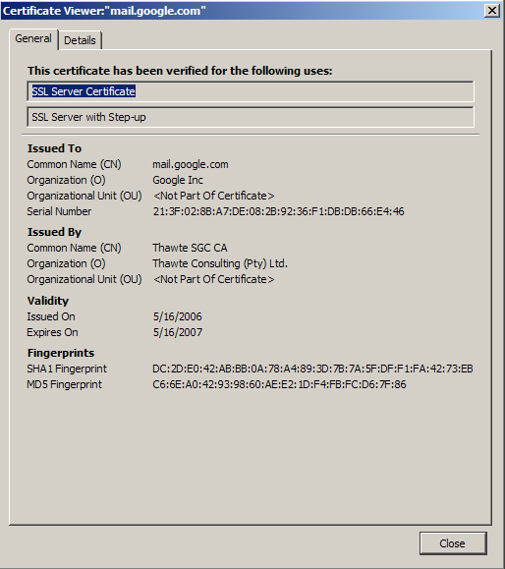
Certificate Contents
info algorithm and key value itself (not shown)
Cert owner
Cert issuer
Valid dates
Fingerprint of signature
Notes:
Wait… didn’t we just say that we needed to have the key’s from the CA’s? What does our browser use?

Slide 59
Which Authority Should You Trust?
Today: many authorities
What about a shared Public Key Infrastructure (PKI)?
  A system in which “roots of trust” authoritatively bind public keys to real-world identities
  So far it has not been very successful
Notes:
PKI’s are notoriously complex

Slide 61
Asymmetric Primitive 1
Diffie-Hellman key agreement
  Public values: large prime p, generator g
  Alice has secret value a, Bob has secret b
  A → B: gª (mod p)
  B → A: g^{b} (mod p)
  Bob computes (gª)^{b} = g^{ab} (mod p)
  Alice computes (g^{b})ª = g^{ab} (mod p)
  Eve cannot compute g^{ab} (mod p)
Example: a=3, b=6, g=2, p=11
Notes:
g^a = 8
g^b = 9
g^a^b = 262144 = 3
g^b^a = 729 = 3

Slide 62
Example
a=3, b=6, g=2, p=11
  A → B: gª (mod p) = 2³ (mod 11) = 8
  B → A: g^{b} (mod p) = 2⁶ (mod 11)
      = 64 (mod 11) = 9
  Bob computes (gª)^{b} (mod p) = 8⁶ (mod 11)
  = 262144 (mod 11) = 3
  Alice computes (g^{b})ª (mod p) = 9³ (mod 11)
  = 729 (mod 11) = 3
Notes:
g^a = 8
g^b = 9
g^a^b = 262144 = 3
g^b^a = 729 = 3

Slide 64
Lack of Collision Resistance
No real effect on most protocols
  SSL, IPsec, SSH, etc. use MD5 in three ways
    Key expansion
    HMAC
    Signatures
  Not affected by collisions
What about PKI certificates?
  Register certificate for www.something.com and use certificate for www.bank.com
  if H(Cert something.com) = H(Cert bank.com)
  Countermeasure?
Notes:
Countermeasure: CA adds randomization to certificate, so that collision cannot be predicted

Slide 65
SHA-1: Broken! or Broken?
SHA-1 does not provide collision resistance any more: requires only 2⁶⁹ operations to find a hash collision
How long would it take on all SETI@home computers to find collision?
  Approximately 16 years!
  2⁶⁹ / (2²⁰ * 2²⁰ ) = 2²⁹ seconds
  (1 year has approximately 2²⁵ seconds)
  2²⁹ / 2²⁵ ~ 16 years
How serious is this?
  Quite serious, more sophisticated attacks may follow
Notes:
2^69 / 2^20 / 2^20 = 2^29 seconds
2^29 / 2^25 = 16 years

Slide 66
Steganography
The act of hiding information
Often in plain sight...
Example: slightly modify pixel data...
  (R,G,B): (255,255,255) → (255,255,254)
See app: steghide
  Operates on both images and audio
  Graph-theoretic basis
  man steghide

Slide 67
Steganography
The act of hiding information
Often in plain sight...
Example: slightly modify pixel data...
  (R,G,B): (255,255,255) → (255,255,254)
See app: steghide
  Operates on both images and audio
  Graph-theoretic basis
  man steghide
When successful, any eavesdropper never knows
that a certain message has been transmitted.

Slide 68

Stegonagraphy
The act of hiding information
Often in plainsight...
Slightly modify pixel data...
See app: steghide
When successful, any eavesdropper never knows
that a certain message has been transmitted.

Slide 69
Stegonagraphy
The act of hiding information
Often in plainsight...
Slightly modify pixel data...
See app: steghide
When successful, any eavesdropper never knows
that a certain message has been transmitted.
Plausible Deniability
I just sent a picture of a flower...
Deny that any message was sent!

Slide 70
Merkle Hash Trees
Authenticate a sequence of data values D₀ , D₁ , …, D_{N}
Construct binary tree over data values
T₀
T₁
T₂
T₃
T₄
T₅
T₆
D₀
D₁
D₂
D₃
D₄
D₅
D₆
D₇

Slide 71
Merkle Hash Trees II
Verifier knows T₀
How can verifier authenticate leaf D_{i} ?
Solution: recompute T₀ using D_{i}
Example authenticate D₂ , send D₃ T₃ T₂
Verify T₀ = H( H( T₃ || H( D₂ || D₃ )) || T₂ )
T₀
T₁
T₂
T₃
T₄
T₅
T₆
D₀
D₁
D₂
D₃
D₄
D₅
D₆
D₇

