Slide 1

Contain Your Excitement
Hands on with Docker

Slide 2
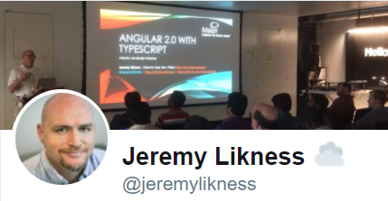
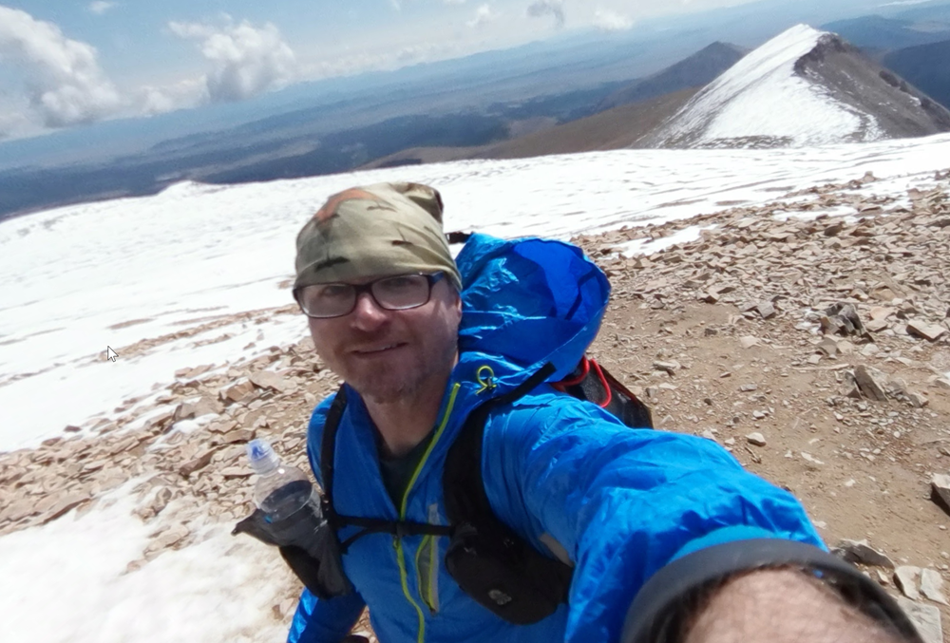
About Me
20 Years Professional Software Development
7-Year Microsoft MVP
First Computer was a Commodore 64 8-bit 64 kilobyte 2.6 MHz machine
Summited my first two “14ers” last year (Mt. Sherman and hiked 13 miles to the summit of Pike’s Peak)
3 Years Vegan (although sometimes I end up with eggs)

Slide 3
Agenda
What is Docker?
Why Docker?
Getting Started
Building Images
Docker Compose
Q & A

Slide 4

What is Docker?
The Journey from Metal to Containers

Slide 5
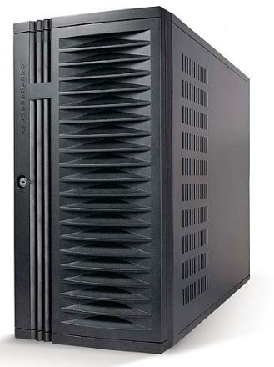
Physical Server

Slide 6
Physical Server
Hardware
Host OS
Binaries/Libraries
App A
App B
Your Responsibility

Slide 7
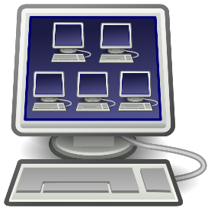
Virtual Machine

Slide 8
Virtual Machine… in the Cloud

Slide 9
Virtual Machine… in the Cloud
Hardware
Host OS
Hyper Visor
Guest OS
Guest OS
Binaries/Libaries
App A
App B
Binaries/Libraries
App C
App D
Your Responsibility

Slide 10
Container (wherever!)
Container
Hardware
Host OS
Docker Engine
Binaries/Libraries
App A¹
Binaries/Libraries
App A²
Binaries/Libraries
App B
Your Responsibility

Slide 11
Docker is …
Standardized Unit of Software Development
Code, runtime, tools and libraries in one place
Shared host
Least privilege and secure by default

Slide 12



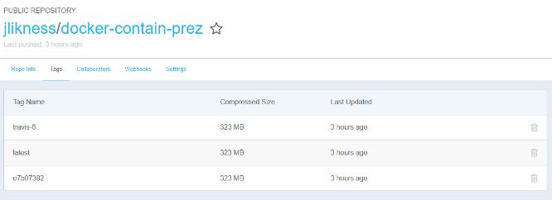
Why Docker?
Standardized
Lightweight
Predictable
Consistent
Fast
Scalable
Elastic
Resilient

Slide 13
Docker at Scale: Orchestration
Mesos DC/OS
Kubernetes
Docker Swarm

Slide 14
Let’s Get Started!
Now for the “Hands on” Part!
https://github.com/JeremyLikness/docker-we-rise

Slide 15

Thank You!
@JeremyLikness
https://github.com/JeremyLikness
http://bit.ly/coderblog
Questions?
https://github.com/JeremyLikness/docker-we-rise

