Slide 1
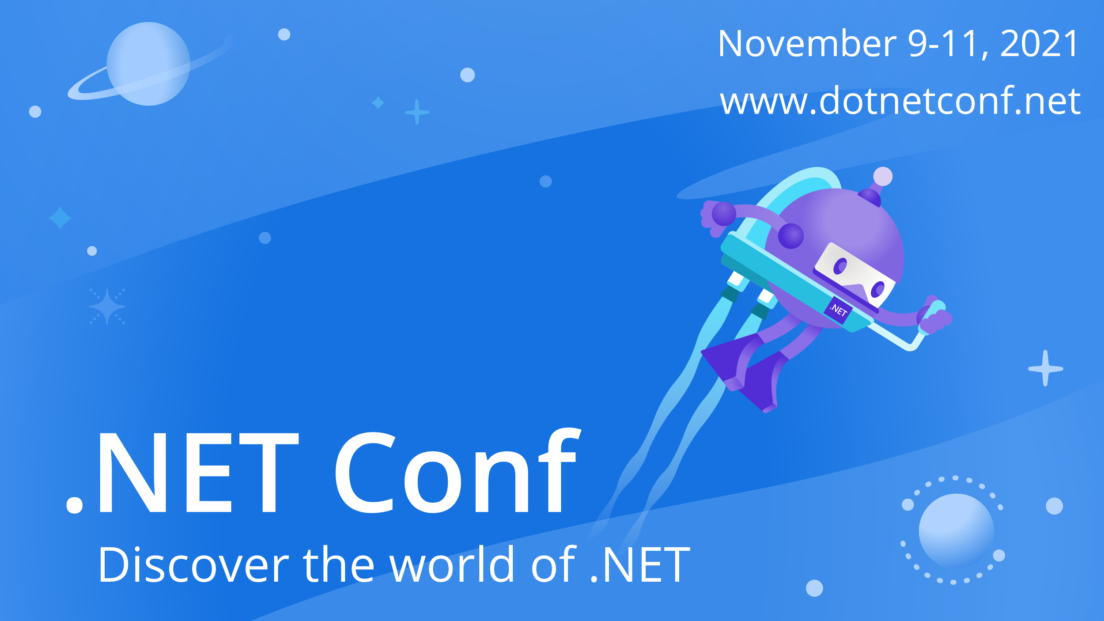

Slide 2



Modern Data APIs with EF Core and GraphQL
Jeremy Likness

Slide 3







What is GraphQL?
Query language for APIs
Runtime to fulfill queries
Focused on frontend-to-backend communication
Operates over HTTP(s)
Strongly typed and discoverable schemas
Client has full control over shape of data
Support for real-time

Slide 4
What about OData?
Area | GraphQL | OData
Schema/Projection | Full control down to n-depth | Limited control
Real-time | Subscriptions | No
Lazy-loading | Defer | No
Batched requests | Yes | Yes (recently added)
Query optimization | Resolvers | Difficult
Façade | Resolvers | Manual
Footprint | Cross-language and platform | .NET-centric
Common use | Backend-for-frontends | Serialize queries over REST

Slide 5
Why use GraphQL?
Single endpoint
Discoverability
Avoid over-fetching data
Minimize round trips
Reduced need to worry about versioning the API
Schema-stitching for schema-governance at scale
Façade to legacy services

Slide 6
Demo: GraphQL
EF Core 6.0 with HotChocolate 12

Slide 7
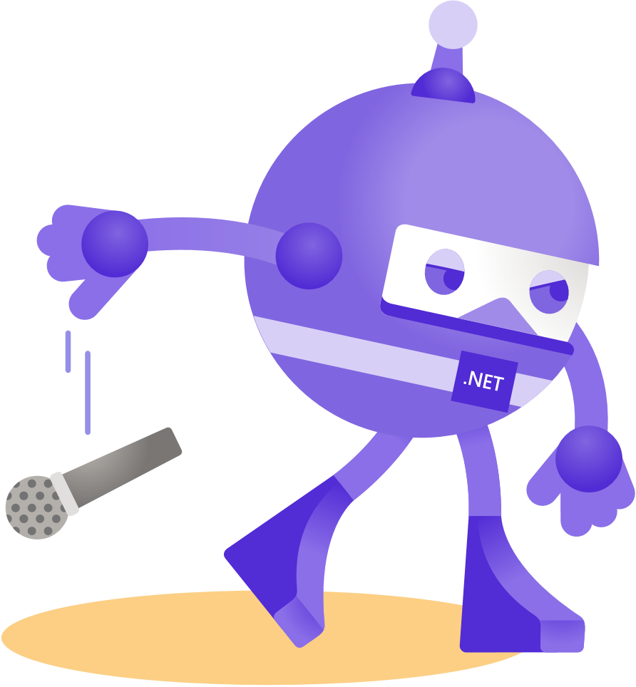
Thanks for joining!
https://aka.ms/efdocs https://chillicream.com/docs/hotchocolate
@JeremyLikness

