Slide 1

Rapid App Development with Angular and TypeScript
Presented by Jeremy Likness

Slide 2


Slide 3



Getting Started
https://github.com/JeremyLikness/ng2ts-workshop-v2
https://nodejs.org/
npm i –g @angular/cli
https://angular.io/
https://code.visualstudio.com/

Slide 4


The Dude in the Front
Jeremy Likness (@JeremyLikness)
https://github.com/jeremylikness
https://bit.ly/coderblog
Director of App Dev, iVision
http://bit.ly/ivisionappdev

Slide 5


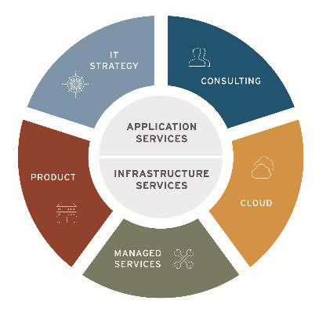
About iVision
About iVision
A privately held, IT consulting firm headquartered in Midtown, Atlanta.
At iVision, we seek to understand our clients’ business first. We work with clients to architect, transform and support their technology — enabling them to realize their vision of a better tomorrow.
The iVision Difference
Engineering Expertise
White Glove Service
Delivery Assurance
Flexible Business Model
Proven Partner Ecosystem
Culture & People
Jeremy Likness| Director of App Dev
https://bit.ly/ivisionappdev

Slide 6

Why?
Because Angular is …

Slide 7
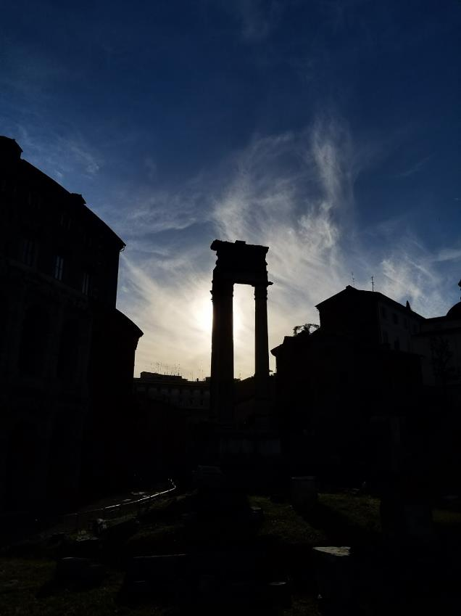
My (Experience-Based) Bias
Working on Angular since 2011
“Built to Last”
Example project:
25 developers
Global parallel development team
Almost 100,000 lines of TypeScript code
Over 200 components
3 years of development
4x improvement
Built to last: the Theater of Marcellus was completed in 12 BC

Slide 8
4x Improvement
6 months spent with JavaScript and Knockout.js
Changed to Angular and TypeScript based on spike
4x development
Modular approach
Testability
Discoverability
Type-safety
Maintainability

Slide 9
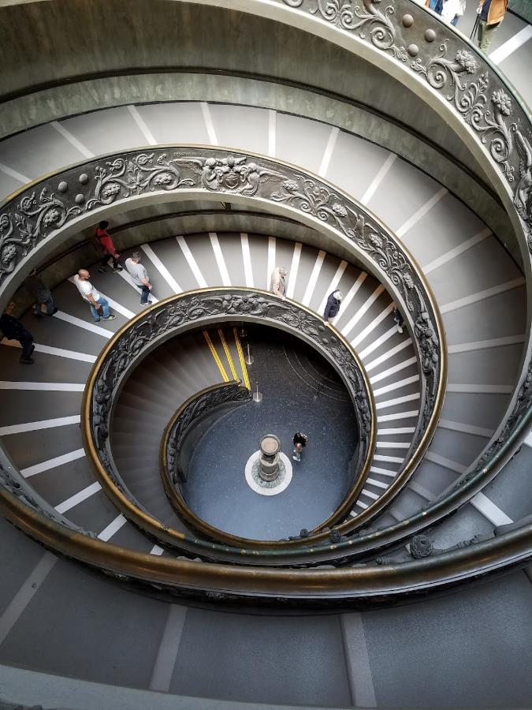
What?
Angular
Expressions
Components
Dependency Injection
Templates
Data-binding
Tools (RxJs, etc.)
Testable

Slide 10
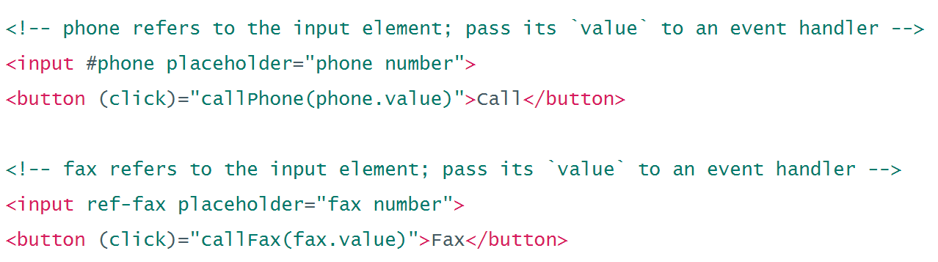
Expressions
Expressions
Parses expressions right in the DOM
Very JavaScript-like (but not JavaScript!)
Conditional DOM compilation
Easily manage UI in a declarative fashion

Slide 11
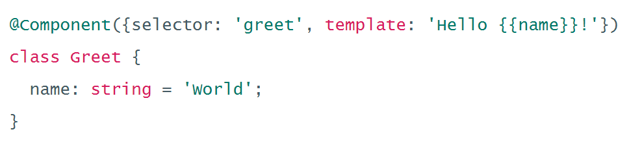
Components
Components
UI Building Block
Always have a template
Scoped CSS
Lifecycle hooks

Slide 12
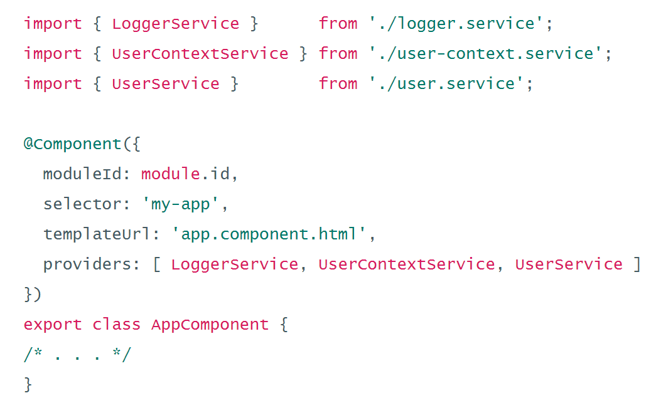
Dependency Injection
Dependency Injection
Provider model
Hierarchical
Mock services
Scope services
Control lifetime

Slide 13
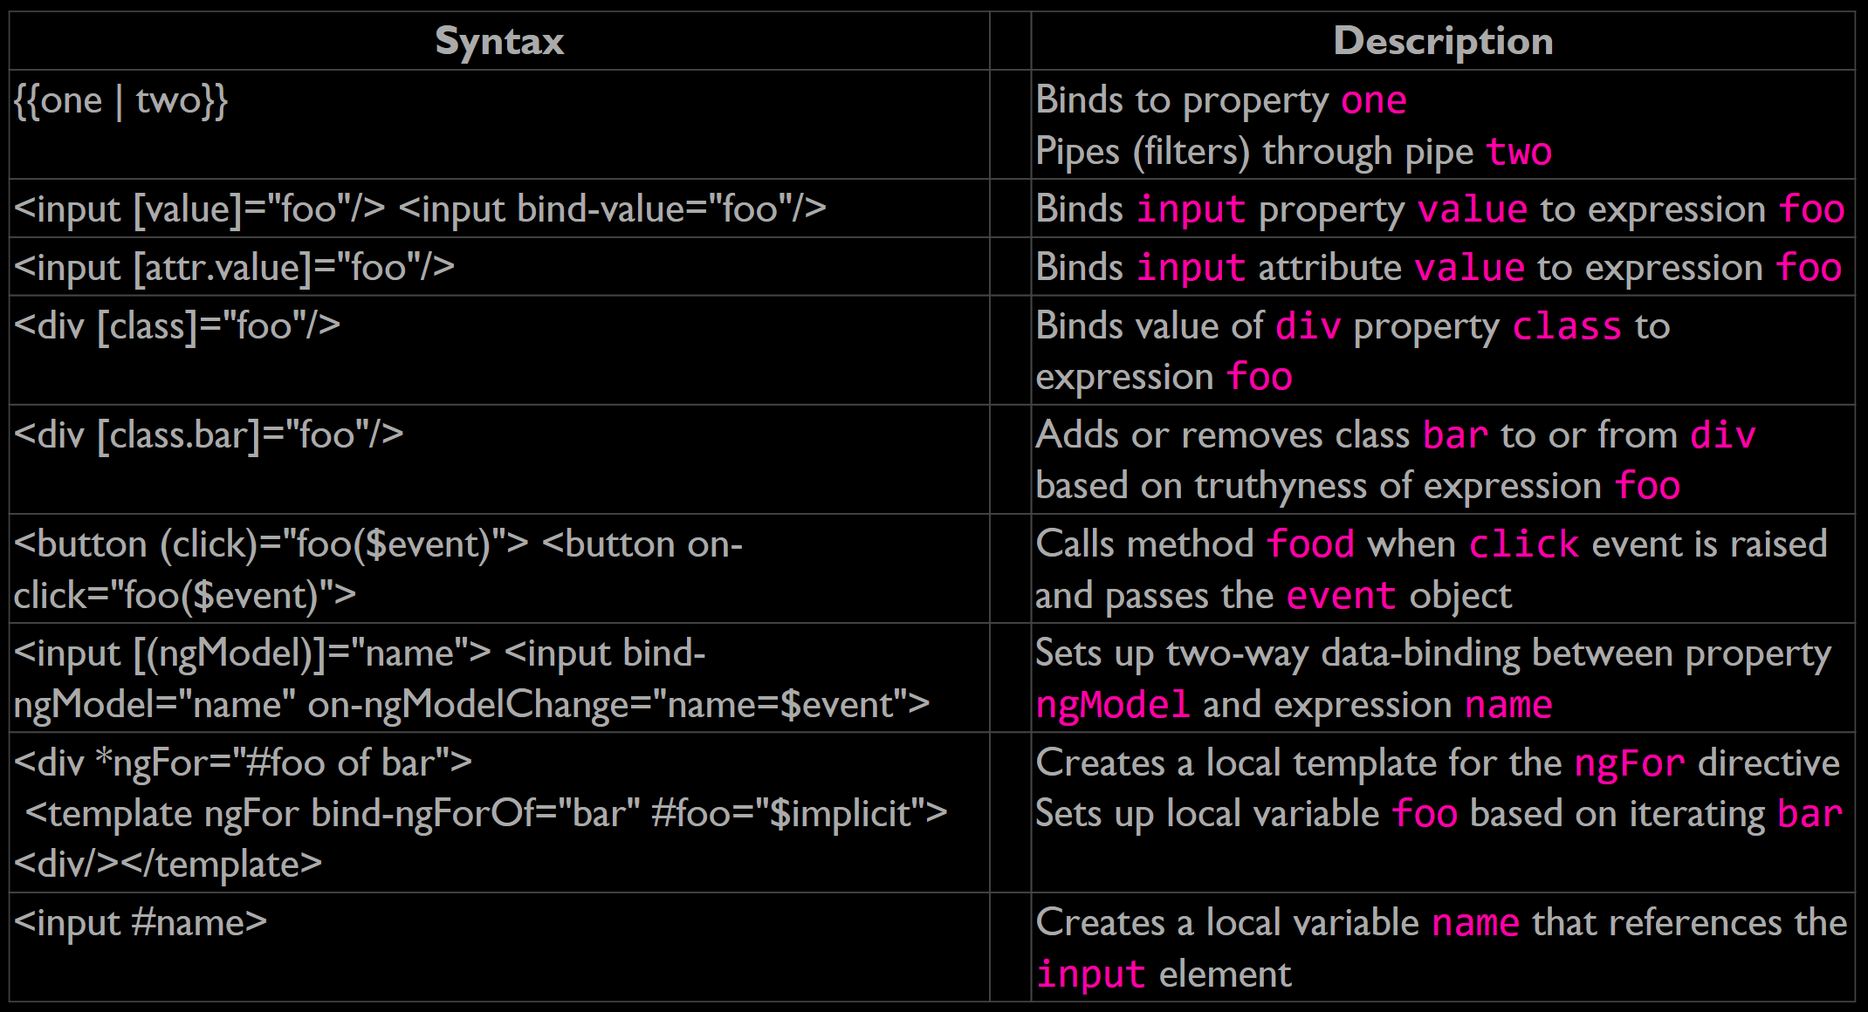
Templates
Templates
Binding syntax
Property binding
Attribute, class, and style binding
Event binding
Two-way data-binding
Inputs and outputs

Slide 14
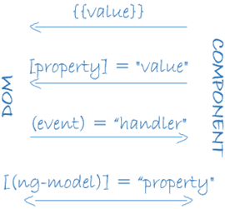
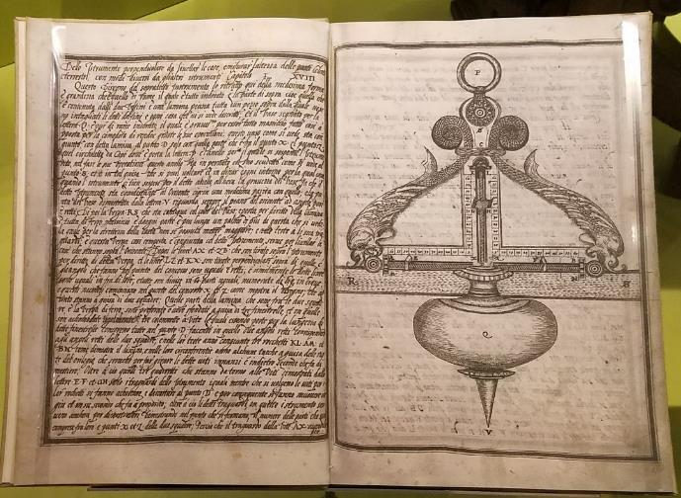
Data-binding
Data-binding
One-way and two-way
Advanced change detection and “zones”

Slide 15
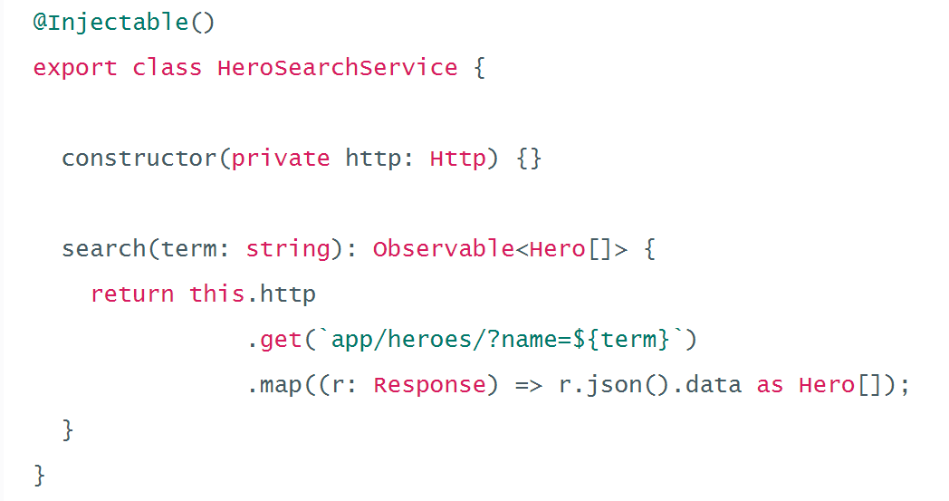
Tools
Tools (RxJs, etc.)
Universal – server-side, mobile, etc.
HTTP
Forms
Material
Router
Animation

Slide 16
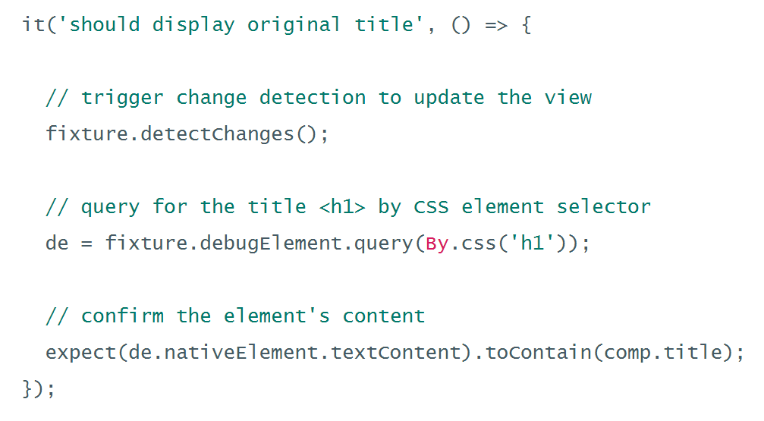
Testable
Testable
Jasmine
Angular mocks
Karma
Protractor

Slide 17
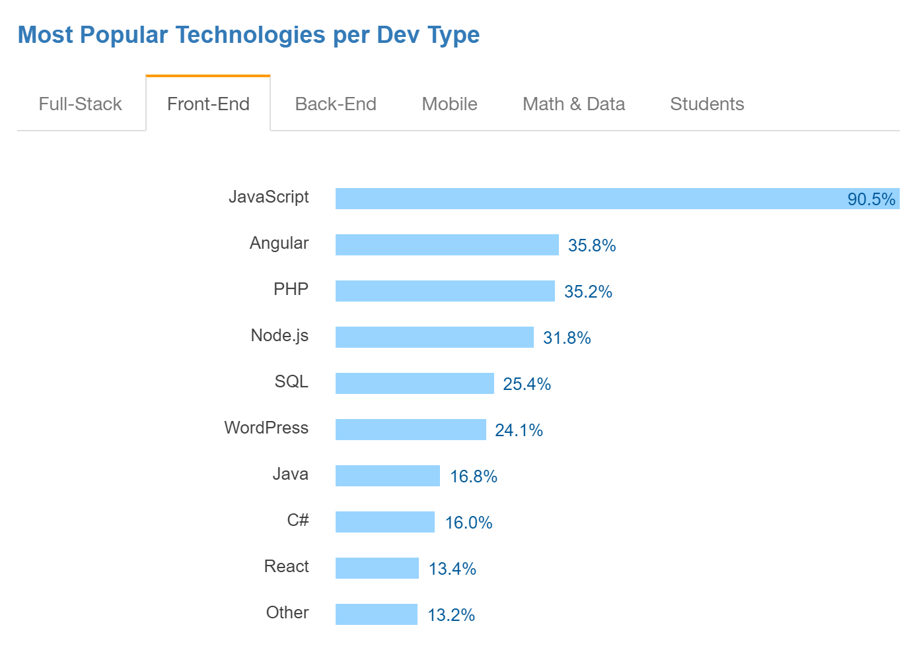
Summary: Why Angular?
Three D’s of Web Development: http://bit.ly/3dofweb
Declarative vs. Imperative
Data-binding
Dependency Injection
Components and Templates
Code Reuse
Parallel Development
Testability
Performance
Source: http://stackoverflow.com/research/developer-survey-2016

Slide 18

Why the Latest Version?
Small footprint (á la carte)
Easy to read, understand, and learn declarative interface
Improved performance (5x rendering in all scenarios over Angular 1.x)
Great CSS management (CSS per component)
Module prefixing (easier to move related files in large projects)
Server-side rendering with Angular universal
Testing support
Advanced scaffolding with Angular-CLI (Webpack!)
TypeScript (stay tuned…)

Slide 19
Why TypeScript?
“I cannot say I have ever been a Microsoft fan but TypeScript has ‘softened’ me, it is easily one of the best web technologies to arrive in the past 3 years.” - https://tedpatrick.com/2013/06/25/7-months-with-typescript/
“Overall, TypeScript is wonderful to work with. It helps developers catch errors quickly, adds types and type-checking, and documents your progress so that if someone else wants to contribute, or you need to return to your work months later, you can easily pick up where you left off.” - http://www.livetiles.nyc/blog/typescript-a-digital-workplace-success-story/
“… we use TypeScript not because we’re part of Microsoft, but because we find tremendous value by improving our productivity and keeping our quality high which together allow us to move much faster.” - https://medium.com/@delveeng/why-we-love-typescript-bec2df88d6c2#.pzp9xp7an

Slide 20
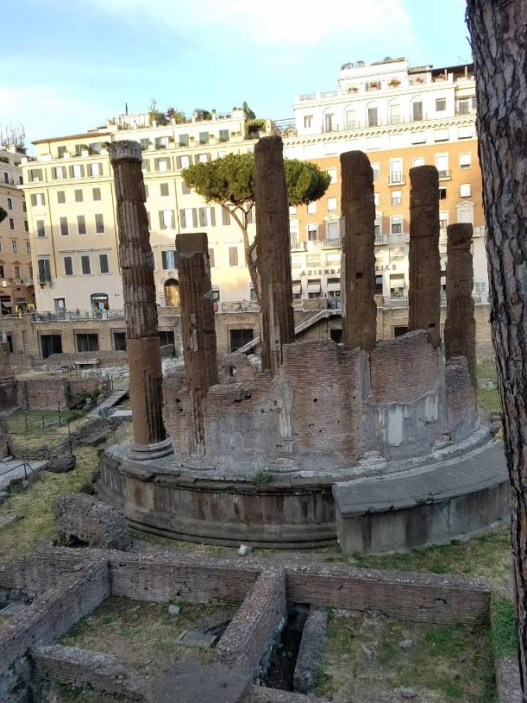
TypeScript: The Basics
Types
Interfaces
Classes
Modules
Temple built by Quintus Lutatius Catulus in 101 BC

Slide 21
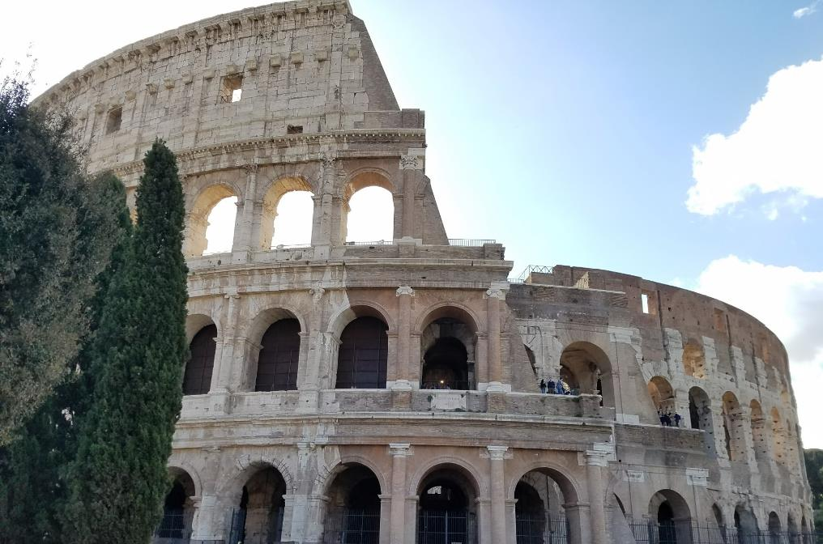
TypeScript: The Cool Stuff
Functions and Lambdas
Complex Type Definitions
Generics
Mixins and Decorators
The Colosseum was finished in 80 AD

Slide 22

TypeScript: The Real World
Library definitions (definitely typed a-la typings)
Migrating JavaScript
Compiler Options
AMD

Slide 23
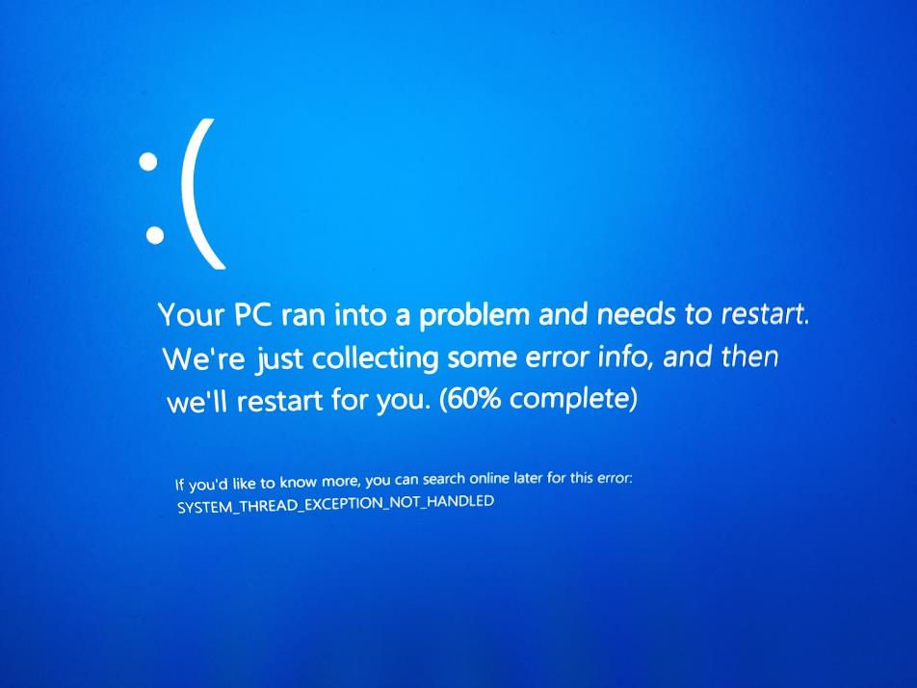
Demo Time!

