Slide 1
ts
Introduction to TypeScript

Slide 2


Trainer Info
Jeremy Likness (@JeremyLikness)
https://github.com/jeremylikness
https://bit.ly/coderblog
Director of App Dev, iVision
http://www.ivision.com

Slide 3
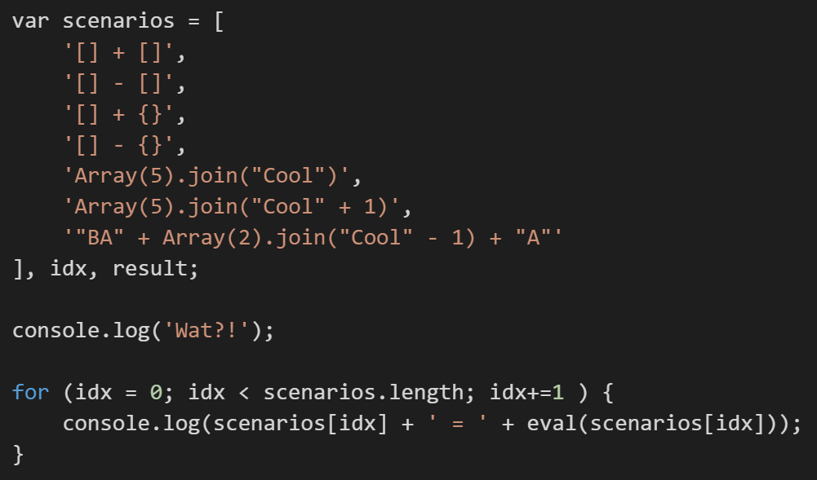
Wat?

Slide 4
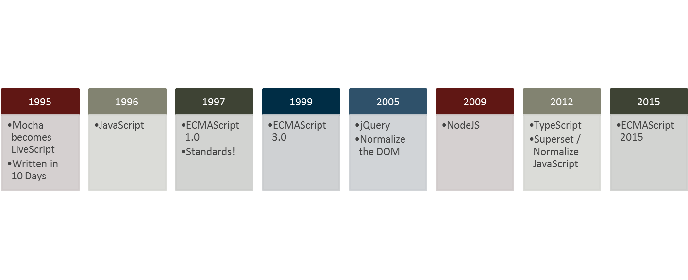
Evolution …
Adoption

Slide 5
Harmony? ECMAScript 2015? Babel?
Popular Option
Introduces Classes, Lexical Scope, Lambda, etc.
Lacks:
Interfaces
Dynamic module affinity (SystemJS, RequireJS, etc.)
External library definitions
Generics
TypeScript = Superscript and is “future-proof”

Slide 6

“The Real World”
Discovery: intent is more clear with types, interfaces, etc.
Documentation: libraries make it easy to discover how to use APIs
Development Time Security: “fat-finger” mistakes less likely, even through complex iterations of calls and callbacks, won’t compile
Scope Safety: Modules, Classes, and Lambdas manage concepts of scope and “this” context
Team Scale: components make it easier for multiple teams to work in parallel
4x: Increased velocity for a team shifting from JavaScript to TypeScript with a data-binding framework (Angular)

Slide 7
Quotable Quotes
“I cannot say I have ever been a Microsoft fan but TypeScript has ‘softened’ me, it is easily one of the best web technologies to arrive in the past 3 years.” - https://tedpatrick.com/2013/06/25/7-months-with-typescript/
“Overall, TypeScript is wonderful to work with. It helps developers catch errors quickly, adds types and type-checking, and documents your progress so that if someone else wants to contribute, or you need to return to your work months later, you can easily pick up where you left off.” - http://www.livetiles.nyc/blog/typescript-a-digital-workplace-success-story/
“… we use TypeScript not because we’re part of Microsoft, but because we find tremendous value by improving our productivity and keeping our quality high which together allow us to move much faster.” - https://medium.com/@delveeng/why-we-love-typescript-bec2df88d6c2#.pzp9xp7an

Slide 8
The Basics
Types
Interfaces
Classes
Modules
Run lab steps through 12b

Slide 9
The Cool Stuff
Functions and Lambdas
Complex Type Definitions
Generics
Mixins and Decorators
Run lab steps 12c – 13

Slide 10
The Real World
Library definitions (definitely typed a-la typings)
Migrating JavaScript
Compiler Options
AMD

