Slide 1

Regression Analysis of Murder Rate by US State
Jeremy McCormick
General Assembly / Data Science Final Project

Slide 2
Goals
Test my intuition about what statistical features of US states might be correlated with their murder rates
Determine if an accurate model can be built for predicting murder rate using the chosen features
Find meaningful/significant correlations between the features and the predicted variable
Cross validate to test and score the models
Explore different regression and cross validation methods in scikit learn

Slide 3
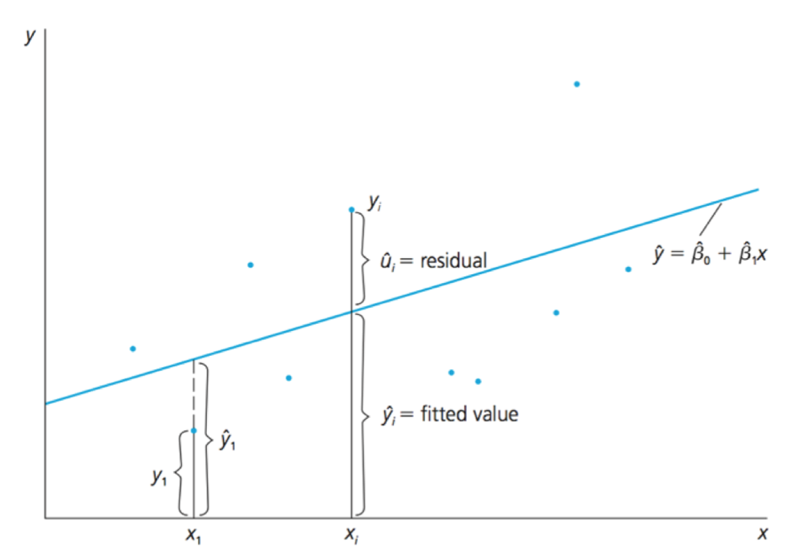
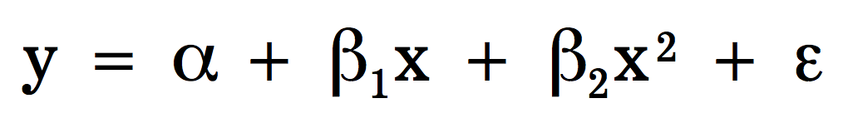
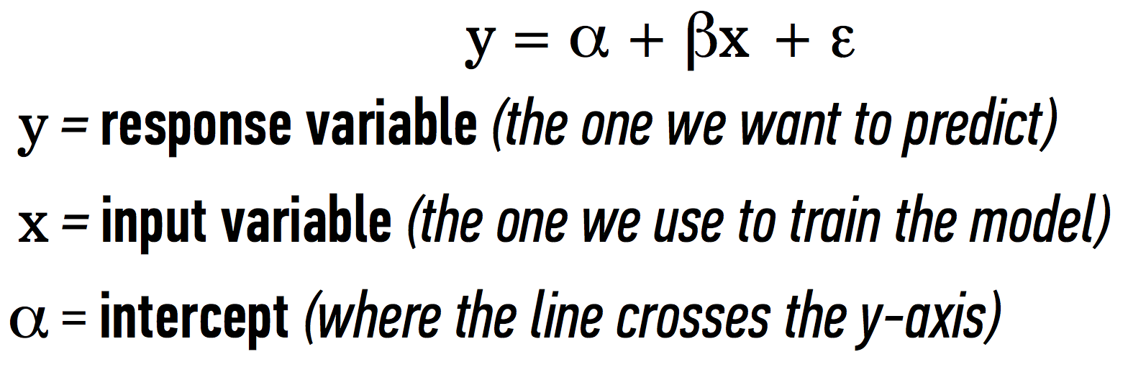
Linear Regression Review
Functional relationship between input (features) and response (predicted)
Minimizes the sum of the squared residuals (errors)
Polynomial Regression
Linear Regression

Slide 4
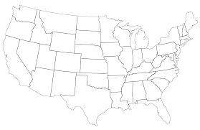
Features
Population density
People / square mile
Median household income
Poverty rate
Percentage of households below federal poverty level
Education
Percentage of population graduating HS
Incarceration rate
Persons incarcerated per 100k
Suicide rate
Suicides per 100k
Gun ownership
Percentage of households claiming to own firearms
Primarily 2010 data

Slide 5
Data Import
Scrape data from Wikipedia and other data sources
Unix ‘awk’ and ‘sed’ are my friends.
Combine into single DataFrame
Join together using merge operation on state name
Leave out Washington D.C.
It is more like a city than a state, so we leave it out.

Slide 6
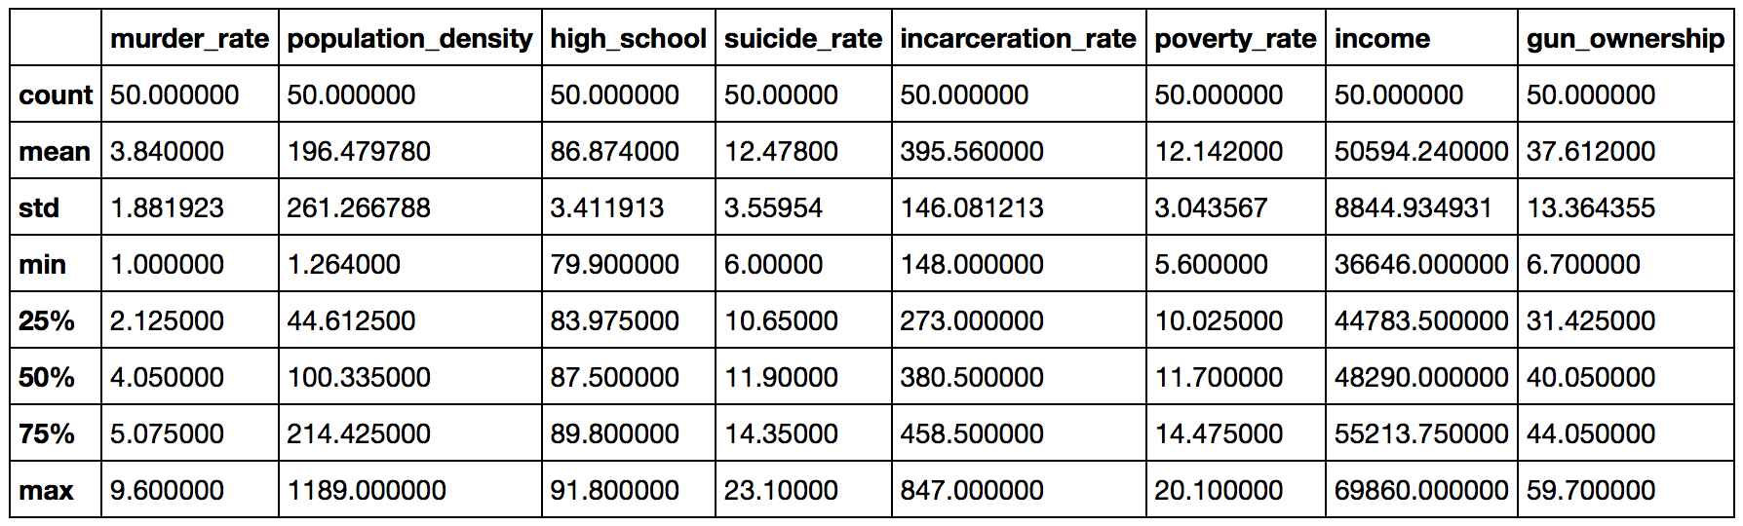
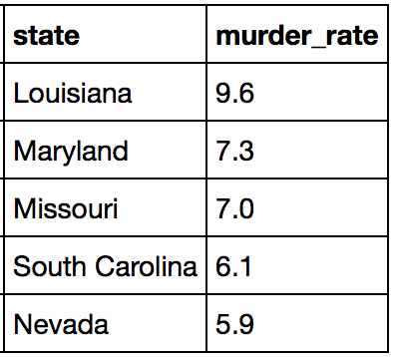
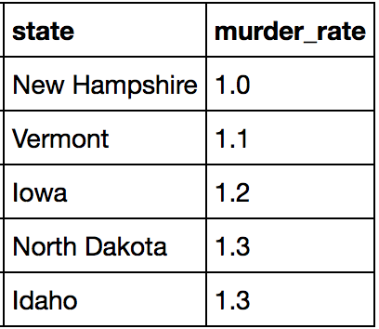
Data Summary

Slide 7
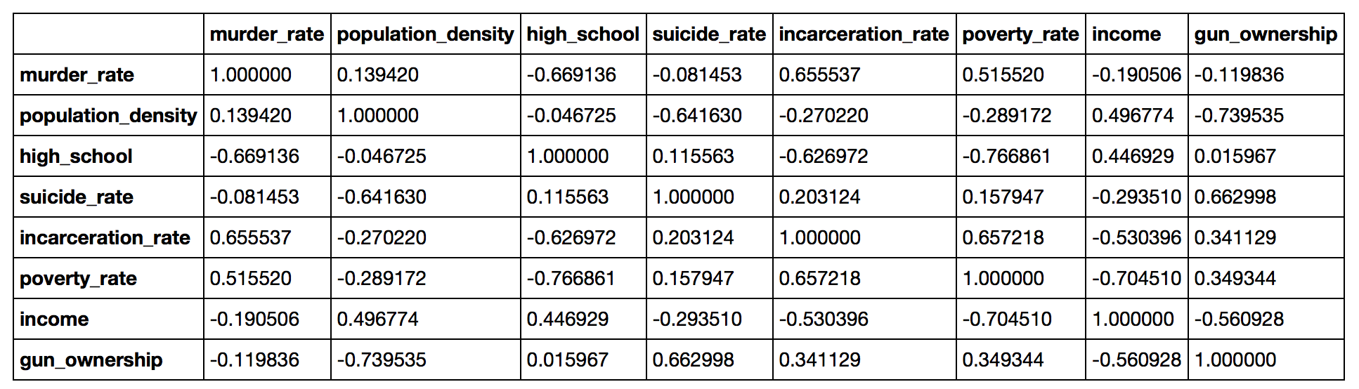
Correlation Matrix
Some of our features seem to have strong correlations, so for this analysis we will look at regression using single input variables.
For instance, poverty rate, % graduating high school, and incarceration rate are all strongly correlated, so multivariate discrimination will not work well.

Slide 8
Issues
Only 50 data points (1 for each US state) which is a small amount of data for many regression models.
Risk of over-fitting!
Do not want to use polynomial regression with too many degrees.
For polynomial fitting use LASSO (L1-norm) to generate sparse solutions that minimize co-efficient values.
Variables strongly correlated.
Use single input variables as predictors (no multi-dimensional fits are used for linear or polynomial).

Slide 9
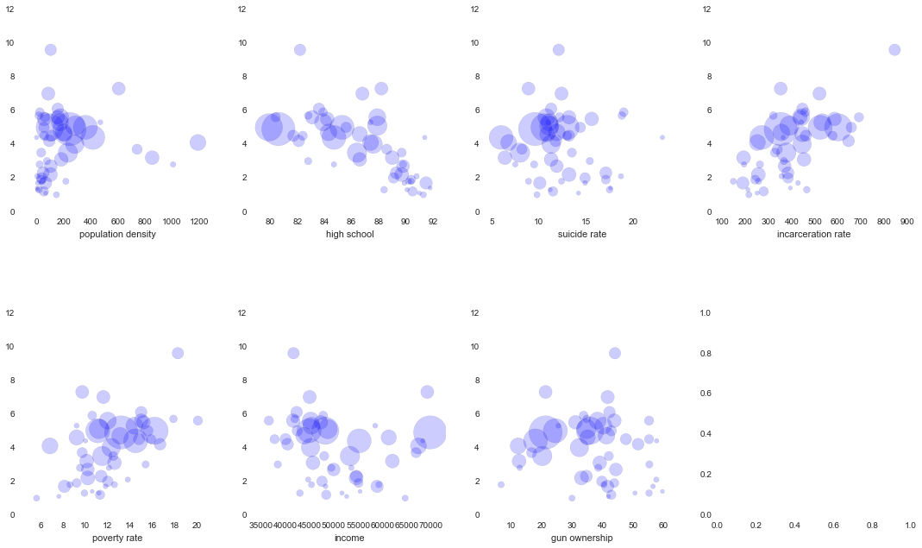
Correlation Plots

Slide 10
Correlation Plots
These features look like they could have strong correlation!

Slide 11
Applying Linear Regression
Linear regression using single degree polynomial (line fit)
This fit will have the largest errors but it is a clear way to visualize positive/negative correlation by looking at the slope of the fit line.
Use a more advanced technique to reduce errors
Polynomial (deg 3) with LASSO
Scatter plot feature vs predicted with the fit line
Compare the Mean Errors to determine how much better the polynomial fit is vs the line fit.

Slide 12
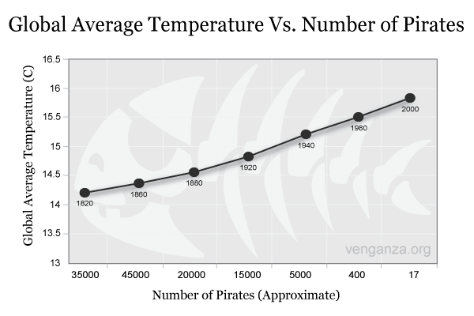
Look at the features which appear correlated first…

Slide 13
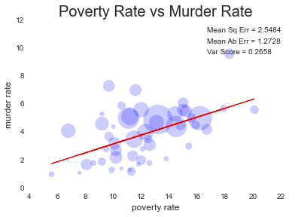
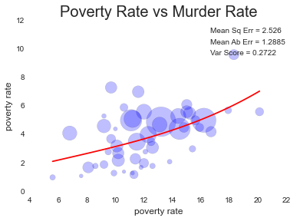
Poverty Rate
The errors are nearly unchanged between the linear and polynomial regression, so the line fit appears to work well.

Slide 14
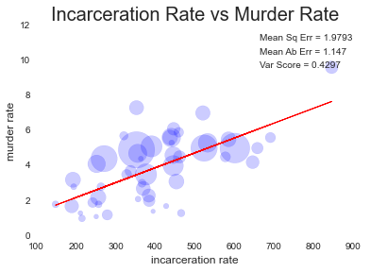
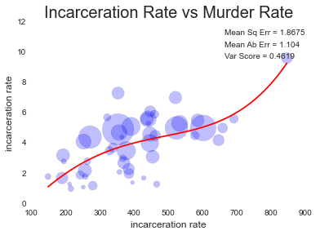
Incarceration Rate
Again, the line fit looks pretty good. There is a clear positive correlation discovered here. Variance Score also indicates a dependence.

Slide 15
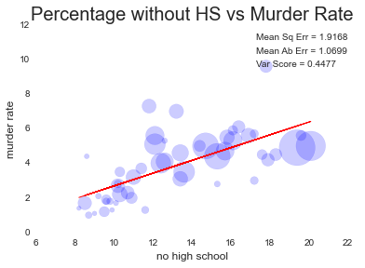
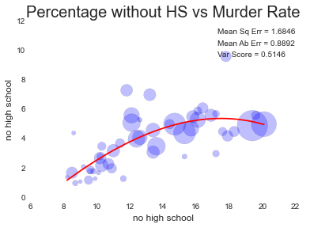
High School Graduation Rate
The line fit reveals a strong positive correlation. The polynomial fit is a little bit better. Variance Score is highest of all the input variables.

Slide 16

Now the features which did not appear to be correlated…

Slide 17
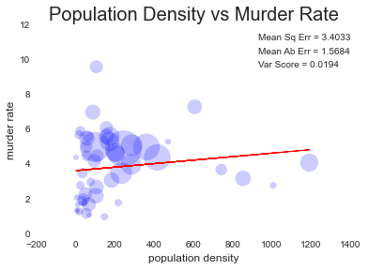
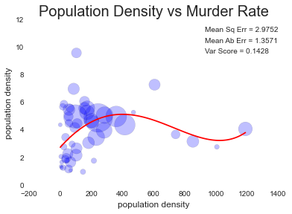
Population Density
The low Variance Score indicates the line fit is poor. The polynomial is better but still not very good, so these techniques do not indicate a correlation between the input and output.

Slide 18
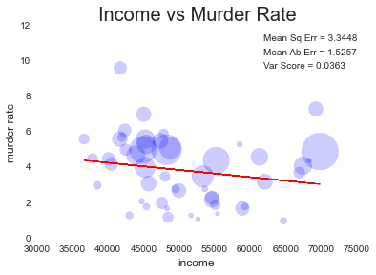
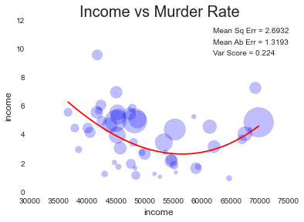
Household Income
The low Variance Score indicates that the line fit does not show correlation. The polynomial has a much better Variance Score, indicating that it reveals some structure in the data, which is a negative correlation that transforms into a (weak) positive correlation past a certain income level.

Slide 19
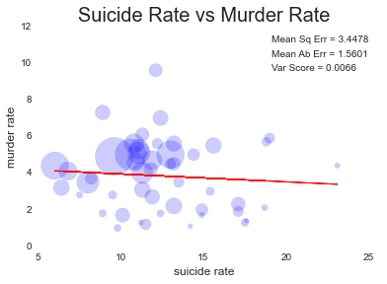
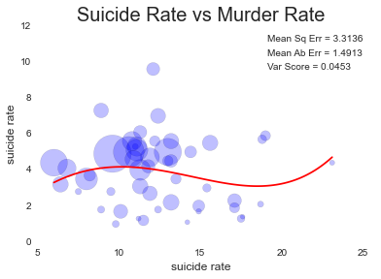
Suicide Rate
Low Variance Scores on both fits indicates that input and output appear to be completely uncorrelated.

Slide 20
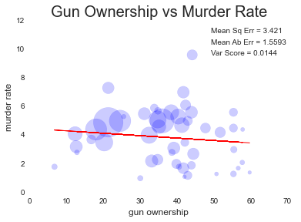
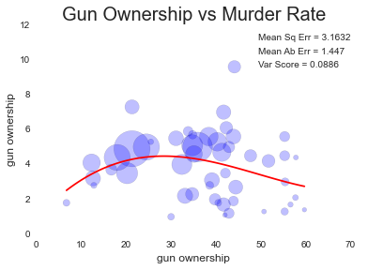
Gun Ownership
I found the lack of correlation with this input surprising! I would have expected a positive correlation.

Slide 21
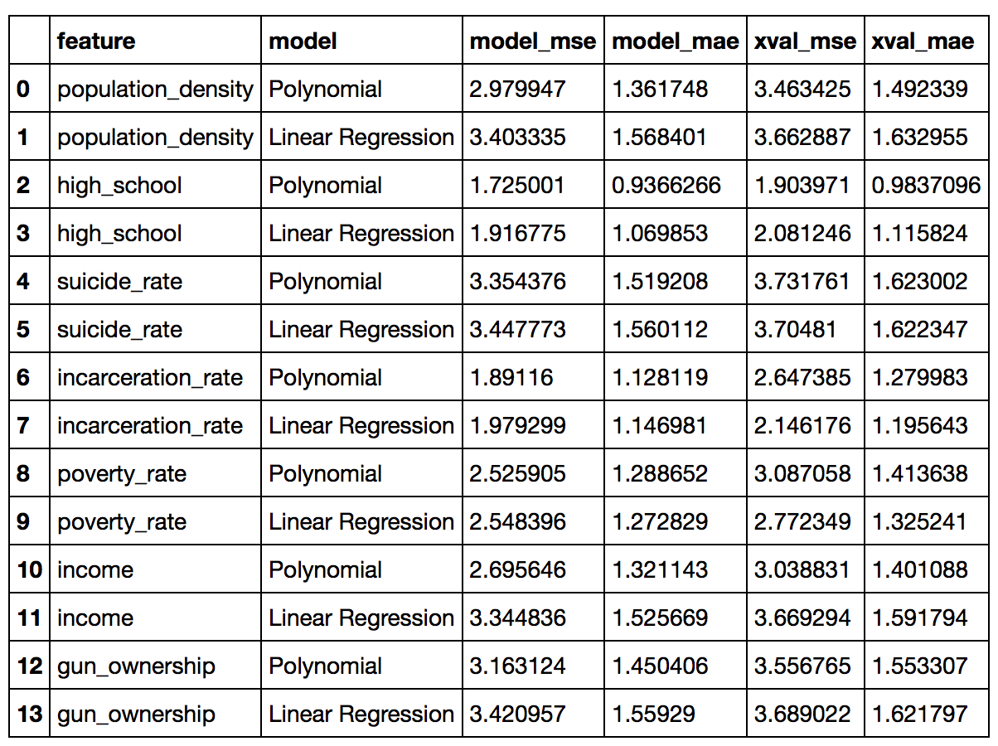
LOO Cross Validation
Compare to ➔ Mean Deviation = 1.5624

Slide 22
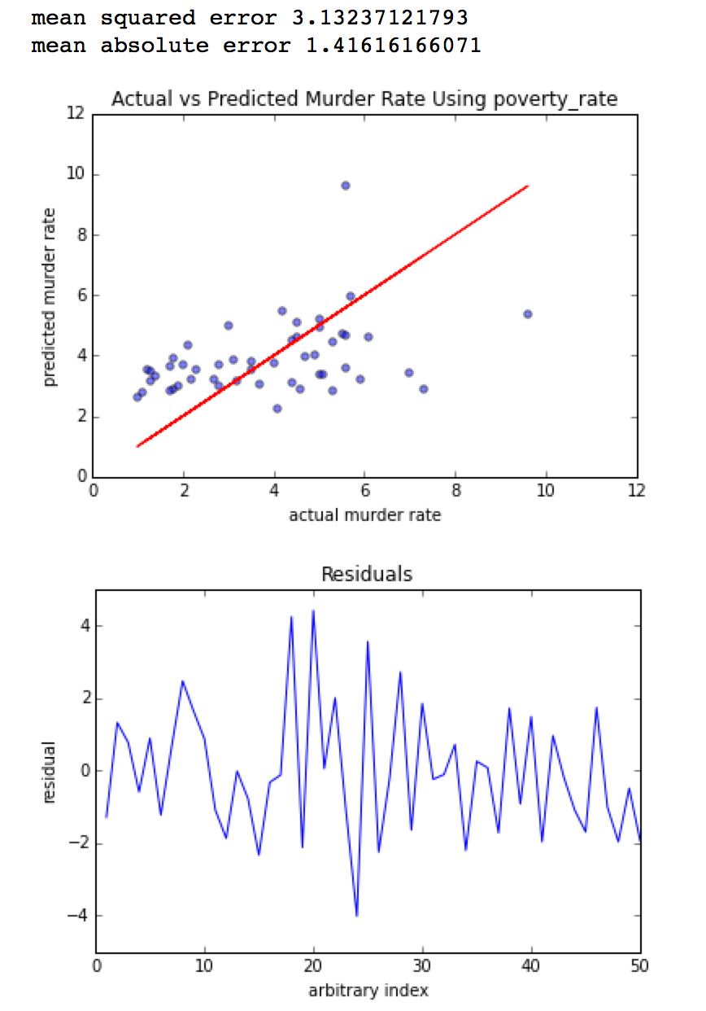
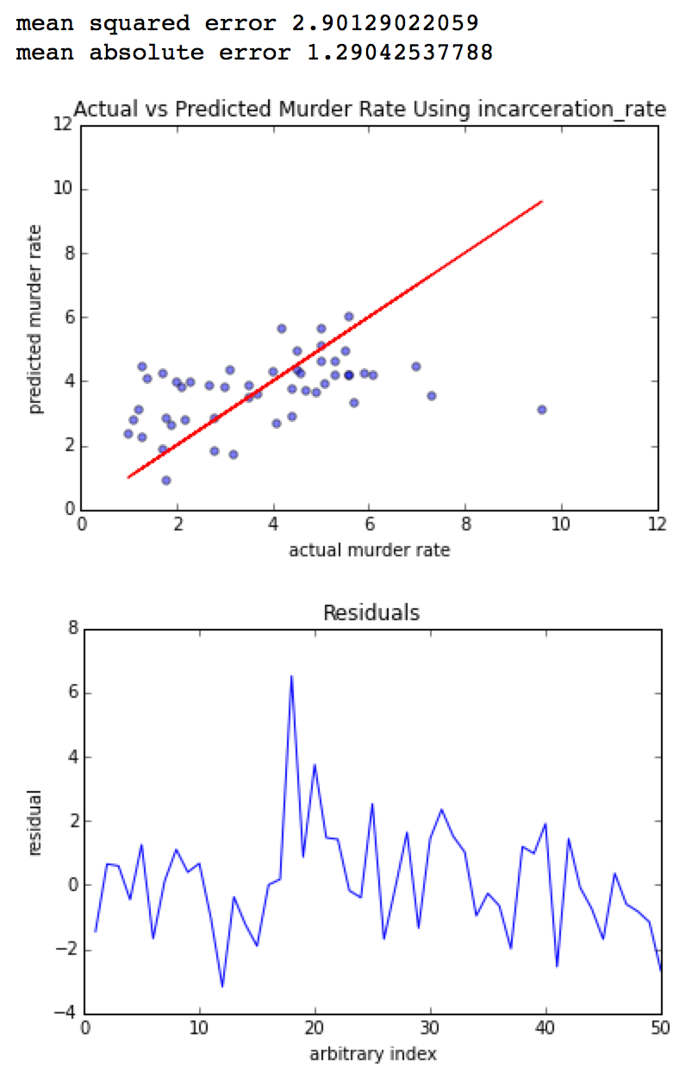
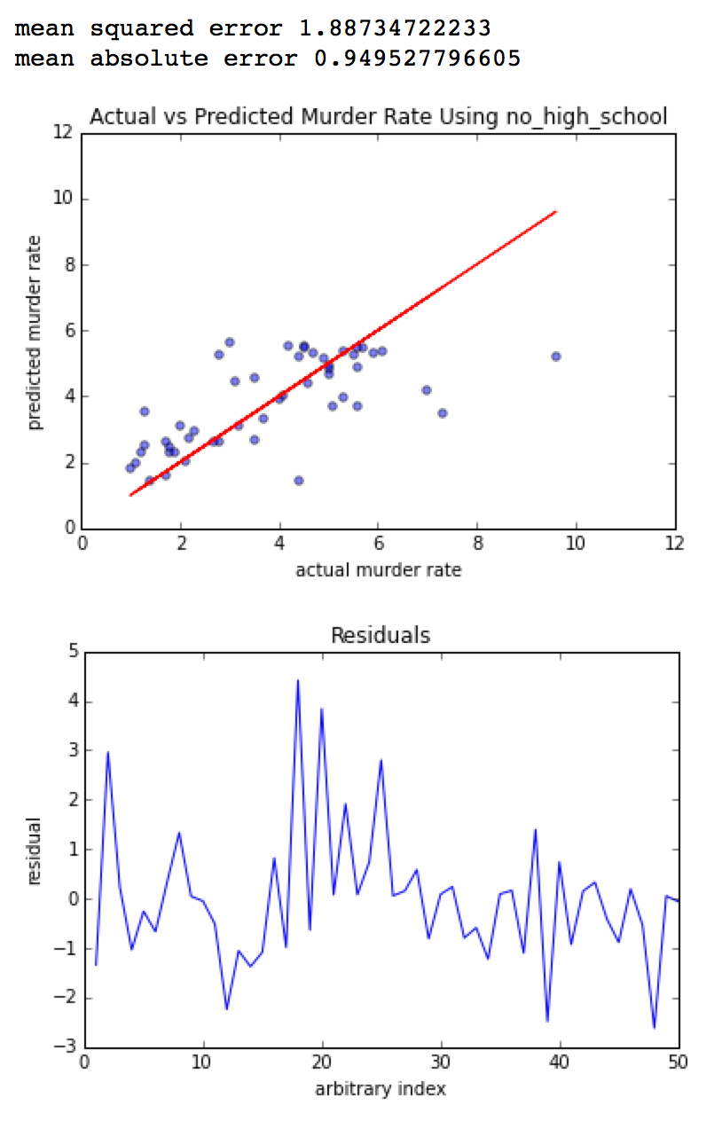
Cross Validation Plots
Poverty Rate
Incarceration Rate
Percentage without HS

Slide 23

Now let’s use a different technique which can utilize all the features simultaneously….
Random Forest Regression

Slide 24
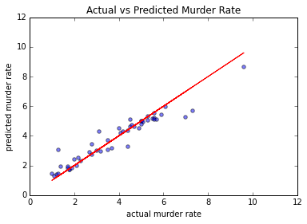
Random Forest Regressor
mean squared error = 0.259334
mean absolute error = 0.3546
This works great BUT I cheated by testing with the same data that was fitted.

Slide 25

Random Forest with LOO
mean squared error 1.7855
mean absolute error 0.948
This method performs better than either linear or polynomial regression, because it is able to weight the inputs and assign them significance. It is also a type of ensemble technique that aggregates the results of many models (or at least such is my understanding!). It probably ends up using the most correlated features and assigns low weight to the uncorrelated ones.

Slide 26
A quick digression on another happy topic….

Slide 27
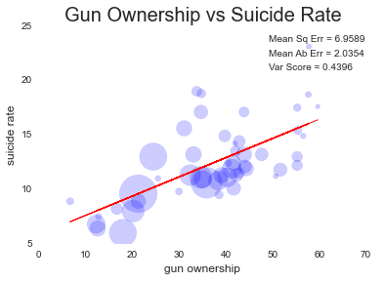
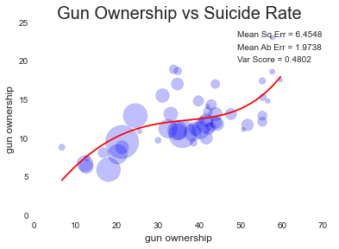
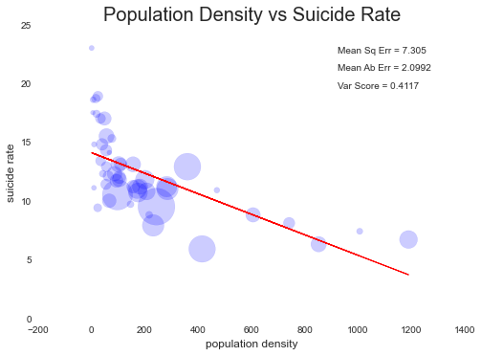
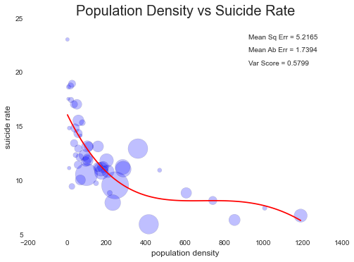
Suicide

Slide 28
What did I learn?
Which features were determined to have identifiable correlations?
Poverty Rate, Incarceration Rate, % Graduating High School
Was it possible to create an accurate statistical model?
Errors when using correlated features were less than mean deviation.
Variance Scores indicated that there was correlation/dependence identified for at least some variables.
Models suffered from the problem of of low statistics.
The errors increased non-negligibly when using LOO.
Removing just 1 data point = 2% of the entire data set!
If I was doing this over again, I would use smaller geographical units like counties or cities and probably violent crime rate rather than murder rate.
Did I explore various regression/validation techniques in scikit-learn?
Linear Regression
Polynomial Regression
Random Forest Regression
LOO Cross Validation
Because lack of education is positively correlated with murder rate, taking classes at GA will make it less likely that you commit homicide. ;-)

