Slide 1

Regression Analysis of Murder Rate by US State
Jeremy McCormick
General Assembly / Data Science Final Project

Slide 2
Goals
Determine if an accurate model can be built for predicting murder rate in US states using the chosen features
Find meaningful/significant correlations between the features and the predicted variable
Cross validate using several different techniques to score the models
Explore different regression methods in scikit learn

Slide 3
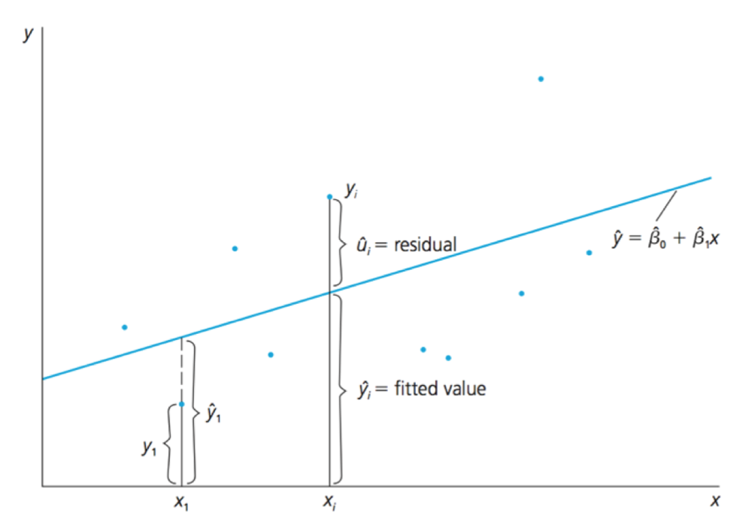
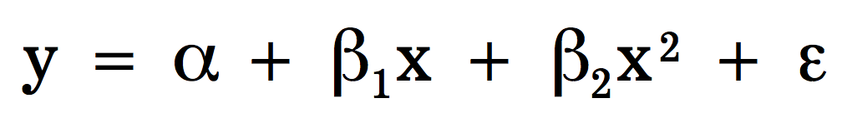
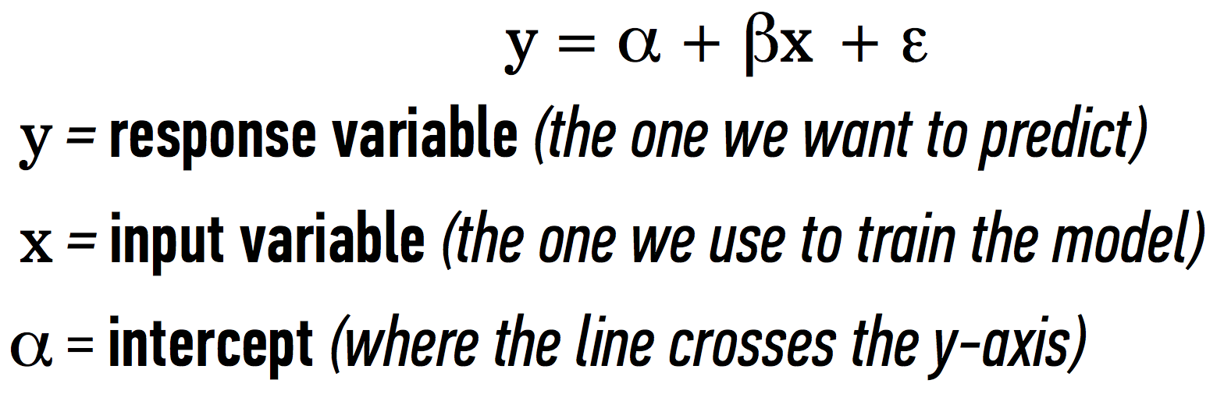
Linear Regression Review
Functional relationship between input (features) and response (murder rate)
Analytically solvable problem which minimizes the sum of the squared residuals (errors)
Polynomial Regression
Linear Regression

Slide 4
Features
Population density
Median household income
Poverty rate
Percentage of households below federal poverty level
Education
Percentage of population graduating HS
Incarceration rate
Persons incarcerated per 100k
Suicide rate
Suicides per 100k
Gun ownership
Percentage of households claiming to own firearms
Primarily 2010 data

Slide 5
Issues
Only 50 data points (1 for each US state) which is a small amount of data for many regression models.
Risk of overfitting!
Do not want to use regression with too many polynomial degrees (probably max 2 or 3).
Use L1-norm to generate sparse solutions.
Variables strongly correlated.
Use single input variables as predictors (no multi-dimensional fits used).

Slide 6
Data Import
Scrape data from Wikipedia and other data sources
Mostly 2010 sources
Combine into single DataFrame
Join together using merge operation on state name
Leave out Washington D.C.
It is more like a city than a state.

Slide 7
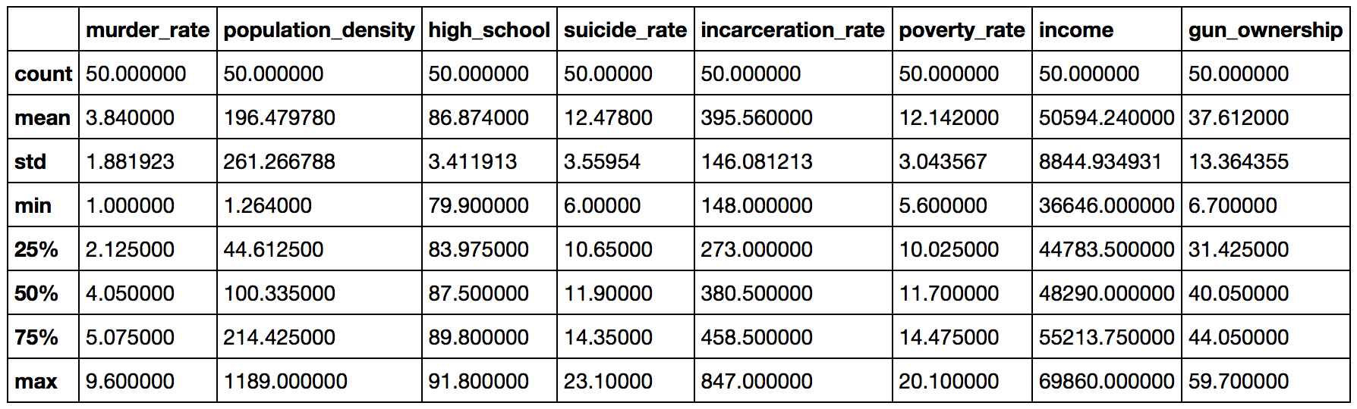
Data Summary

Slide 8
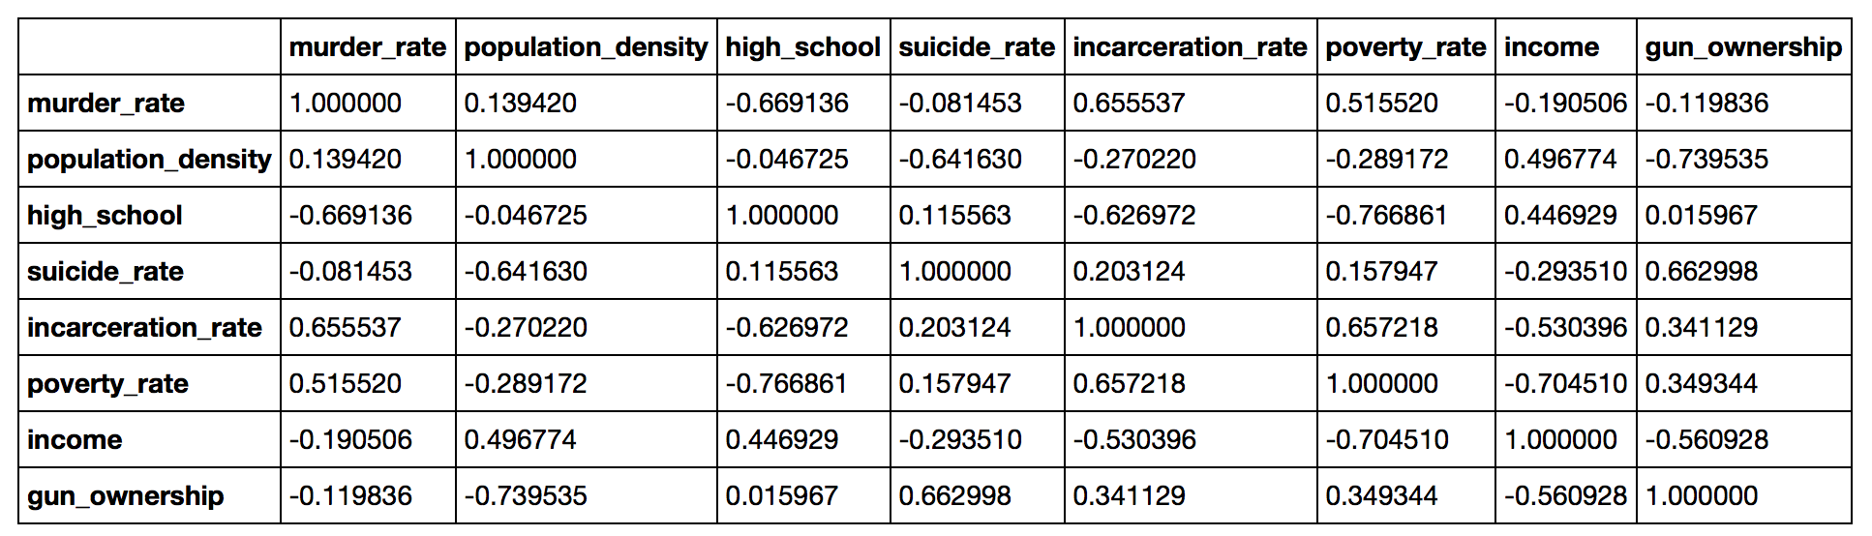
Correlation Matrix
Some of our features seem to have strong correlations, so for this analysis we will look at regression using single input variables.
For instance, poverty rate, % graduating high school, and incarceration rate are all strongly correlated, so multivariate discrimination will not work well.

Slide 9
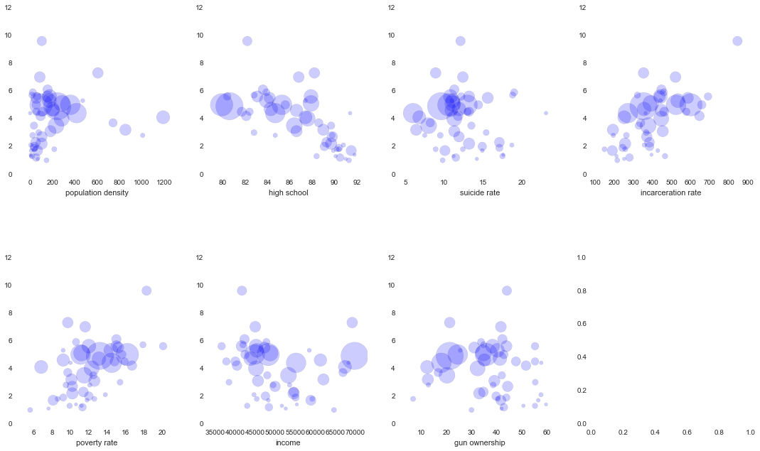
Correlation Plots

Slide 10
Correlation Plots

Slide 11
Applying Linear Regression
Start with linear regression using single degree polynomial
Likely the errors will be large but this will show basic features and correlations in the data
Identify type and level of correlation
Positive or negative
Uncorrelated, weak, moderate or strong
Scatter plot feature vs predicted variable with the fit line
Then for a single feature apply more advanced regression models and do cross validation.

Slide 12
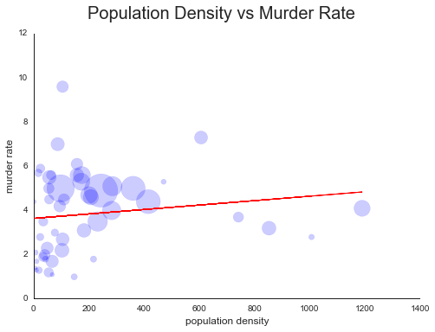
Population Density
Weak positive correlation

Slide 13
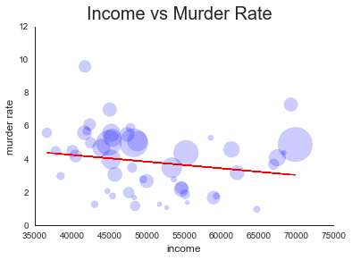
Median Household Income
Moderate negative correlation

Slide 14
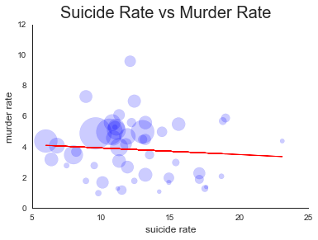
Suicide Rate
Weak negative (or no) correlation

Slide 15
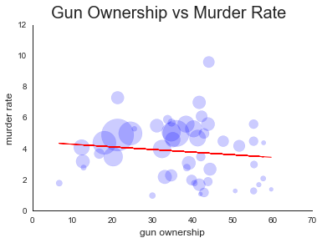
Gun Ownership
Weak negative correlation (or uncorrelated)

Slide 16
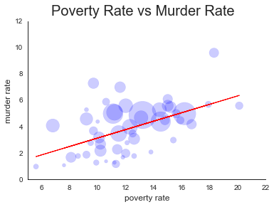
Poverty Rate
Strong positive correlation

Slide 17
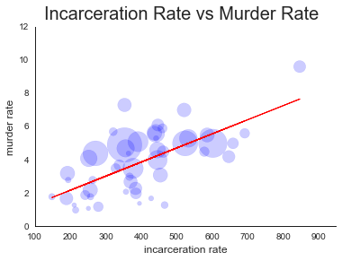
Incarceration Rate
Strong positive correlation

Slide 18
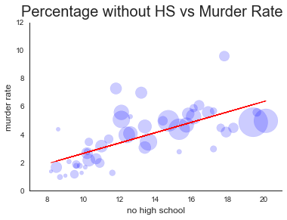
Education
Strong positive correlation

Slide 19
Further Data Exploration
Use a single feature
Percentage without HS Education
Polynomial with 3 degrees
Cross validation
LOO
K-Fold
Random Forest Regressor
LOO

Slide 20
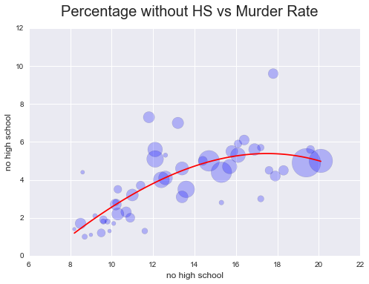
Polynomial Regression

Slide 21
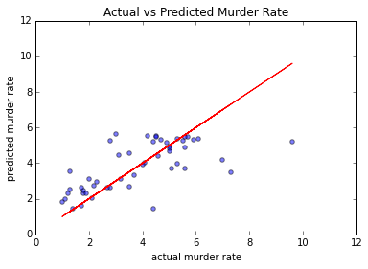
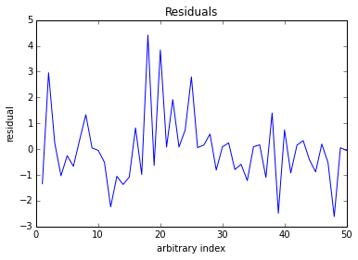
Leave One Out Cross Validation
mean squared error = 2.00880314729
mean absolute error = 0.949527796605

Slide 22

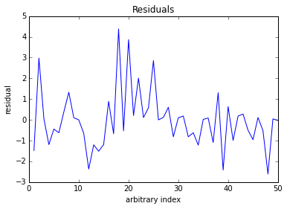
K-Fold Cross Validation
mean squared error = 1.93131328262
mean absolute error = 0.949527796605

Slide 23
Cross Validation Results
Both LOO and K-fold result in similar mean errors for the dataset.
The polynomial regression model results are relatively unchanged when run using these two techniques.
This shows that outliers are not strongly effecting the model parameters determined from training.

Slide 24

Random Forest Regressor
Great! But I cheated by testing with the training data.

Slide 25

Random Forest with LOO

Slide 26
Discovered Correlations
No correlation with suicide rate
No correlation with gun ownership
Weak negative correlation with average income
Weak positive correlation with population density
Strong positive correlation with poverty rate
Strong positive correlation with percentage of population that did not graduate HS
Strong positive correlation with incarceration rate

Slide 27
Conclusions
Population density, suicide rate, average income, and gun ownership by US state are not good predictors of murder.
Poverty rate, education level, and incarceration rate are good predictors of murder rate and show strong correlation.
In particular, murder rate has a strong positive correlation with poverty rate, percentage of the population without a HS education, and incarceration rate.
Analysis is hindered by small sample size. This could be improved by using smaller geographic units (cities, counties).

