Slide 1
Regression Analysis of Murder Rate by US State
Jeremy McCormick

Slide 2
Input Variables
Population density
Median household income
Poverty rate
Percentage of households below federal poverty level
Education
Percentage of population graduating HS
Incarceration rate
# incarcerated per 100k
Suicide rate
Suicides per 100k
Gun ownership
Percentage of households claiming to own firearms
Primarily 2010 data

Slide 3
Predicted Variable
Murder rate
Number of murders per 100k population
Strong correlated with violent crime rate
Same analysis technique could easily be applied to other types of crimes

Slide 4
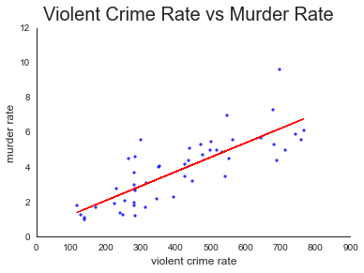
Violent Crime
Violent crime rate and murder rate are strongly correlated.

Slide 5
Analysis Technique
Simple Linear Regression model
Ordinary Least Squares (OLS)
Linear Fit
Scatter plot data points (X vs Y) with the predicted fit line
Identify type and level of correlation
Positive or negative
Uncorrelated, weak, moderate or strong

Slide 6
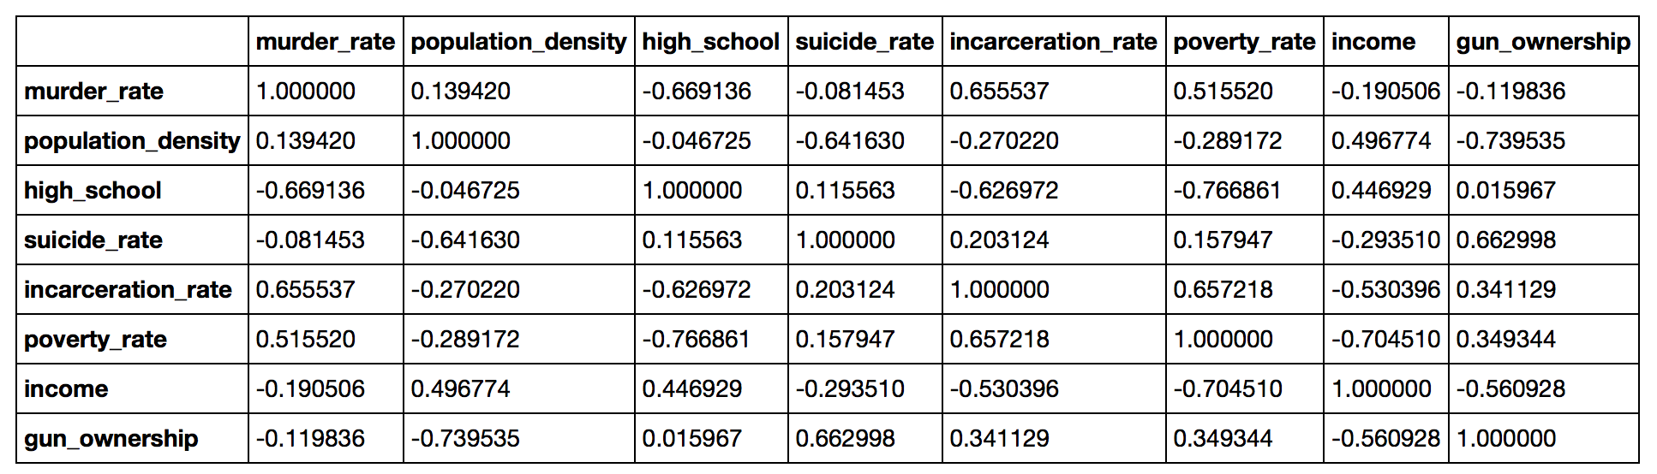
Simple Correlation Matrix

Slide 7
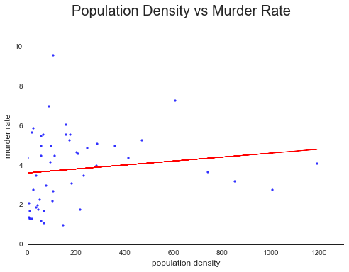
Population Density
Weak positive correlation

Slide 8
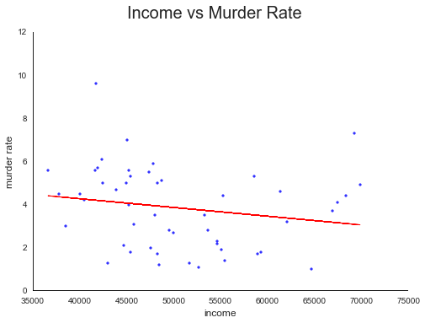
Median Household Income
Moderate to weak negative correlation

Slide 9
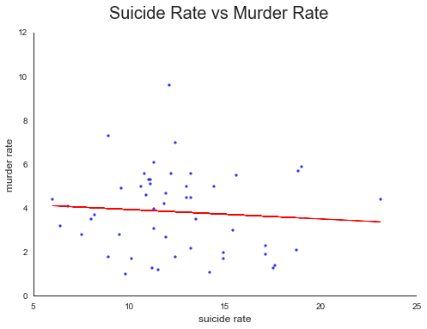
Suicide Rate
Weak negative correlation (or possibly uncorrelated)

Slide 10
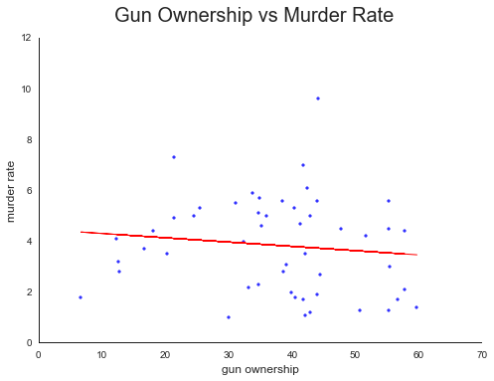
Gun Ownership
Weak negative correlation (or uncorrelated)

Slide 11
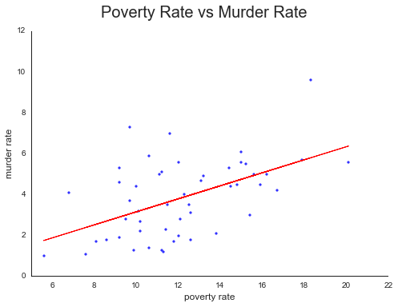
Poverty Rate
P-value = 0.000127
Strong positive correlation

Slide 12
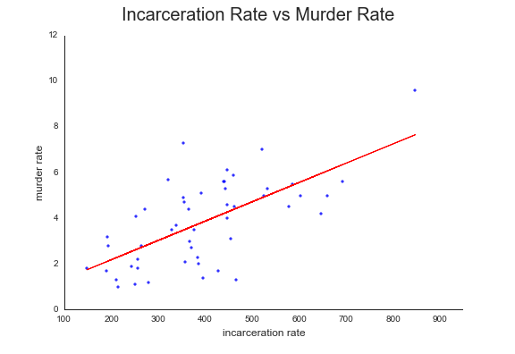
Incarceration Rate
Strong positive correlation

Slide 13
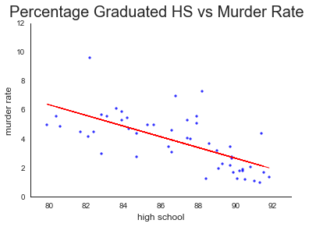
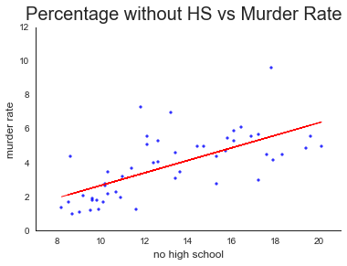
Education
P-value < 10e-6
Strong negative correlation
Strong positive correlation

Slide 14
Review
No correlation with suicide rate
No correlation with gun ownership
Weak negative correlation with average income
Weak positive correlation with population density
Strong positive correlation with poverty rate
Strong negative correlation with percentage of population graduating HS
Or strong positive correlation with percentage of population who did not graduate HS.
Strong positive correlation with incarceration rate

Slide 15
Conclusions
Population density, suicide rate, average income, and gun ownership are not good predictors of murder rate (and probably overall violent crime rates).
Weak correlation or uncorrelated
Poverty rate, education level, and incarceration rate are good predictors of murder rate.
In particular, murder rate has a strong positive correlation with poverty rate, percentage of the population without a HS education, and incarceration rate.

