Slide 1
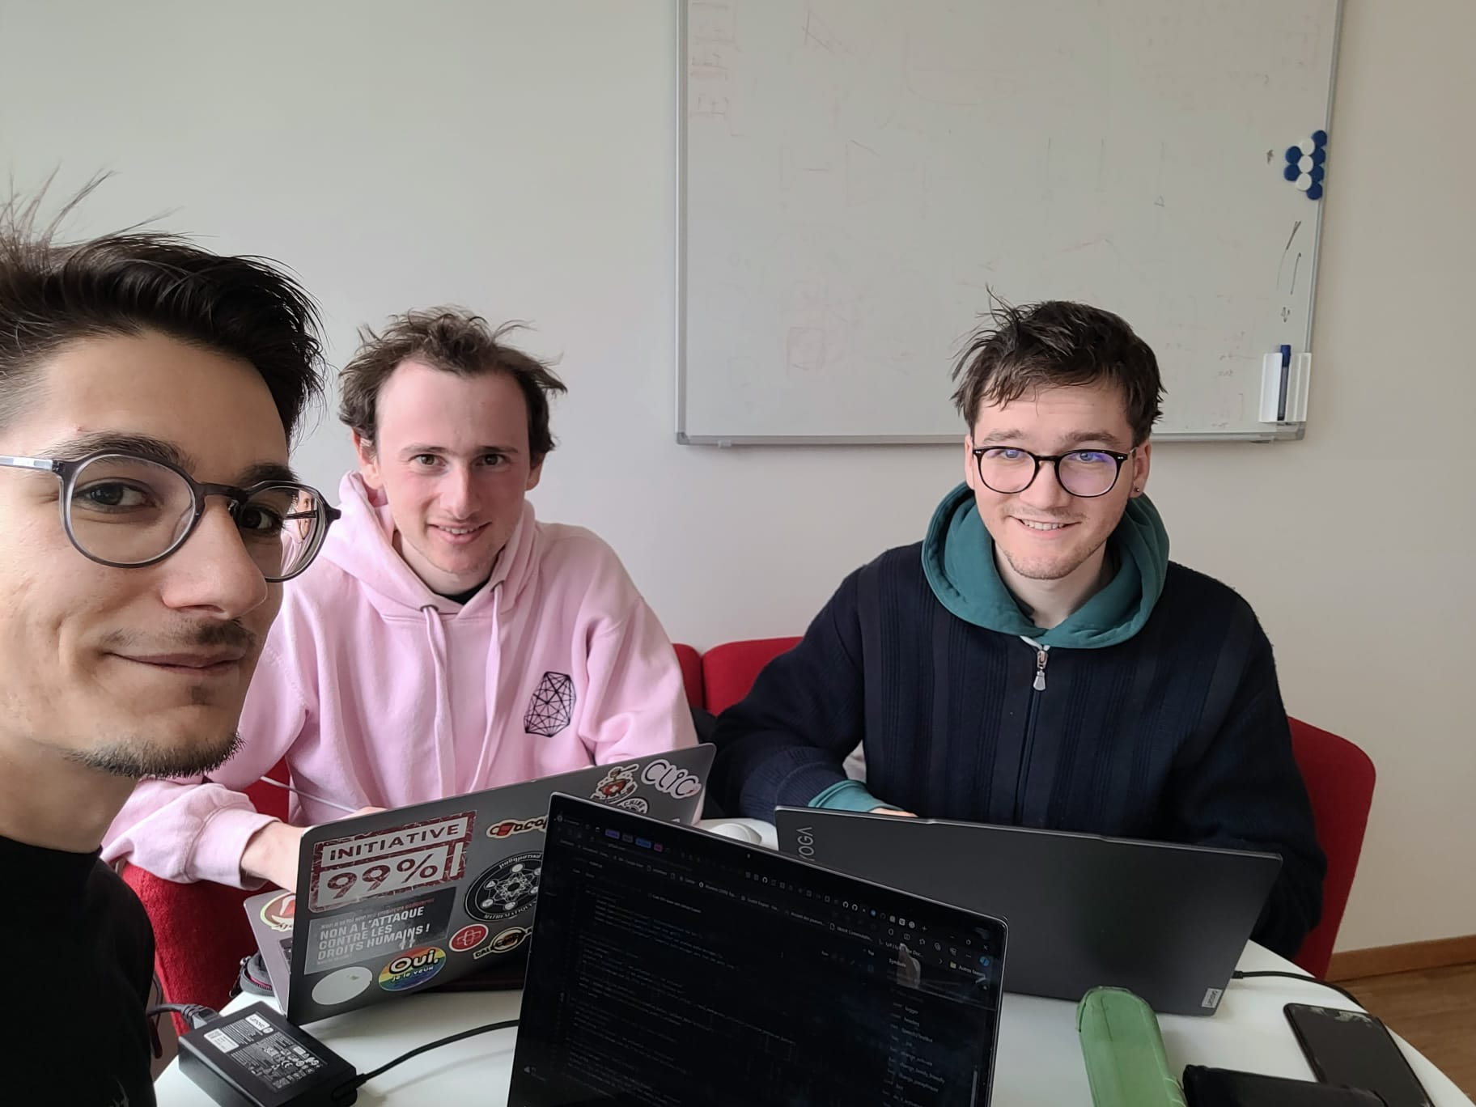
The BlahBlahBot
Made by Jérémy M., Matthew M. & Casimir N.

Slide 2
What is the problem encountered?
Everyone has that annoying friend who sends voice messages all the time. You can’t listen to it right now? You don’t have the time? Well now, our Telegram bot will solve this for you!

Slide 3
What are the functionalities?
Activation: you can activate or deactivate the bot with the command /activate.
Family friendly: you instruct the bot not to transcribe messages containing profanities. This option can be toggled on or off with the command /family_friendly.
Paraphraser: the bot will summarise messages that are more than 100 words long. This option can also be toggled on or off using the command /paraphrase.

Slide 4
How to set up the bot?
Create your own Telegram Bot Key and Hugging face key
Create a keys.py file with your keys.
Example:
TELEGRAM_KEY = "xxxxxxxxxxxxxxxxxxxxxxxxxxxxxxxxx"
HUGGING_FACE_KEY = "xxxxxxxxxxxxxxxxxxxxxxxxxxxxxxxxx"

