Slide 1
Python String
Justin Jian Chen

Slide 2
1
Slicing String

Slide 3
Slicing
It can return a range of characters by using the slice syntax.
Specify the start index and the end index, separated by a colon ( : ), to return a part of the string.
Example
Get the characters from position 3 to position 16 (not included): a = ‘We are studying python course’
Print(a[3:16])

Slide 4
Slice From the Start
By leaving out the start index, the range will start at the first character:
Example
Get the characters from the start to position 5 (not included): b =‘Student should learn’
print(b[:6))

Slide 5
Slice To the End
By leaving out the end index, the range will go to the end:
Example
Get the characters from position 10, and all the way to the end: c=‘School is closed’
Print(c[10:])

Slide 6
Negative Indexing
Use negative indexes to start the slice from the end of the string:
Example
Get the characters:
From: "o" in "World!" (position -5)
To, but not included: "d" in "World!" (position -2):
b = "Hello, World!" print(b[-5:-2])

Slide 7
2
Modify String

Slide 8
Upper Case
Example
The upper() method returns the string in upper case: a = "Hello" b = "World" print(a.upper())
Print(b.upper())

Slide 9
Lower Case
Example
The lower() method returns the string in lower case:
a = "Hello" b = "World" print(a.lower())
Print(b.lower())

Slide 10
Remove Whitespace
Whitespace is the space before and/or after the actual text, and very often you want to remove this space.
Example
The strip() method removes any whitespace from the beginning or the end:
a = " What a wonderful day! " print(a.strip()) # returns " What a wonderful day!"

Slide 11
Replace String
The replace() method replaces a string with another string:
Example
x = “Sky is blue” print(x.replace(“Sky”, “Water”)

Slide 12
Split String
The split() method returns a list where the text between the specified separator becomes the list items :
Example
The split() method splits the string into substrings if it finds instances of the separator:
x = “Hi, guys”
print(x.split(“,“)) # It Will return [“Hi”, “ guys”]

Slide 13
3
GitHub

Slide 14
What is GitHub?
At a high level, GitHub is a website and cloud-based service that helps developers store and manage their code, as well as track and control changes to their code. To understand exactly what GitHub is, it need to know two connected principles:
Version control
Git

Slide 15
What is Version Control?
Version control helps developers track and manage changes to a software project’s code. As a software project grows, version control becomes essential.

Slide 16
What is Git?
Git is a specific open-source version control system created by Linus Torvalds in 2005.
Specifically, Git is a distributed version control system, which means that the entire codebase and history is available on every developer’s computer, which allows for easy branching and merging.

Slide 17
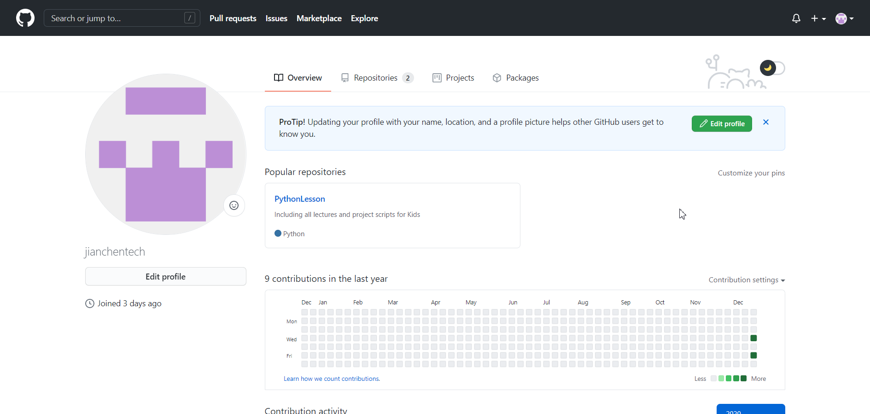
Code resource in GitHub
https://github.com/jianchentech
https://github.com/jianchentech/PythonLesson

Slide 18
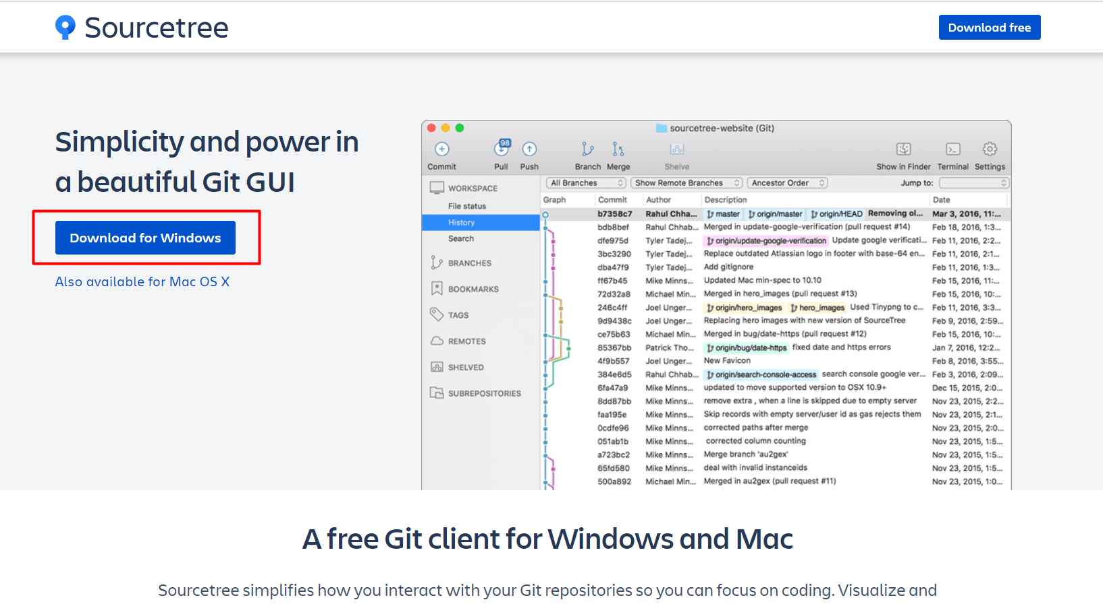
SourceTree
Website for download
https://www.sourcetreeapp.com

Slide 19
Merci !
Avez-vous des questions ?

