Slide 1
Python List and For Loop
Justin Jian Chen

Slide 2
1
Python List

Slide 3
Python List
Lists are used to store multiple items in a single variable.
Lists are created using square brackets:
Example
Create a List: thislist = ["apple", "banana", "cherry"] print(thislist)

Slide 4
Loop Lists
It can loop through the list items by using a for loop:
Example
Print all items in the list, one by one:
thislist = ["apple", "banana", "cherry"] for x in thislist: print(x)

Slide 5
2
For Loop

Slide 6
For Loop
A for loop is used for iterating over a sequence (that is either a list, a tuple, a dictionary, a set, or a string)
With the for loop we can execute a set of statements, once for each item in a list, tuple, set etc
Example
fruits = ["apple", "banana", "cherry"] for x in fruits: print(x)

Slide 7
String Looping
Strings contain a sequence of characters as well which are iterable objects:
Example
Loop the following string
for x in “school": print(x)

Slide 8
Combining For Loop with range() Function
To loop through a set of code a specified number of times, we can use the range() function,
The range() function returns a sequence of numbers, starting from 0 by default, and increments by 1 (by default), and ends at a specified number.
Example
for x in range(1, 10): print(x)
for x in range(1, 30, 3): print(x)

Slide 9
Nested For Loops
A nested loop is a loop inside a loop.
The "inner loop" will be executed one time for each iteration of the "outer loop":
Example
adj = ["red", "big", "tasty"] fruits = ["apple", "banana", "cherry"] for x in adj: for y in fruits: print(x, y)

Slide 10
3
Print

Slide 11
Print() with end parameter
By default, python's print() function ends with a newline. This function comes with a parameter called 'end.' The default value of this parameter is '\n,' i.e., the new line character. You can end a print statement with any character or string using this parameter.
Example
print ("Welcome to", end = ' ‘)
print ("Guru99", end = '!')

Slide 12
Project – Pattern Printer
https://github.com/jianchentech/PythonLesson/blob/master/pythonProject/BeginnerProject/patternPrinter.md
Deadline: January 16 12:00PM, 2021

Slide 13
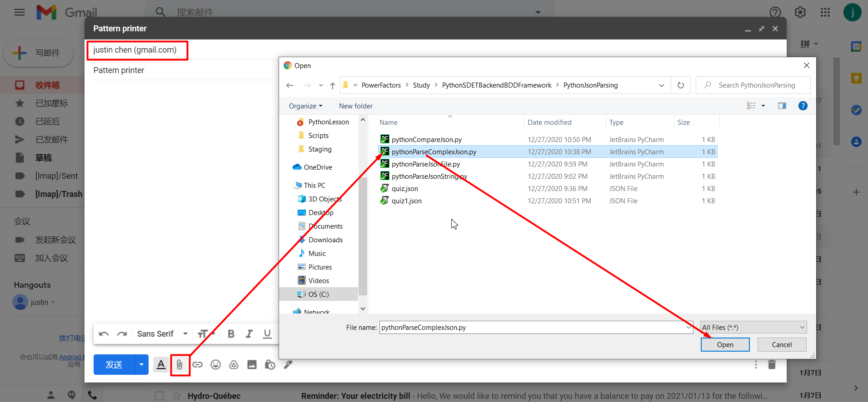
Email attach Python file
justinchenmtl@gmail.com

Slide 14
Merci !
Avez-vous des questions ?

