Slide 1
Python Introduction
Justin Jian Chen

Slide 2
1
Coding

Slide 3
What is Coding?
Coding is just telling a computer what to do
Coding is almost everywhere for now or in future
Browser, OS, the apps on phone, Facebook, website, drones, auto self-driving car, smart watch, 3-D printers
Example of code, written in the Python language:
What is code?
print 'Hello, world!'

Slide 4
Why learn to code?
9. Increased resilience in the face of challenges
10. Enhanced reasoning, organization, and planning skills
1. Increased academic motivation
2. Acquisition of mathematical skills
3. Ability to problem solve
4. Acquisition of computer skills
7. Development of creativity
8. Ability to find information
key benefits of learning to code
10
5. Teamwork, collaboration, and mutual assistance
6. Development of critical thinking

Slide 5
2
Python

Slide 6
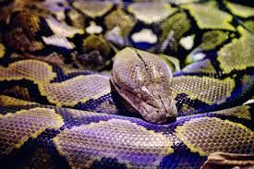
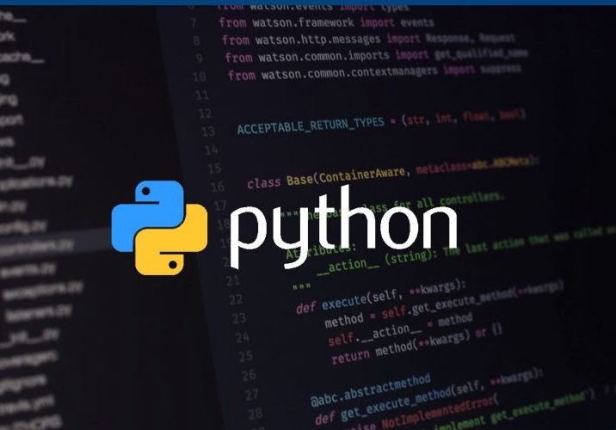
Why is Python called Python?

Slide 7
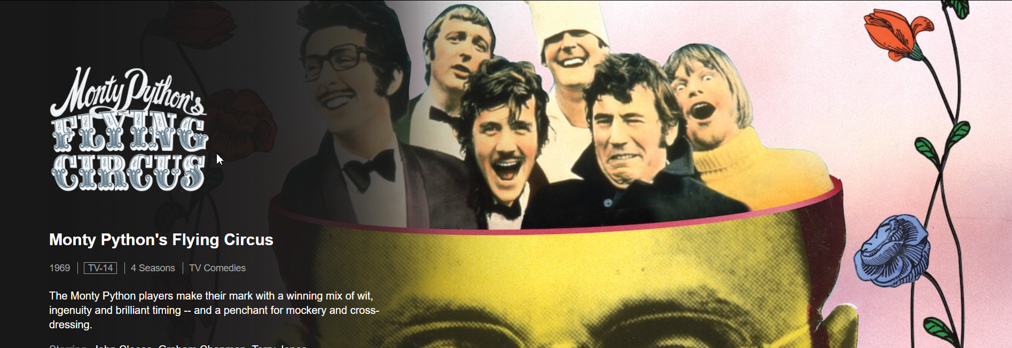
Python Origin The interesting fact is that the programming language Python was implemented by Guido van Rossum. While Guido van Rossum was implementing Python, he was also reading the published scripts from Monty Python’s Flying Circus.

Slide 8
What is Python?
Python is a popular programming language. Thousands of companies have built their websites with Python, including Google, Facebook, Dropbox, Instagram, and Reddit. Python is used for all sorts of things like building websites, web scraping, data analysis, machine learning, and natural language processing.

Slide 9
3
Installing
Python

Slide 10
Python Installation
Download Link:
https://www.python.org/
Step1 Python Installation
3
2
1

Slide 11
Pycharm Installation
Download IDEs – Pycharm Link
https://www.jetbrains.com/pycharm/
Step1 Python Installation
Step2 Pycharm Installation
3
2
1

Slide 12
Initializing first program by Python
# Python 3: Simple output (with Unicode)
>>> print("Hello, World!")
Hello, World!
# Input, assignment
>>> name = input('What is your name?\n’)
>>> print('Hi, %s.' % name)
What is your name?
Python
Hi, Python.
Step1 Python Installation
Step2 Pycharm Installation
Step3 Initialize Program
3
2
1

Slide 13
Project
Mad Libs Generator
Mad Libs Generator is the perfect project for beginners who are just starting out with software development. Primarily focused on strings, variables, and concatenation, this project will teach you how to manipulate user-inputted data. The program design is such that it will ask users to enter a series of inputs that will be considered as a Mad Lib. The input could be anything, an adjective, a noun, a pronoun, etc. Once all the inputs are entered, the application will take the data and arrange the inputs into a story template form. Sound fun?

Slide 14
Project
""" Mad Libs Generator ---------------------------------------- """ //Loop back to this point once code finishes loop = * while (loop < *): // All the questions that the program asks the user noun = input(“****************") p_noun = input(“*****************") noun2 = input(“****************") place = input(“*******************") adjective = input(“******************** ") noun3 = input(“***********************") // Displays the story based on the users input print ("------------------------------------------") print (“*************************************") print (“*************************************") print ("Be kind to your***********************”) print (*************************************“) print () print (*************************************“) print (“***********************************") print ("------------------------------------------") // Loop back to "loop = 1" loop = loop + *

Slide 15
Merci !
Avez-vous des questions ?

