Slide 1
Python Variable
Justin Jian Chen

Slide 2
1
Install Pycharm

Slide 3
What is IDE?
An IDE, or Integrated Development Environment, enables programmers to consolidate the different aspects of writing a computer program.
IDEs increase programmer productivity by combining common activities of writing software into a single application: editing source code, building executables, and debugging.

Slide 4
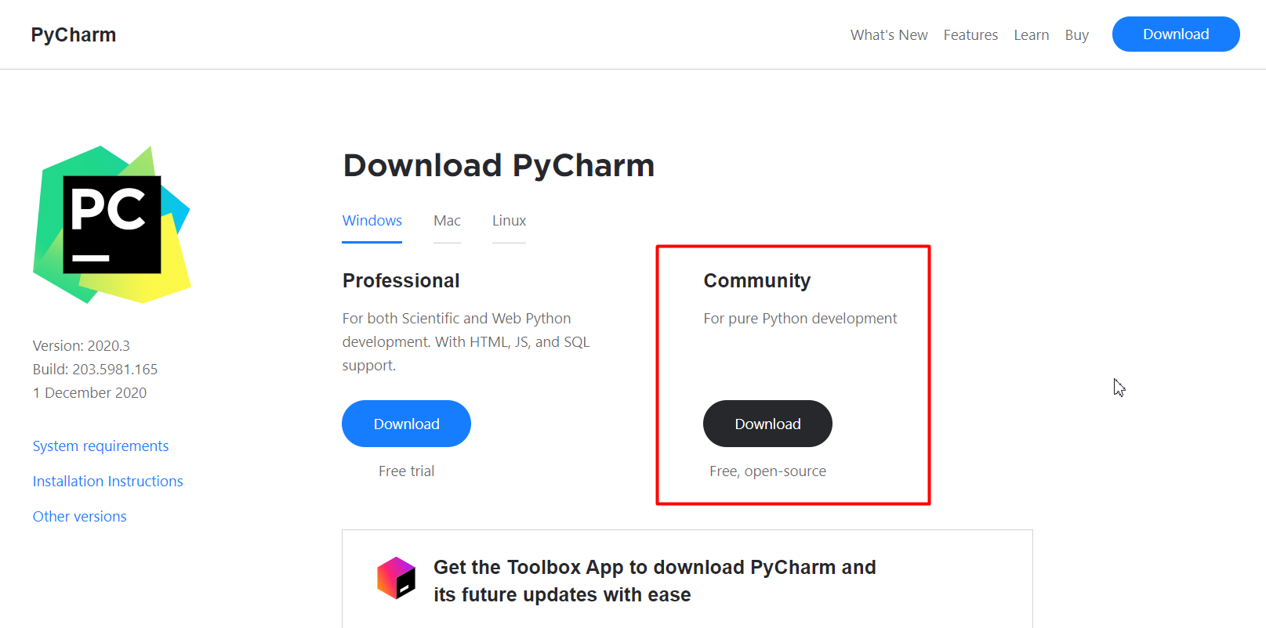
Pycharm Installation
Download IDEs – Pycharm Community Link
https://www.jetbrains.com/pycharm/download/#section=windows

Slide 5
Creating python project and file
5. Writing your scripts and execute it
1. Open PyCharm Editor
2. Open a new project under ‘File’
4. Create a python file under project
5 Steps
3. Create Pure Python project under your own location

Slide 6
2
Python Variable

Slide 7
Variable
Variables are containers for storing data values
Variables are something we want the computer to remember
Python is completely object oriented, and not "statically typed". You do not need to declare variables before using them, or declare their type. Every variable in Python is an object

Slide 8
Type of Variable
Numbers
Two types of numbers - integers and floating point numbers:
To define an integer, use the following syntax:
myint = 7
print(myint)
To define a floating point number, use the following notations:
myfloat = 7.0
print(myfloat)

Slide 9
Type of Variable
Strings
Strings are defined either with a single quote or a double quotes:
mystring = 'hello’
print(mystring)
mystring = "hello“
print(mystring)

Slide 10
3
Python Graphics

Slide 11
Drawing with Turtle
“Turtle” is a Python feature like a drawing board, which lets us command a turtle to draw all over it!
turtle.forward( )
turtle.right( )
turtle.Pen( )
Turtle.speed( )
Turtle.done( )

Slide 12
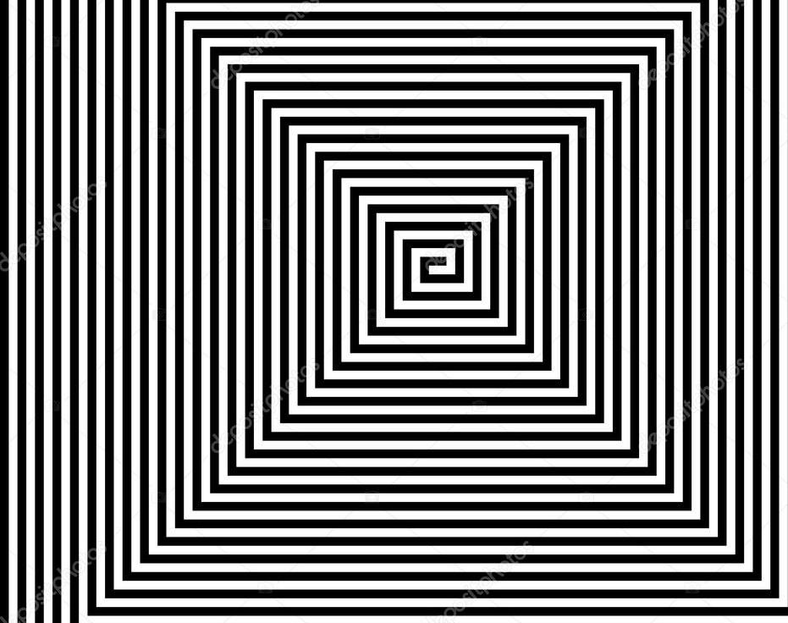
Square Spiral
import turtle pen = turtle.Pen() for i in range(200): pen.forward(i) pen.left(90) turtle.done()

Slide 13
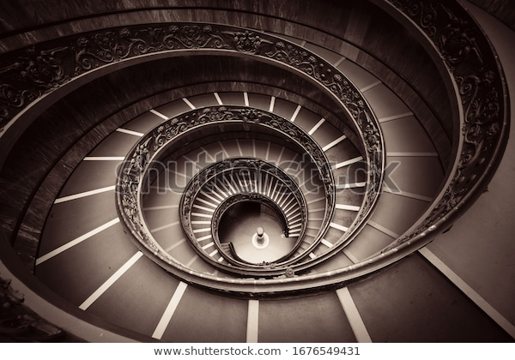
Winding Spiral
import turtle pen = turtle.Pen() pen.speed(0) for i in range(200): pen.forward(i) pen.left(91) turtle.done()

Slide 14
Project
""" Mad Libs Generator ---------------------------------------- """ //Loop back to this point once code finishes loop = * while (loop < *): // All the questions that the program asks the user noun = input(“****************") p_noun = input(“*****************") noun2 = input(“****************") place = input(“*******************") adjective = input(“******************** ") noun3 = input(“***********************") // Displays the story based on the users input print ("------------------------------------------") print (“*************************************") print (“*************************************") print ("Be kind to your***********************”) print (*************************************“) print () print (*************************************“) print (“***********************************") print ("------------------------------------------") // Loop back to "loop = 1" loop = loop + *

Slide 15
Merci !
Avez-vous des questions ?

