Slide 1
Python Boolean and Condition
Justin Jian Chen

Slide 2
1
Boolean

Slide 3
Boolean
Booleans represent one of two values: True or False
In programming you often need to know if an expression is True or False.
When you compare two values, the expression is evaluated and Python returns the Boolean answer:
Example
print(10 > 9) print(10 == 9) print(10 < 9)

Slide 4
Evaluate Values and Variables
The bool() function allows you to evaluate any value, and give you True or False in return
Example
print(bool("Hello")) print(bool(15))
x = "Hello" y = 15 print(bool(x)) print(bool(y))

Slide 5
2
Python Condition

Slide 6
Python Conditions
Python supports the usual logical conditions from mathematics:
Equals: a == b
Not Equals: a != b
Less than: a < b
Less than or equal to: a <= b
Greater than: a > b
Greater than or equal to: a >= b

Slide 7
If Statements
These conditions can be used in several ways, most commonly in "if statements" and loops.
An "if statement" is written by using the if keyword.
Example
If statement:
a = 49 b = 100 if b > a: print("b is greater than a")

Slide 8
Indentation
Python relies on indentation (whitespace at the beginning of a line) to define scope in the code. Other programming languages often use curly-brackets for this purpose.
Example
If statement, without indentation (will throw an error):
a = 15 b = 39 if b > a: print("b is greater than a") # you will get an error

Slide 9
Elif
The elif keyword is pythons way of saying "if the previous conditions were not true, then try this condition".
Example
a = 19 b = 19 if b < a: print("b is lower than a") elif a == b: print("a and b are equal")

Slide 10
Else
The else keyword catches anything which isn't caught by the preceding conditions.
Example
a = 149 b = 98 if b > a: print("b is greater than a") elif a == b: print("a and b are equal") else: print("a is greater than b")

Slide 11
3
Internet of Things

Slide 12
What is IoT
The Internet of Things, or IoT, refers to the billions of physical devices around the world that are now connected to the internet, all collecting and sharing data. Thanks to the arrival of super-cheap computer chips and the ubiquity of wireless networks, it's possible to turn anything, from something as small as a pill to something as big as an aeroplane, into a part of the IoT. Connecting up all these different objects and adding sensors to them adds a level of digital intelligence to devices that would be otherwise dumb, enabling them to communicate real-time data without involving a human being. The Internet of Things is making the fabric of the world around us more smarter and more responsive, merging the digital and physical universes.
Internet of Things

Slide 13
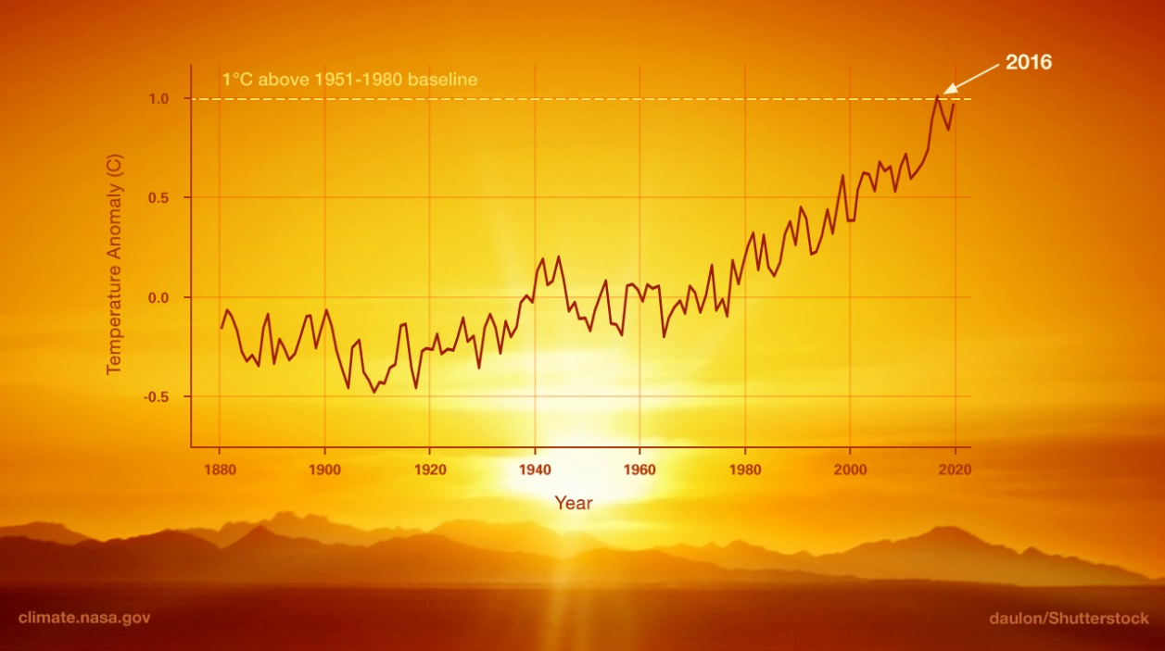
Global Warming
Global warming is the long-term heating of Earth’s climate system observed since the pre-industrial period (between 1850 and 1900) due to human activities, primarily fossil fuel burning, which increases heat-trapping greenhouse gas levels in Earth’s atmosphere.
-- NASA

Slide 14
Glacier Melting due to Climate change
Glacier -- OUr Planet
Documentary from Our Plantet Series by Netflix

Slide 15
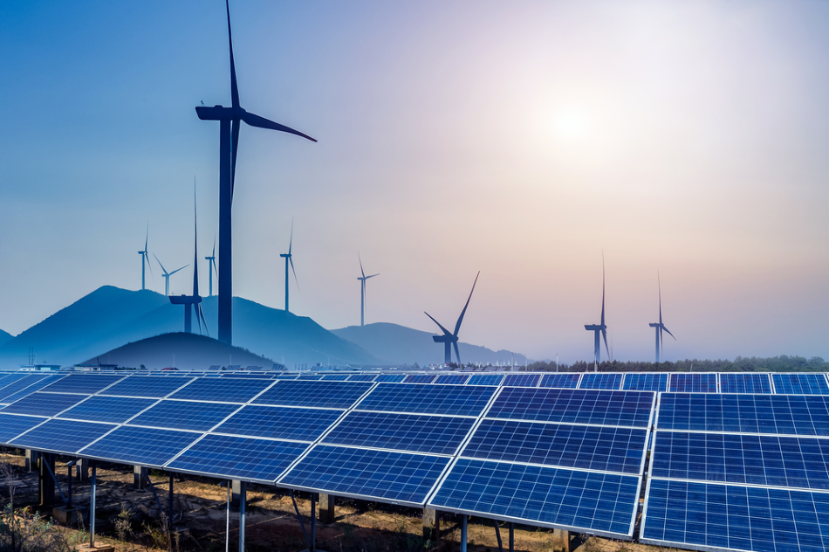
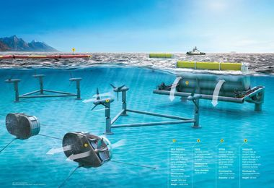
Renewable Energy
An energy source derived from natural resources which will not deplete when used. Examples of renewable energy include offshore and onshore wind, solar, geothermal power and tidal power.

Slide 16
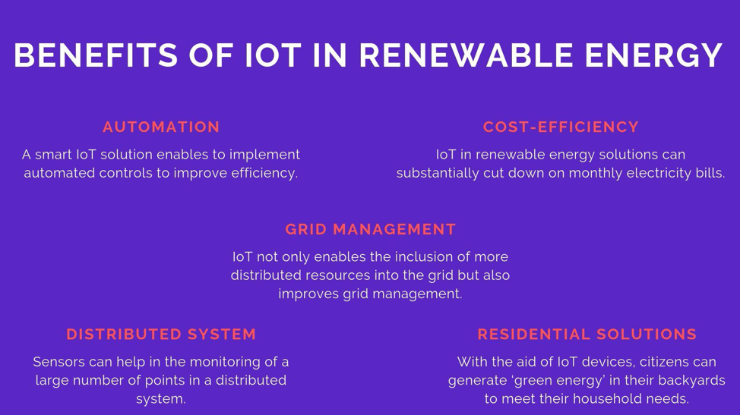
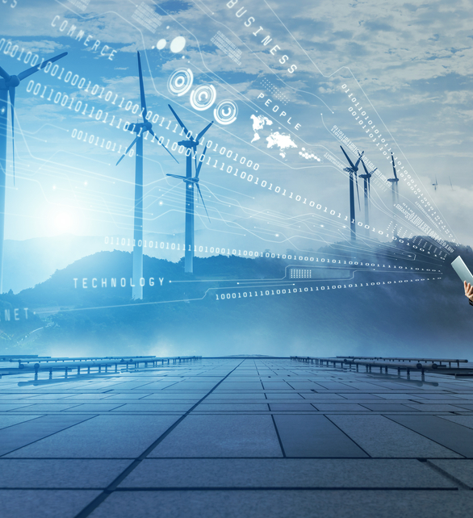
IoT in Renewable Energy Generation

Slide 17
Project – Pattern Printer
https://github.com/jianchentech/PythonLesson/blob/master/pythonProject/BeginnerProject/patternPrinter.md
Deadline: January 16 12:00PM, 2021

Slide 18
Merci !
Avez-vous des questions ?

