Slide 1
Big Mountain
Ticket Pricing
A Data Science Approach

Slide 2
We need to raise revenue or cut costs to pay for our new lift
We have a sense that our ticket prices might be a little low
We would like to consider a more scientific approach
Let’s use data science!

Slide 3
Key findings
At $81 weekend, our prices are already at the 80th percentile nationally (though the top 20% go as high as double).
We are already the highest-priced resort in Montana.
Based on competitive analysis there may be room for a $1.50 price increase.
Our data do not support a tool for a one-click price recommendation for proposed change scenarios. Try more-general data.
Our modeling is excellent at revealing the key factors that contribute to ticket prices.

Slide 4
Recommendations
Pricing is tricky–you can lose customers by pricing too high. Need more data on our customers. Need input from marketing.
Snow-making is extremely important (We are a leader in this area. Let’s not fall behind as we develop our mountain.)
The Data Science approach has merits. Let’s study our customers, local area, amenities next.

Slide 5
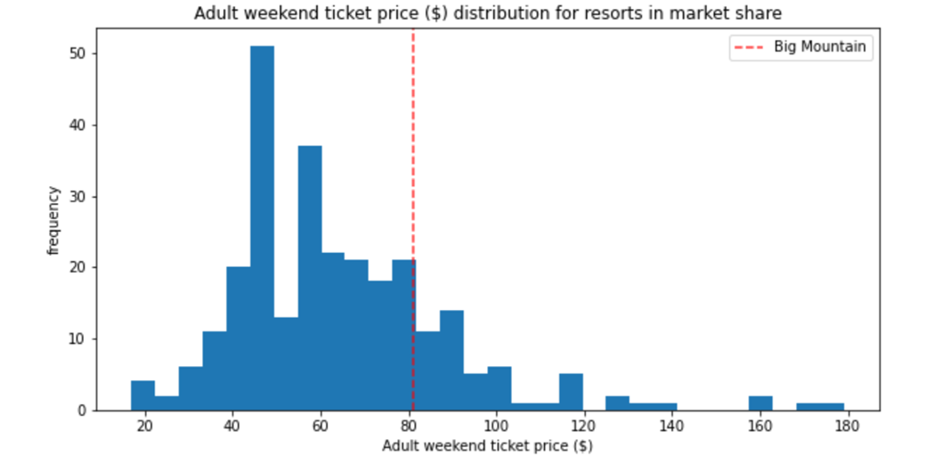
Modeling - Big Mountain price vs nation

Slide 6
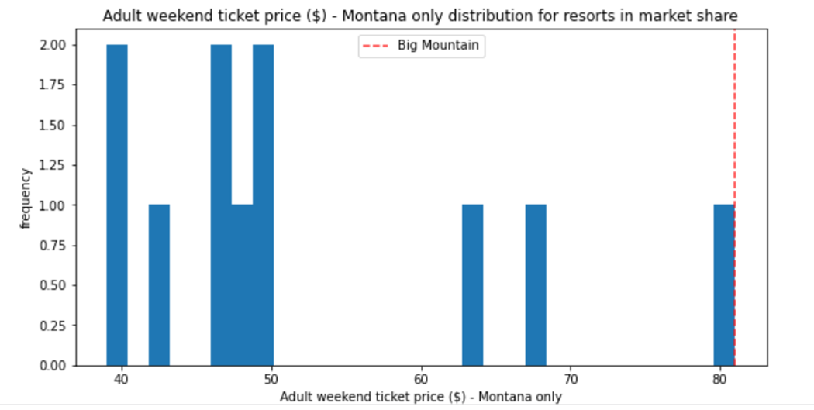
Modeling - Big Mountain price vs Montana

Slide 7
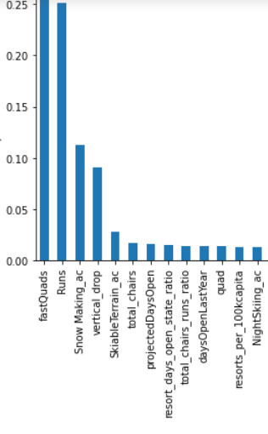
Modeling - What’s Important?
importance
features

Slide 8

Modeling - One click tool on analyzing changes
Data we have does not support this type of model
Incremental changes don’t move the needle much.
More runs and greater vertical = higher prices. Fine tuning prices in response = ??
On closing runs
Traffic flow? Marketing? Cost information?
Development vs. Un-development

Slide 9
Conclusions
Possible room for increasing prices, but pricing is tricky
Modeling led to in-depth analysis o Competitive position o Most important features: Number of runs, snow-making
Change analysis tool demos what we could build (and apply to more general data, less prospectively - more descriptively)

Slide 10
Conclusions - more
Need more data
Customers
local region
local amenities
Traffic-flow
Queue-length And more!

