Slide 1
Post Pandemic Housing Relocator Tool
Cuong Ha
Saidee Padilla
Jeremy Vargas

Slide 2
Project scope
User Story :
As a person looking to move
I would like to look up apartment rental rates
So that I can see what is affordable to me
Solution:
Our team developed a tool that provides the user with US rental market data which can be utilized to evaluate moving options in a Post-Pandemic economy.
The app provides information such as number of properties available, rental prices, property types, etc.
As an output, the app will produce a report of data pulled into CSV file.

Slide 3
Resources
Data Sources:
Zillow .com ➔ API (zwpid)
Rapid API (paid subscription from Rapid API.com)
Craigslist.com
Apartmentlist.com
Python
Libraries and Dependencies:
Questionary
Pandas
Hvplot
Matplotlib
Requests
Path
Time
Beautiful Soup
Fire
Holoviews

Slide 4


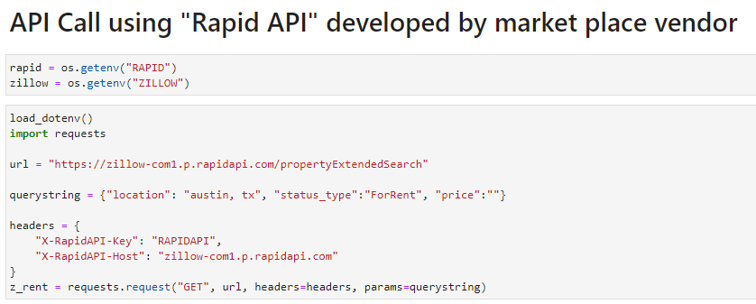


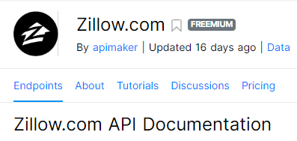
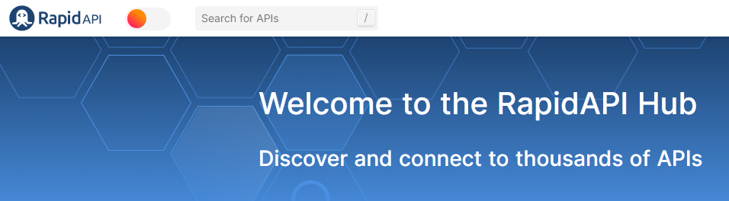

API Request code

Slide 5
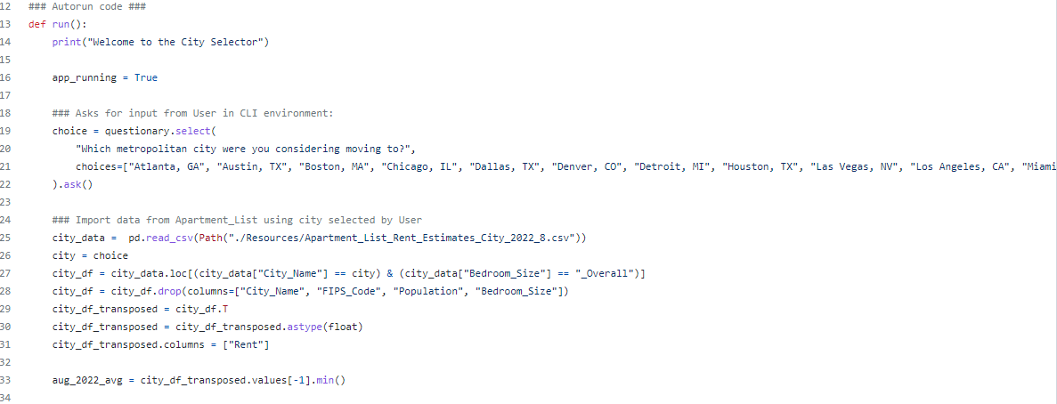
City Selector code

Slide 6
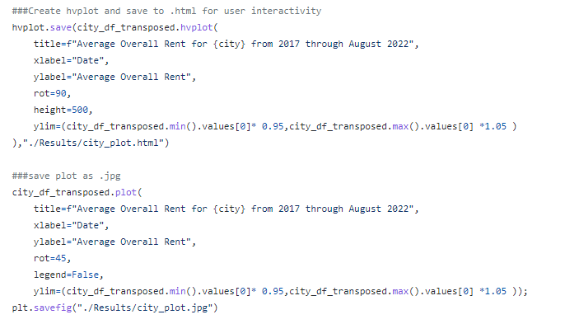
Graphs and Outputs

Slide 7
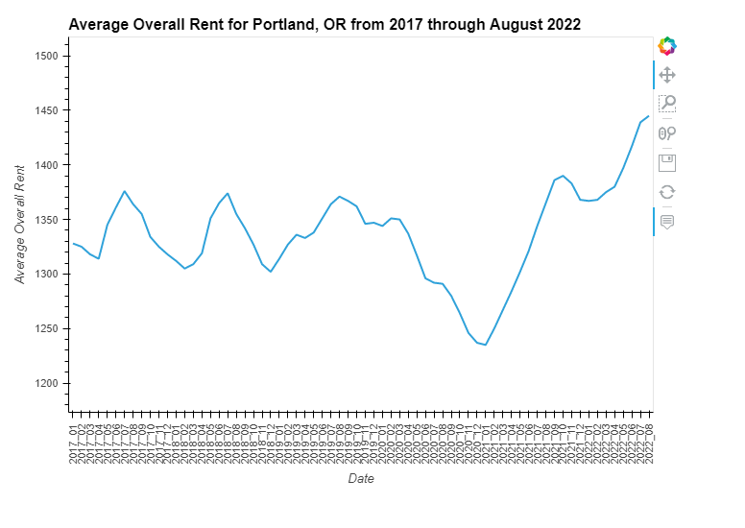
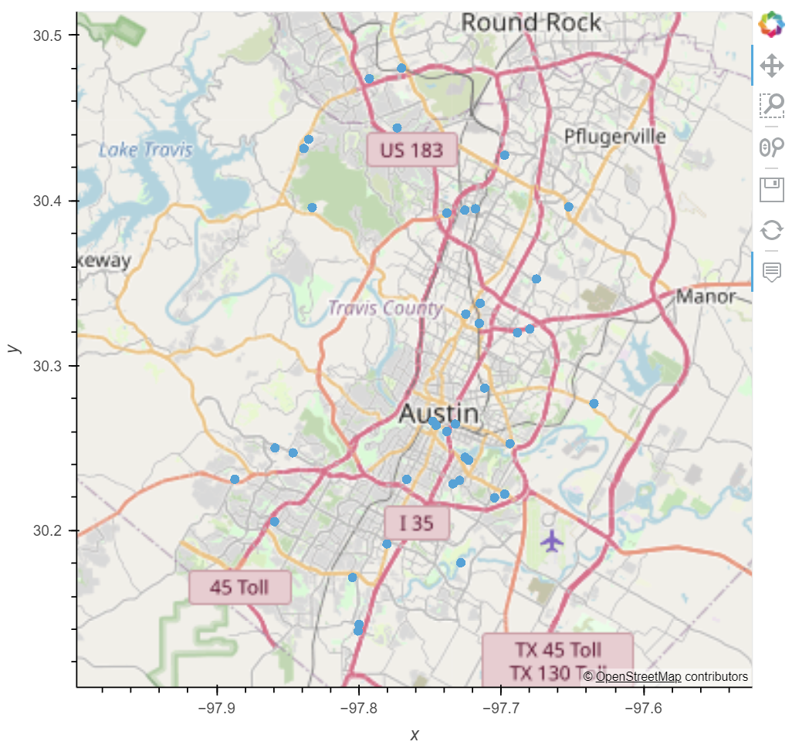
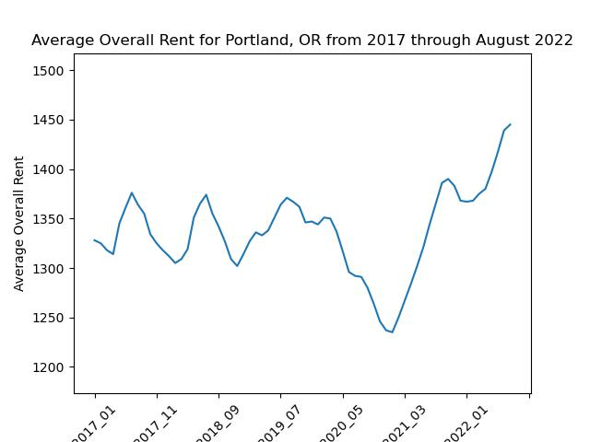
Outputs
Hvplot – available for view while app is running
Average rent in city selected 2017 to 2022
Jpeg – available as an output
Geolocation of apartments available for rent

Slide 8
Conclusion
What we accomplished
Wrote our first application in Python
Incorporated prior concepts from bootcamp modules
We used the Agile approach to software development
Pulled data from an API provided by a vendor, which was designed to have several restrictions.
Challenges and issues we encountered
Data quality, availability, cost of data acquisition
Data clean was very challenging
Minor changes in original scope
Could not find an API to provide “walk score”
Next
More cities
Improved reports
Job data per city selected

Slide 9
Questions?

