Slide 1
Health Insurance calculating chatbot by AWS Pay for insurance premium with ETHER or PayPal
by:
Austin Means
Jeremy Vargas
UW FinTech Bootcamp – Capstone Project - January 2022
Notes:
Introduction
Names
Github infro

Slide 2
Background – About this application
Purpose
Develop an application that would automate the selection and purchase of health insurance for a fictitious startup named FOR LIFE Health Insurance. Payment for the selected plan can be transacted upon plan selection and purchased via PayPal, and Ethereum.
Our approach
Created 4 health insurance products based on a 4-tier model. All plans were designed to start with a base premium and adjusted to increase based on several factors such as age and healthy habits such as smoking, drinking, or drug use.
User interacts with a chatbot, which would be hosted on a public website. The chatbot would ask questions to find age, and healthy habits.
The chatbot uses AWS Lambda function to calculate the 4 medical coverage premium prices labeled as “Bronze”, “Silver”, “Gold”, “Platinum”. These are saved in an AWS 3S bucket.
A Streamlit web application calls the prices saved in the S3 bucket and interacts with the user creating the offering and allowing for the purchase to be completed on the same page.
User can complete the purchase using PayPal or Ethereum.

Slide 3
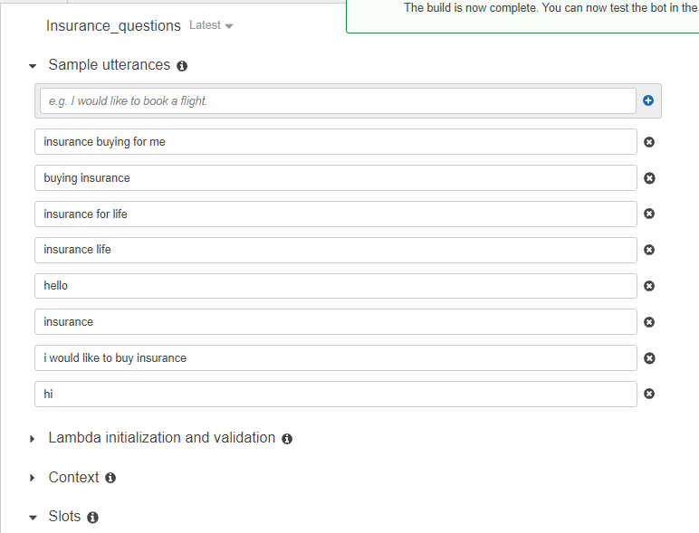
AWS Lex Chat Bot
Utterances
These are some sample utterances to start the conversation with the chatbot

Slide 4
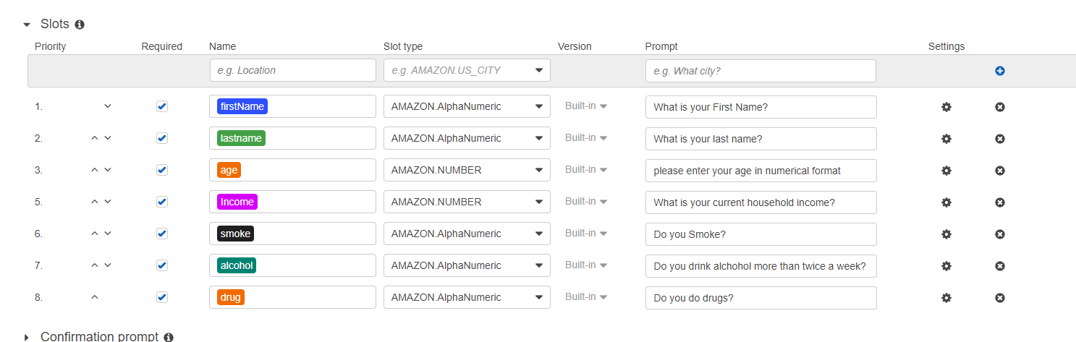
AWS Lex Chat Bot
Slots and dialog

Slide 5
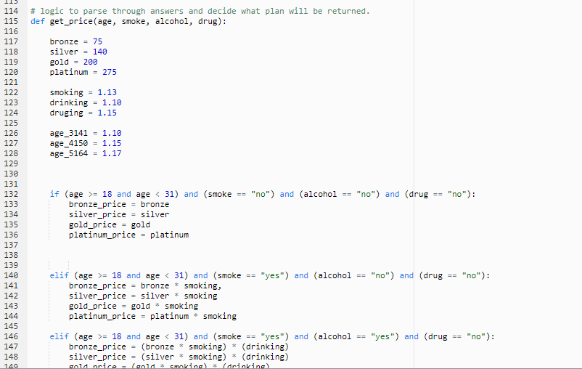
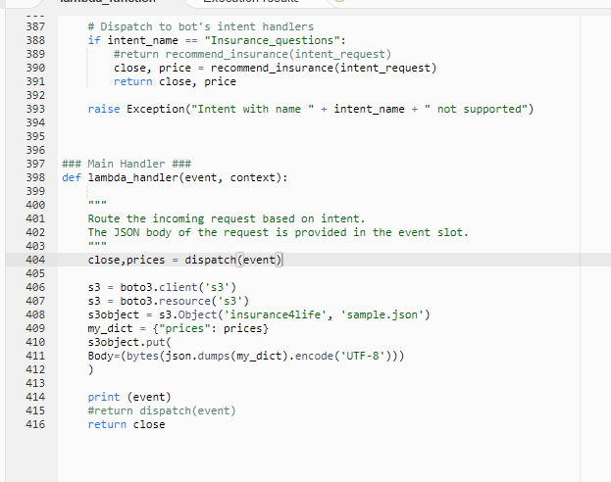
AWS Lambda
Function to calculate prices of insurance plans
Lambda handler routing to S3

Slide 6
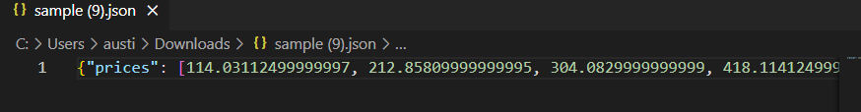
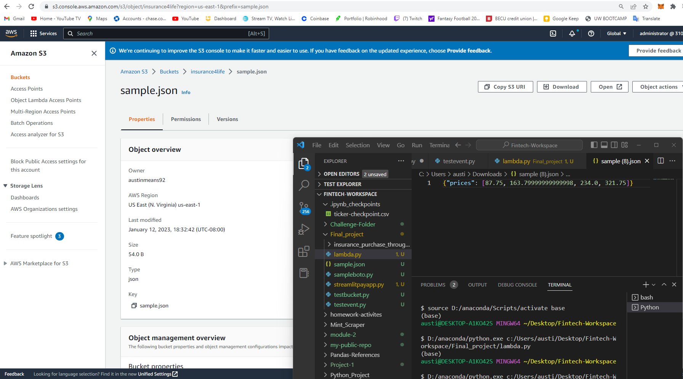
AWS S3
Amazon S3 bucket to save .json file with prices.
.json file with calculated prices
[bronze, silver, gold, platinum]

Slide 7



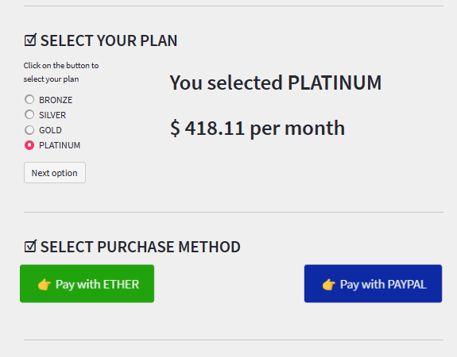
Streamlitpayapp.py
“For Life Health Insurance” - offering and purchase site

Slide 8

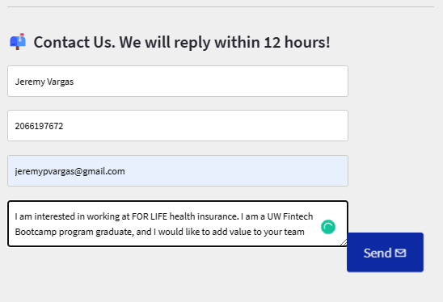
Streamlitpayapp.py
Other features

Slide 9
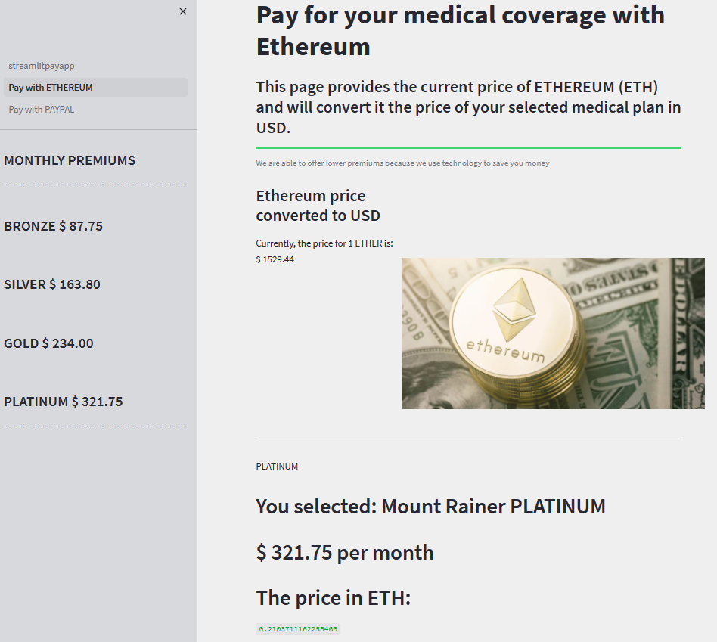
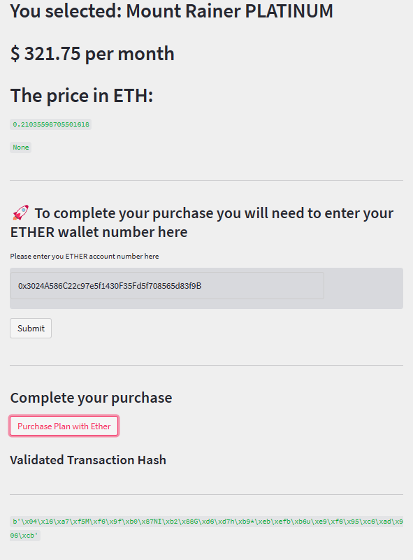
Streamlitpayapp.py
Pay with ether - subpage

Slide 10

Streamlitpayapp.py
Pay with PayPal - subpage

Slide 11
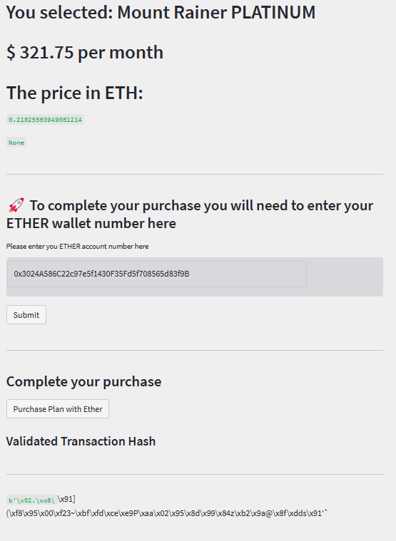
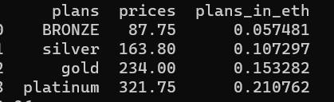
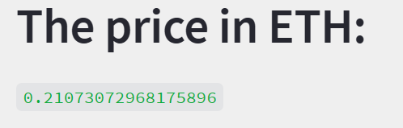
Application tested – part 1
Prices extracted from AWS S3 json file and calculated
API call to CoinGecko to retrieve ETHER price and subsequent price calculations

Slide 12
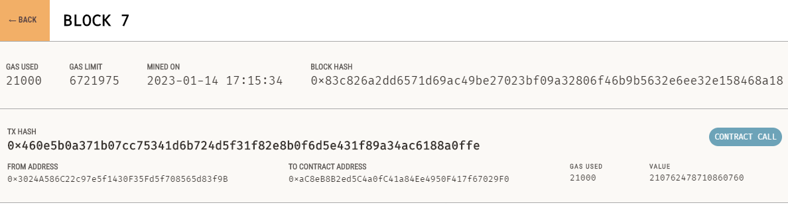
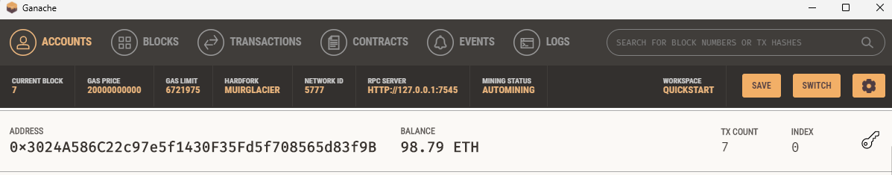
Application tested – part 2
Ganache account balance reduced
Transaction – contract call
Hashtags

Slide 13
Discussion
Challenges
Time constraints and Unknown – Unknowns
Next steps (if we had more time)
Include additional logic for pricing based on income, number in household, discounts for military status or other health habits such as diet, exercise, etc.
Hosted chatbot on a website
Find new way to host website for improved functionality and better user experience
Include secure encrypted features and a way to save user profiles or create accounts.
Included smart-contract features functions to formalize purchase of premium through public blockchain.

Slide 14
Questions & Answers
Find our code in GitHub:
Austin Means
aimeans (github.com)
Jeremy Vargas
JeremyPVargas (Jeremy Vargas) (github.com)

Slide 15
Thank you

