Slide 1
QuickCheck Case Study(User Data Clusters)
By Jeremiah Odigie

Slide 2
CONTENT
Introduction
Data Description
Data preprocessing
Methodologies
Cluster Analysis
Recommendation
Conclusion

Slide 3
INTRODUCTION
Project overview: The User Data Clustering Project aims to segment customers of a loan company into distinct groups based on their financial behavior and engagement metrics.
By leveraging advanced clustering techniques, such as KMeans and Hierarchical clustering, the project seeks to uncover meaningful patterns and insights that can drive targeted marketing strategies and improve customer engagement.

Slide 4
DATA DESCRIPTION
The data is a loan company data having the following columns:
loan_score: Indicates the creditworthiness of customers.
bureau_score: Reflects the financial history as reported by credit bureaus.
device_rating: Evaluates the quality and usage of devices used by customers.
data_quality: Measures the accuracy and completeness of customer data.
ltv_rate: Loan-to-Value ratio, indicating the risk associated with the loans.
total_tenure: Total duration of the customer's relationship with the company.

Slide 5
DATA DESCRIPTION
months_active: Number of months the customer has been actively using the services.
savings_score: Reflects the customer's savings habits and stability.
tx_score: Transaction score, indicating the frequency and value of transactions.
usage_score: Reflects the overall usage and engagement with the company's services.
airtime_score: Evaluates the customer's usage of airtime or communication services.

Slide 6
DATA PREPROCESSING
Data cleaning: The data had no missing or duplicate values.
Outlier detection: Outlier values were detected in each of the data columns
Flooring and capping techniques were used to treat these outliers but this affected the Hopkins test score poorly. This meant we had to use the original data.

Slide 7
METHODOLOGIES
The Hopkins test was caried out on the dataset to verify its suitability for clustering. The test produced about 95% which makes the data highly suitable for clustering.
Two clustering techniques were performed on the data which are Kmeans and Hierarchical clustering techniques.

Slide 8
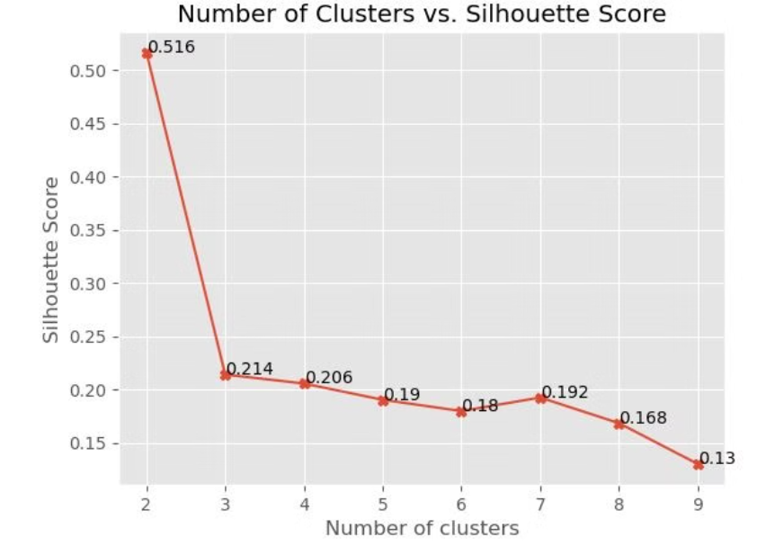
METHODOLOGIES
Using the Elbow method, Kmeans clustering showed that there are about three to four clusters that can be derived from the data.
Elbow point

Slide 9
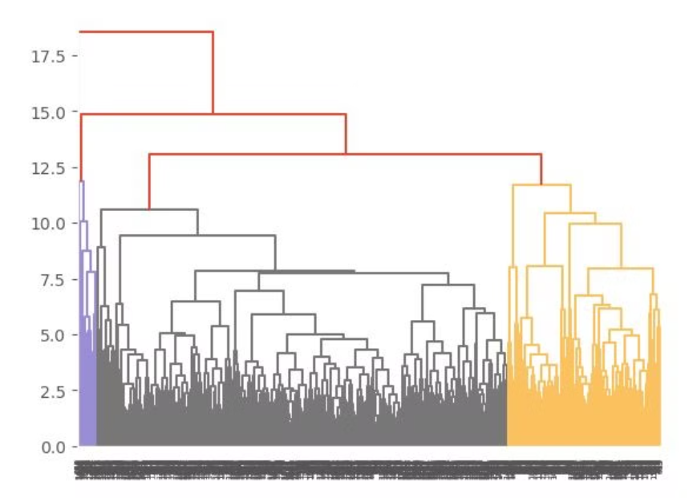
METHODOLOGIES
Using the dendogram plot, the hierarchical clustering showed only three visible clusters that can be created from the data.
Dendogram plot

Slide 10
METHODOLOGY
After applying the two techniques to the data, Kmeans proved to be the best for creating up to four clusters, while hierarchical could only create three accurate cluster.
Kmeans technique was chosen to create the clusters

Slide 11
CLUSTER ANALYSIS
The distribution of the clusters by the average value of their features is as follows:
Cluster 0: Moderate loan score (7.19)
Average device rating (0.61)
Very low data quality (0.12)
Short total tenure (13.43 months)
Low months active (34.80)
High savings score (0.99)
Moderate transaction score (3.41)
Low usage score (0.61)
High airtime score (10.48)

Slide 12
CLUSTER ANALYSIS
Cluster 1: Higher loan score (8.49)
Lower device rating (0.53)
Moderate data quality (0.50)
Shorter total tenure (15.36 months)
Highest months active (63.25)
Very high savings score (0.99)
Lower transaction score (3.04)
Highest usage score (1.28)
Lower airtime score (9.50)

Slide 13
CLUSTER ANALYSIS
Cluster 2: Highest loan score (10.12)
Lowest device rating (0.39)
Moderate data quality (0.47)
Shortest total tenure (10.65 months)
Lowest months active (28.85)
Highest savings score (0.99)
Moderate transaction score (3.21)
Moderate usage score (0.72)
Highest airtime score (10.82)

Slide 14
CLUSTER ANALYSIS
Cluster 3: Moderate loan score (8.16)
Average device rating (0.53)
Low data quality (0.29)
Longest total tenure (27.12 months)
Highest months active (89.42)
High savings score (0.99)
Moderate transaction score (3.29)
Low usage score (0.63)
Moderate airtime score (9.89)

Slide 15
CLUSTER ANALYSIS
Customer Segment Interpretation:
Cluster 0: Low-engagement, short-term customers with moderate potential
Cluster 1: Active, high-usage customers with good loan potential
Cluster 2: High-potential, high-loan-score customers with limited activity
Cluster 3: Long-term, stable customers with extended engagement

Slide 16
RECOMMENDATION
Cluster 0 ("Emerging Prospects"):
Develop entry-level loan products
Focus on building credit history
Implement educational programs about financial services
Cluster 1 ("Active Engaged Users"):
Create premium loan products
Offer loyalty rewards
Develop cross-selling opportunities based on high usage

Slide 17
RECOMMENDATION
Cluster 2 ("High-Potential, Low-Activity"):
Design activation campaigns
Provide incentives for increased platform usage
Create tailored loan products leveraging high loan scores
Cluster 3 ("Loyal Long-Term Customers"):
Implement retention programs
Develop exclusive long-term customer benefits
Create specialized products for seasoned customers

Slide 18
CONCLUSION
The cluster analysis reveals distinct customer segments with varying potential and risk profiles. The segmentation shows a clear progression from emerging customers to established, long-term users.
The high variation in loan scores (7.19 to 10.12) and engagement metrics (months active ranging from 28 to 89) indicates diverse customer needs and behaviors.
By leveraging these insights, the loan company can optimize its offerings, improve risk assessment, and enhance customer satisfaction through targeted services.

