Slide 1
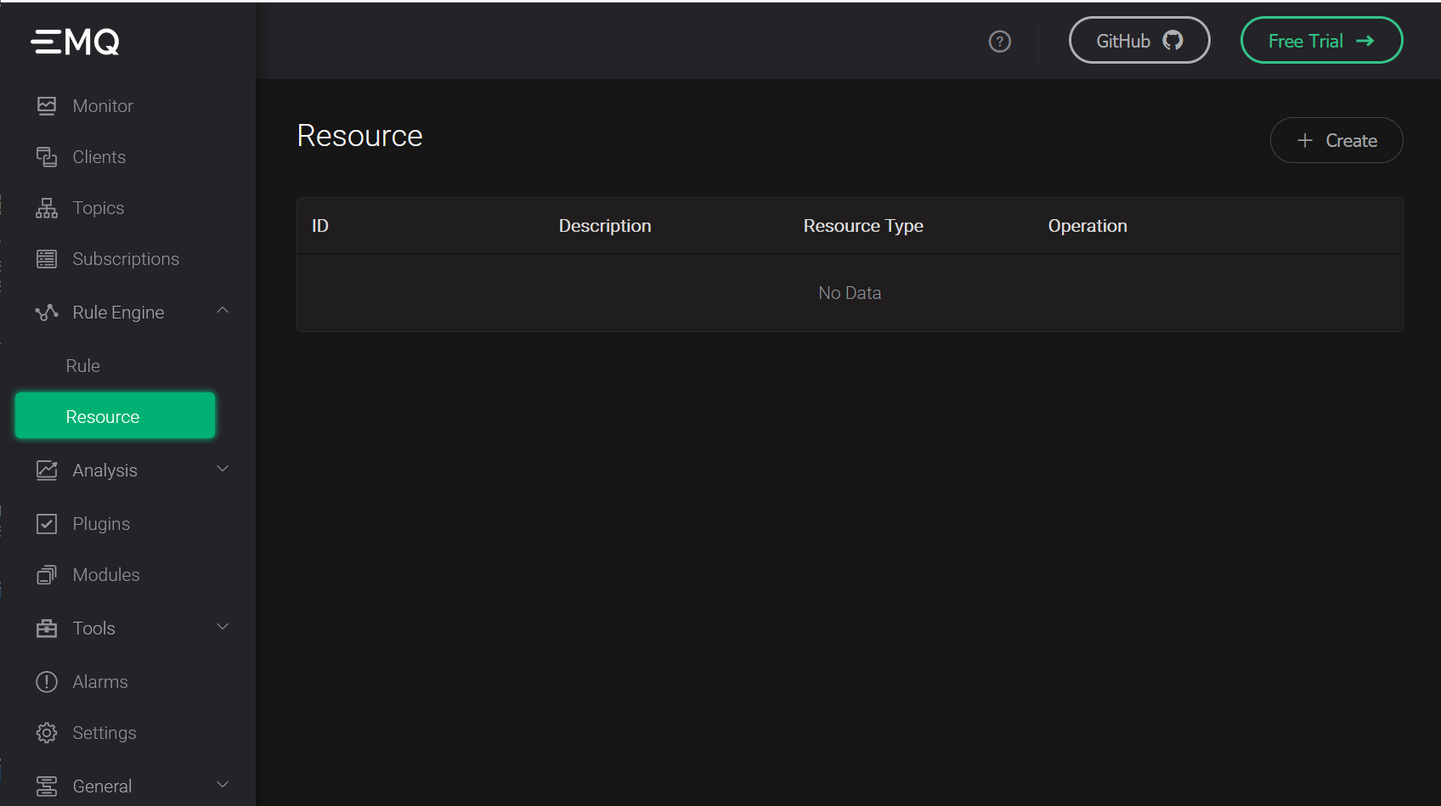
Create new Resource

Slide 2
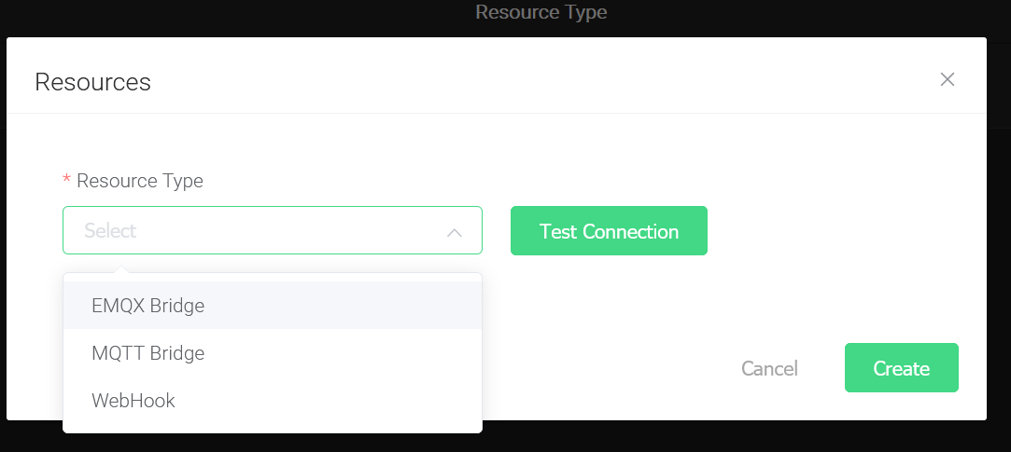
Select MQTT bridge

Slide 3
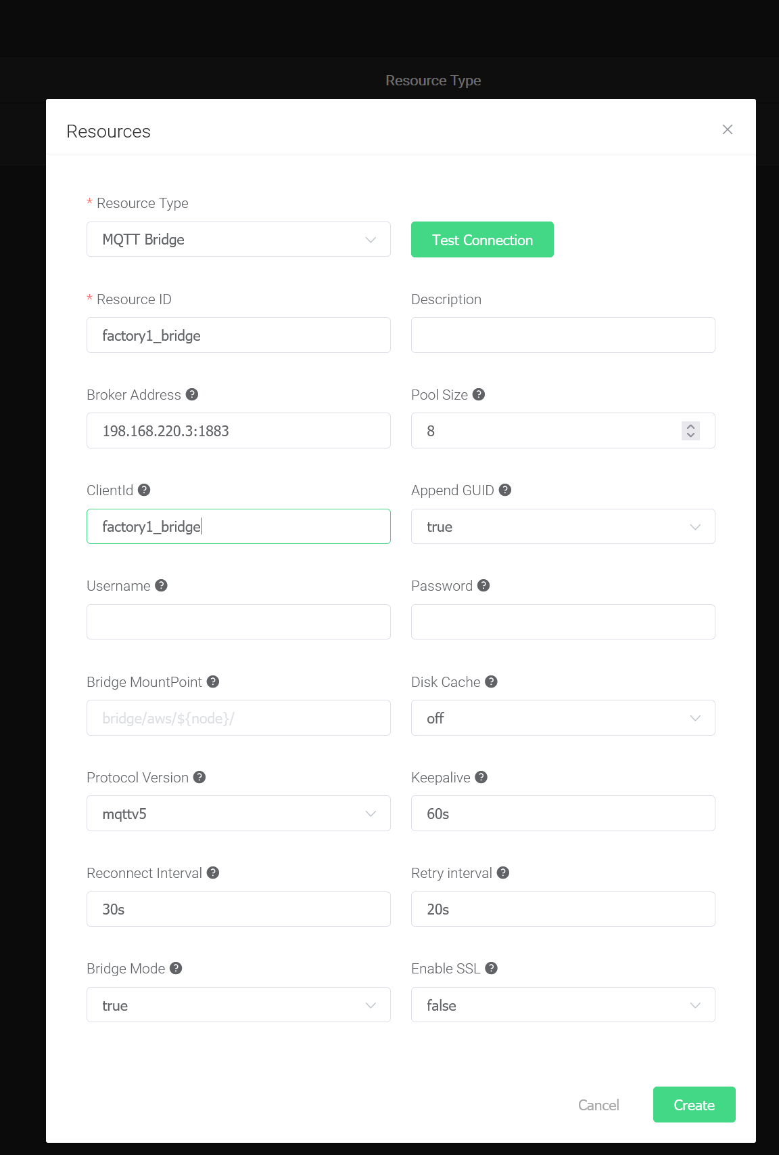
2. Give Meaningful client name to edge cluster
3. Username & Password of enterprise broker
1. Address of the Corporate MQTT Cluster
4. Set protocol to MQTT5
5. Test Connection before creating resource

Slide 4
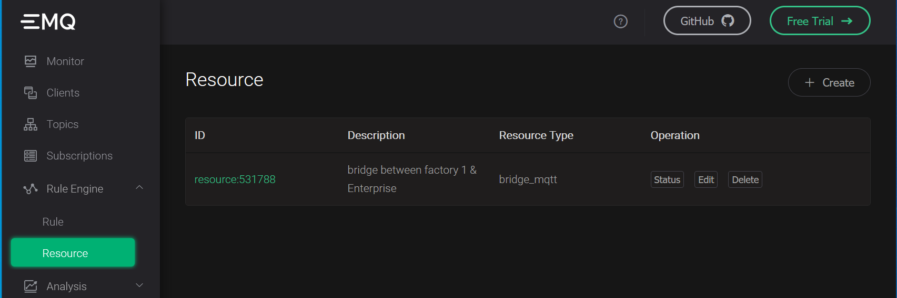
Resource successfully created

Slide 5
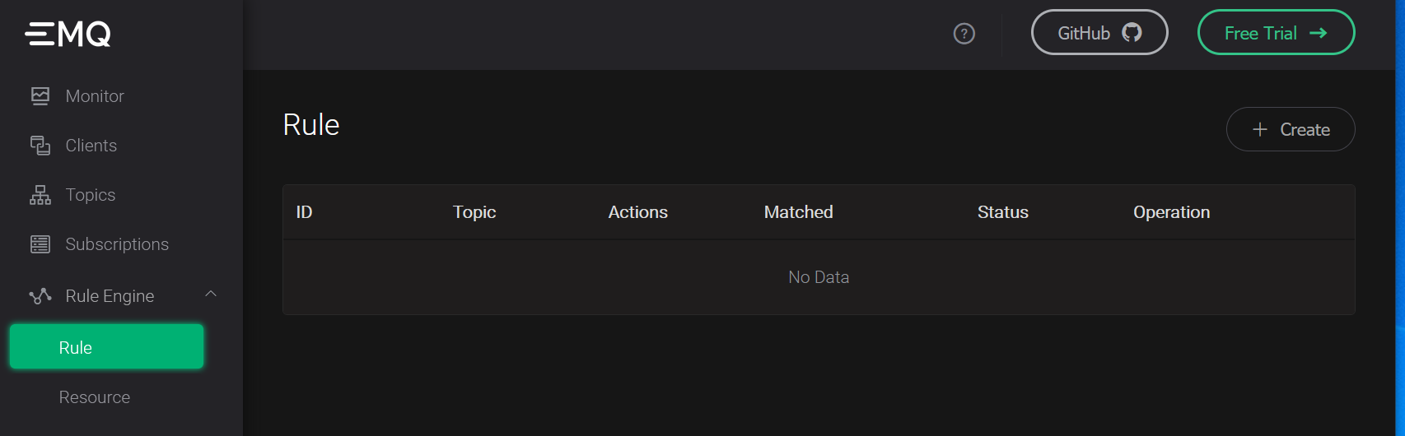
Create new rule

Slide 6
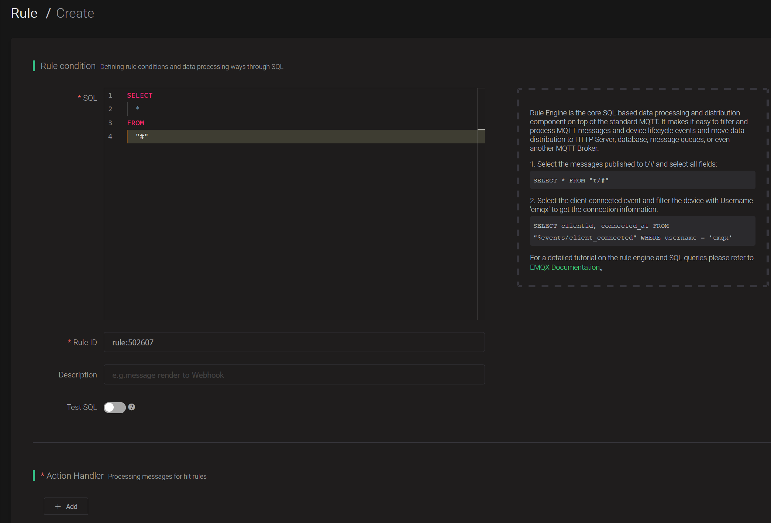
Provide Rule Condition ( currently set to send all messages). If required to filer user where clause e.g. filter topics being bridged
Add Action Handler

Slide 7
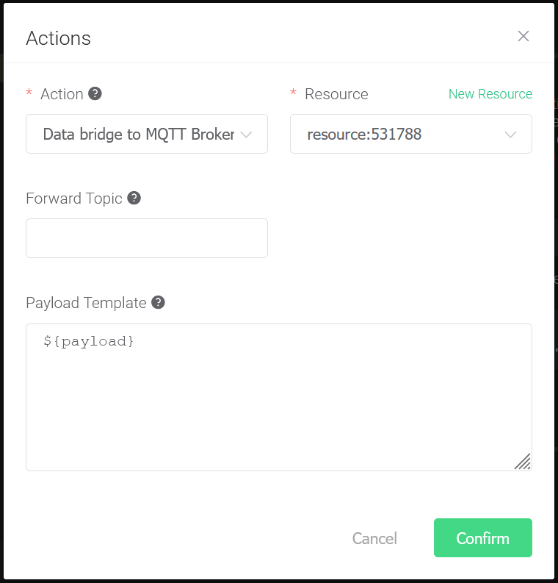
1. Select Data bridge to MQTT broker
2. Select Resource ( id should match the one you created earlier)
3. Set the payload template to ${payload} to have just the message sent

Slide 8
