Slide 1

Visualization For Citi Bike Transportation Data
Tugce Ozdemir, Rui Liu, Zilin Xu

Slide 2
Introduction
Why Citi bike?
Largest bike share system in the US
90,000 rides per day
13,000 bikes, 800 stations
Ride data is arbitrary and hard to see the correlations
within dataset

Slide 3
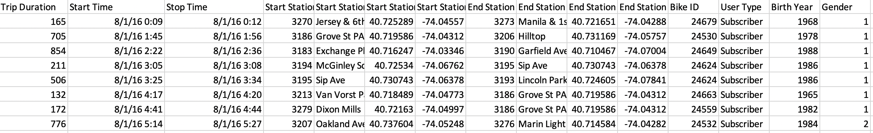
Dataset
Data size: 42k

Slide 4
Related Work
1.Outlier Detection in Bus Routes of Rio de Janeiro
2.Visual Exploration of Big Spatio-Temporal Urban Data: A Study of New York City Taxi Trips

Slide 5
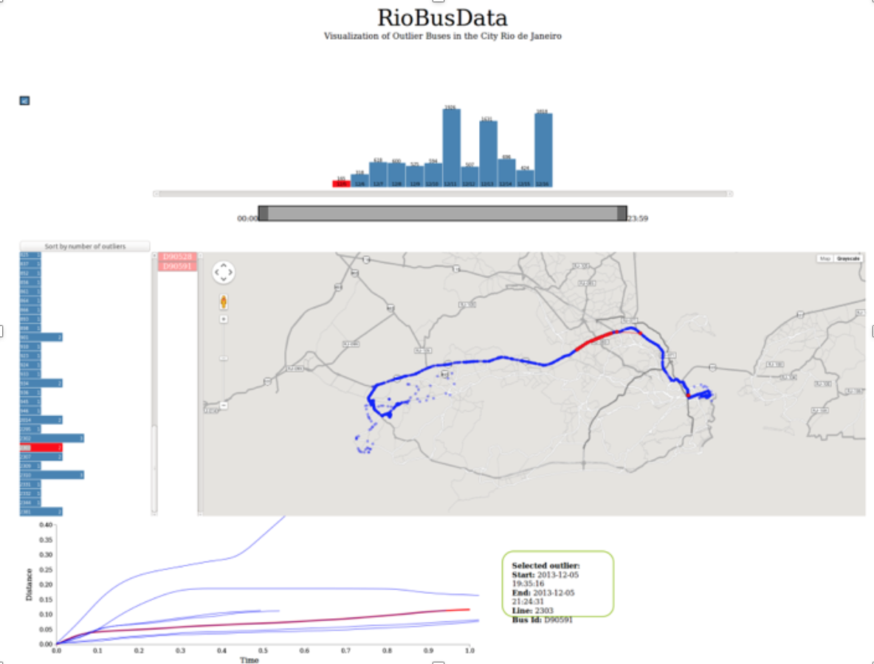
Outlier Detection in Bus Routes of Rio de Janeiro

Slide 6
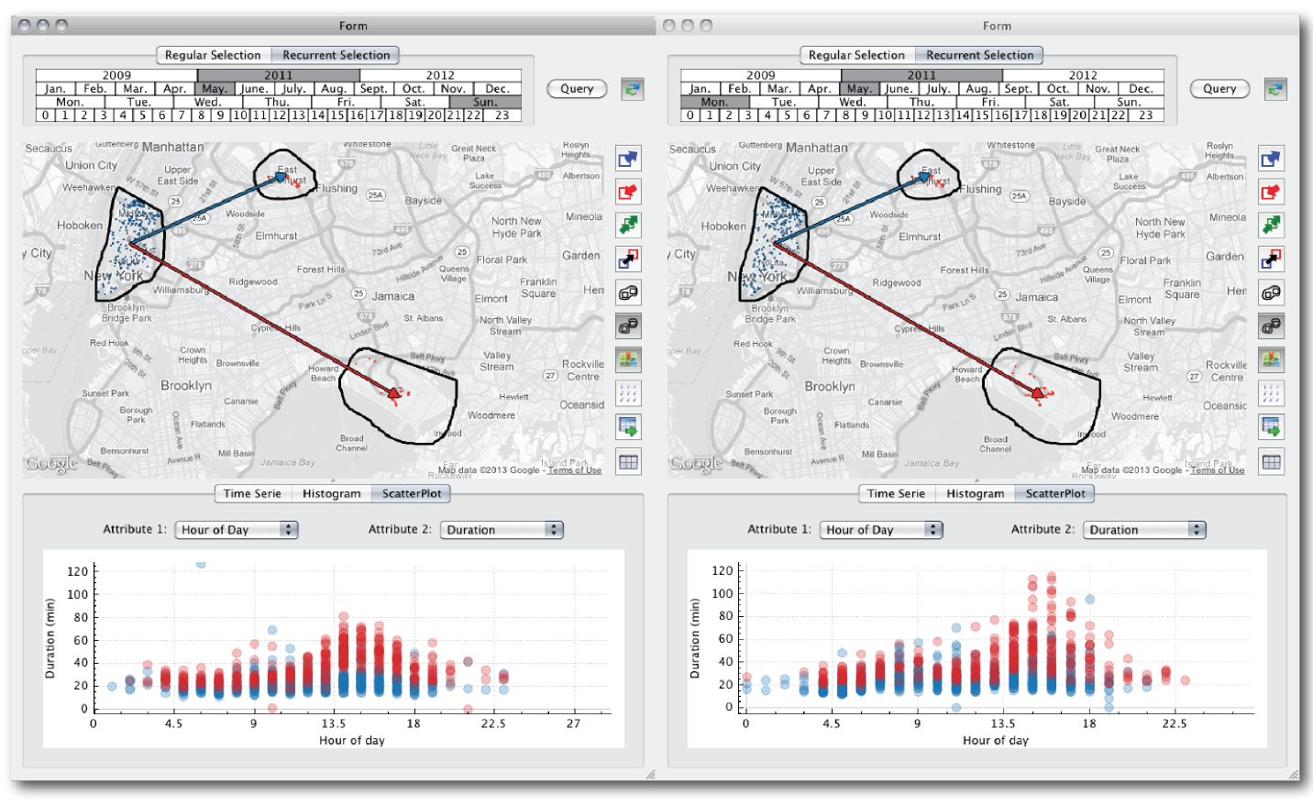
A Study of New York City Taxi Trips
Time selection widget
Map
Tool bar
Data summary

Slide 7
Contributions
(i) Which stop is used more frequently (the most popular stops)?
(ii) What is the distribution of trip duration at all time during the day (morning-afternoon-evening)?
(iii) How long does it take between 2 stops (Duration between 2 stops)?

Slide 8
Task line
Tugce: Scatter plot, Interactive table
Rui: Line chart, Pie chart
Zilin: Parallel Coordinates, Interactive units

Slide 9
Method
Local time based:
Pie chart: to show top frequent stations
Scatter plot: to indicate the relationship between start time and trip duration
Parallel coordinates: to overview data relation in high dimension
Station based:
Line chart: to display trip duration between any two specified station

Slide 10
Demo Presentation
http://127.0.0.1:8050/

Slide 11
Summary
Our visualization tool is able to help people clearly see the most frequent stops/ time duration with all freedom
It not only helps citizens to arrange their trip, but also help bike company to restructure stops more reasonably.

Slide 12
Reference
Ferreira, Nivan, Jorge Poco, Huy T. Vo, Juliana Freire, and Cludio T. Silva. “Visual exploration of big spatio-temporal urban data: A study of new york city taxi trips.” Visualization and Computer Graphics, IEEE Transactions on 19, no. 12 (2013): 2149-2158.
Aline Bessa, Fernando de Mesentier Silva, Rodrigo Frassetto Nogueira. “Outlier Detection in Bus Routes of Rio de Janeiro”. In Symposium on Visualization in Data Science, IEEE VIS, Chicago, Illinois, US, 2015.

