Slide 1
Lecture 3: Informed Search
Shuai Li
John Hopcroft Center, Shanghai Jiao Tong University
https://shuaili8.github.io
https://shuaili8.github.io/Teaching/CS410/index.html

Slide 2
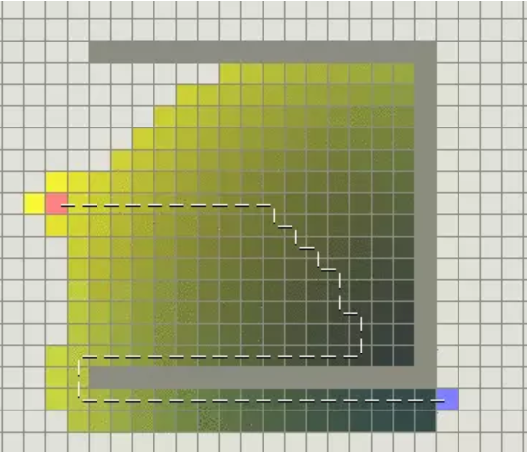
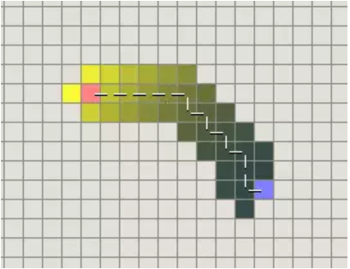
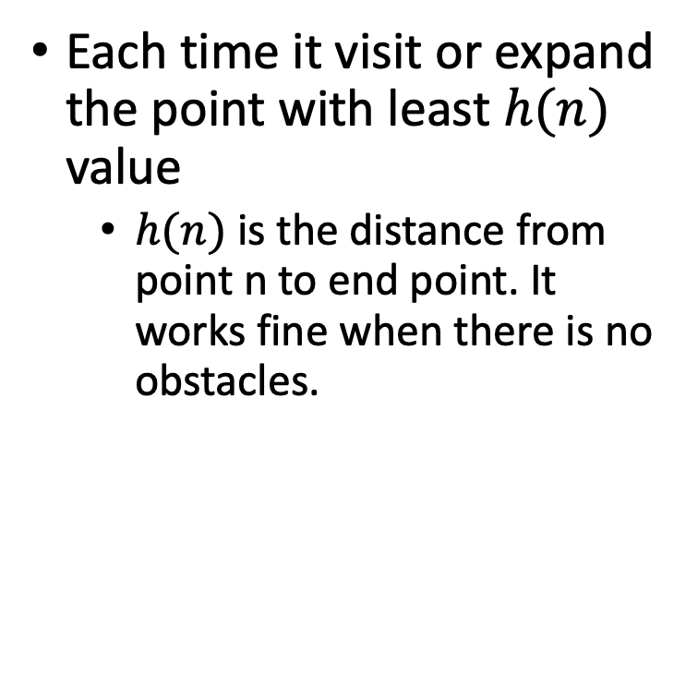
Greedy Searching
Each time it visit or expand the point with least $h(n)$ value
$h(n)$ is the distance from point n to end point. It works fine when there is no obstacles.
The cost doubles when there is obstacles

Slide 3
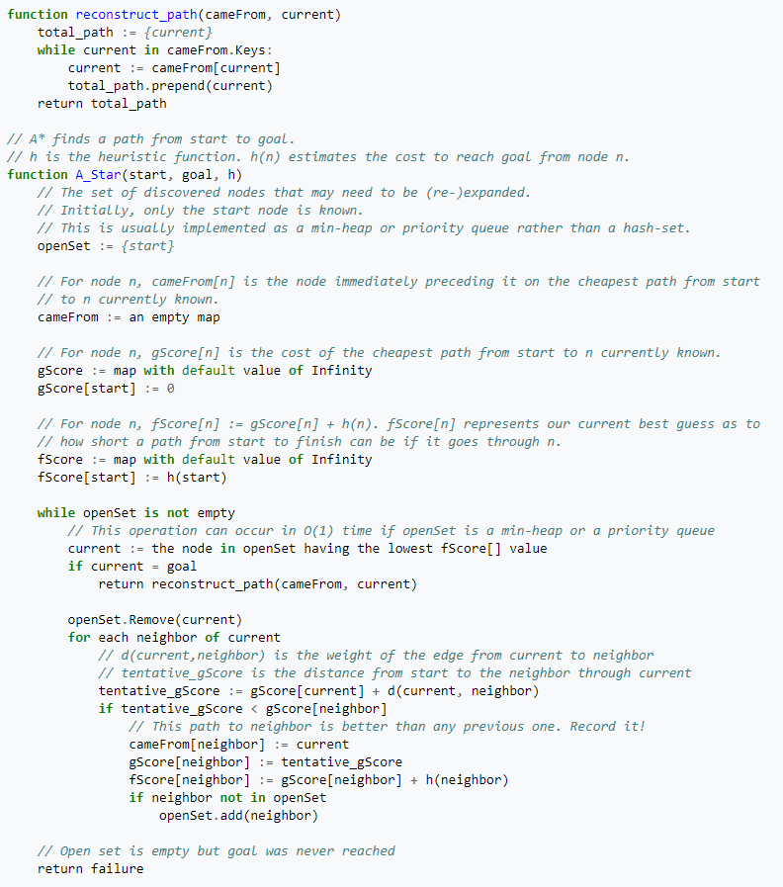
A* Algorithm

Slide 4
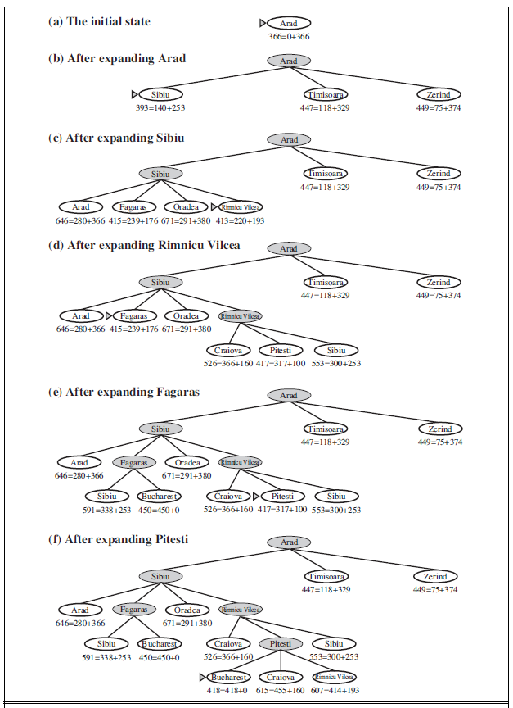
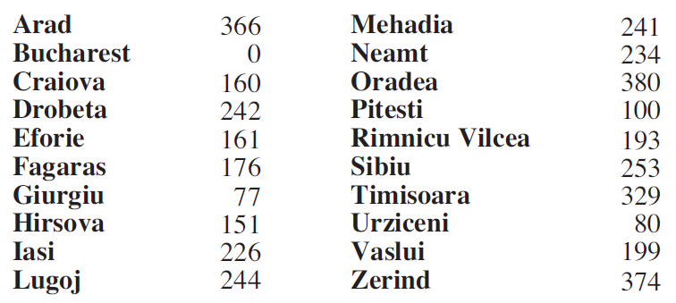

Slide 5
UCS vs A* algorithm

