Slide 1
BeSolveRD Solving the unsolved rare diseases
Peter Van Hauwe
Executive TAM, Belgium

Slide 2
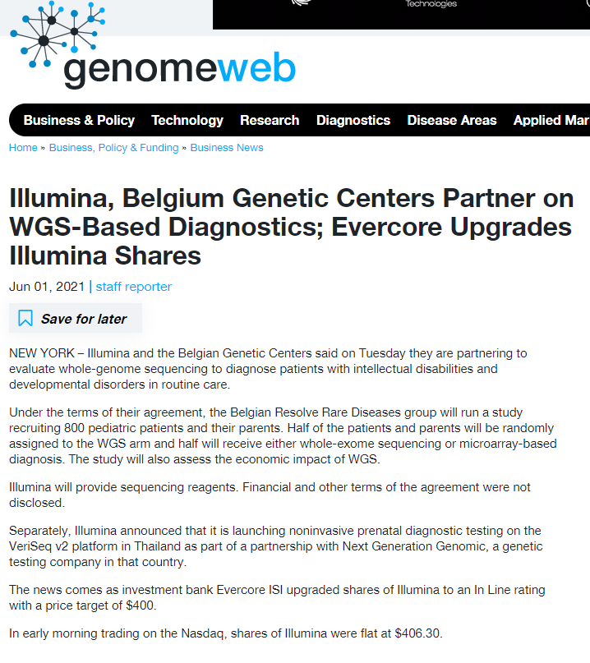
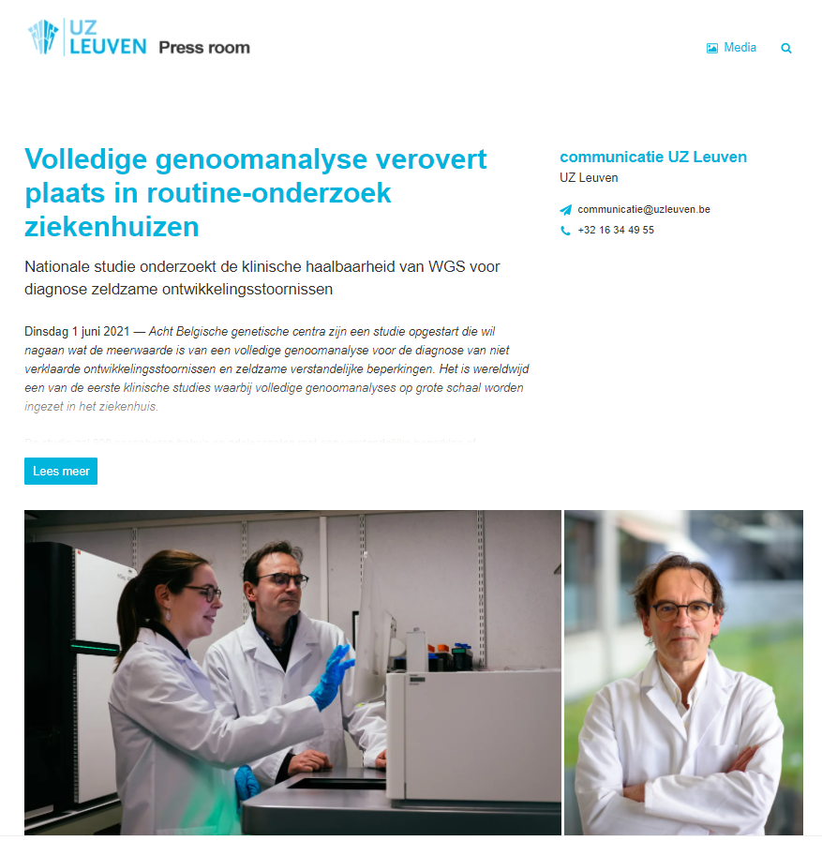
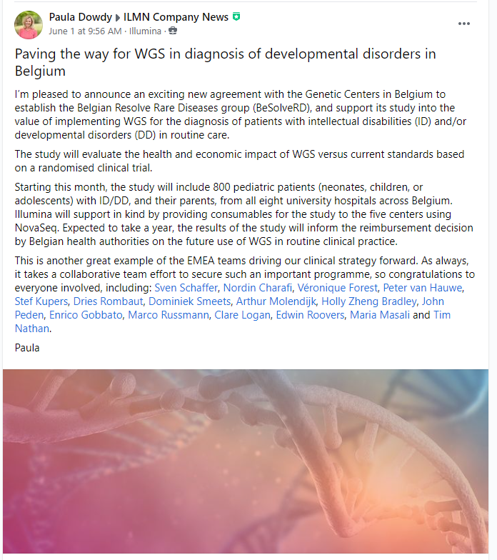

Slide 3
Agenda
1
Diagnostic genetic landscape Belgium
2
BeSolveRD
3
What will we get in return?
4
Key learnings

Slide 4
Genetic diagnostic landscape Belgium
How they are organized
How they are funded
RUGD testing
8 medical genetic centers
All linked to university hospital and university
Use a central sequencing facility
5/8 centers have a Novaseq
All labs are ISO15189 accredited
Reimbursement levels according to complexity of test
Level 3 (eg WES): 1.407 euro
Level 2 (eg arrays): 570 euro
Only analysis of index patient is reimbursed
Fixed envelope of €42,65 M per year
SoC: WES + array
Incidence: 4%
Average time for diagnosis: 4 years
Average TAT sample to result is 8 – 12 months
Around 20.000 WES/year

Slide 5
BESolveRD Solving the unsolved rare diseases
What is the project about ?
01
Technical validation of WGS workflow in 5 testing labs.
02
Demonstrate clinical utility of WGS
Nationwide study
2-arm RCT against WES/array
800 trio’s with ID/DD will be included in study
Illumina supports study with reagents
03
Assess health economic impact
04
Support reimbursement of WGS

Slide 6
Work packages
01
Patient selection criteria.
02-04
Technical evaluation of wet lab and bioinformatics
05
Diagnostic Analytical validation.
06
Clinical impact.
07
Health Economic impact.
08
Implementation in Health Care.

Slide 7
BESolveRD from casual conversation to implementation
2019 | 2020 | 2021 | 2022
First contact
Handover to SA and MA
Fine tuning study design
Finalize collaboration agreement and EC approval
Validation of WGS workflows
Engagement of reimbursement authorities (MOH, RIZIV)
Press release (01/06)
Start of patient recruitment and study

Slide 8
What do we get in return?
Seat at the table of a pivotal study in Belgium
Treasure trove of data for our Medical Affairs organisation
How are our products performing in a real world routine setting?
What hurdles exist in implementing WGS in a routine setting?
Paving the way towards reimbursement
NGS focus drives commercial leads
Novaseq opportunity at UCL Saint-Luc Medical Genetics
Two customers will implement illumina PCR-free in routine
Several customers interested in Trusight Software Suite
Total available market of 20.000 samples per year

Slide 9



Key learnings
Know your customer
Build your dream team
Be patient

Slide 10
Build your dream team
BeSolveRD
Scientific Affairs
Market Access
Local Sales team
Bioinformatics support team
Marketing
Legal
Public Relations
Clinical support team
Local FAS team

Slide 11
Build your dream team
BeSolveRD
8 CMG
KCE
Clinical trial unit
Dept of Economics
Legal
Public Relations
Belgian college of genetics
Joris Vermeesch

Slide 12
Thank You
Peter Van Hauwe
08.06.2021| pvanhauwe@illumina.com

