Slide 1

Success Story: Molecular Pathology Trier
Today’s Date
Benjamin Farnung
TAM Germany West Clinical

Slide 2
Introduction to the account
1
Part of Sonic Healthcare
2
Prospect account since 2015
3
Largest German private pathology lab: 150,000 spl/year
4
Processing 800 -1000 NGS spl/year
5
Longstanding TMO customer
6
Technological leader

Slide 3
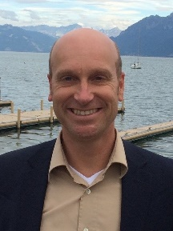
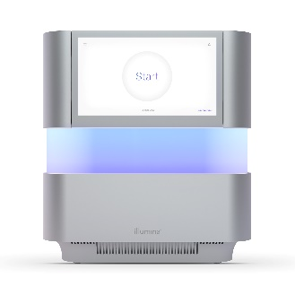
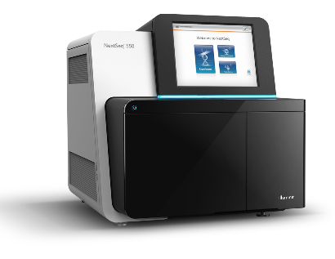
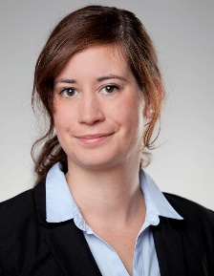
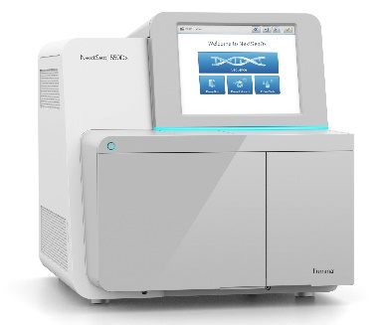
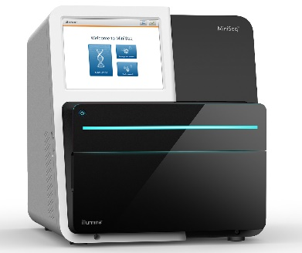
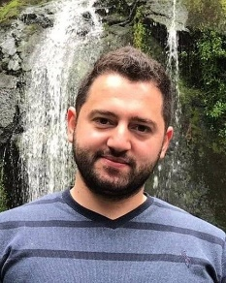
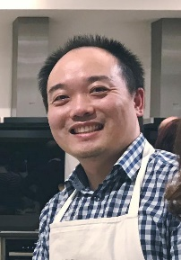
Team & deal
OSS: Andreas Keck
+
Comprehensive panel
NextSeq 550 or 2000
FAS: Christina Roth
Ampliseq for Illumina training
+
TSO500 training
+
+
+
TSO500
FSE: Feras Lutfi
NextSeq 550 Dx
MiniSeq
2020 revenue: $343k 2021 pot. revenue: $420k
Onc FAS: Mai Sun

Slide 4

Call to action
Persistence – get back to TMO oncology customers
Right timing (TMB, MSI)
Utilise the IVDR

