Slide 1
COVIDSeq Adoption by Randox Laboratories
11th March 2021
Jonathan McHugh PhD
Executive Account Manager, Northern Ireland

Slide 2

COVID-19

Slide 3
Agenda
1
Background on Randox
2
COVID-19 Action Plan
3
Incorporation of NGS
4
Key Learnings

Slide 4
Global Reach
Background on Randox
1982
Dr Peter FitzGerald
1500 Employees
145 Countries
$153M Revenue in 2018

Slide 5
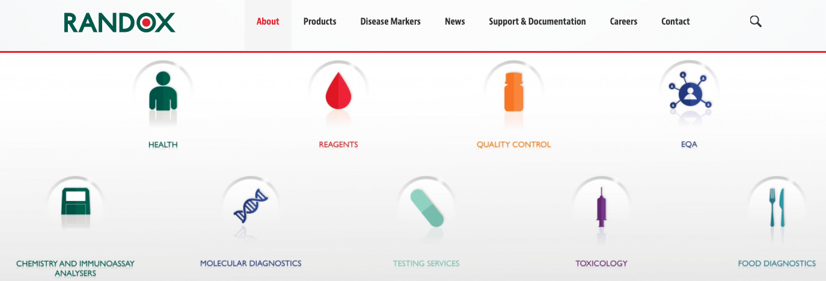
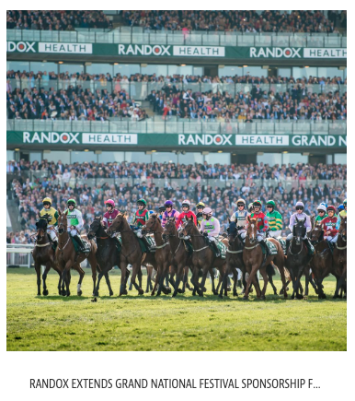
Market Focus
Background on Randox

Slide 6



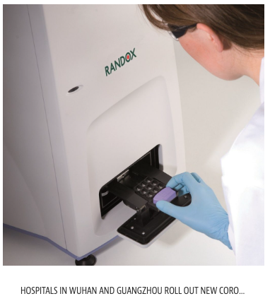
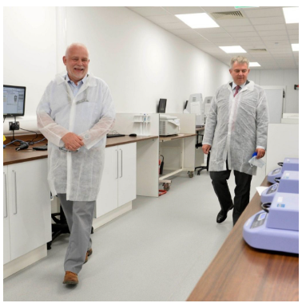
Decisive Planning and Execution
COVID-19 Action Plan
Early in the Pandemic
Randox Maneuvering to Ensure they are a Key Player in the Testing Space
Technology Shift to qPCR
March - No interest in NGS
Awarded £130M Contact
Hospitals in China use Randox test
Establish £30M testing facility
Jan
Apr
July
Oct
Jan
Apr
2020
2021

Slide 7
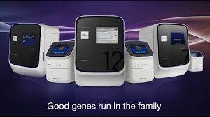
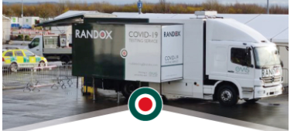
Decisive Planning and Execution
COVID-19 Action Plan
Scaled to 60k samples per day
Mobile Testing Facilities
Multi Testing Options
80 Quant Studio Systems
Commandeered Equipment from UK laboratories
Deployed at Airports and Ferry Ports
1000 tests per day
qPCR
Antibody
Point of care
Jan
Apr
July
Oct
Jan
Apr
2020
2021

Slide 8
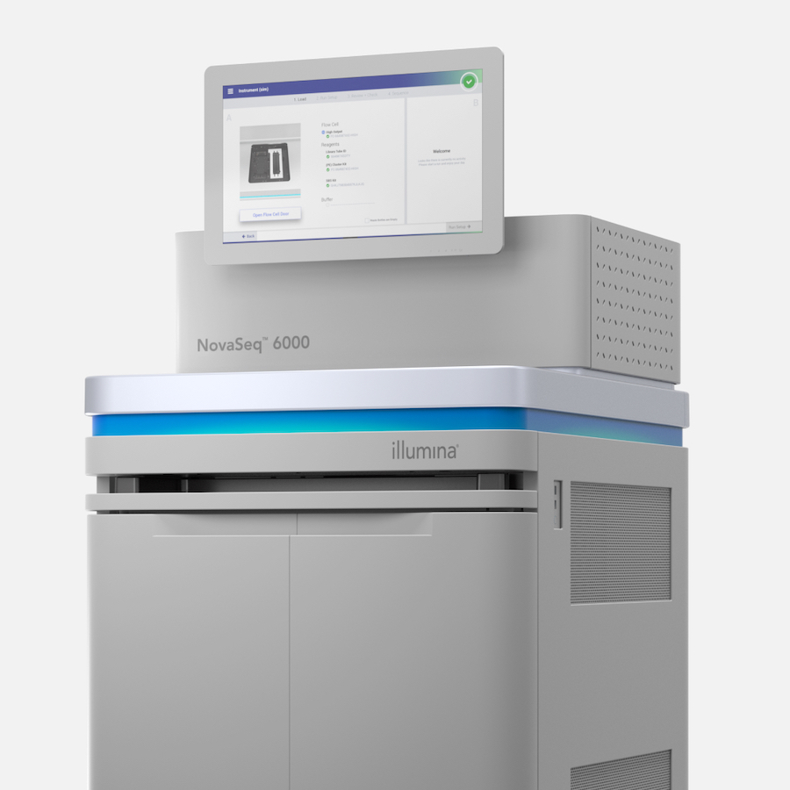
Persistence Pays Off
COVID-19 Action Plan
* Support
Clare Logan
Gaelle Vilchez
Jingwen Wang
Debbie Keenan
Stephen Moxom
Ed Hibbert
Chris Hale
Tonya McSherry
Gregg Ritchie
Matteo Spagnoletti
Pain Points
Scale from 60k to 100k Samples per Day
qPCR Supply Chain Issues
Certified Assay for Diagnostics
Limited NGS Experience
Customer asks for presentation on our solutions
COVIDSeq Onsite Training
Internal Team*
Data Presentation
COVIDSeq Email
PPT
Jan
Apr
July
Oct
Jan
Apr
2020
2021

Slide 9
What does our Solution Look Like?
COVID-19 Action Plan
Randox Must Deliver
Bring Randox Staff up to Speed and Scale COVIDSeq Testing
15,000 samples / week for Public Health England
Mostly positives but also % of Negatives
Surveillance testing to Private Market
Make further use of their MiSeq
COVIDSeq + NovaSeq + BSSH + DRAGEN
Virtual and Onsite: CovidSeq, New to NGS and Instrument Training
Weekly Project Planning Meetings
Guidance on Automation
Initial Libraries Sequenced @ Illumina Centre in Cambridge
Data Analysis Training and Support
Initial Investment
NovaSeq
$2M Reagents
12 Tecan Robots
32 Thermal Cyclers
Run Rate
5 CovidSeq kits + Flowcells
$351k per week!

Slide 10



Upon Reflection
Key Learnings
Engage Early and Often
Listen, Respond and Guide
Win Together

Slide 11
Q&A

