Slide 1


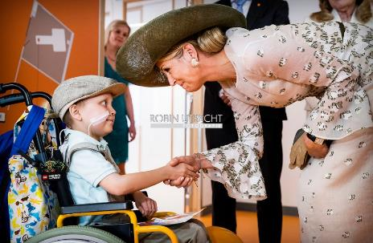
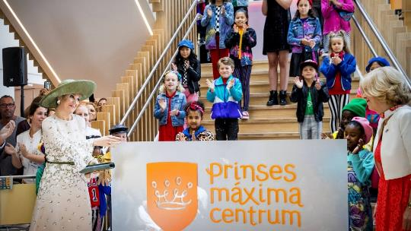
Account background
‘To cure every child with cancer, whilst retaining optimal quality of life’
Paediatric cancer hospital; opened their doors in June 2018
All national care and research for paediatric oncology centralized at the PMC
Largest childhood oncology centre in Europe

Slide 2


Business opportunity
1 1
2 2 3 1
Nextseq2000
WGS of all patient samples
9000 30x GE.
3 Year commitment….
Contract value 6.8M$

Slide 3
Important milestones
March
April
May
June
July
August
01
1ST MEETING -> LOCK-DOWN
March 15th
02
VIRTUAL MEETINGS
Negotiations, mapping, but most importantly…. building trust…

Slide 4
Important milestones
March
April
May
June
July
August
01
1ST MEETING -> LOCK-DOWN
March 15th
July 24th
Received PO!!
Aug 6th
$600 Genome
02
VIRTUAL MEETINGS
Negotiations, mapping, but most importantly…. building trust…

Slide 5

Important milestones
March
April
May
June
July
August
01
1ST MEETING -> LOCK-DOWN
March 15th
July 24th
Received PO!!
Aug 6th
$600 Genome
02
VIRTUAL MEETINGS
Negotiations, mapping, but most importantly…. building trust…
F2F MEETING & NEW PROPOSAL V1.5
Bring sequencing in-house
03

Slide 6
Key learnings
Trusted Advisor
Team Effort
Create Value
Virtual Selling

