Slide 1
Utilization Analysis
Jericho Timbol

Slide 2
Problem Overview
PILOT Experiment
Questions
We were measuring teams that were part of a pilot to measure a 10% utilization requirement in order to transition to Support vs our traditional 20% requirement. Utilization Requirement is a specific number of Expense Reports or Invoices that need to be submitted to validate the customers site to ensure it's working correctly BEFORE we can transition a project to Support (which is then considered completed)
- Example, a customer is contracted for 100 Expense Reports or Invoices - 20% is 20 reports, 10% is 10 reports.
How can lowering utilization rates affect, the time it takes to complete a project?
What role does the activation experience play in this?
Are there any other attributes and correlations that could present observable significance regarding the performance between of the two groups?

Slide 3
Dataset Overview
Key Metrics
Utilization Groups
Hours Per Project (HPP)
(Hour between Contract date → Implementation Complete Date)
Days Per Project (DPP)
(Days between Contract date → Implementation Complete Date)
Pilot Group – Express <$3lK
Pilot Group – Orig Mgr Group
Control
20%
10%
Activation Experience
Activation Coach Productivity
Values: Express, Guided Workshop, Directed 1:1
Activity Experience Grouping
Quarterly Comparison
Skew in distribution
Considerations include:
Activation Experience Grouping
Quarterly Comparison
DTV and HPP as productivity measure

Slide 4
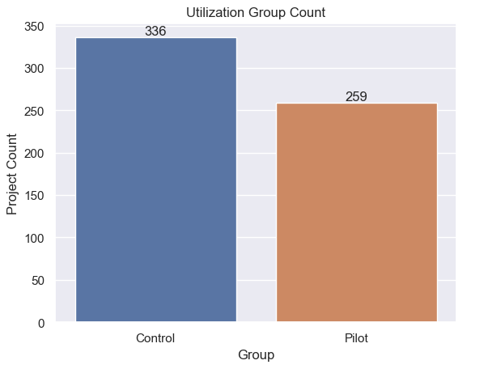
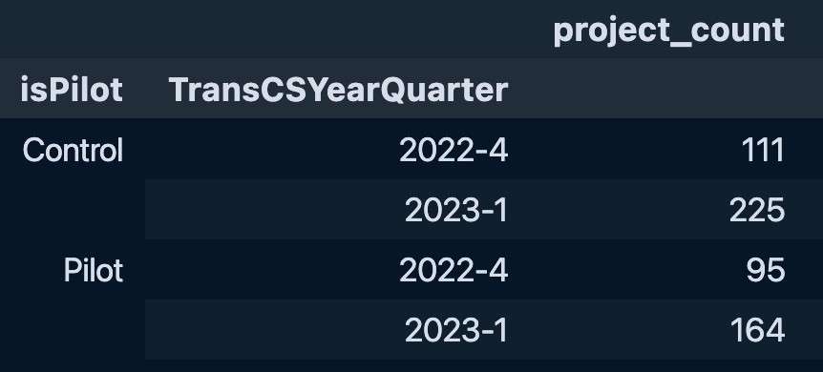
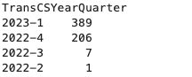

Dataset Overview
Control vs. Pilot
Quarterly Trends

Slide 5
Approach
Create clean DataFrame Tables with overall statistics on key columns
Utilization Group (Pilot: 10%, Control:20%)
YearMonth, YearQuarter
HPP, DTV
Processing
Exploration
Python Pandas in tandem with Excel
Visualizing
Temporal graphs
Statistical analysis between groups
Analyze
Implications and results of the Utilization Rate Experiment

Slide 6
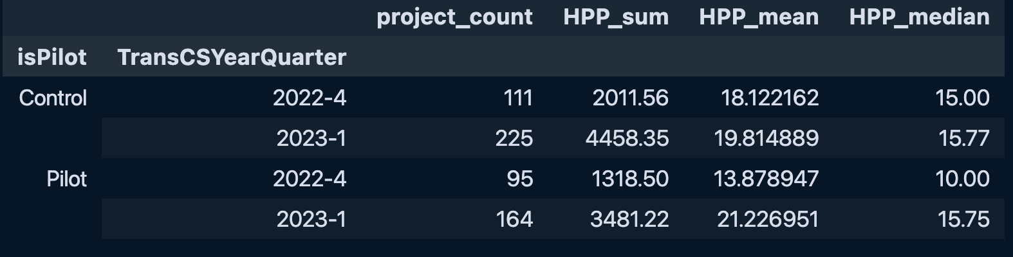
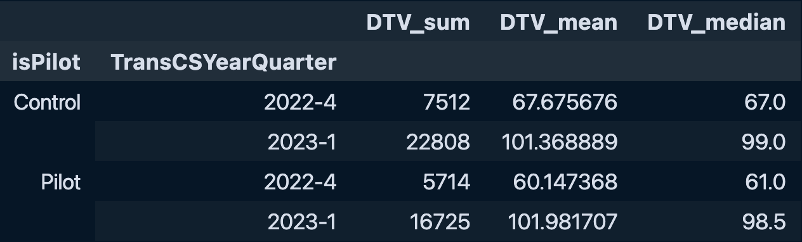
Statistical Overview
Hours Per Project
Days Per Project

Slide 7
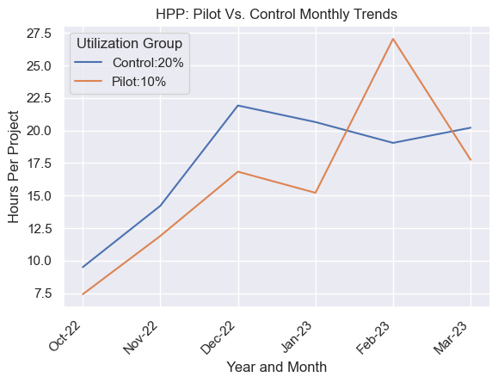
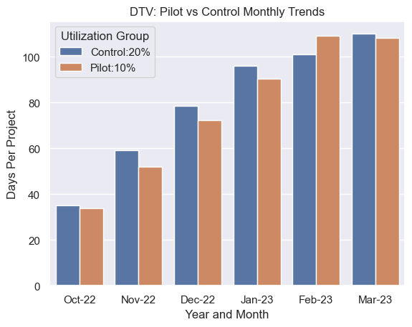
Control vs. Pilot: HPP and DTV

Slide 8
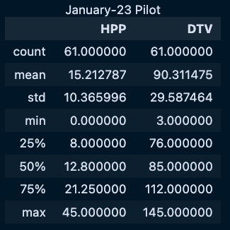
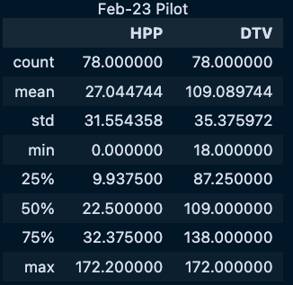
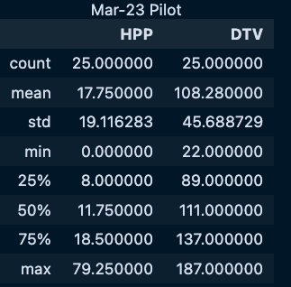
Exploring The Spike

Slide 9
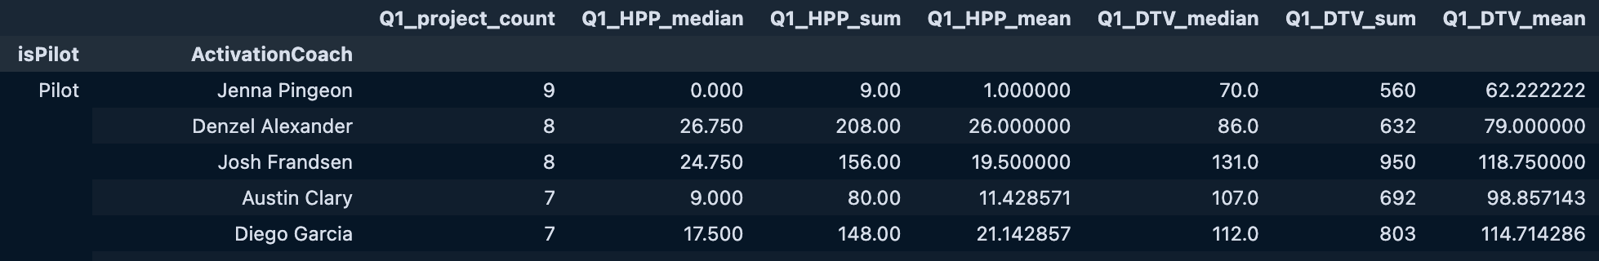
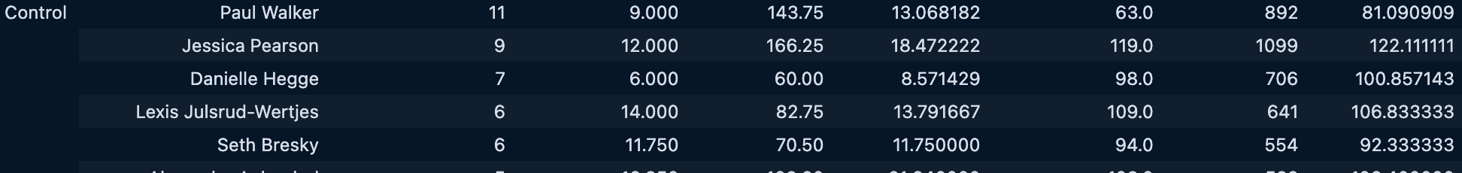
Activation Coach productivity

Slide 10
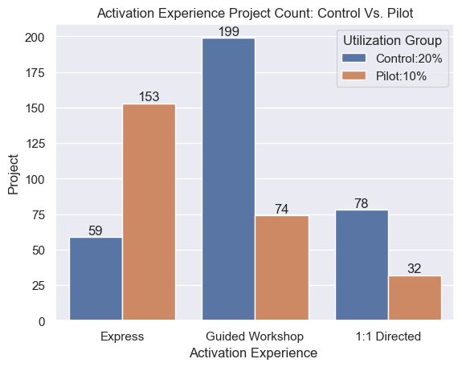
Activation Experience
$1 Billion
Opportunity to build
Fully inclusive market
Total addressable market

Slide 11
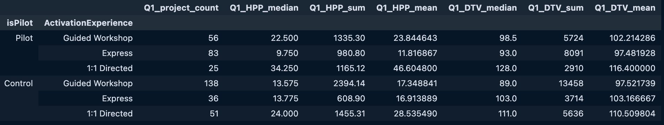
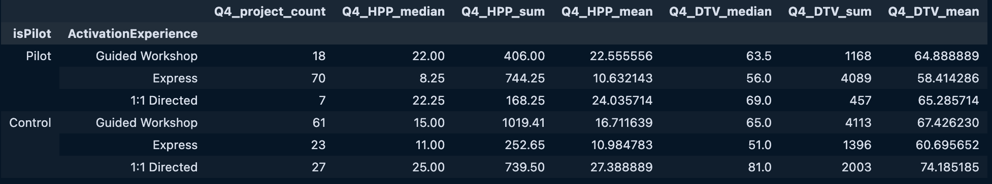
Grouped Activation Experience Statistics

Slide 12
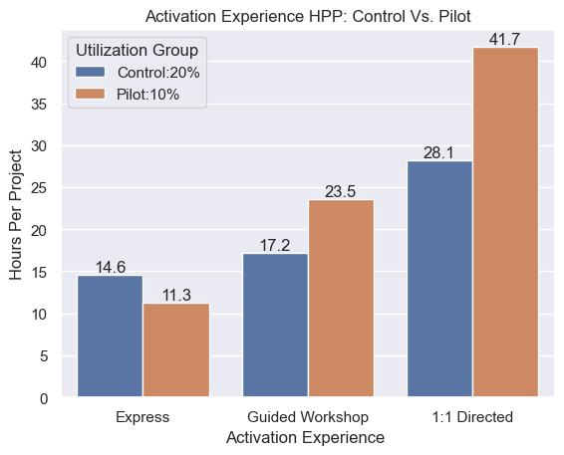
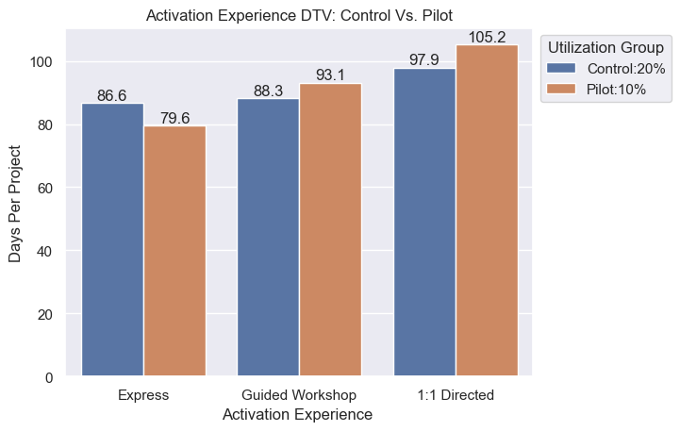
Activation Experience: HPP and DTV

Slide 13
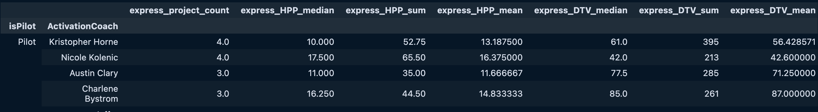
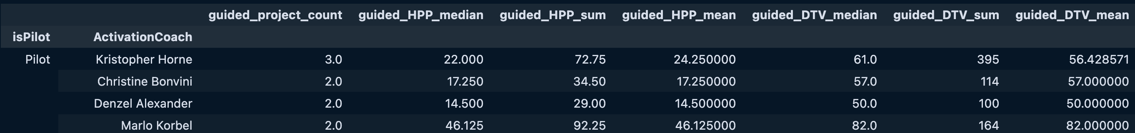
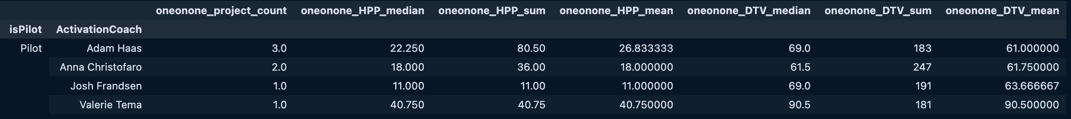
Activation Experience: Activation Coach Productivity

Slide 14
THANK YOU
Jericho Timbol
425-420-6143
jerichotimbol6@gmail.com
https://github.com/Jeri-Code

