Slide 1

TEAM ID : CONO10189
PROBLEM DOMAIN :
natural disaster protection
10 Hours track
Team Name : CODING PHOENIXES
College/Institution : Ramco institute of technology
Team Lead : jerita d
Team Member 1 : abarna s
Team Member 2 : harshavardhini a s
Team Member 3 : abinaya p

Slide 2

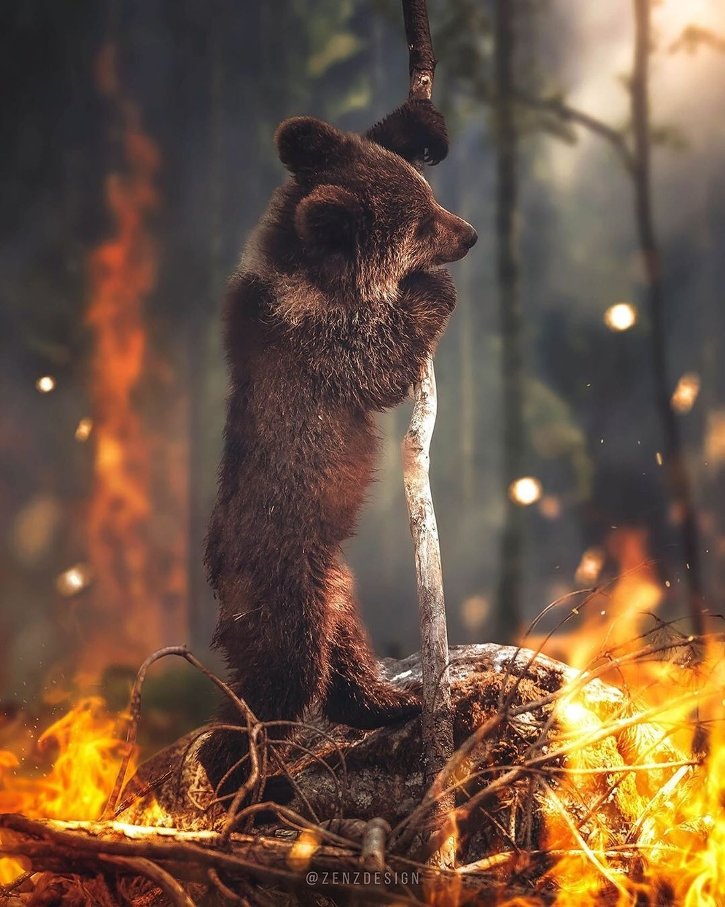
Goal:
“Protecting Wildlife from Wildfire”

Slide 3
IMPACT OF WILD FIRE:
Wildlife can be significantly impacted by forest fires, and sadly, many animals may perish as a result of these flames. Depending on the severity of the fire, the type of habitat it affects, and the behaviour of the animals, the extent of wildlife mortality as a result of forest fires might vary.
Even if animals are able to escape the fire in some circumstances, the loss of their habitat and food supplies still does them harm. Many animals, however, are unable to escape the fire in time and risk dying from exposure to flames or smoke.

Slide 4
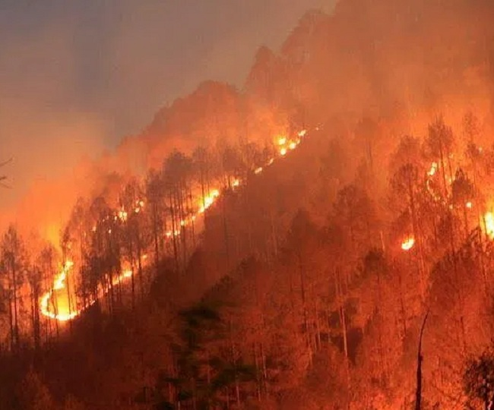
Species that are already threatened or endangered may suffer particularly severe effects from forest fires.
A study published in the journal "Nature" estimated that up to 90% of the animals in a forest can die during a severe fire.
According to statistics, an average of 7 million acres of forest and grassland burn each year due to wildfires and may have killed or displaced more than 2.5 billion birds in the USA , 3 billion animals in Australia, and more than 20,000 moose In Canada .
Overall, forest fires can significantly affect animals, thus it's critical to take precautions to prevent and control them in order to reduce their negative effects on the environment.

Slide 5
Idea :
In this presentation, we propose a system to control wildfires that damages rare and peculiar species and makes many species to an extended condition. Till today the condition of controlling wildfires is a big task and takes much more time which leads to a lot of animal and tree damage.
Using this idea we hope to resolve and tend to suppress the wildfire as soon as possible and save lives.

Slide 6
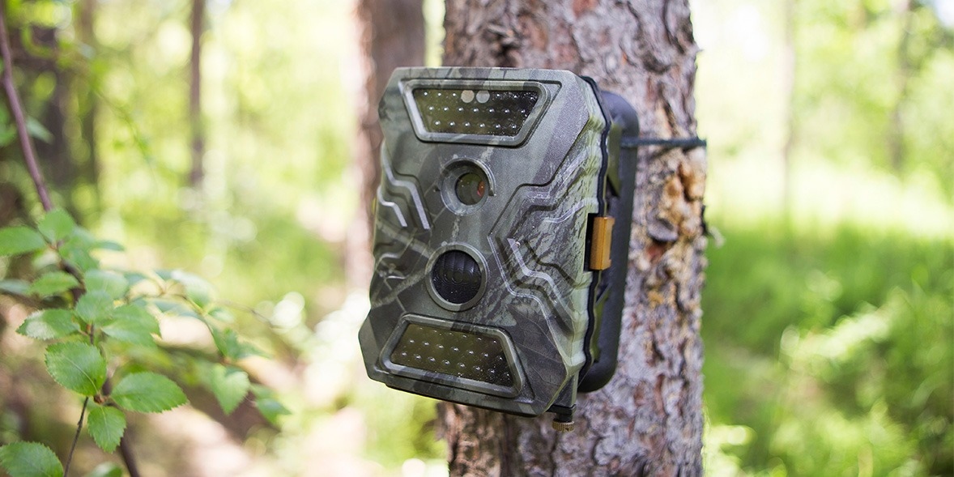
The general idea is to use cameras similar to the cameras used to capture wildlife , this will be sensing the smoke and will alert the system
Once the alert is received water is pumped to the location of the sensor cameras and effectively suppress the forest fire.
Artificial intelligence (AI) and machine learning (ML) technologies could be used to improve the functionality and effectiveness of these alarms.

Slide 7
Early detection: AI-powered sensors can detect heat patterns and smoke behavior in real-time, allowing the system to pump water before the fire grows too large.
Reduces risk of false alarms: Our model can be used to reduce false alarms by learning the difference between real smoke and other airborne particles such as dust or steam.
Predictive maintenance: In built Features can help monitor the health of the fire alarm system and predict when maintenance is required. This can prevent unexpected downtime or system failures that could compromise the safety of the occupants.

Slide 8
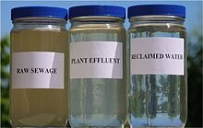
Water resource:
Since this idea requires considerably large quantity of water, we summarized that potable reuse water could be used for this instead of drying up the natural resources of the locality .The sewage water is collected from the surrounding cities and treated more efficiently in such a way that it is suitable for drinking. The potable reuse process typically involves several steps, including primary treatment, biological treatment, advanced treatment, and disinfection. The advanced treatment stage is the most critical in removing impurities, and it may involve processes such as reverse osmosis, membrane filtration, or ultraviolet disinfection. Once the water has undergone these treatment processes, it is safe for even human consumption.
This treated water from the purification plant is sent to the artificially created lake dug inside the forest. This water can be used to put off the wildfire and quench the thirst of wildlife during drought season

Slide 9
CONCLUSION:
Our fire alarm system is a game-changer in the fight against forest fires. It not only detects the presence of a fire but also uses sustainable water sources to put it out quickly and effectively. With this innovative technology, we hope to protect our forests, promote sustainable water management, and protect our flora and fauna.

Slide 10

THANK YOU

