Slide 1
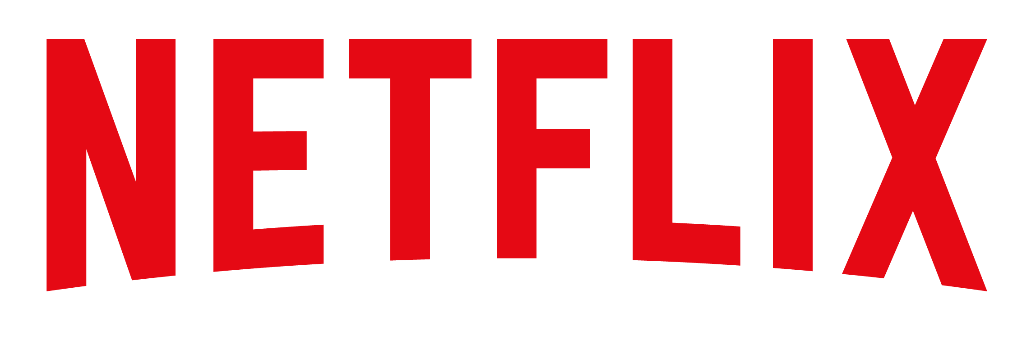




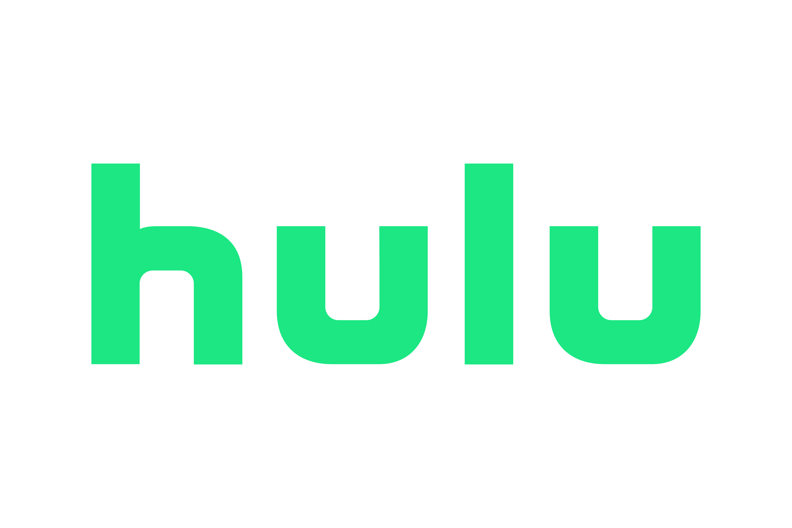
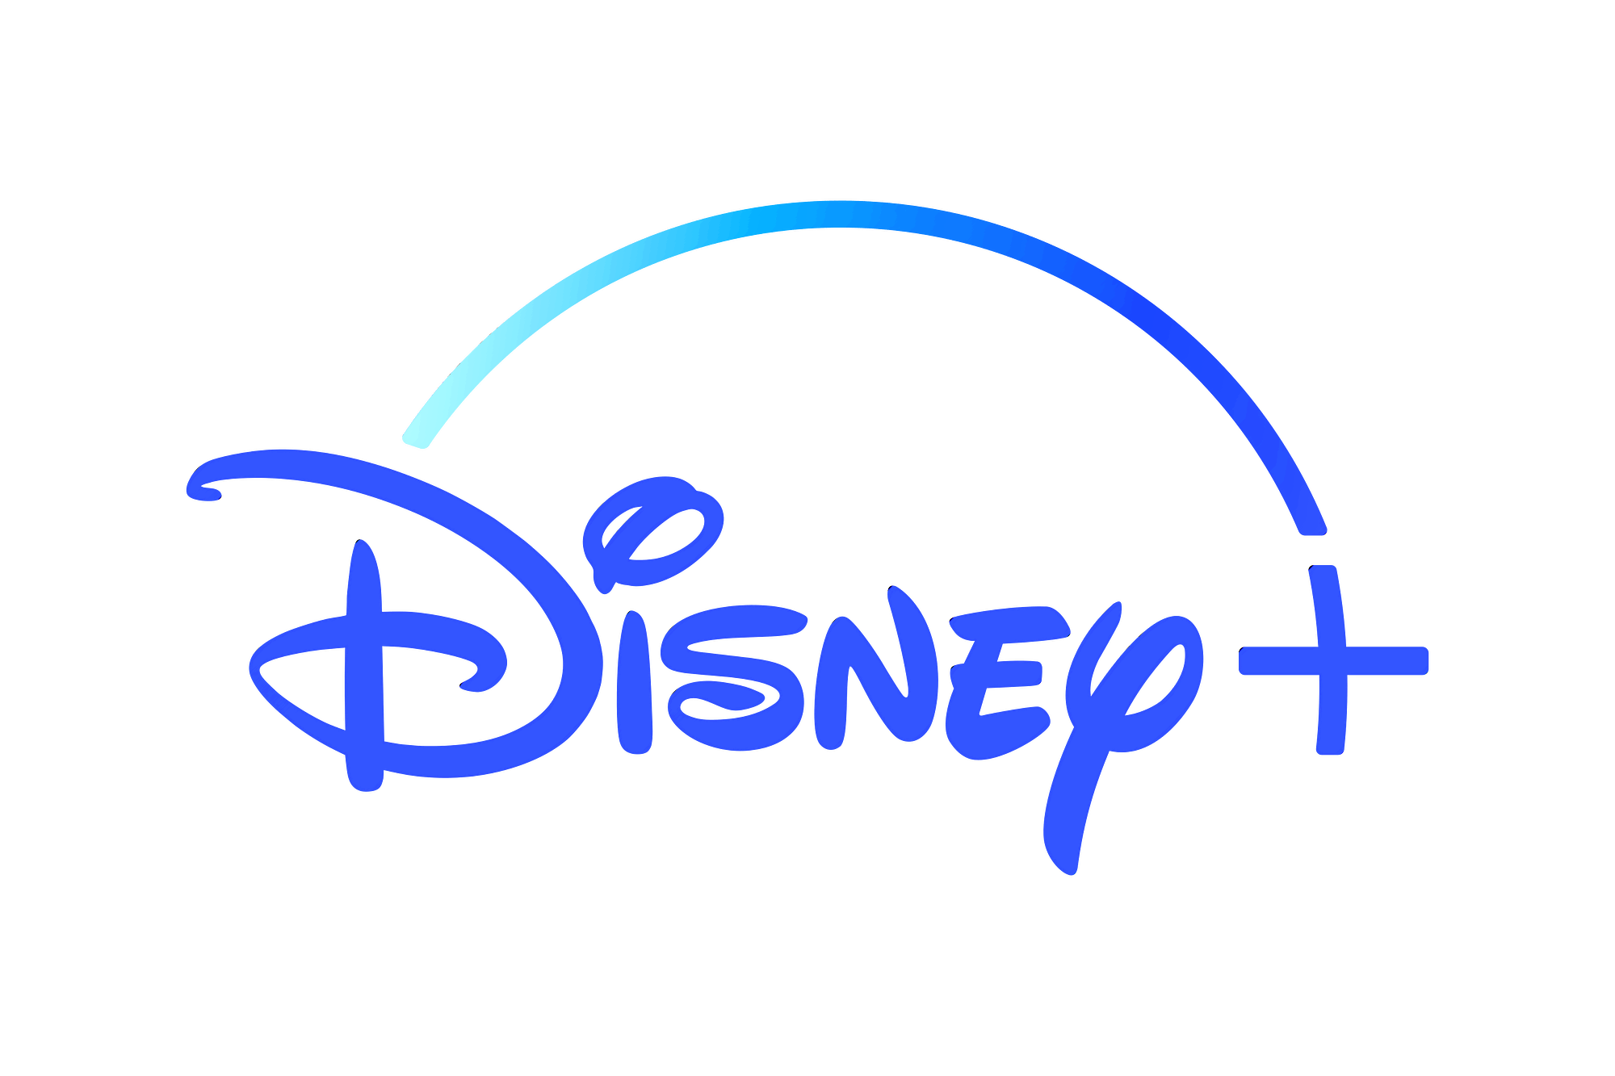


Analytics Dashboard
Uncovering Global Content Trends and Viewer Insights!
Welcome to the Netflix Movies & TV Shows Dashboard!
This report offers a comprehensive overview of Netflix’s content library, highlighting distribution by rating groups, genre-wise trends in average ratings and title counts, and global engagement metrics. Dive into the interactive visuals to uncover patterns in viewer preferences, regional popularity, and content performance across the platform.
01
Fun Fact!
Netflix almost got sold to Blockbuster for just $50 million in 2000!
Netflix's founders pitched the idea to Blockbuster to buy them out, but Blockbuster laughed them out of the room. Today, Netflix is worth over $150 billion—and Blockbuster has just one store left!
02
The iPhone’s First Day’s Without Netflix
Netflix almost missed out on iPhone Glory in 2007
Netflix almost skipped creating an iPhone app, but thankfully they didn’t, setting them up as a leader in mobile streaming.
03
The Streaming Wars: The Battle of Titans
Netflix
230 Million Subscribers $31.6 Billion Revenue
Amazon Prime Video
200 Million + Subscribers $10.5 Billion Revenue
Hulu
47 Million Subscribers $4.4 Billion Revenue
Disney +
164 Million Subscribers $5.5 Billion Revenue
HBO Max
90 Million Subscribers/ $7.5 Billion Revenue
*2023 Data
Netflix Almost Became a Social Media Platform
They planned to be the “Facebook of movies.” Seriously.
In 2007, Netflix considered creating a social platform where users could share reviews and recommendations. They quickly realized streaming was the real goldmine — and dropped the idea.
04
05
Netflix Nearly Teamed Up with YouTube
They almost joined forces before going solo.
Netflix once explored a partnership with YouTube in the early days of online video. They wanted to blend streaming with social content — but chose to focus on premium entertainment instead.
Probably a smart move!

