Slide 1
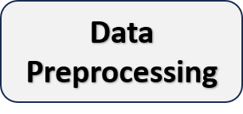
Feature Fusion
Dataset
Label Encoding
Feature Selection
Train-Test Split
XGBoost Training
No Baby
Low Risk
Medium Risk
High Risk
Risk Prediction

