Slide 1
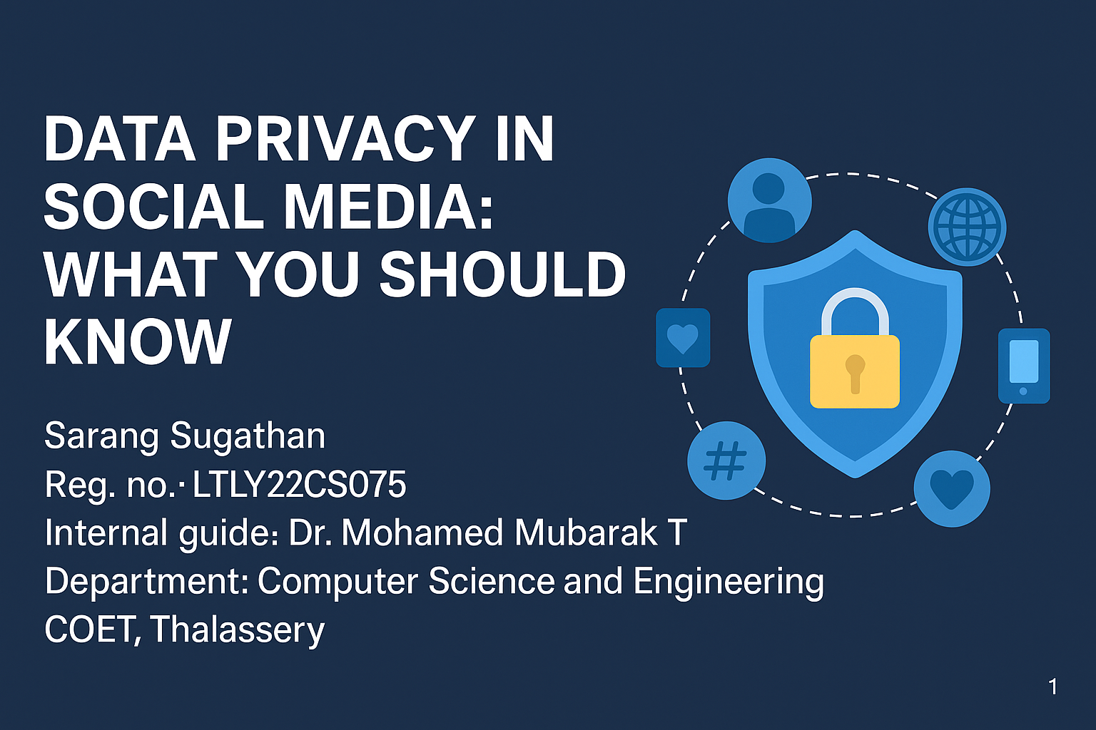
1

Slide 2
Abstract
Social media widely used in education, business, entertainment.
Users unknowingly share sensitive info.
Privacy policies are often misunderstood.
Securing personal data is crucial.
Paper explores threats, user behavior & preventive solutions.
2

Slide 3
Table of Contents
1. Introduction
2. Problem Definition and Objective
3. Methodology
4. Predicting User Behavior
5. Privacy Threats in Social Media
6. Attacks and Solutions
7. Privacy Settings Overview
8. Trust Management
9. Survey Insights
10. Conclusion
11. References
3

Slide 4
Introduction
Background: Social media connects billions of users worldwide.
Need: Protect personal and sensitive information online.
Scope: Covers security risks and user behavior.
Application: Used in business, education, entertainment, personal domains.
4

Slide 5
Problem Definition and Objective
Problem: Increased exposure of personal data on social platforms.
Users unaware of privacy implications.
Objective: Identify privacy issues.
Propose countermeasures to protect user data.
5

Slide 6
Predicting User Behavior
78% respondents were male; 22% female.
Majority aged 20–35 years.
90% use Facebook, 62% Twitter, 36% use other platforms.
Users with higher education more aware of privacy settings.

Slide 7
Privacy Threats in Social Media
Unauthorized access due to poor privacy settings.
Information reused without user's consent.
Disclosures influenced by rewards or goals.
Limited awareness of privacy settings usage.

Slide 8
Types of Attacks in Social Media
1. Privacy Breach – Links between users exploited.
2. Passive Attacks – Undetectable monitoring.
3. Active Attacks – Fake identities to access data.

Slide 9
Major Attacks and Solutions
Infrastructure Attacks – Use antivirus, IDS.
Malware – Avoid unknown links/apps.
Phishing – Validate email sources.
Evil Twin – Authenticate profiles before sharing.
Identity Theft – Use strong, unique passwords.
Cyberbullying – Report & archive abuse.
Physical Attacks – Enable profile-level privacy.

Slide 10
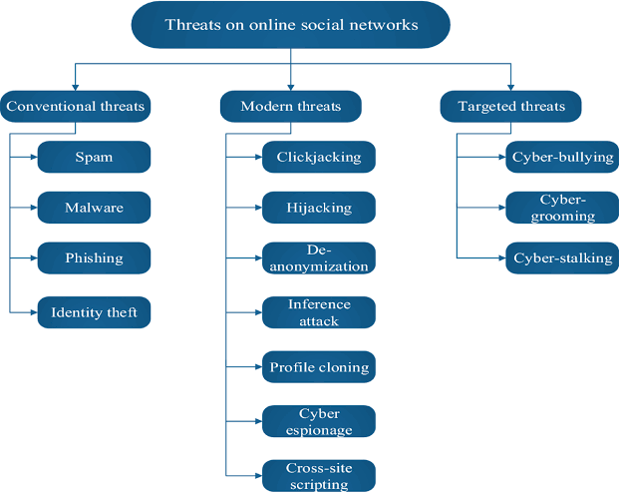

Slide 11
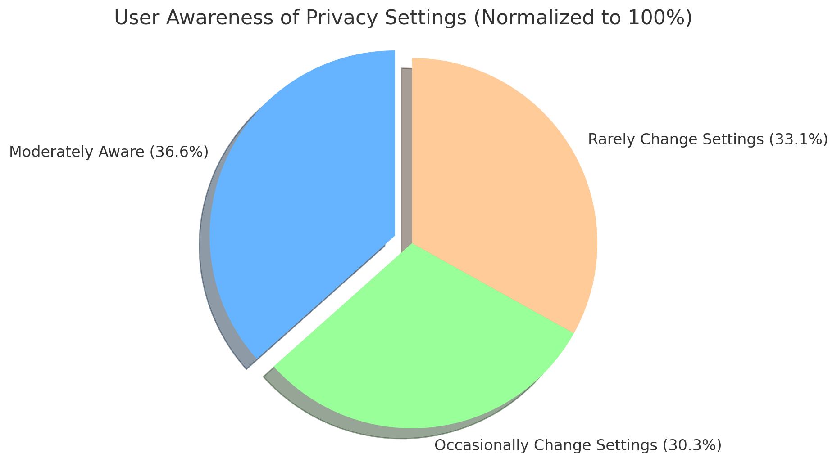

Slide 12
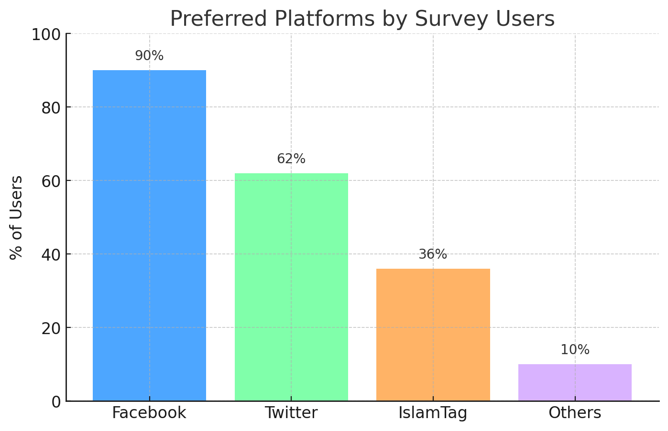

Slide 13
Survey Insights
52% moderately aware of privacy policies.
87% restrict profile access to some users.
43% change settings occasionally; 47% rarely.
Most don't frequently update privacy settings.

Slide 14
Privacy Settings on Social Media
Facebook: 'Friends Only' by default.
Twitter: Enable 'Protect my Tweets'.
LinkedIn: Edit your public profile settings.
Google+: Limit audience via Circles.

Slide 15
Privacy Setting Comparison
Facebook: Most comprehensive options.
Twitter: Limited control over tags/messages.
LinkedIn: Moderate profile visibility settings.
Google+: Audience limited via Circles only.
15

Slide 16
Conclusion
Users lack technical awareness of privacy settings.
Social media platforms need better defaults.
Strong passwords and routine updates essential.
Defined policies can reduce future vulnerabilities.
16

Slide 17
Recommendations
Use antivirus & avoid unknown links.
Regularly update privacy settings.
Educate users on platform privacy tools.
Use strong, non-repeating passwords.
17

Slide 18
References
1. Mvungi & Iwaihara, 2014
2. Shibchurn & Yan, 2015
3. Li et al., 2015
4. Van Eecke & Truyens, 2010
5. Benson et al., 2015
6. Yuan Li, 2012
7. Alkeinay & Norwawi, 2013
8. Ahn et al., 2011
9. Lowry et al., 2011
10. Timm & Perez, 2010
18

