Slide 1
SkillMatch
A Platform Connecting University Students with Freelance Projects
Course : CSE495
Section : 02
Group : 04
Course Instructor : Deepak Chandra Ray

Slide 2
Group Members
2022-1-60-070
2022-1-60-153
2022-1-60-148
2022-1-60-132
Maria Hasan
Fatema Tuz Zannat
Shamima Sharmin Ananna
Jerin Anan Proma

Slide 3
Introduction
Student Challenges
Students lack real-world experience.
Market
Demand
Startups need affordable skilled help.
Existing
Gap
No platform links students’ micro-jobs.
Our Solution – SkillMatch
SkillMatch connects students with projects.
Core Impact
Empowers students, supports business needs.

Slide 4
Project Objectives (SMART Goals Overview)
Specific
Connect students with projects
Measurable
50 profiles, 20 jobs
Achievable
Pilot using university resources
Relevant
Support students and startups
Time-Bound
MVP within 5 Months

Slide 5

Key Project Management Components
Project Charter
1.Defines project purpose clearly.
2.Authorizes project and resources.
Work Breakdown Structure
Breaks project into smaller tasks.
Provides clear task hierarchy.
Gantt Chart
Visualizes project timeline easily.
Shows task dependencies and duration.
Network Diagram
Illustrates task sequence logically.
Highlights project critical path.
Costing
Estimates project financial requirements.
Tracks budget allocation and usage.

Slide 6
Project Charter
Project Title
SkillMatch: A Platform Connecting University Students with Freelance Opportunities
Project Purpose
SkillMatch links students with freelance micro-projects to gain experience and earn, while startups access affordable skilled talent for short-term tasks.
Project Approval
Prepared By :
1. Maria Hasan
2. Shamima Sharmin Ananna
Approved By :
Deepak Chandra Ray (Course Instructor)
Approved Date
20/7/25
3. Jerin Anan Proma
4. Fatema Tuz Zannat
Project Objectives
Milestones
Time
Deliverables
1. Develop MVP freelance web platform
1. Project Planning & Charter Approval
21days(9/1/25)
Requirements, WBS, Timeline
2. Enable student registration and profiling
2. Platform Design Completion
20 days
UI/UX, Branding , Architecture
3. Implement job browsing and filtering
3. Core Development Completion
40 days
Functional modules, Admin Panel
4. Integrate communication and admin tools
4. Testing & Debugging
41 days
Unit, Integration user acceptance testing
5. Achieve pilot adoption and satisfaction
5. Pilot Launch & Evaluation
28 days(4/1/26)
Hosting, Feedback, Data analysis
Project Teams
Sponsors
Budget Estimate
1. Project Manager
1. East West University Career Center
Category
Estimated Cost (BDT)
2. System Analyst
2. Bangladesh Youth Foundation
1. Development
~74.4% ≈ 21,083 USD
3. Front-End Developers
3.Grameenphone Innovation Fund
2. Management
~7.1% ≈ 2,000 USD
4. Back-End Developers
4. Startup Bangladesh Limited
3. General Labor
~18.5% ≈ 5,250 USD
5. QA Tester
5. Orange Corners Bangladesh
Total
28,333 USD
6. UI/UX Designer
Constraints
Limited technical resources or skills may delay development, while low student or employer adoption and technical issues during the pilot phase could affect usability.
7. Marketing/Outreach

Slide 7
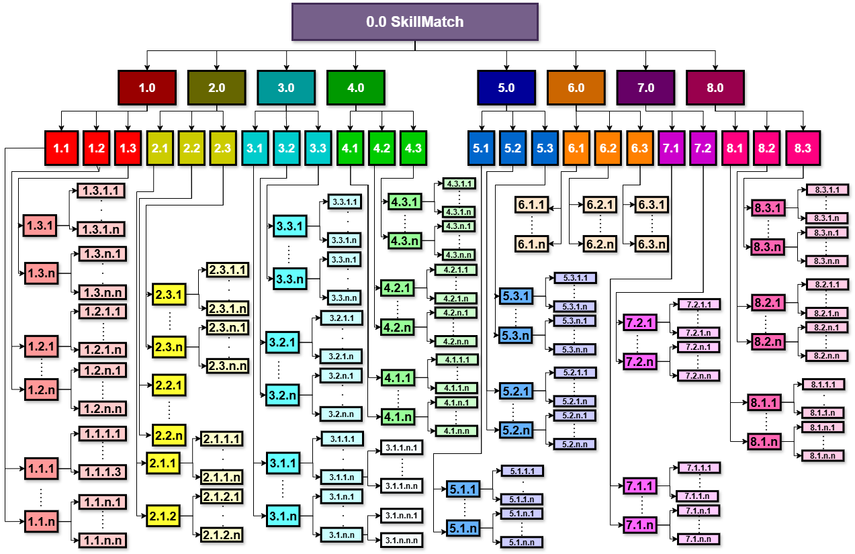
Overall Work Breakdown Structure (WBS)

Slide 8
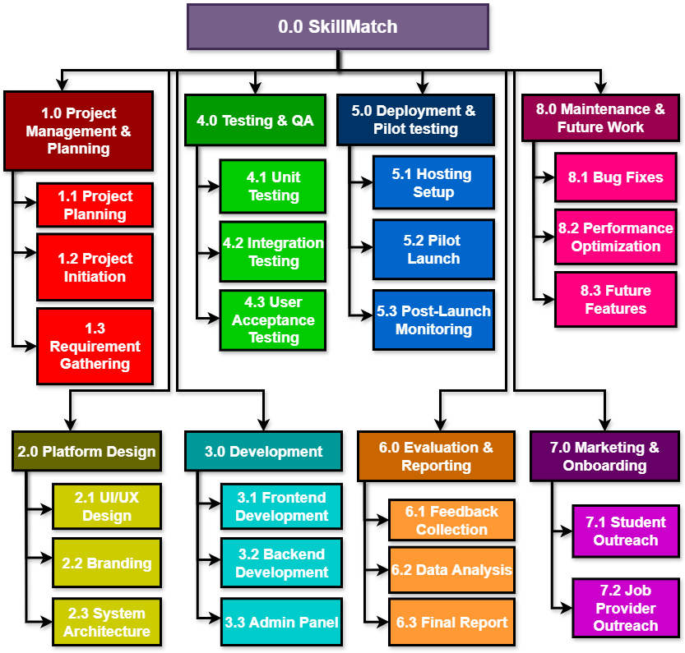
Work Breakdown Structure (WBS) Level 0 - Level 2

Slide 9
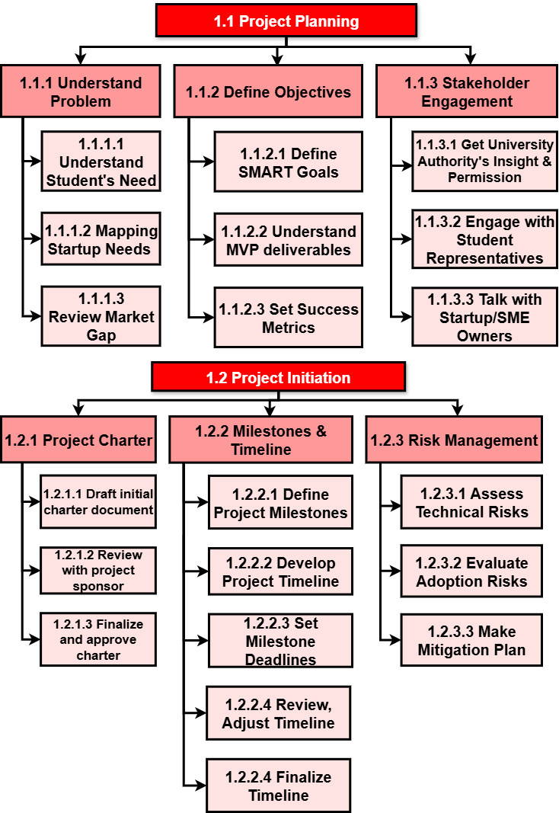
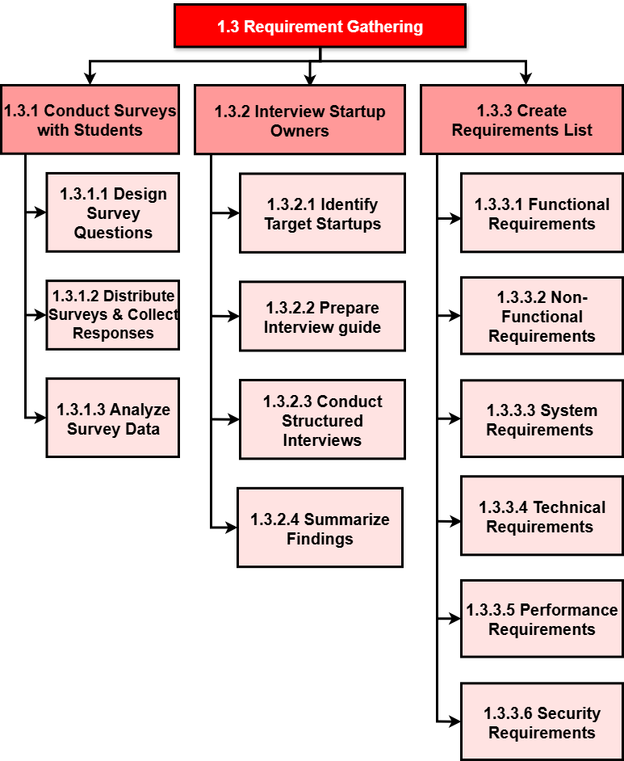
Detailed WBS of Level 2

Slide 10
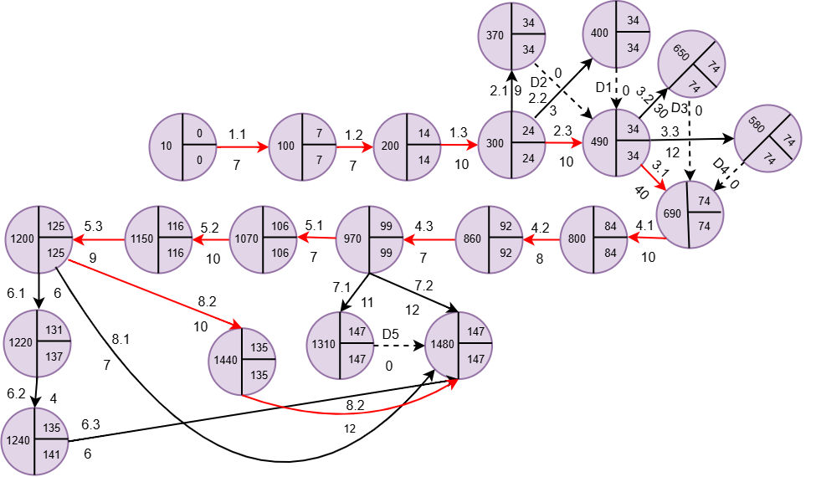
Overall Network Diagram
Critical Path: 10 → 100 → 200 → 300 → 400 → 690 → 800 → 860 → 970 → 1070 → 1150→ 1200 → 1440 → 1480
Total Time for whole Project: 7 + 7 + 10 + 10 + 40 + 10 + 8 + 7 + 7 + 10 + 9 + 10 + 12 = 147 days

Slide 11
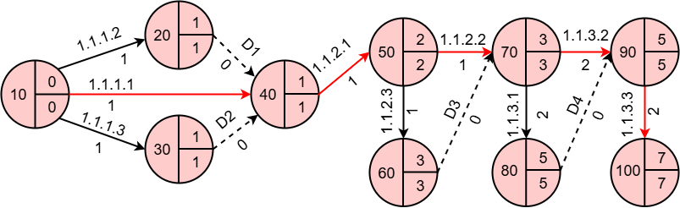
In Depth Network Diagram 1.1 Project Planning
Node | Predecessor | Duration
1.1.1 | None | 1 day
├─1.1.1.1 | None | 1 day
├─1.1.1.2 | None | 1 day
└─1.1.1.3 | None | 1 day
1.1.2 | 1.1.1 | 2 days
├─1.1.2.1 | 1.1.1 | 1 day
├─1.1.2.2 | 1.1.2.1 | 1 day
└─1.1.2.3 | 1.1.2.1 | 1 day
1.1.3 | 1.1.2 | 4 days
├─1.1.3.1 | 1.1.2 | 2 days
├─1.1.3.2 | 1.1.2 | 2 days
└─1.1.3.3 | 1.1.3.1,1.1.3.2 | 2 days
Critical Path: 10 → 40 → 50 → 70 → 90 → 100
Total Time for 1.1: 7 days

Slide 12
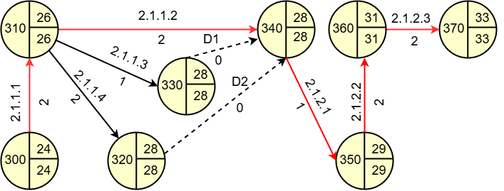
In Depth Network Diagram 2.1 UI/UX Design
Node | Predecessor | Duration
2.1.1 | 1.3 | 4 days
├─2.1.1.1 | 1.3 | 2 days
├─2.1.1.2 | 2.1.1.1 | 2 days
├─2.1.1.3 | 2.1.1.1 | 1 day
└─2.1.1.4 | 2.1.1.1 | 2 days
2.1.2 | 2.1.1 | 5 days
├─2.1.2.1 | 2.1.1 | 1 day
├─2.1.2.2 | 2.1.2.1 | 2 days
└─2.1.2.3 | 2.1.2.2 | 2 days
Critical Path: 300 → 310 → 340 → 350 → 360 → 370
Total Time for 2.1: 9 days

Slide 13
Gantt Chart
Gantt Chart
A visual project management tool that shows tasks over time.
Specific
Purpose
Visualize project timeline
Tasks
Show start and end
Dependencies
Highlight task relationships
Progress
Track work visually
Resources
Plan allocation efficiently

Slide 14
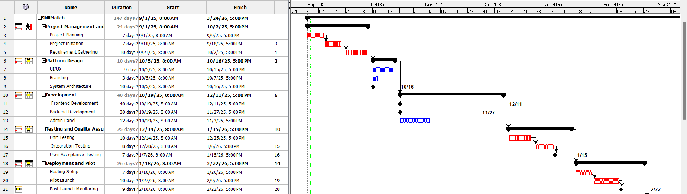
Gantt Chart

Slide 15
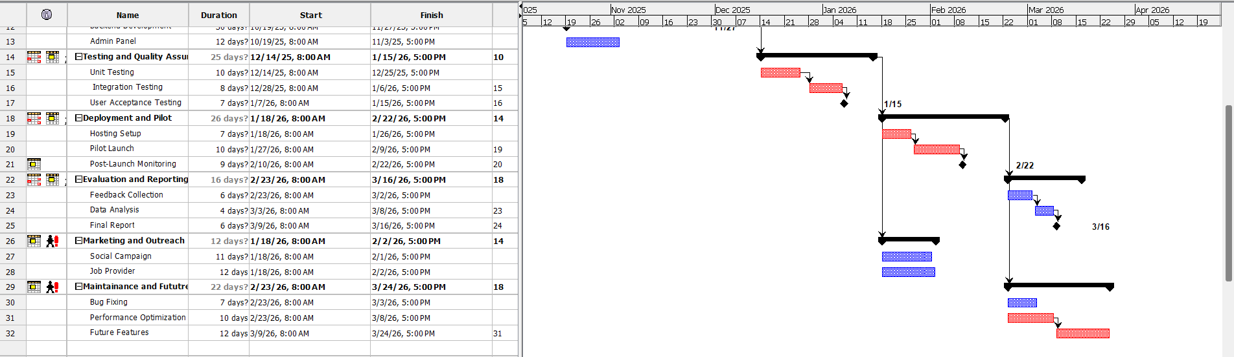
Gantt Chart

Slide 16
Costing
Helps in budgeting, resource allocation, and project planning
Ensures realistic expectations for effort, staffing, and expenses
Guides decision-making on tools, infrastructure, and risks

Slide 17
Rationale behind Choosing COCOMO Model
Static Models
Use fixed factors (LOC, complexity, experience)
Limitation
Cannot adapt if project conditions change.
Dynamic Models (COCOMO)
Variables are interdependent.
Advantage
Adjust to project size, team skills, and tools.
For SkillMatch
More accurate since it is a medium, multi-phase project.

Slide 18
Rationale behind Choosing Semi-Detached COCOMO for SkillMatch
Project Size
Medium (~5 months, 147 days)
Team
Mixed experience.
CRUD, dashboards, matching algorithm, deployment pipeline.
Complexity
Uncertainty
Moderate (UAT, scaling, integration).
Tech Stack
React, Firebase/PHP, MySQL.

Slide 19
Effort Estimation and Key Metrics
From Gantt chart → 147 days ≈ 4.90 months
Metric | Derived Formula | Result
Effort (PM) | Effort= (T_{DEV} / 2.5)^{1/0.35} | 6.84 PM
Average Manning | Effort ÷ T_{DEV} | 1.4 Persons
Project Size | KLOC= (Effort /3.0)^{1/1.12} | ≈ 2.09 KLOC (~2,090 LOC)
Productivity | Productivity = LOC ÷ Effort | 305 LOC/PM

Slide 20
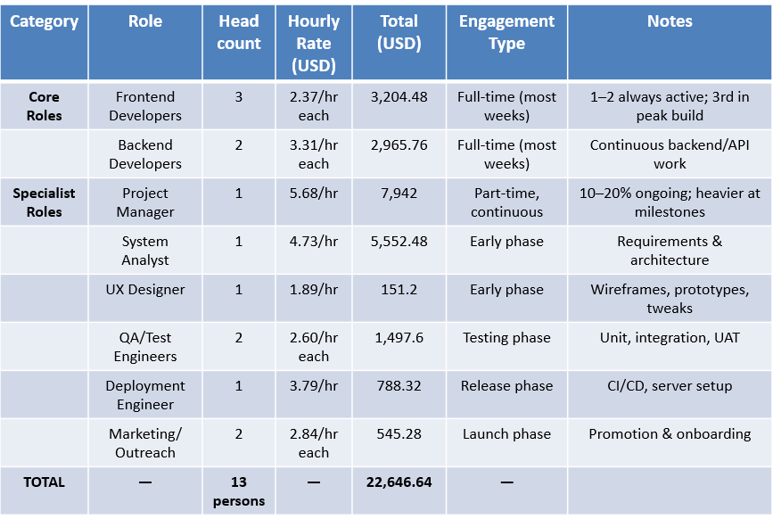
Mapping Roles to COCOMO Estimate

Slide 21
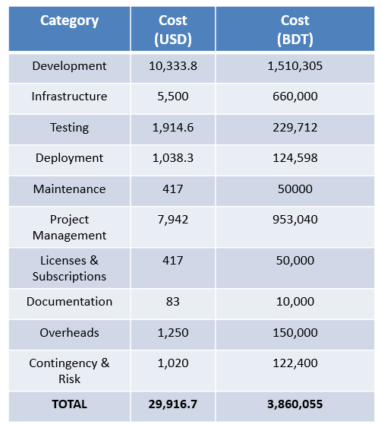
Costing Framework (10 Components)

Slide 22
Conclusion
In conclusion, the SkillMatch is a carefully structured and planned project designed specially for the Students and StartUp Owners looking skilled individuals.

Slide 23
Thank You

