Slide 1

Course: Software Engineering
Presentation on-Extreme Programming
Submitted by
Shafinaj Jerin Asha
ID: IT-21031
3rd year 2nd semester
Submitted To
Mr. Ziaur Rahman Assistant
Professor
Dept. of ICT
Mawlana Bhashani Science and Technology University

Slide 2
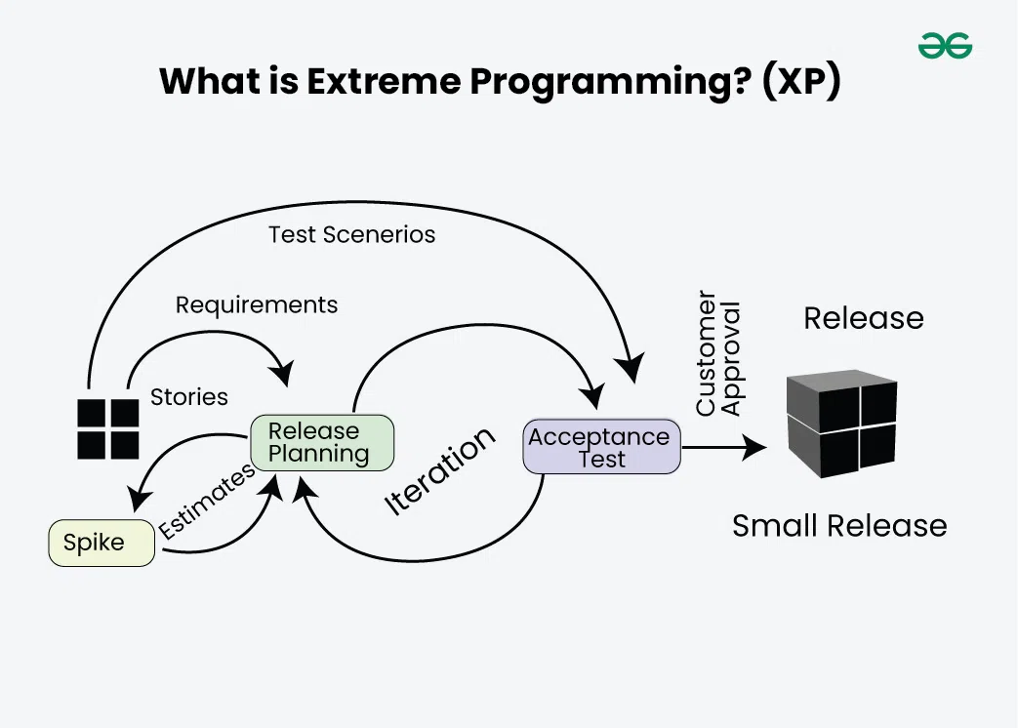
Extreme Programming !
Extreme Programming(XP) is an agile software development methodology which was designed for improving the software quality and responsiveness to customer needs. It has some unique abilities like simplicity , continuous feedback , frequent delivery , teamwork etc.
Here we can see different steps of
extreme programming :

Slide 3
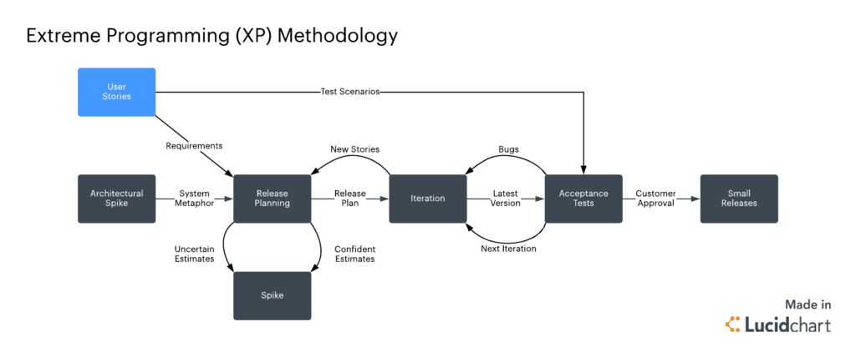
How Does Extreme Programming (XP) Work?
XP is very opinionated when it comes to engineering practices.
Besides practices, XP is built upon values and principles.
Values provide purpose to teams. They act as a “north star” to guide your decisions in a high-level way. However, values are abstract and too fuzzy for specific guidance. For instance: saying that you value communication can result in many different outcomes.
Practices are, in some ways, the opposite of values. They’re concrete and down to earth, defining the specifics of what to do.
Practices help teams hold themselves accountable to the values. For instance, the practice of Informative Workspaces favors transparent and simple communication.
Principles are domain-specific guidelines that bridge the gap between practices and values.

Slide 4
Extreme Programming(xp) Values
1. Communication: Lack of communication prevents knowledge from flowing inside a team. Often, when there’s a problem, someone already knows how to solve it. But lack of communication prevents them from learning about the problem or contributing to its solution. So, the problem ends up being solved twice, generating waste.
Communication
Respect
Values
Simplicity
2. Respect: A fundamental premise of XP is that everyone cares about their work. No amount of technical excellence can save a project if there’s no care and respect.
Every person is worthy of dignity and respect, and that includes, of course, the people affected by a software development project. When you and your team members respect and care about each other, the customer, the project, and its future users, everyone gains.
Courage
Feedback

Slide 5
Extreme Programming(xp) Values
3. Simplicity: Simplicity says you always strive to do the simplest thing that works. It’s often misunderstood and taken as the simplest thing, period, ignoring the “that works” part.
It’s also crucial to remember that simplicity is highly contextual. What’s simple for one team, is complex for another depending entirely on each team’s skills, experience, and knowledge.
4. Courage: Kent Beck defines courage as “effective action in the face of fear.” As a software engineer, you have plenty to be afraid of and therefore plenty of opportunities to show courage.
It takes courage to speak the truth, especially unpleasant ones — for instance, honest estimates. Giving and receiving feedback also takes courage. And it takes courage to avoid falling into the sunk cost fallacy and discard a failing solution that received substantial investments.

Slide 6
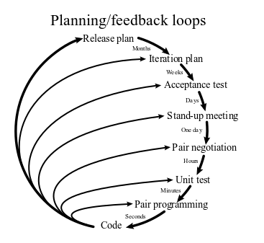
Extreme Programming(xp) Values
5. Feedback: Feedback in more traditional, waterfall-like software development methodologies often is “too little, too late”. XP, however, embraces change and XP teams strive to receive early, constant feedback.
When you’re pair programming, the comments of your peer are vital feedback. So are the opinions from other team members about an idea, including the customer who, ideally, is a member of the team.
Tests are another source of precious feedback that go beyond the test results. Whether writing tests is easy or hard is feedback too.

Slide 7
Extreme Programming(xp) Practice
1. Incremental Planning :
Incremental planning in Extreme Programming (XP) focuses on breaking the development process into small, manageable iterations to ensure flexibility and continuous delivery of value. Customers collaborate with the team to prioritize user stories based on business value, selecting the most critical features for implementation.
2. Small Releases : Small releases in Extreme Programming (XP) involve delivering functional, incremental updates to the software frequently, ensuring early value delivery to users. By releasing small, tested, and usable features, teams can gather feedback quickly and adapt to changing requirements effectively. This approach reduces risk and keeps the development aligned with customer needs.

Slide 8
Extreme Programming(xp) Practice
3. Simple Design :
Enough to meet the requirements
No duplicated functionality
Fewest possible classes and methods
4. Test-Driven Development (TDD): Writing tests before actual code.
5. Refactoring : Improving code without changing its behavior. It basically means that we have to restore or fixup the code without changing anything. It just set up the unorganized code into a organized one.

Slide 9
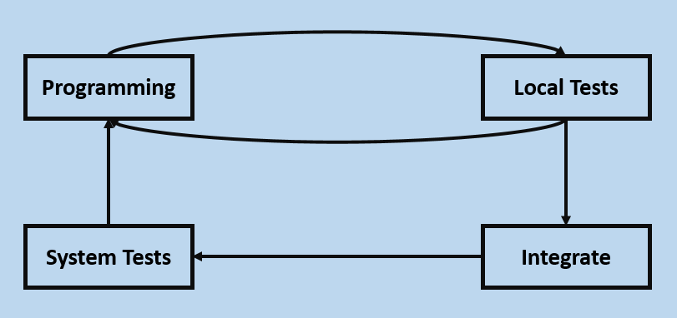
Extreme Programming(xp) Practice
6. Pair Programming:
Pair programming in Extreme Programming (XP) is a collaborative practice where two developers work together on the same code. One acts as the "driver," writing the code, while the other, the "observer," reviews it in real-time to catch errors and suggest improvements. This approach enhances code quality, fosters knowledge sharing, and reduces defects.
7. Continuous Integration : It means that frequent code integration into the repository.

Slide 10
Benefits of XP
Improved Code Quality
Faster Adaptation to Changes
Enhanced Collaboration
Customer Satisfaction
Reduced Project Risks
Continuous Improvement
Increased Developer Productivity
Better Team Morale

Slide 11
ADVANTAGES & DISADVANTAGES OF XP
ADVANTAGES | DISADVANTAGES
1. Slipped schedules | 1. High commitment
2. Misunderstanding the business or domain | 2. Time investment
3. Canceled projects | 3. Not suitable for all teams
4. Business changes | 4. Not highly focused on design

Slide 12
THANK YOU

