Slide 1
Project Title
🔐 Password Manager – A GUI-Based Secure Storage Tool
Presented by: Shafinaj Jerin Asha
Session : 2020-21
ID : IT21031 Department of ICT, MBSTU

Slide 2
Introduction:
In today’s digital world, we have to remember many passwords.
Writing them down or reusing them is not safe.
This project provides a simple and secure solution using Python and GUI.

Slide 3
Project Objective
🎯 Goal of the Project :
Build a secure, user-friendly password manager
Use encryption to store passwords safely
Provide easy access to saved passwords using a master key

Slide 4
Technology Used
Programming Language:
Python 3
Libraries/Modules:
tkinter – GUI design
cryptography – Encryption
json – Data storage
hashlib – Password hashing
File Used:
data.json – to store encrypted password data

Slide 5
Working Mechanism
User enters a master password
User can:
🔐 Save a password (with site name & username)
🔎 Retrieve saved password
Passwords are encrypted using Fernet from cryptography library
Data is saved in data.json file
🔐 Security Layer:
Master password is converted to a secure encryption key using hashlib.

Slide 6
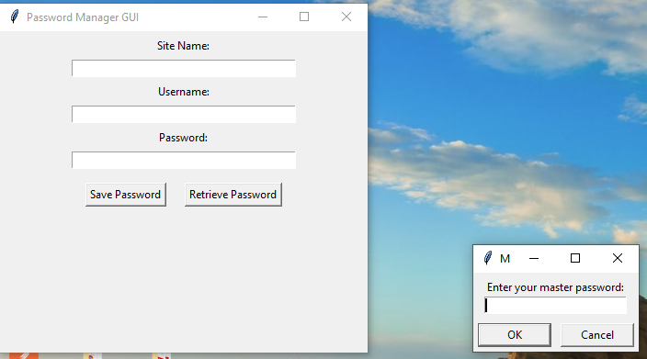
GUI Interface
🖼️ Features of GUI:
Simple and clean interface using tkinter
Inputs for:
Site Name
Username
Password (hidden field)
Buttons:
Save Password
Retrieve Password
Alert messages and popups for feedback

Slide 7
Benefits & Use Cases
✅ Advantages:
Easy to use for beginners
Fully offline and secure
Easily extendable (e.g., generate passwords, add categories)
‍💻 Use Cases:
Students managing accounts
Developers handling test credentials
General users tired of remembering multiple passwords

Slide 8
Conclusion
🔚 This Password Manager is:
A practical Python GUI application
A great start to learn encryption & GUI
Highly useful in daily digital life
📌 Future scope:
Add password generator
Use login system
Store data in cloud database

