Slide 1
Sales Dataset Analysis Advanced Excel Project
S Jerline Sagaya Rani
21-04-2025
DADS Online Course

Slide 2
Objective: To analyze sales data to identify trends, understand sales performance, and provide actionable business insights. Goals: o Analyze sales trends over time. o Identify high-performing products and sales channels. o Determine the impact of returns and discounts. o Create a dynamic dashboard with key metrics.

Slide 3
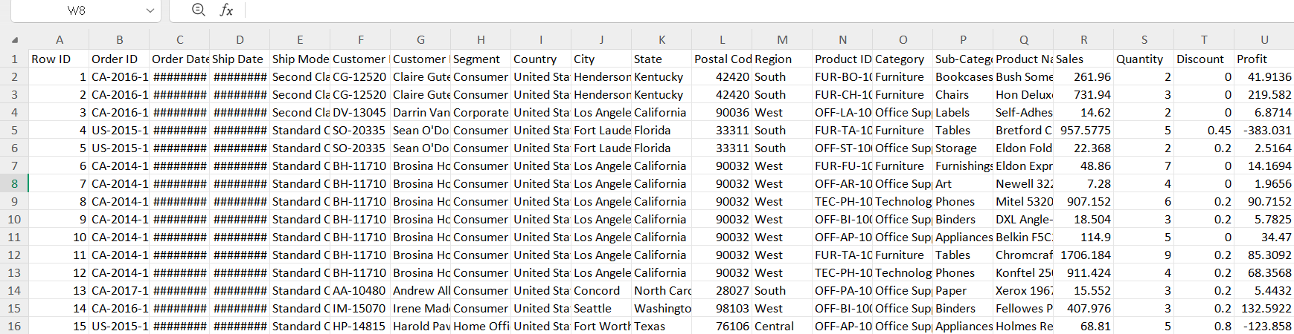
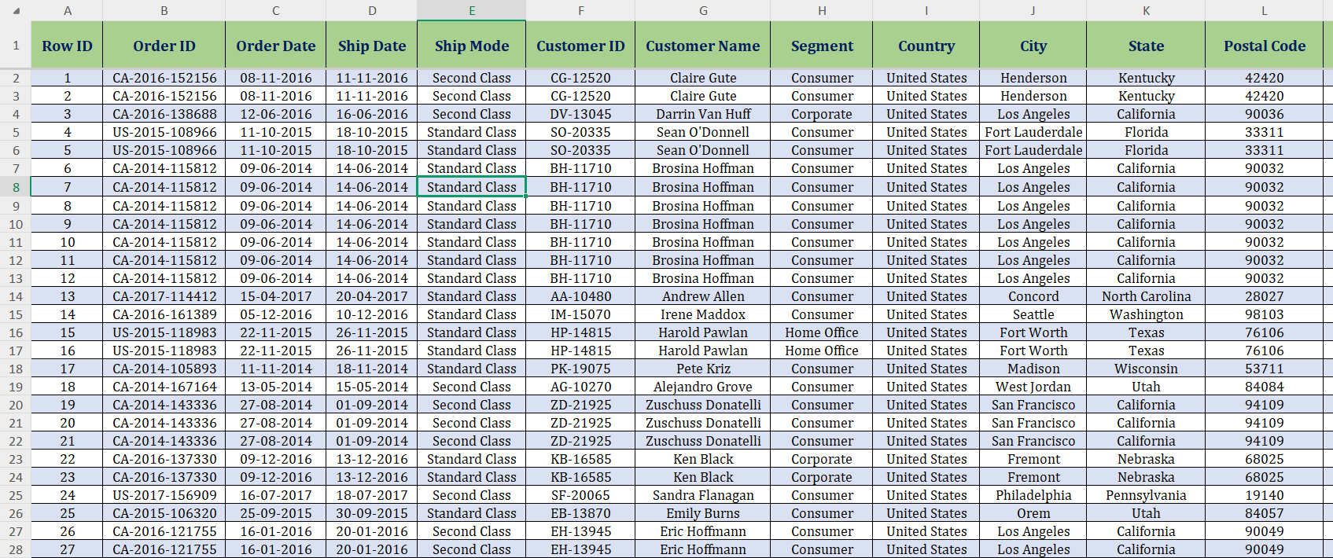
Dataset Overview: Super store data is a collection of data based on products, sales and discounts. It contains customer information based on their location, ID and sales channel. Data Cleaning Process: I used some of the formatting and cleaning method to clean the data. The below listed are the methods: *Rearrange the row’s width and column’s height as per the data * Changed the font size, font style and freeze panes * Added Border to the entire data set and formatted the date for Order date & Ship date column * By clicking on Remove Duplicate Rows and Blanks the data was completely cleaned Visuals: Before After

Slide 4
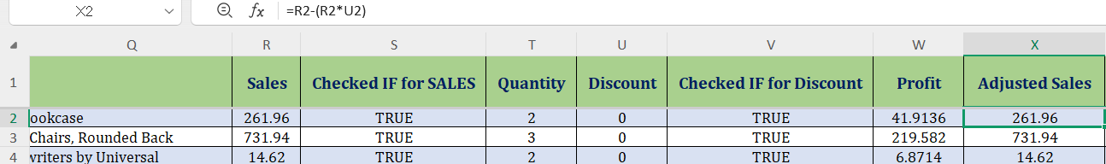
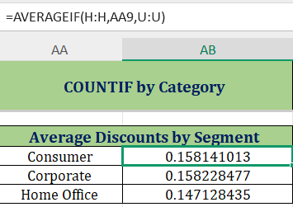
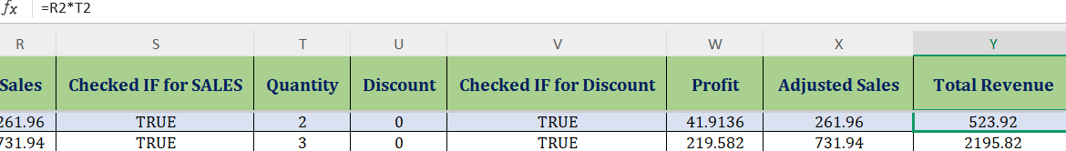
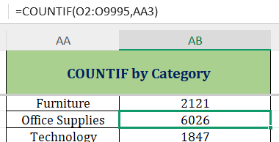
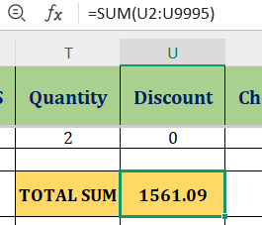
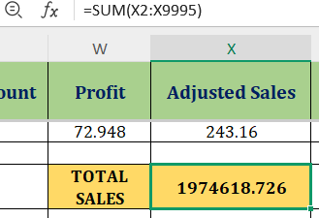
Important Calculations: Adjusted Sales = Sales – Sales* Discount Total Discount = SUM(R2: R9995) Total Revenue = Sales * Quantity COUNTIF =COUNTIF(O2:09995,AA3) Average of Sales = SUM(R2: R9995) AVEAGEIF=AVERAGEIF(H:H,AA9,U:U)

Slide 5
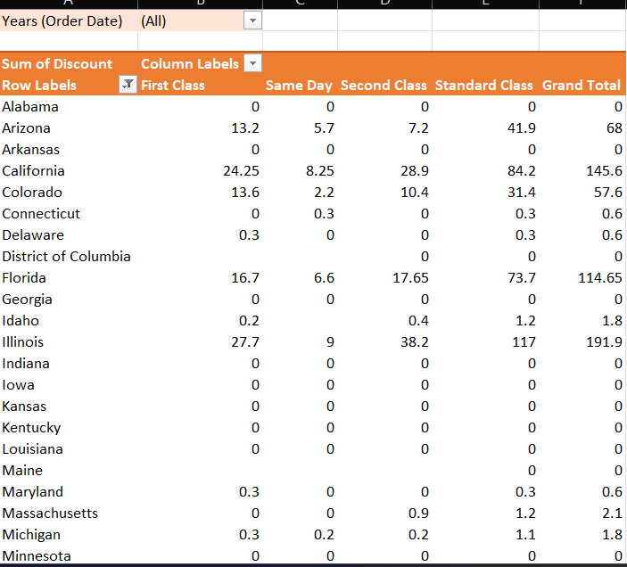
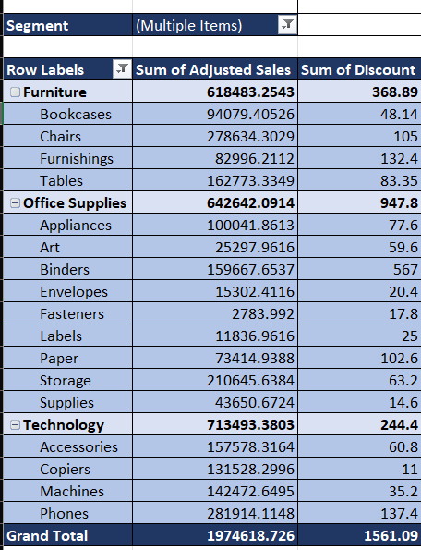
Pivot Table Summary: Pivot is used to aggregate the data in different dimension.
Sales and discounts based on the categories
Time Based Analysis
Top-performing products
Discount by states
Average sales per order

Slide 6
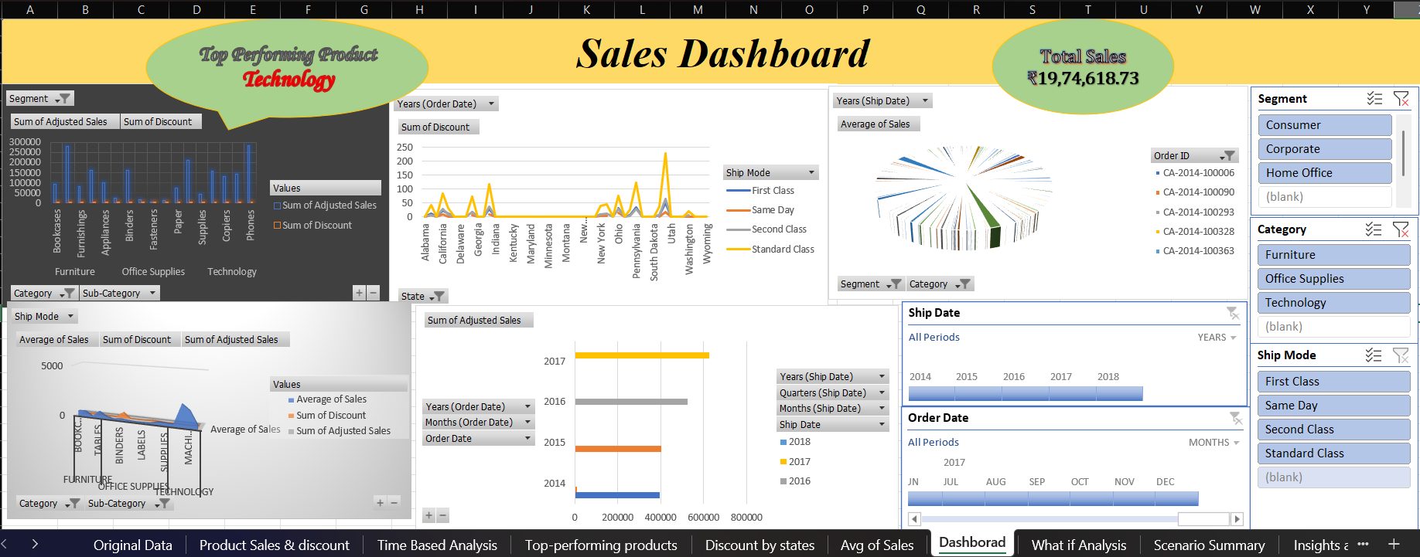
Dashboard Design: Dashboard is a visual tool that presents key metrics and data summaries in a concise and easy-to-understand format, often using charts, graphs, and other visual elements It's a way to consolidate information from various sources into a single view, making it easier to monitor performance, identify trends of the data set.

Slide 7
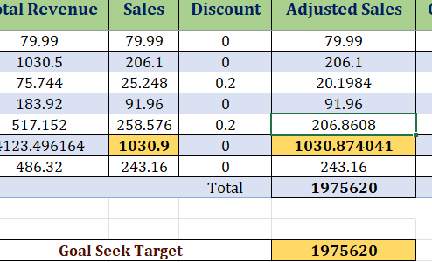
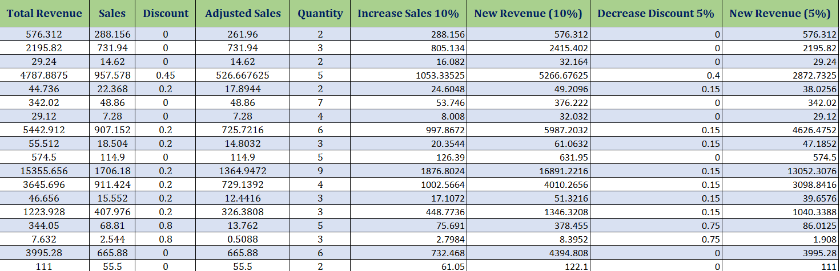
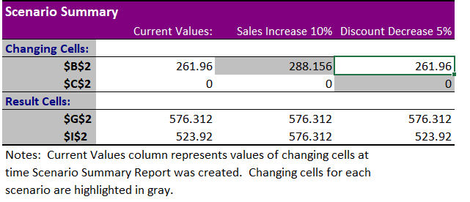
What-If Analysis & Goal Seek : *Using What-If Analysis I increased the sales by 10% and decrease the discount by 5% *Using Goal Seek I setted a target for Adjusted Sales and

Slide 8
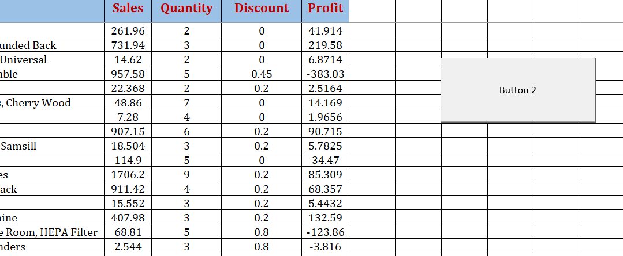
Macros and Automation: Macros are sequences of instructions or code that automate repetitive tasks within Excel. Benefits of Macros *Time Savings: Automating repetitive tasks speeds up operations. *Error Reduction: By removing manual input, macros minimize data entry errors. *Efficiency: Complex processes that would take hours can be completed in seconds with the help of macros. Uses of Macros *Financial Reporting: Automating the generation of balance sheets, profit and loss statements, and cash flow reports. *Data Analysis: Streamlining data processing, pivot table creation, and visualizations. *Payroll Processing: Automating payroll calculations and employee data management.

Slide 9
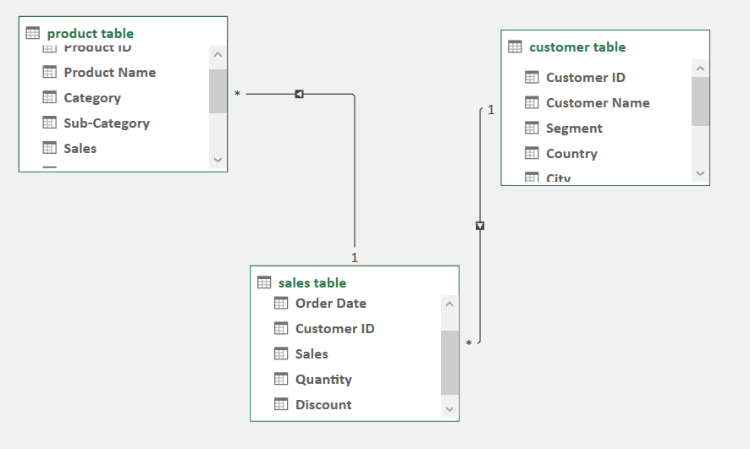
Power Pivot : It enables you to create data models, establish relationships between tables, and perform advanced calculations using Data Analysis Expressions (DAX). I have created the relationship between the Product table and customer table based on sales transaction

Slide 10
Insights and Recommendation * First, we should understand the customers. Learning their challenges, desires, fears and concerns can help you sell a product or service that meets their needs. * Giving them a variety of Payment options * Offering periodic specials and discounts can also encourage repeat purchases. * Providing a money-back guarantee can gain a customer's trust and encourage them to buy a company's products or enroll in a subscription service.

Slide 11
Conclusion By analyzing this Super store Data set , Technology is the top performing product category Standard Class is driving the highest sales Questions are welcome

