Slide 1
TP1 : Image processing
Harris corner detection
TRAN Jérémy 07/10/2024
<numéro>

Slide 2
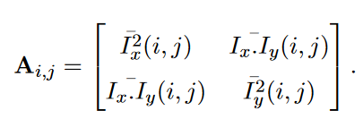

Objective : implement the Harris Corner Detection method
Motivation : The edges can be used to find the edges of the objects and follow their movements
Idea : Corners are points where the gradient has a great intensity, in any direction
Algorithm :
Step 1 : Compute an approximation of the gradient over x Ix and y Iy using the gaussian_filter1d
Step 2 : Compute Ix2, Iy2 and Ixy to get the areas with the greatest variations of gradient intensity
Step 3 : Smoothen the previously obtained vectors with another gaussian filter with a higher σ
Step 4 : Compute the autocorrelation matrix Aij and the Harris response Hij
Step 5 : Non max suppression : The Harris response values give information about the points
Input image
Ix , Iy
Ix2, Iy2 , Ixy
Ix2s, Iy2s , Ixys
Negative value Large positive value Near-zero value
Edge Corner Flat region
<numéro>

Slide 3
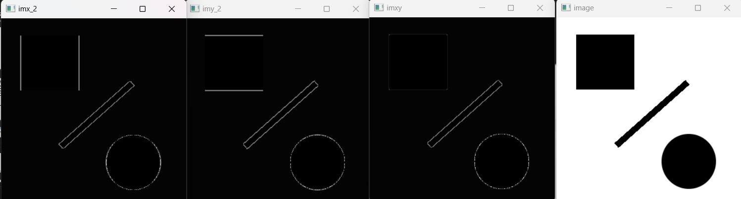
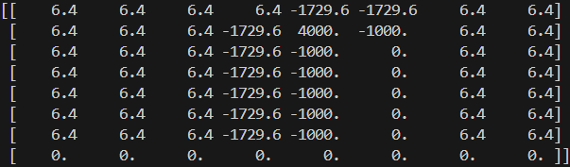
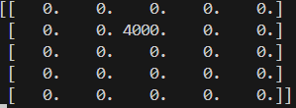
Implementation
Smooth vatiations of gradient intensity
Non max suppression
My idea was to compute the Harris response around a point to see if there is a corner then step over in the image using this mask to map all the corners.
However I ran into some issues afterward.
Corner
Flats
Edge
<numéro>

Slide 4
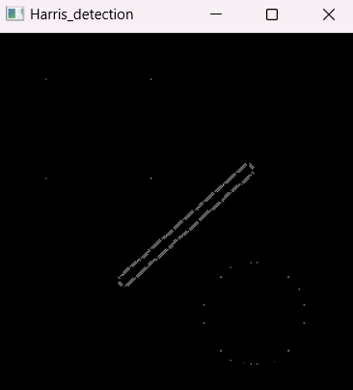
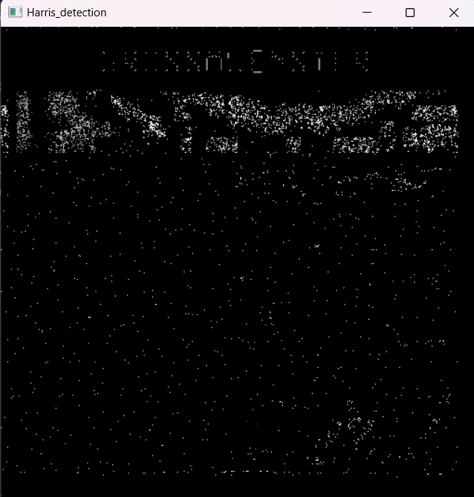
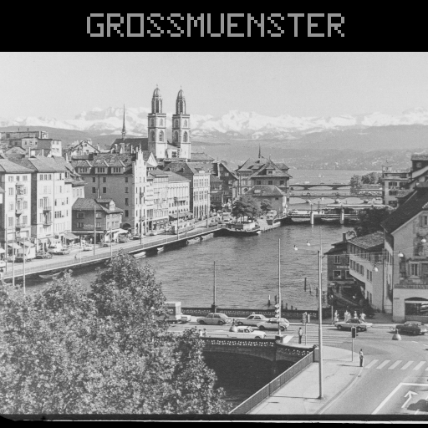
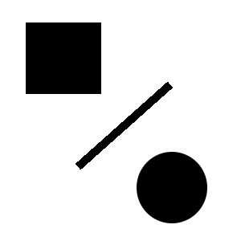
These are my final results
However there are a few major issues
1 : the computation time = 501 s for the zurlim image which i suspect is due to the numerous matrices multiplications in the algorithm or extra image copies I couldn’t find
2 : Very few corners are actually detected, and all are scaled based on the corner with the highest value
<numéro>

Slide 5
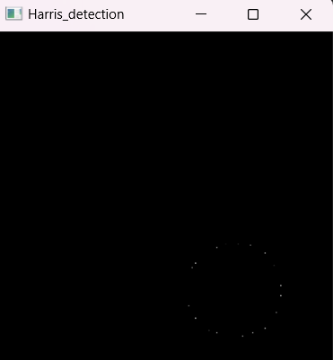
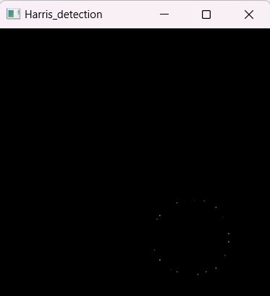
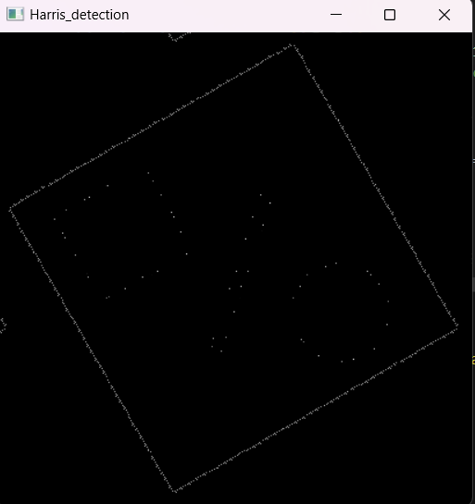
Using the simple image to discuss the sensitivity of the detector to image transformations
Intensity scaling
ɑ = 1,25 ɑ = 3
The issue here is the saturation : the edges values reach the saturation value and create a flat surface
Rotation
θ = 30°
The detector is robust to rotations and translations since it is sensitive to the gradient intensity regardless of the direction.
<numéro>

