Slide 1
Towards a Broadly Configurable Wearable Device
for Continuous Hemodynamic Monitoring
Jeremy Yun, Steeve Nzama, Sahil Shah
Department of Electrical & Computer Engineering
University of Maryland, College Park
2024 IEEE Midwest Symposium on Circuits and Systems
August 11th – 14th, Springfield, MA
Notes:
Say name year school, say title, thank shah and steeve

Slide 2
Outline
Introduction
Motivation
Comparison
System Architecture
Results
Conclusion & Future Work

Slide 3
Introduction
Cardiovascular diseases take ~20.5 million lives yearly
Hemodynamically based signals are essential to early diagnostics
Most efficient method is through non-invasive, continuous monitoring, wearable devices
*Hemodynamic – blood related
Notes:
Explain hemodynamic
Cardiovascular diseases is leading cause of death
Early diagnostics is critical, needs continuous monitoring
Talk about wearable devices

Slide 4
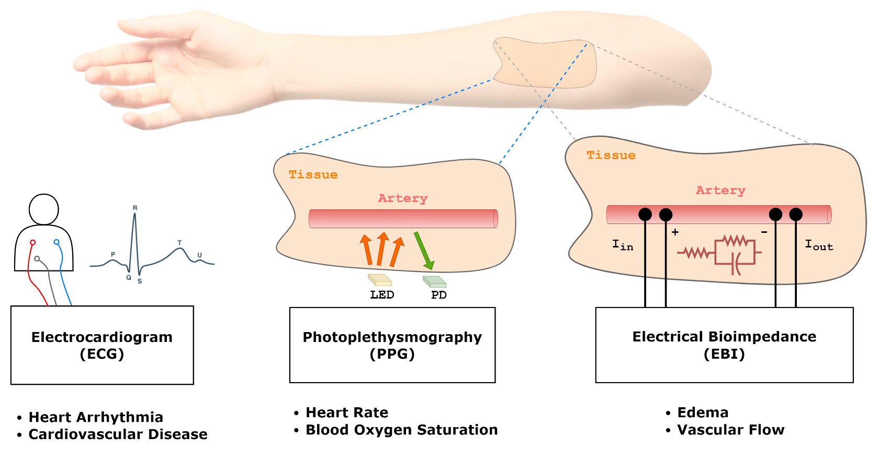
Three Critical Biosignals
Notes:
Within most cardiovascular diseases, these three biosignals can cover most applications
Explain how each signal is acquired
EBI less commonly found in wearable tech

Slide 5
Improvement Opportunity for Wearables
Typical Wearables | Proposed Wearable
Measure a single biosignal Nonconfigurable | Multi-channel biosignal acquisition Broader hemodynamic monitoring applications
No onboard processing Only front end sensing | Onboard processing before wireless transmit Lower power Better data security Less latency
Proprietary Hardware | Open-source Hardware
Notes:
Often nonconfigurable, unintegrated
Within academia, emphasis usually on front end sensing for a single application, less on backend integration
Commercial wearables have targeted applications, don’t have multiple channels.
Holter monitors dedicated to ECG, fitness wearables dedicated to PPG
Want to offer platform for full stack integration and new/broader multichannel applications
Lower power
Better data security
Less latency

Slide 6
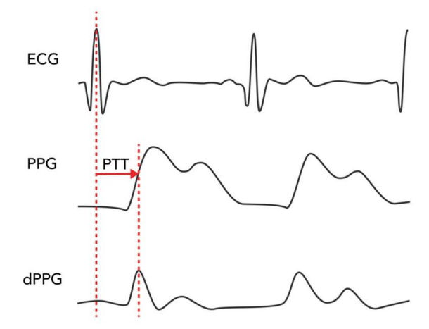
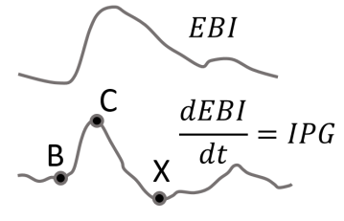
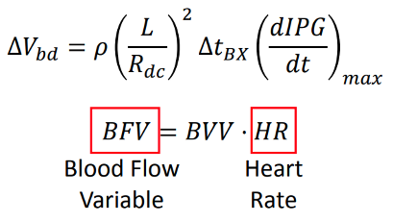
Concurrent Acquisition Examples
Pulse transit time (PTT) for blood pressure estimation
Requires Δt between ECG R-peak & PPG rising edge
Impedance plethysmography (IPG) for blood flow monitoring
Requires EBI and heart rate from ECG or PPG

Slide 7
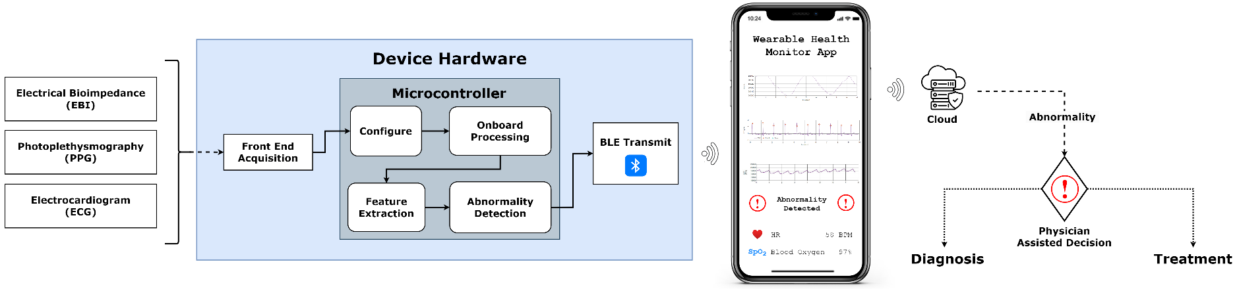
Proposed System Flowchart
*mobile app is for visual illustration only
Notes:
Focus is on the hardware

Slide 8
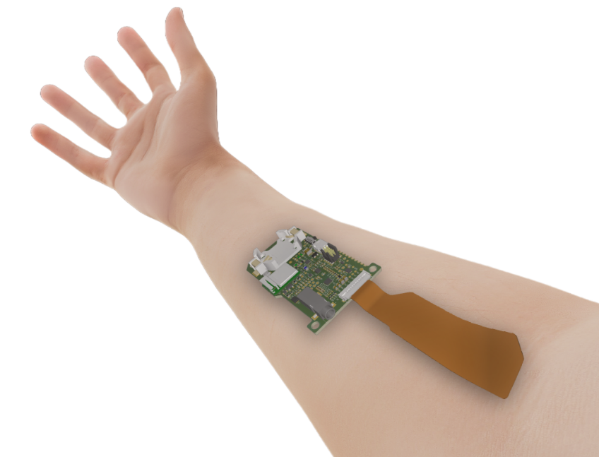
Wearable Device Hardware
60.5mm by 38.75mm
Integrated commercial ECG, EBI, PPG front ends
Onboard microcontroller (MCU)
Wireless transmit
Power management system
Open-source hardware

Slide 9
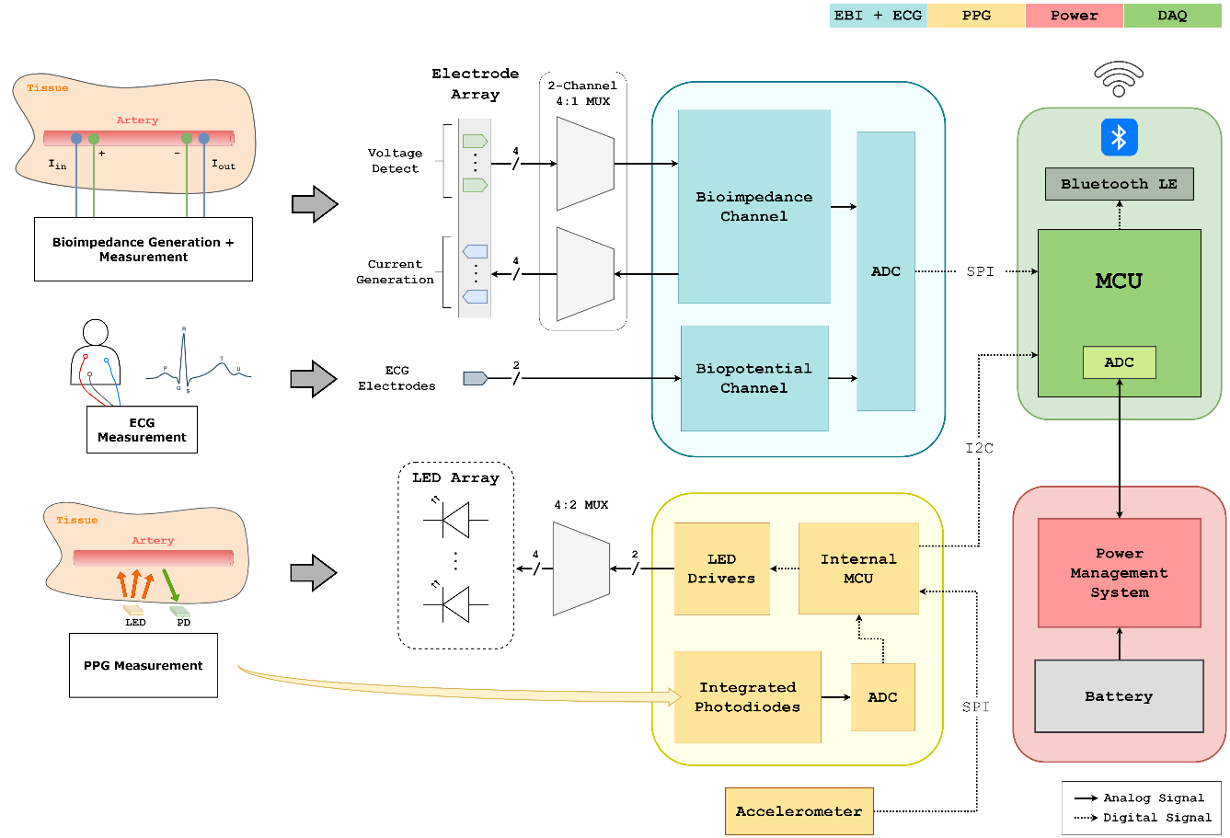
Hardware Architecture
Notes:
4 main blocks color coded, on left are the front ends

Slide 10
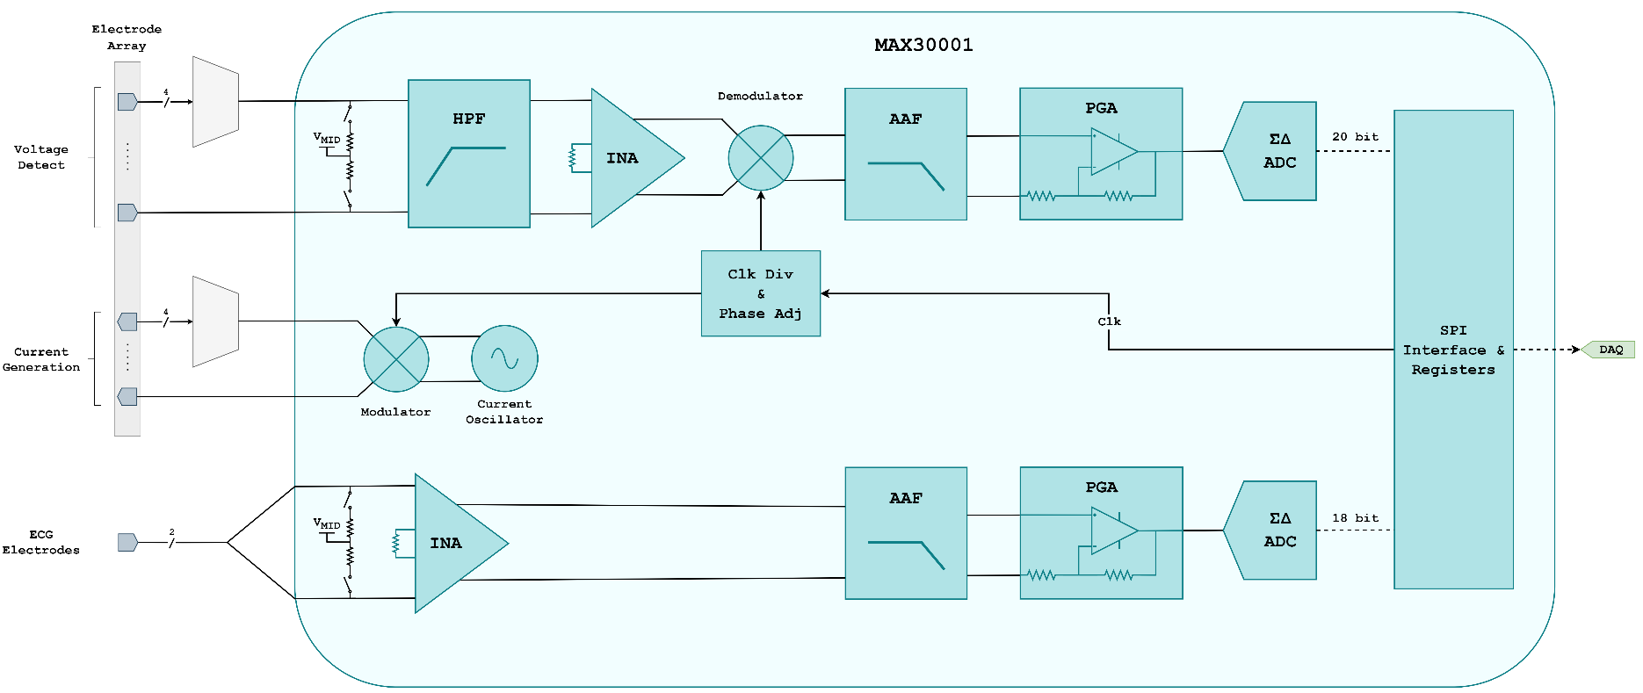

ECG & EBI Front End
Notes:
Generating current at configured levels and electrodes
Input is biased at a reference between your voltage rails to prevent saturation and eliminate common mode (no ref electrode needed)
In-amp takes the filtered voltage diff btwn electrodes
Gain can be programmed
Need phase sensitive circuitry to extract resistive and reactive
15.9 Bits ENOB (Effective Number of Bits) with 3.1µVP-P (typ) Noise for ECG
17 Bits ENOB with 1.1µVP-P Noise for BioZ

Slide 11
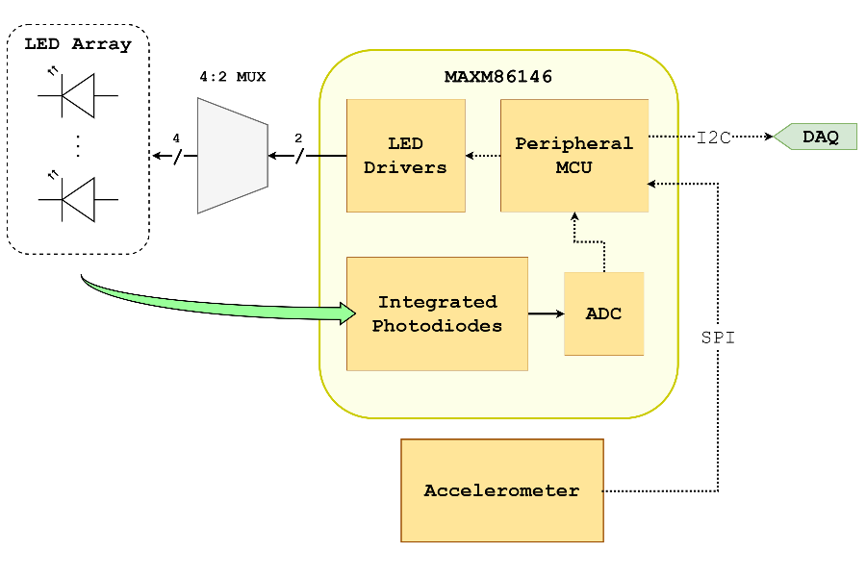
PPG Front End
Built around the MAXM86146 Optical Biosensing module
Pulse heart rate and SpO₂ modes
Multiwavelength LED array
Integrated motion & ambient light compensation
Peripheral 3-axis accelerometer
Notes:
PPG system is built around commercial front end
At a high level, there are two modes, HR with green LEDs, SpO2 with red and IR
Hemoglobin has different spectra depending on its oxygenation
Compensation

Slide 12
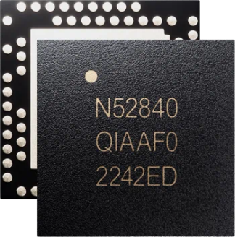
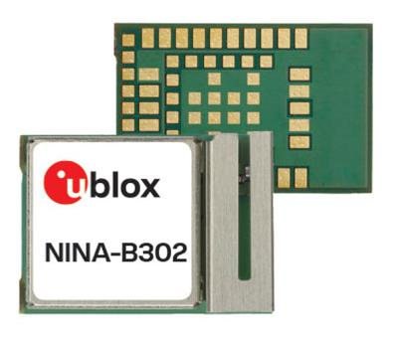
Data Acquisition Unit (DAQ)
nRF52840 microcontroller (MCU) SoC
Bluetooth (BLE) capable
Extensive development resources
Arduino library compatible
Wearable & IoT heritage
Processes input from front ends
Feature extraction
Performs battery monitoring
Notes:
ARM M4 Cortex CPU
Internal ADC & memory

Slide 13
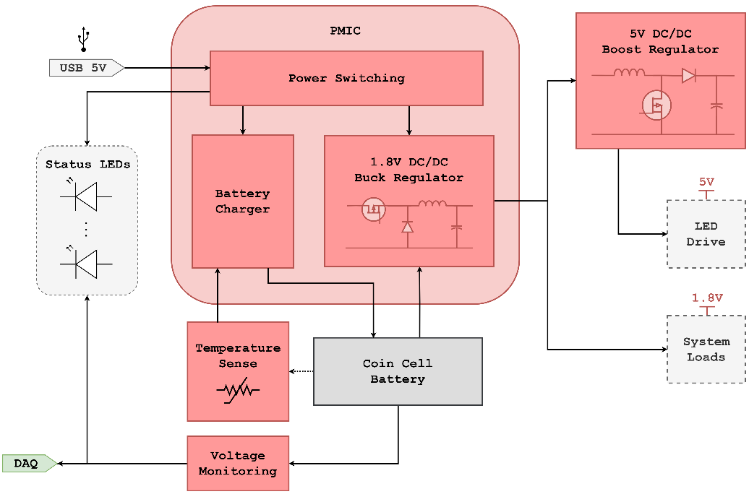
Power Management System
Battery either:
CR2032 coin cell battery
LIR2032 rechargeable coin cell
Monitoring requires only a few seconds of measurement every few hours
2 min/day
CR2032 last over 2.5 months*
LIR2032 need recharge every 2 weeks*
*Calculated from datasheets
Notes:
Power management is very important for continuous monitoring wearables
With all systems active and transmitting, a CR2032 battery is depleted in a day
PPG Is by far the most power intensive (LED drive current) – 90% of power draw
Only ECG and EBI would last over a year

Slide 14
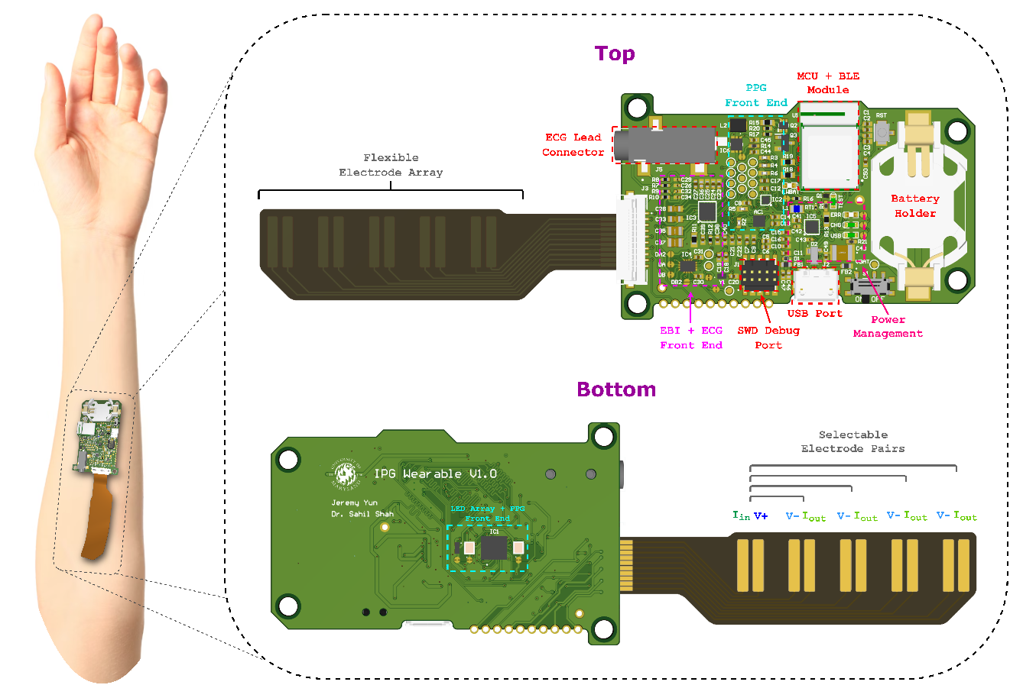
Device Physical Model
*electrode array may be
customized to other shapes

Slide 15
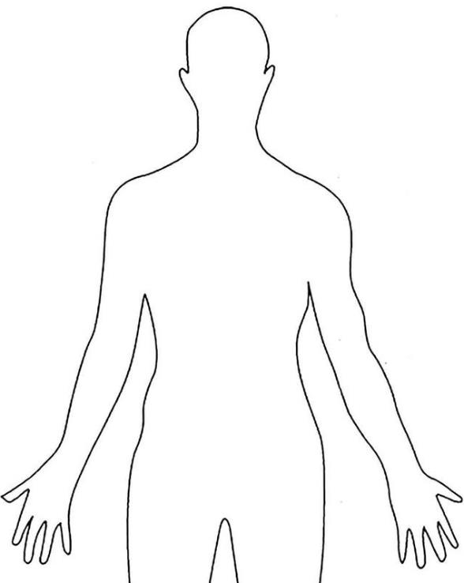

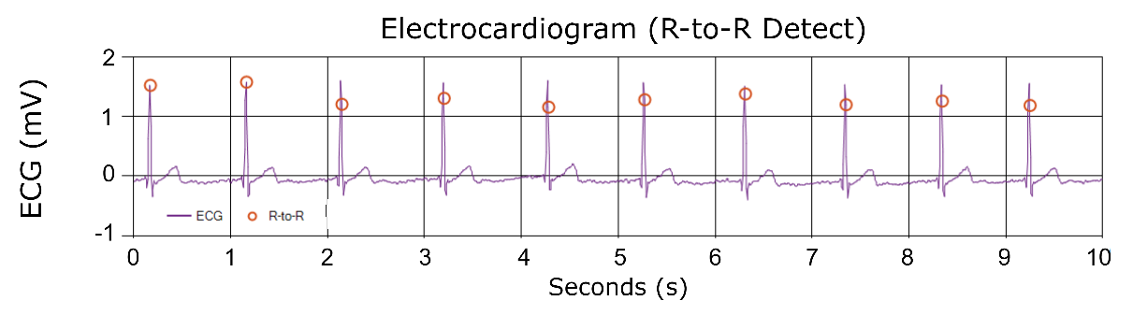
Results
ECG signal from the analog front end
Real time R-to-R detection
Onboard signal filtering & noise removal
-
+
Notes:
Healthy patient
Concurrently measured with…

Slide 16
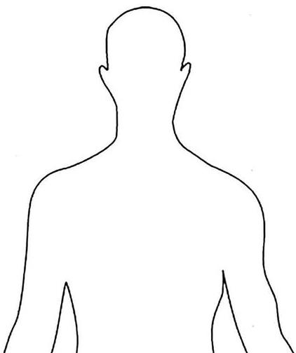
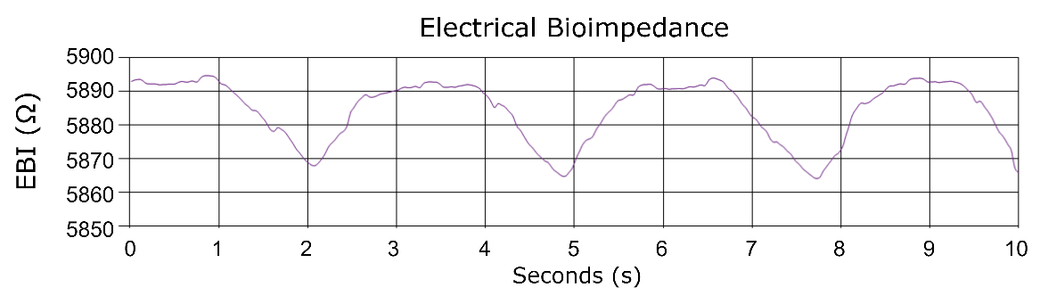

Results
EBI signal from the analog front end
Electrodes placed across thoracic cavity during respiration
Current injection configured to 8μA amplitude at 16kHz
Within IEC-60601 standard
IN
+
-
OUT
Notes:
Freq in the kHz range to penetrate thoracic cavity
Current level chosen to remain within the IEC-60601 standard perception threshold

Slide 17
Comparison Table
 | [1] | [2] | [3] | [4] | Proposed Device
Sensor Type | ECG, EBI, PPG | EBI | ECG, EBI | ECG, EBI, PPG | ECG, EBI, PPG
EBI Resolution [mΩ] | 200 | 100 | N/A | 66 | 40
Size [mm²] | 130 x 70 x 20 | Nonintegrated | 50 x 90 x 15 | 29 x 90 x 20 | 60 x 39 x 15
Current Draw [mA] | 23.6 | 50 | 440 | 25 | 0.221*
Open-Source HW? | No | No | No | No | Yes
*Not including LED drive (will depend on application)
[1] G. Squillace et al., "Bio-impedance System for Wearable Vital Sign Monitoring", 16th International Conference on Electrical Bio-Impedance (ICEBI), pp. 60, 2016.
[2] S. Hersek et al., “A Robust System for Longitudinal Knee Joint Edema and Blood Flow Assessment Based on Vector Bioimpedance Measurements,” IEEE Transactions on Biomedical Circuits and Systems, vol. 10, no. 3, pp. 545–555, Jun. 2016, IEEE Transactions on Biomedical Circuits and Systems
[3] J. Ferreira et al., "Portable bioimpedance monitor evaluation for continuous impedance measurements. Towards wearable Plethysmography Applications", Proceeding of the 35th Annual International Conference of the IEEE Engineering in Medicine and Biology Society, pp. 559-562, 2013.
[4] S. Lee, B. Grundlehner, R. G. van der Westen, S. Polito and C. Van Hoof, "Nightingale V2: Low-power Compact-sized Multi-Sensor Platform for Wearable Health Monitoring," 2019 41st Annual International Conference of the IEEE Engineering in Medicine and Biology Society (EMBC), Berlin, Germany, 2019, pp. 1290-1293, doi: 10.1109/EMBC.2019.8856847.

Slide 18
Conclusions & Future Work
Proof-of-concept signal acquisition demonstrated
Configurable open-HW platform can aid in rapid algorithm development
Future steps:
More channels (e.g. ultrasound)
Use as a platform to target specific conditions
Notes:
Add more acquisition capability to enable HW to be used for broader range of applications
Following this, can using this as a platform to hone-in on more specific applications

Slide 19
Thank You!
Questions?
Contact: jyun1129@umd.edu

