Slide 1

能力评审-中二
李宁 2021.06.24

Slide 2

CONTENT
01 技术能力
02 软件工程能力
03学习能力
04其他

Slide 3

PART.01
01技术能力

Slide 4
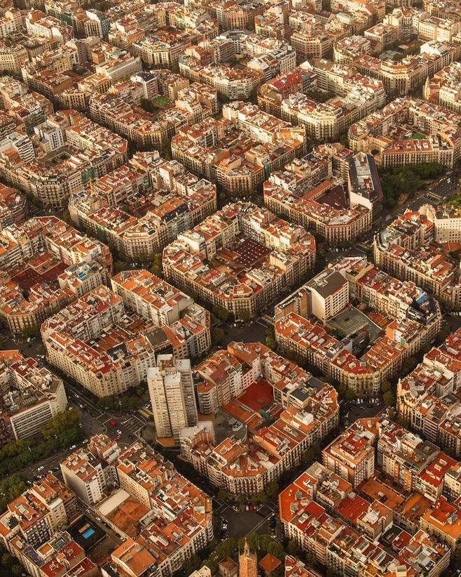
MQTT
MQTT（Message Queuing Telemetry Transport，消息队列遥测传输协议）,在物联网、小型设备、移动应用等方面有较广泛的应用。
产品：emqttd消息服务器
项目：智慧用电、
智慧停车

Slide 5
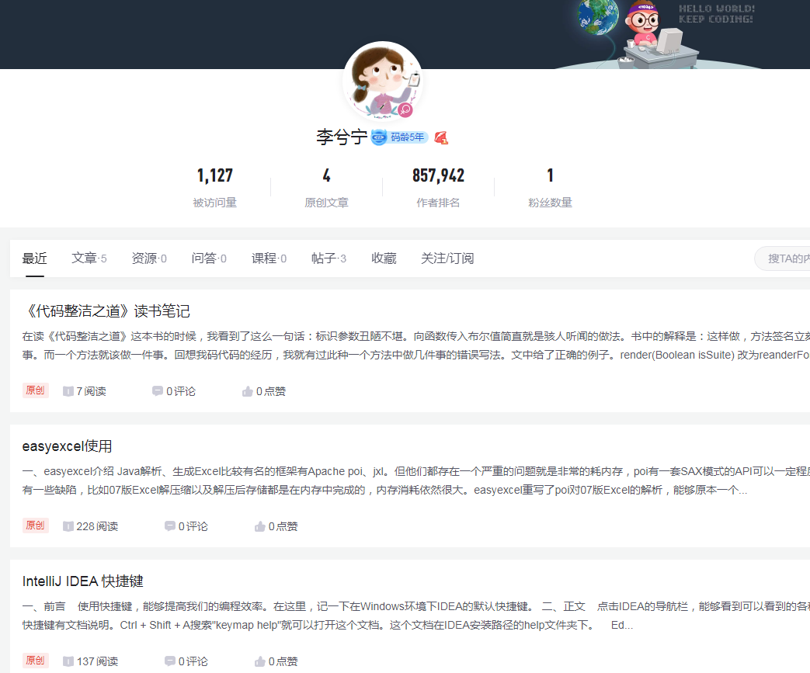
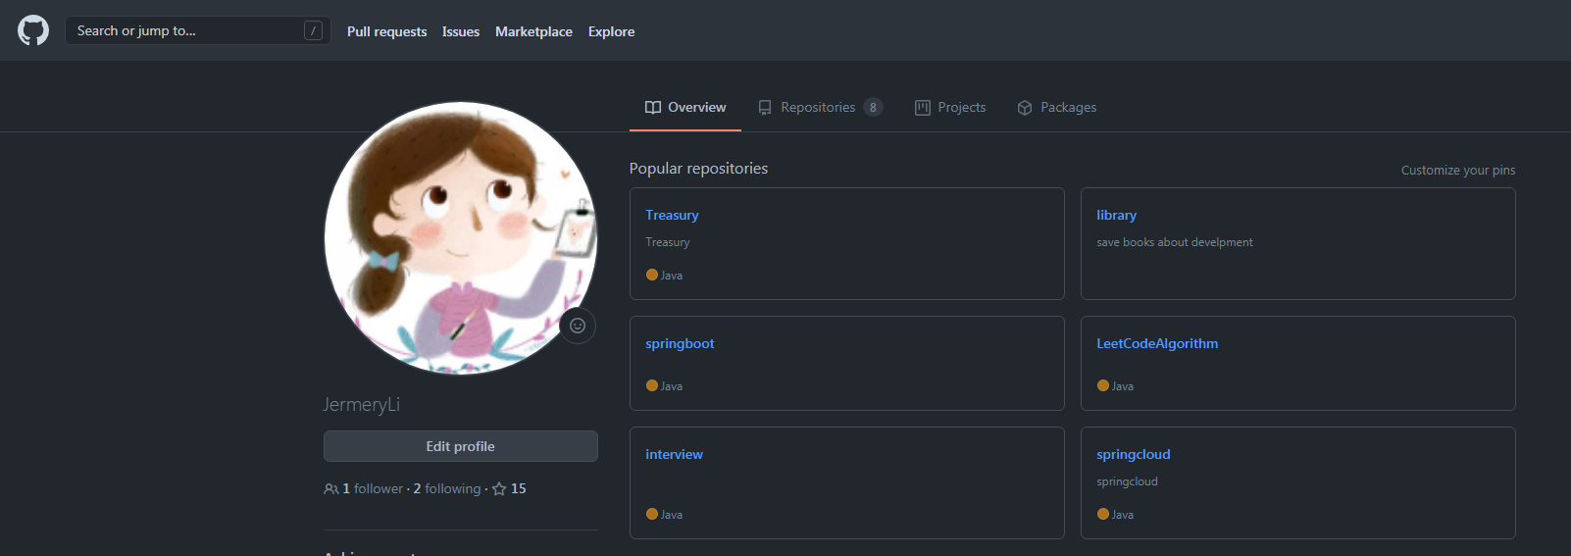
编程、思考、博客
https://blog.csdn.net/li_xiao_ning
https://github.com/JermeryLi

Slide 6
微服务的使用
SpringCloud Dubbo
项目：人像、社区

Slide 7
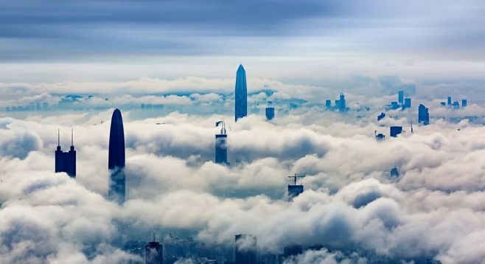
AI 中台
搭建应用、框架
接口封装（科大讯飞）
接口鉴权 （key、secret 、 headers）
接口QPS控制
日志记录

Slide 8

ANYONE
Anyone can make you smile. Many people can make you cry. But it takes someone really special to make you smile with tears in your eyes.
EUROPEAN
Anyone can make you smile. Many people can make you cry. But it takes someone really special to make you smile with tears in your eyes.

Slide 9


MINIMALISM
Anyone can make you smile. Many people can make you cry. But it takes someone really special to make you smile with tears in your eyes.
Anyone can make you smile. Many people can make you cry. But it takes someone really special to make you smile with tears in your eyes.

Slide 10

MINIMALISM
MINIMALISM
Anyone can make you smile. Many people can make you cry. But it takes someone really special to make you smile with tears in your eyes.
Anyone can make you smile. Many people can make you cry. But it takes someone really special to make you smile with tears in your eyes.

Slide 11
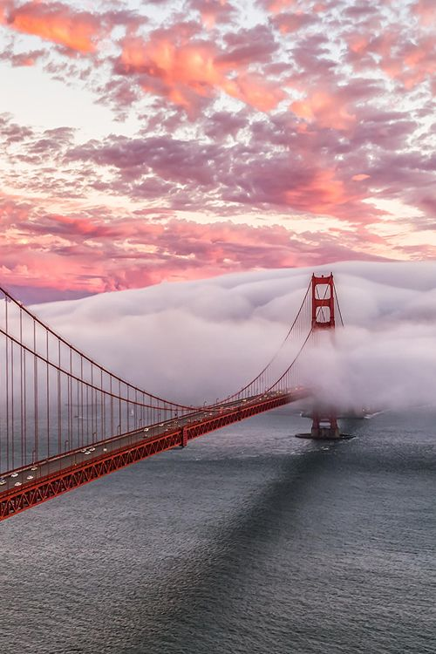
PART.02
02‘SPECIAL
Anyone can make you smile. Many people can make you cry. But it takes someone really special to make you smile with tears in your eyes.

Slide 12


EUROPEAN
SPECIAL
Anyone can make you smile. Many people can make you cry. But it takes someone really special to make you smile with tears in your eyes.
Anyone can make you smile. Many people can make you cry. But it takes someone really special to make you smile with tears in your eyes.

Slide 13

MINIMALISM
Anyone can make you smile. Many people can make you cry. But it takes someone really special to make you smile with tears in your eyes.
EUROPEAN
Anyone can make you smile. Many people can make you cry. But it takes someone really special to make you smile with tears in your eyes.

Slide 14
Anyone can make you smile. Many people can make you cry. But it takes someone really special to make you smile with tears in your eyes.
EUROPEAN
Anyone can make you smile. Many people can make you cry. But it takes someone really special to make you smile with tears in your eyes.

Slide 15
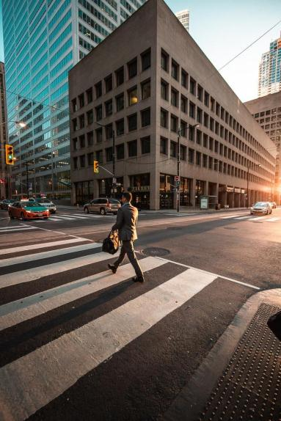

EUROPEAN
Anyone can make you smile. Many people can make you cry. But it takes someone really special to make you smile with tears in your eyes.
Anyone can make you smile. Many people can make you cry. But it takes someone really special to make you smile with tears in your eyes.

Slide 16

PART.03
03‘ANYONE
Anyone can make you smile. Many people can make you cry. But it takes someone really special to make you smile with tears in your eyes.

Slide 17
ANYONE
Anyone can make you smile. Many people can make you cry. But it takes someone really special to make you smile with tears in your eyes.
EUROPEAN
Anyone can make you smile. Many people can make you cry. But it takes someone really special to make you smile with tears in your eyes.

Slide 18



EUROPEAN
Anyone can make you smile. Many people can make you cry. But it takes someone really special to make you smile with tears in your eyes.

Slide 19

EUROPEAN
Anyone can make you smile. Many people can make you cry. But it takes someone really special to make you smile with tears in your eyes.
Anyone can make you smile. Many people can make you cry. But it takes someone really special to make you smile with tears in your eyes.

Slide 20

MINIMALISM
Anyone can make you smile. Many people can make you cry. But it takes someone really special to make you smile with tears in your eyes.
Anyone can make you smile. Many people can make you cry. But it takes someone really special to make you smile with tears in your eyes.

Slide 21

PART.04
04‘SMILE
Anyone can make you smile. Many people can make you cry. But it takes someone really special to make you smile with tears in your eyes.
PPT模板 http://www.1ppt.com/moban/

Slide 22

EUROPEAN
Anyone can make you smile. Many people can make you cry. But it takes someone really special to make you smile with tears in your eyes.
Anyone can make you smile. Many people can make you cry. But it takes someone really special to make you smile with tears in your eyes.
MINIMALISM

Slide 23

MINIMALISM
Anyone can make you smile. Many people can make you cry. But it takes someone really special to make you smile with tears in your eyes.

Slide 24

04‘SMILE
Anyone can make you smile. Many people can make you cry. But it takes someone really special to make you smile with tears in your eyes.
EUROPEAN
Anyone can make you smile. Many people can make you cry. But it takes someone really special to make you smile with tears in your eyes.
Anyone can make you smile. Many people can make you cry. But it takes someone really special to make you smile with tears in your eyes.

Slide 25

EUROPEAN
Anyone can make you smile. Many people can make you cry. But it takes someone really special to make you smile with tears in your eyes.
Anyone can make you smile. Many people can make you cry. But it takes someone really special to make you smile with tears in your eyes.

Slide 26
THANK
YOU
Anyone can make you smile. Many people can make you cry. But it takes someone really special to make you smile with tears in your eyes.

