Slide 1
Faster RCNN
RPN
region proposals
image
CNN
feature map
FC
classification scores
CNN
RoIs
RoI Pooling
FC
bounding box regression
selected RoIs
RoI Align
FCN
mask

Slide 2

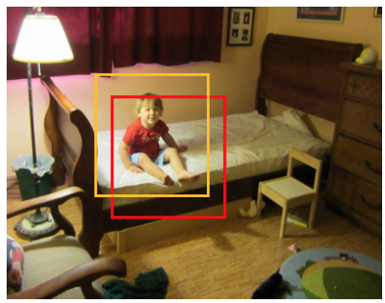

Mask
GT
loss
RoI Pooling+
FCN
Conv
？
loss

Slide 3
Mask
Log+softmax
GT
m
m
K
K
m
m
Mask
GT
m
m
Log+sigmoid
K
K
m
m

