Slide 1
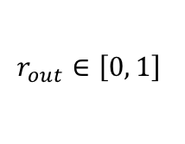
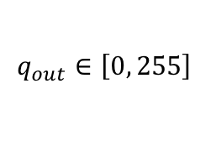





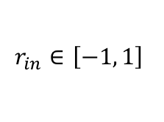
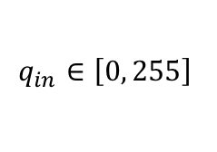
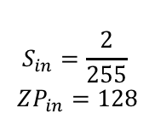


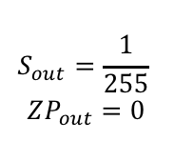
$$x$$
Conv
$$y$$
BN
$$y_{bn}$$
$$r_{in}∈\left[−1, 1\right]$$
$$r_{out}∈\left[0, 1\right]$$
$$r_{in}=0.5$$
ReLU
$$r_{out}=0.5$$
$$S_{in}=\frac{2}{255}$$
$$ZP_{in}=128$$
$$S_{out}=\frac{1}{255}$$
$$ZP_{out}=0$$
$$q_{in}=192$$
ReLU
$$q_{out}=192$$
$$q_{in}∈\left[0, 255\right]$$
$$q_{out}∈\left[0, 255\right]$$

Slide 2


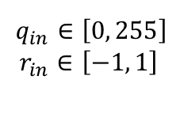

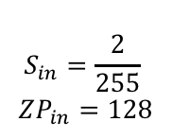
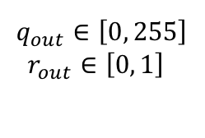
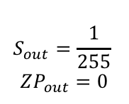



$$q_{in}∈\left[0, 255\right]$$
$$r_{in}∈\left[−1, 1\right]$$
$$q_{out}∈\left[0, 255\right]$$
$$r_{out}∈\left[0, 1\right]$$
$$S_{in}=\frac{2}{255}$$
$$ZP_{in}=128$$
$$S_{in}=\frac{2}{255}$$
$$ZP_{in}=128$$
Conv
ReLU
$$r_{in}=−0.5$$
$$r_{out}=0$$
$$q_{in}=64$$
$$q_{out}=128$$
Merge ReLU in Conv
$$q_{out}∈\left[0, 255\right]$$
$$r_{out}∈\left[0, 1\right]$$
$$S_{out}=\frac{1}{255}$$
$$ZP_{out}=0$$
Conv
$$r_{in}=−0.5$$
$$r_{out}=0$$
$$q_{out}=0$$

