Slide 1

Automated Code Documentation
& Bug Report Analysis
Name: Jernai Bennett
Major: Data Science and Ai – Computational Data Analytics Track
Mentor: Olualowa Odigun
Class: Capstone in Data Science
Notes:
"Good [morning/afternoon], my name is Jernai Bennett and I'm a graduate student in the MS Data Science and AI program here at FIU. Today I'll be presenting my capstone project. I'll walk you through the motivation behind this work, my goals for the semester, my data sources, and the next steps I'll be taking."

Slide 2
Project Overview & Motivation
Problem Statement
Software documentation is time-consuming and error-prone when written manually
Bug reports are verbose; engineers spend significant time parsing them
LLMs offer a path to automated, context-aware code summarization
Motivation
Software documentation is one of the most neglected parts of development
Writing documentation manually is inconsistent, error-prone, and rarely prioritized under tight deadlines.
Bug reports on platforms like GitHub are verbose and unstructured
Existing NLP models trained on general text struggle with code-specific vocabulary, syntax, and logic structures
2
Notes:
The core motivation here comes from a real pain point in software engineering. Research shows developers spend roughly 20 to 30 percent of their time on documentation tasks — time that could be spent building. And even when documentation exists, it's often inconsistent or gets outdated quickly when code changes hands between teams. The opportunity I see is using a code-specific language model to automate this work at scale. On the challenges side — and this is something that came up during my data exploration — collecting high quality, multi-language code samples at scale is non-trivial. Code syntax varies wildly between languages, and a lot of publicly available code has messy or missing comments that require significant cleaning before they're useful for training."

Slide 3
Goals
Automate code documentation and bug report summarization using fine-tuned encoder-decoder models
Compare full fine-tuning vs. parameter-efficient adaptation (LoRA) to identify the best approach for resource-constrained deployment
Build a reproducible evaluation pipeline applicable to future code NLP tasks
3

Slide 4
Objectives
Train and compare CodeT5-small, CodeT5+ 220M, and CodeT5+ 220M + LoRA on a combined Python documentation and bug report dataset
Implement a 4-metric evaluation suite (BLEU-4, ROUGE-L, METEOR, CodeBLEU) to measure both surface-level and semantic output quality
Apply PyPlus-style target enrichment to improve supervision signal during training
Select the best-performing model and run full fine-tuning on the combined dataset
Evaluate generalization across two task domains: structured docstring generation and unstructured bug report summarization
4
Notes:
The core objective of this project is to fine-tune CodeT5 — which is a pre-trained transformer model specifically built for code — on two tasks: generating documentation from source code, and summarizing/classifying bug reports from GitHub Issues. CodeT5 was pre-trained on over 8.3 million code-function pairs from GitHub, so it already understands programming syntax and semantics. My job this semester is to get the data right. That means collecting the datasets, cleaning and preprocessing them, validating quality, and establishing baseline evaluation metrics so I have something to compare my fine-tuned model against later."

Slide 5
Prior Art & Anticipated Challenges
Shaalan & Zakaria 2023 (ConcodePlus)
Fine-tuned CodeT5-small specifically on the Python subset of CodeSearchNet for automated code documentation
demonstrated that a lightweight 60M parameter model could generate meaningful docstrings when trained on high-quality, filtered pairs
introduced logic-enriched target summaries (PyPlus) that append block-level descriptions derived from the AST to the docstring
Challenges
GPU memory and compute budget may not be sufficient for task
Dataset scale is extensive with over 2 million samples in 6 languages, requires reduction
Filters selected must capture high quality data and remove noise
Wang et al. (2021). CodeT5: Identifier-aware Unified Pre-trained Encoder-Decoder Models for Code Understanding and Generation. EMNLP 2021.
5

Slide 6
Data Sources & Description
CodeSearchNet — Python
Source: Hugging Face, contains 412,178 Python functions
Fields:
full function code
Docstring
tokenized representations
repository metadata
~30% of raw samples contained noise:
placeholder docstrings,
single-word comments
near-empty bodies
Quality filter:
10–200 doc words
50–8,000 code chars, ≥3 identifiers
286K pairs retained (69.4%)
Husain, H., Wu, H., Gazit, T., Allamanis, M., & Brockschmidt, M. (2019). CodeSearchNet Challenge: Evaluating the State of Semantic Code Search. Retrieved from: https://huggingface.co/datasets/code-search-net/code_search_net
6
Notes:
"My primary dataset is CodeSearchNet, which is an industry-standard benchmark dataset originally released by GitHub and Microsoft Research. It contains over 1 million function-documentation pairs spanning 6 programming languages — Python, Java, JavaScript, PHP, Ruby, and Go. The key advantage of this dataset is that the alignments between code and documentation already exist — they come from real open-source repositories where developers wrote docstrings and comments. This makes it ideal for supervised fine-tuning on the documentation generation task. I'm using the Hugging Face version of this dataset, which is well-maintained and easy to load programmatically."
References to add:

Slide 7
Data Sources & Description
GitHub Issues Dataset
Source: HuggingFace, contains 114,073 real-world issues
Fields: title, body, labels, priority, severity
Body length highly variable, ranged from one-liners to full incident reports
48.3% contain embedded code blocks
Quality filter: title ≥3 words, body 20–600 words, no generic titles ("bug", "fix") → 100,947 retained (88.5%)
sharjeelyunus (2023). GitHub Issues Dataset. Retrieved from: https://huggingface.co/datasets/sharjeelyunus/github-issues-dataset
7
Notes:
My secondary dataset is a GitHub Issues dataset from Kaggle containing over 500,000 labeled bug reports across popular open-source repositories. Each issue is tagged with a category — bug, feature request, question, or documentation. This dataset supports the bug report analysis component of the project, where the goal is to train the model to understand and summarize real developer-written issue descriptions. One thing I'll need to handle carefully here is class imbalance — bug labels are typically underrepresented compared to feature requests and general questions, so part of my preprocessing work will involve handling that."

Slide 8
Methods & Tools
Google Colab Pro :
initial development and prototyping; T4 GPU (15GB VRAM)
Google Cloud Platform (GCP) :
production training environment; A100 40GB GPU
Hugging FaceTransformers:
AutoTokenizer, RobertaTokenizer for tokenization
Python AST module:
identifier extraction, logic summary generation and quality filtering
Pandas and NumPy:
EDA summary statistics
Matplotlib and Seaborn:
EDA visualizations
HuggingFace evaluate:
CODEBLEU, BLEU-4, ROUGE-L, METEOR
8

Slide 9
EDA Results: CodeSearhNet
Descriptive Statistics
Metric | Mean | Median | Std
Code chars | 981 | 615 | 1,315
Code lines | 24.5 | 17 | 28.1
Doc words | 34.2 | 19 | 52.6
Identifiers | 23.8 | 14 | 33.0
Key Findings
High docstring coverage (99.7%) makes CSN ideal for supervised doc generation training.
Only ~32% of functions have structured param docs.
Wide variance in code length (std 1,315 chars) motivates the 50–8,000 char quality filter.
Identifier-aware tokenization (CodeT5 feature) well-suited: avg. 23.8 identifiers per function.
EDA on 8,000 randomly sampled training examples. CodeT5 identifier-aware pretraining: Wang et al. 2021 (EMNLP).
9
Notes:
Now I'll walk through what the exploratory data analysis revealed. Looking at the descriptive statistics for CodeSearchNet — the average function is about 981 characters long with a median of 615, which tells us the distribution is right-skewed, meaning a small number of very long functions are pulling the mean up. The average docstring is 34 words with a median of 19, again right-skewed. What's most relevant to the model is the identifier count — on average 23.8 identifiers per function, which is exactly why CodeT5's identifier-aware pretraining is such a strong fit for this dataset. The wide standard deviation in code length — 1,315 characters — is what motivated the 50 to 8,000 character quality filter I applied during preprocessing."

Slide 10
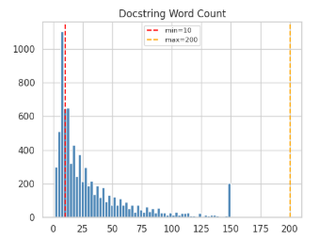
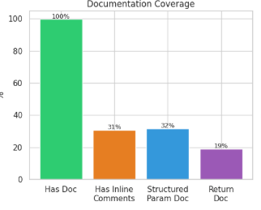
EDA Results: CodeSearchNet
Red dashed lines = quality filter thresholds. Documentation Coverage (bottom-left): Has Doc 100%, Inline Comments 31%, Structured Param Doc 32%, Return Doc 19%.
10
Notes:
These plots give a visual picture of the distributions. The red dashed lines mark the quality filter thresholds I applied. You can see that the bulk of the data falls well within the filter bounds, which confirms the 69.4% retention rate wasn't arbitrary — most functions genuinely met quality standards. The documentation coverage breakdown in the bottom left is particularly important: while 100% of retained samples have a docstring, only about 32% have structured parameter documentation and 19% have return documentation. That low structured doc rate is actually what motivated the PyPlus target enrichment strategy I mentioned in the objectives — without it, most training targets would be thin one-sentence summarie

Slide 11
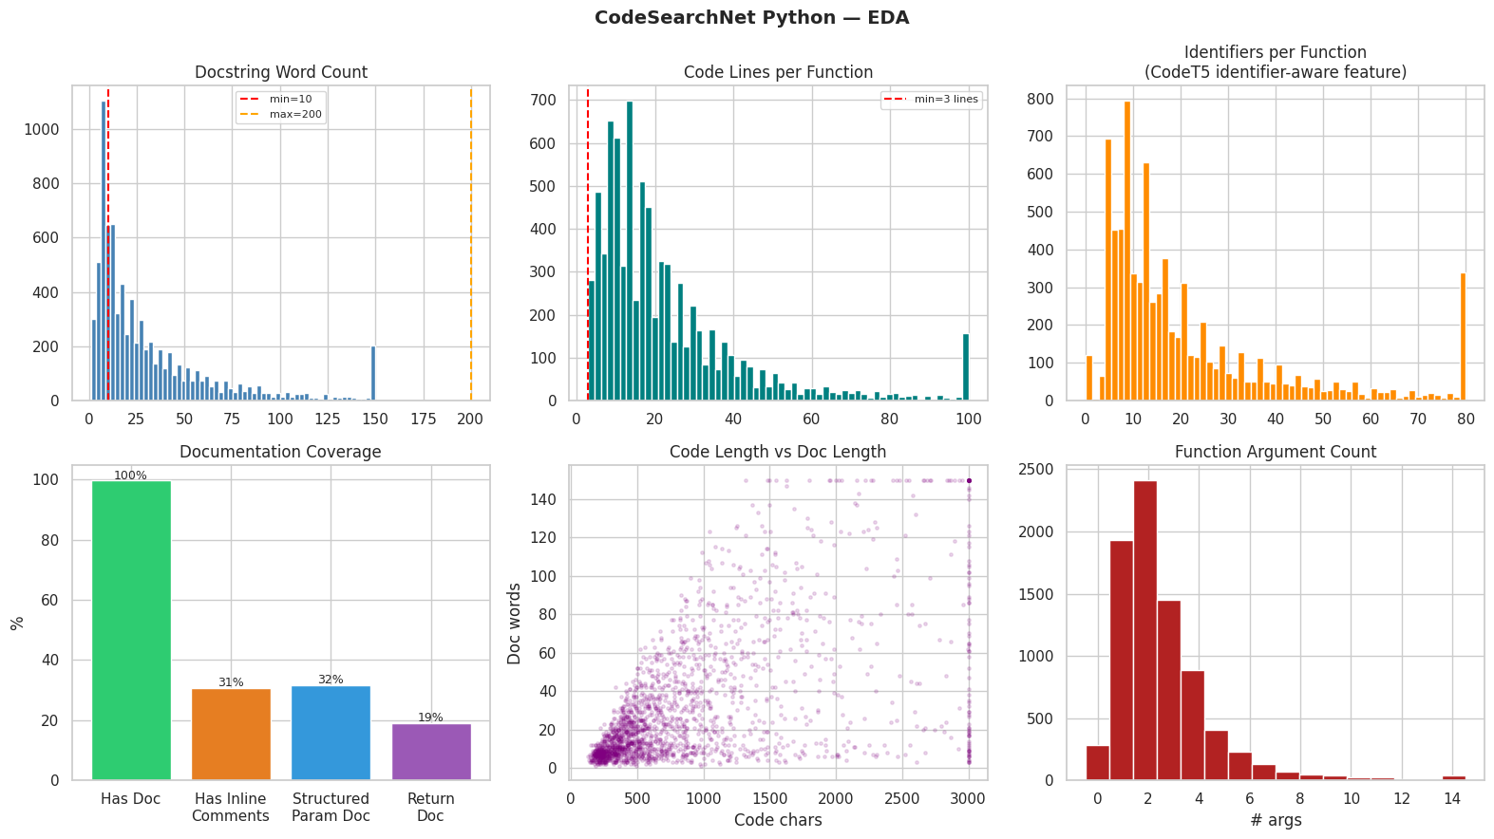
EDA Results: CodeSearchNet
Red dashed lines = quality filter thresholds. Documentation Coverage (bottom-left): Has Doc 100%, Inline Comments 31%, Structured Param Doc 32%, Return Doc 19%.
11
Notes:
These additional plots reinforce the same story. The distributions confirm that code length and docstring length both follow a long-tail pattern, which is common in real-world codebases. The concentration of samples in the lower ranges is a good sign — it means the model will be trained mostly on reasonably sized functions rather than outliers. The identifier distribution also clusters in a range that CodeT5 handles well given its pretraining, so we're working with the model's strengths rather than against them.

Slide 12
EDA Results: CodeSearchNet
Red dashed lines = quality filter thresholds. Documentation Coverage (bottom-left): Has Doc 100%, Inline Comments 31%, Structured Param Doc 32%, Return Doc 19%.
12
Notes:
This final set of CodeSearchNet EDA plots gives a fuller picture of the data after filtering. Together, these three slides of visualizations validate the preprocessing decisions — the filters were calibrated to the actual distribution of the data, not arbitrary cutoffs. The retained 286,000 pairs represent a clean, representative sample that should give the model a strong and consistent training signal for the documentation generation task."

Slide 13
EDA Results: Github Issues
Descriptive Statistics
Metric | Mean | Median | Max
Title words | 7.5 | 7 | 26
Body words | 181.8 | 123 | 18,481
Label count | N/A | N/A | top: needsInvestigation
Key Findings
48.3% of issues include code blocks — high lexical overlap with CSN, justifying shared architecture
Body word count is heavily right-skewed (std 339) — max-length cap of 600 words prevents noisy targets
Low traceback/error-msg rates mean model must learn semantic summarization, not pattern matching
Dataset: sharjeelyunus/github-issues-dataset (HuggingFace). Quality filter: title ≥3 words, body 20–600 words; generic single-word titles discarded.
13
Notes:
Shifting to the GitHub Issues dataset — the statistics here tell a very different story from CodeSearchNet. Title length is fairly compact, averaging 7.5 words with a median of 7, which makes titles strong summarization targets. The body length distribution is where things get interesting — a mean of 181 words but a median of only 123, with a maximum of 18,481 words. That extreme right skew is why the 600-word cap in the quality filter was essential. Without it, a handful of massive incident reports would have dominated batch loss and pushed the model toward generating unnecessarily verbose outputs. The most common label in the dataset is 'needsInvestigation,' which reflects how real-world issue tracking actually works."

Slide 14
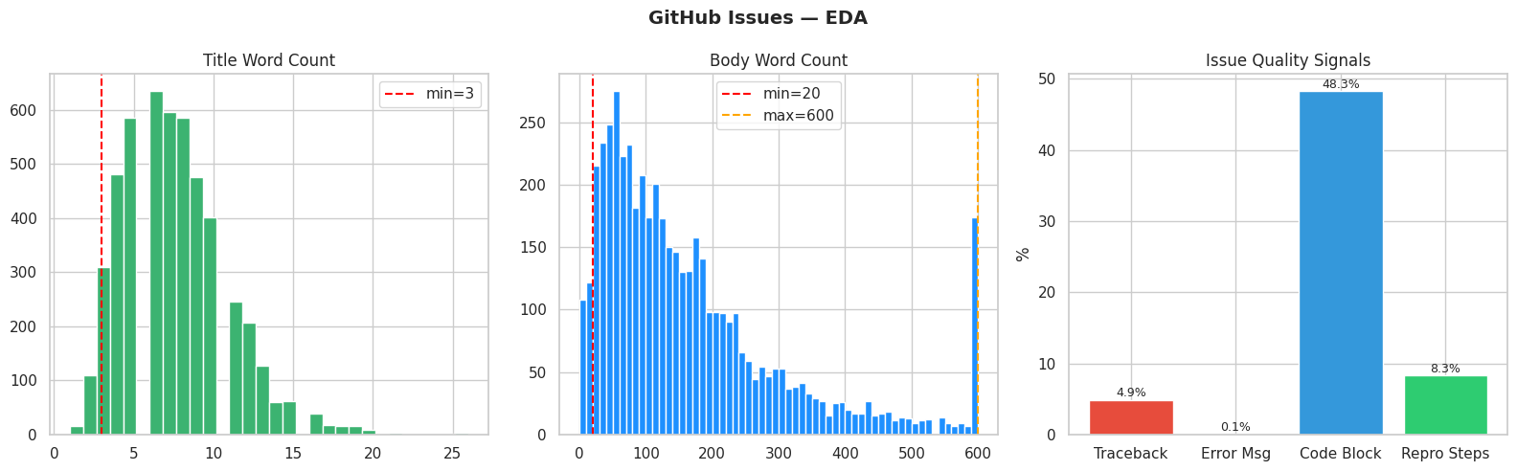
EDA Results: Github Issues
Majority of issue titles are brief and descriptive, making them suitable summarization targets.
The red dashed line at min=3 words filters out single-word generic titles like "bug", "fix", and "help" that carry no meaningful content for the model to learn from
14
Notes:
"This plot shows the distribution of title word counts. The distribution peaks between 5 and 8 words with a median of 7, and is right-skewed. The red dashed line at 3 words marks the minimum threshold from my quality filter — it cuts out single-word or near-empty titles like 'bug,' 'fix,' or 'help' that carry no meaningful content for the model to learn from. The fact that the vast majority of titles fall well above that threshold confirms that most issue reporters do write descriptive titles, making them suitable summarization targets."

Slide 15
EDA Results: Github Issues
The wide spread reflects the diversity of GitHub issue quality, ranging from one-line questions to full incident reports with logs and stack traces.
15
Notes:
The original dataset before preprocessing had heavily right-skewed distribution with a median of 123 words but a mean of 182 and a maximum of 18,481.
The orange dashed line at max=600 words confirms the cap was essential .Without it, a small number of extremely long issues would have dominated batch loss and pushed the model to generate unnecessarily verbose summaries.

Slide 16
EDA Results: Github Issues
Code blocks are present in 48.3% of issues
The low traceback rate (4.9%) and near-zero error message rate (0.1%) reveal that the majority of issues are written in natural language rather than structured error output
16
Notes:
by far the strongest quality signal, and the key justification for training a single shared model across both CodeSearchNet and GitHub Issues, since both datasets share significant code vocabulary overlap.
this means the model cannot rely on pattern matching and must learn to semantically understand and compress the issue description

Slide 17
Discussion
The 99.7% docstring coverage in CSN confirms supervised fine-tuning was the right approach, no semi-supervised methods needed.
Low structured param doc rate (32%) validates the PyPlus enrichment decision
Scoping to Python-only and applying strict quality filtering produced a cleaner training distribution, expected to reduce noise in evaluation.
Training on both CSN and GitHub Issues tests with a single encoder-decoder generalizes across structured and unstructured text
EDA was conducted on a sample so distributions may shift slightly at full scale; full model comparison results are pending.
17
Notes:
"Pulling the EDA findings together — a few key decisions get validated here. The 99.7% docstring coverage in CodeSearchNet confirmed that supervised fine-tuning was the right approach; there was no need for semi-supervised methods since nearly every sample has a clean label. The low structured parameter doc rate of 32% validates the PyPlus enrichment decision — without enriched targets, most training examples would have been thin one-sentence summaries with limited signal. Scoping to Python only and applying strict quality filters produced a cleaner training distribution, which we expect to reduce noise in evaluation. And training on both datasets together tests whether a single encoder-decoder can generalize across structured docstring generation and unstructured bug report summarization — a key practical finding for multi-task deployment. One caveat worth noting: the EDA was conducted on samples of 8,000 and 5,000 respectively, so distributions may shift slightly at full scale. Full model comparison results are still pending."

Slide 18
Contribution
Full EDA on both datasets (8000 CodeSearchNet + 5000 Github Issues samples)
Quality filtering pipeline: 69.4% CSN, 88.5% GH retained
PyPlus target enrichment across all 200K+ CSN pairs
All 4 metrics verified and operational
Model registry defined, tokenizers patched and validated
Comparison training framework implemented on GCP A100
18

Slide 19
Conclusion
Automated code documentation and bug report summarization is a tractable problem when the right model architecture and data quality standards are applied
CodeSearchNet and GitHub Issues together provide complementary training signal — structured docstrings and unstructured natural language — that tests real generalization
Fine-tuning a code-specific model like CodeT5 is more effective than applying general-purpose NLP models to code, given the unique vocabulary and syntax of programming languages
19

Slide 20
Next Steps
Run full comparison (all 3 models × 3 epochs)
Select best model by composite BLEU/ROUGE/METEOR/CodeBLEU
Full fine-tuning on combined 225K dataset (CodeSearchNet + Github Issues)
Final evaluation of CodeSearchNet and Github Issues separately
Inference demo on unseen code and bug report examples
20
Notes:
The immediate next step is running the full comparison across all three models — CodeT5-small, CodeT5+ 220M, and CodeT5+ 220M with LoRA — each trained for three epochs. From there I'll select the best-performing model based on a composite score across BLEU-4, ROUGE-L, METEOR, and CodeBLEU, then run full fine-tuning on the combined 225,000-sample dataset. Final evaluation will be done separately on CodeSearchNet and GitHub Issues to measure how well the model generalizes across both task domains. I'll also run inference demos on unseen code and bug report examples to qualitatively validate the outputs. If time permits, the stretch goal is building a lightweight interface for deployment."

Slide 21
References
[1]
Wang, Y., Wang, W., Joty, S., & Hoi, S. C. H. (2021). CodeT5: Identifier-aware Unified Pre-trained Encoder-Decoder Models for Code Understanding and Generation. In Proceedings of EMNLP 2021, pp. 8696–8708. ACL. https://aclanthology.org/2021.emnlp-main.685
[6]
Papineni, K., Roukos, S., Ward, T., & Zhu, W.-J. (2002). BLEU: A Method for Automatic Evaluation of Machine Translation. In Proceedings of ACL 2002, pp. 311–318.
[2]
Wang, Y., Le, H., Gotmare, A. D., Bui, N. D. Q., Li, J., & Hoi, S. C. H. (2023). CodeT5+: Open Code Large Language Models for Code Understanding and Generation. In Proceedings of EMNLP 2023, pp. 1069–1088. ACL. https://aclanthology.org/2023.emnlp-main.68
[7]
Lin, C.-Y. (2004). ROUGE: A Package for Automatic Evaluation of Summaries. In Proceedings of ACL Workshop on Text Summarization Branches Out, pp. 74–81.
[3]
Hu, E. J., Shen, Y., Wallis, P., Allen-Zhu, Z., Li, Y., Wang, S., Wang, L., & Chen, W. (2021). LoRA: Low-Rank Adaptation of Large Language Models. arXiv:2106.09685. https://arxiv.org/abs/2106.09685
[8]
Banerjee, S., & Lavie, A. (2005). METEOR: An Automatic Metric for MT Evaluation with Improved Correlation with Human Judgments. In Proceedings of the ACL Workshop on Intrinsic and Extrinsic Evaluation Measures, pp. 65–72.
[4]
Shaalan, K., & Zakaria, L. (2023). Code Generation Documentation Using CodeT5. In Proceedings of the International Conference on Advanced Intelligent Systems and Informatics (AISI 2023). Springer.
[9]
Ren, S., Guo, D., Lu, S., Zhou, L., Liu, S., Tang, D., Sundaresan, N., Zhou, M., Blanco, A., & Ma, S. (2020). CodeBLEU: A Method for Automatic Evaluation of Code Synthesis. arXiv:2009.10297. https://arxiv.org/abs/2009.10297
[5]
Husain, H., Wu, H.-H., Gazit, T., Allamanis, M., & Brockschmidt, M. (2019). CodeSearchNet Challenge: Evaluating the State of Semantic Code Search. arXiv:1909.09436. https://arxiv.org/abs/1909.09436
21

