Slide 1
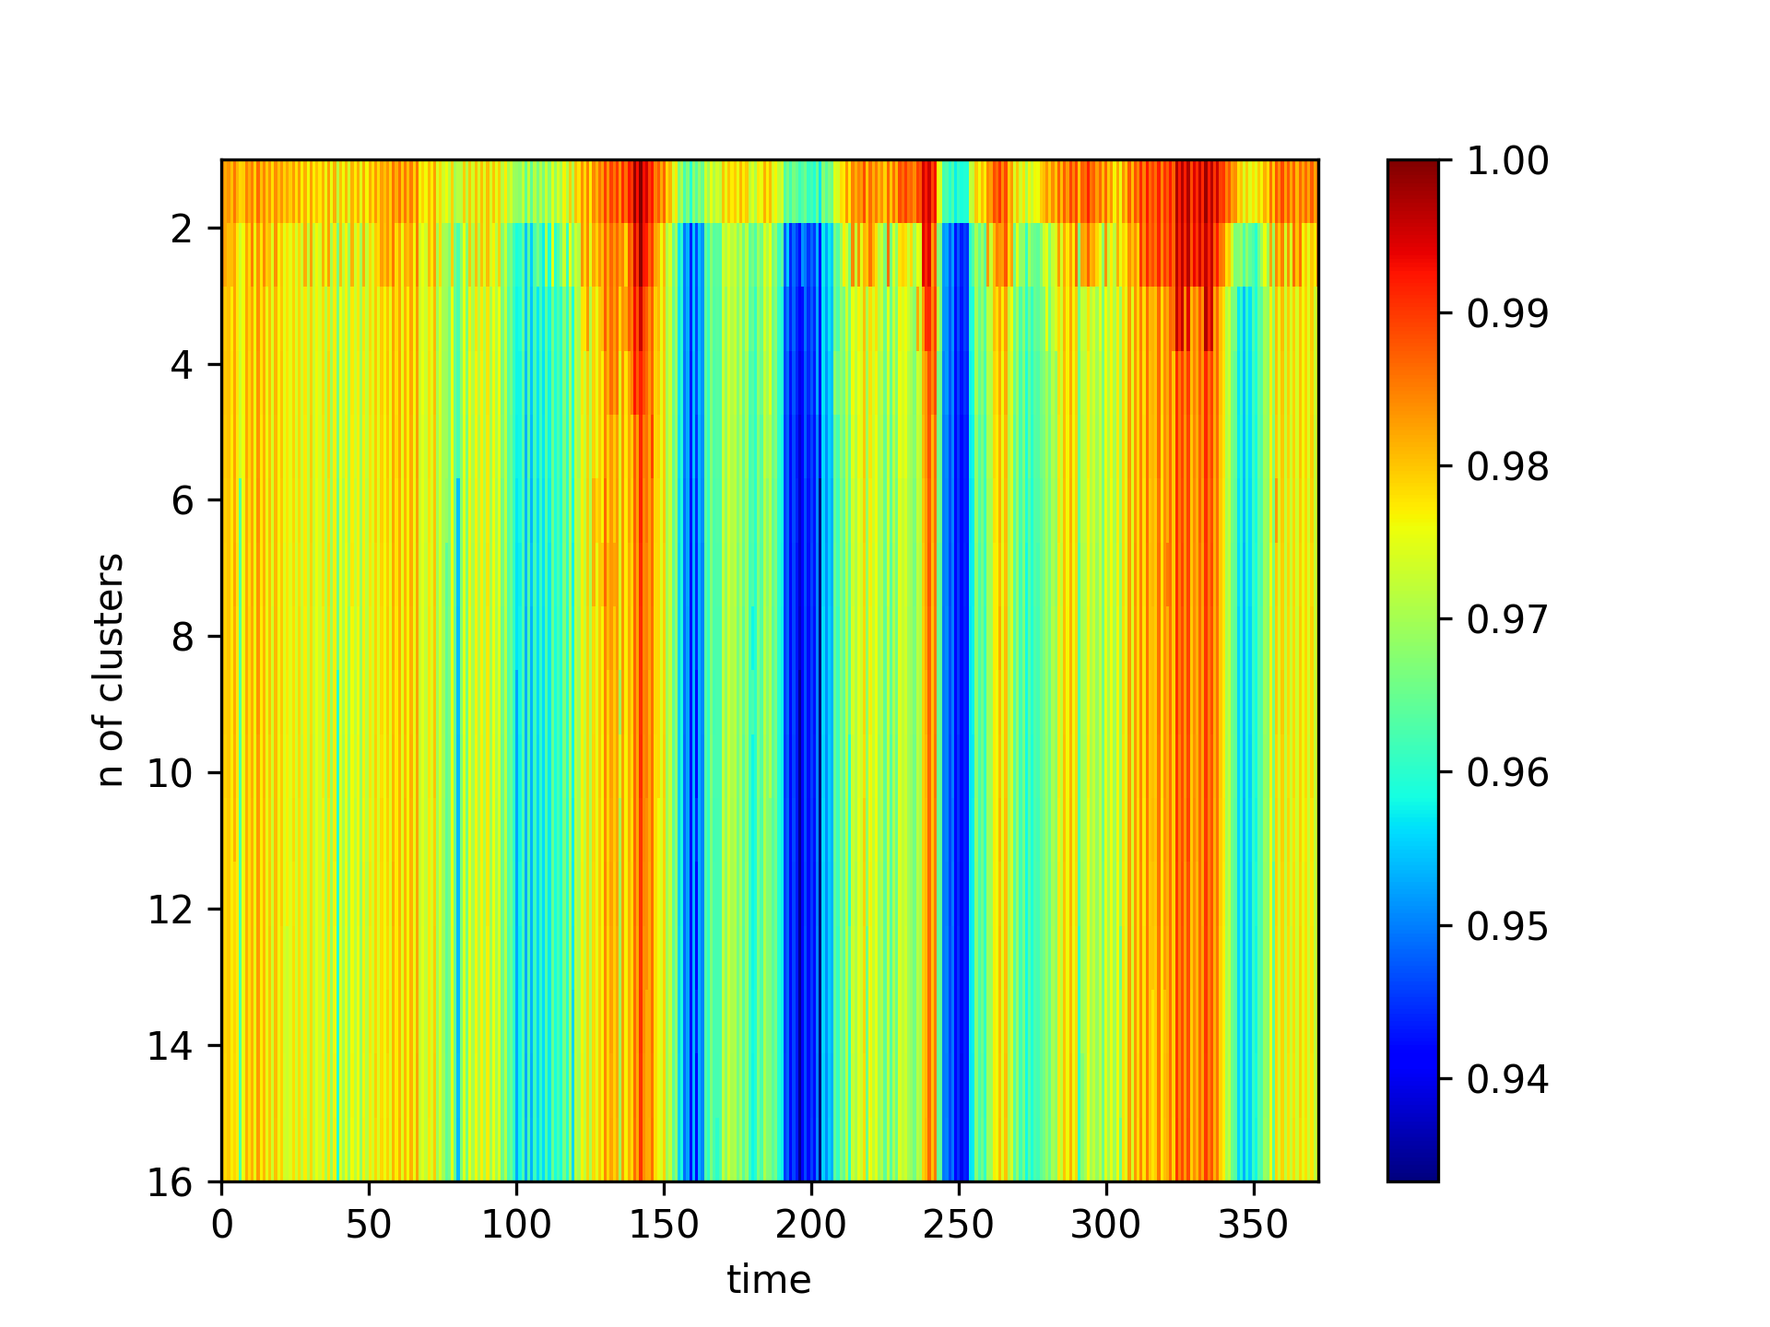
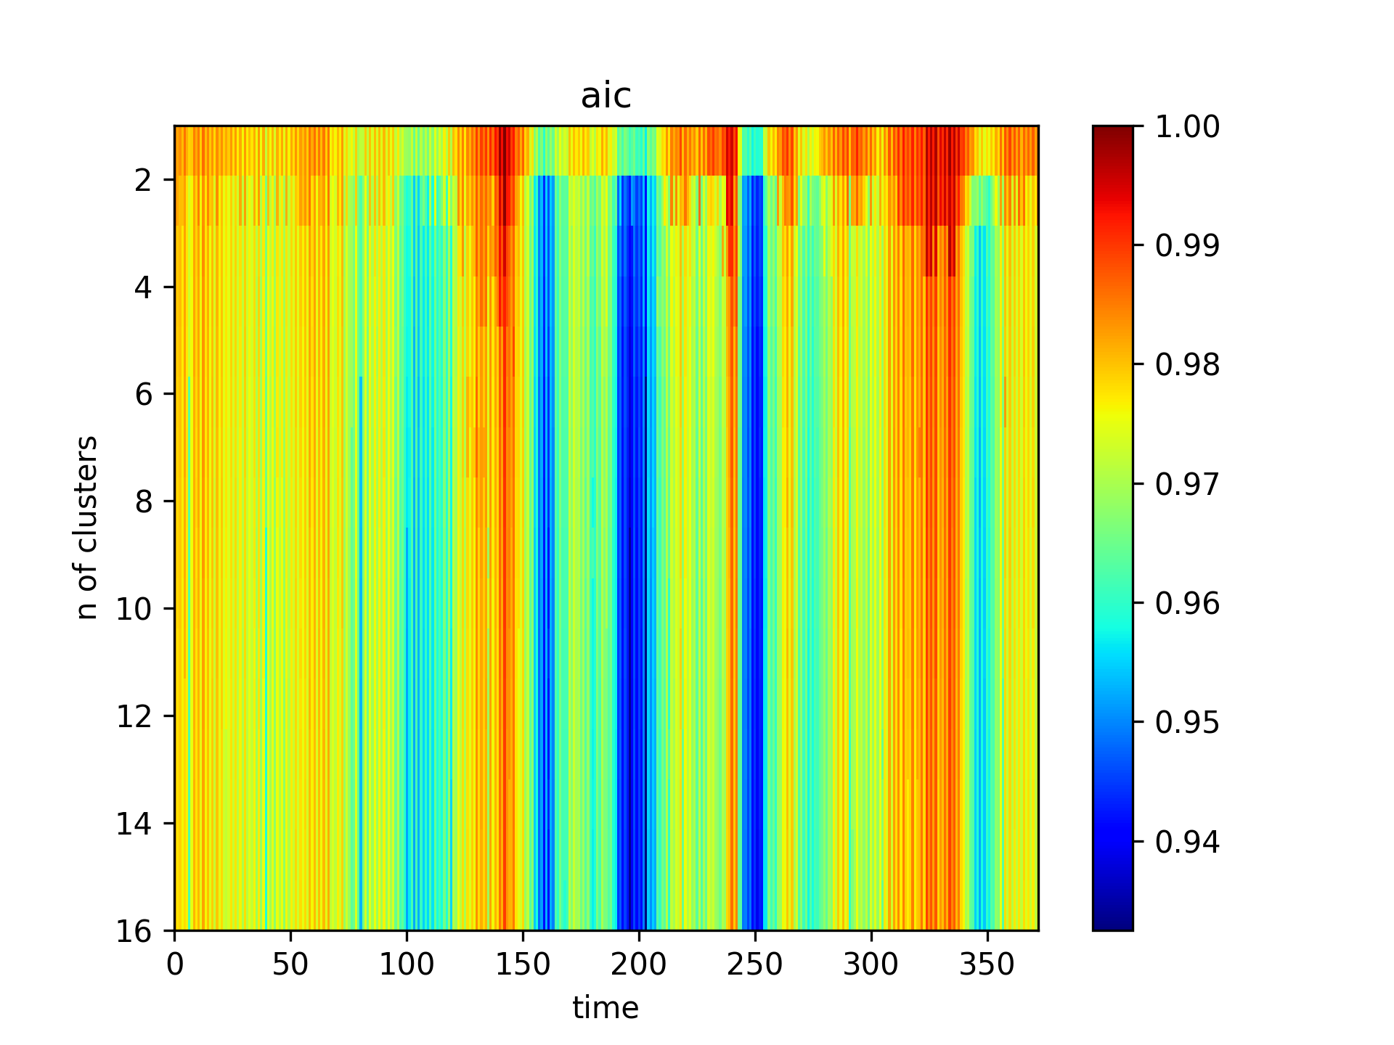
BIC or AIC → same conclusion
BIC

Slide 2
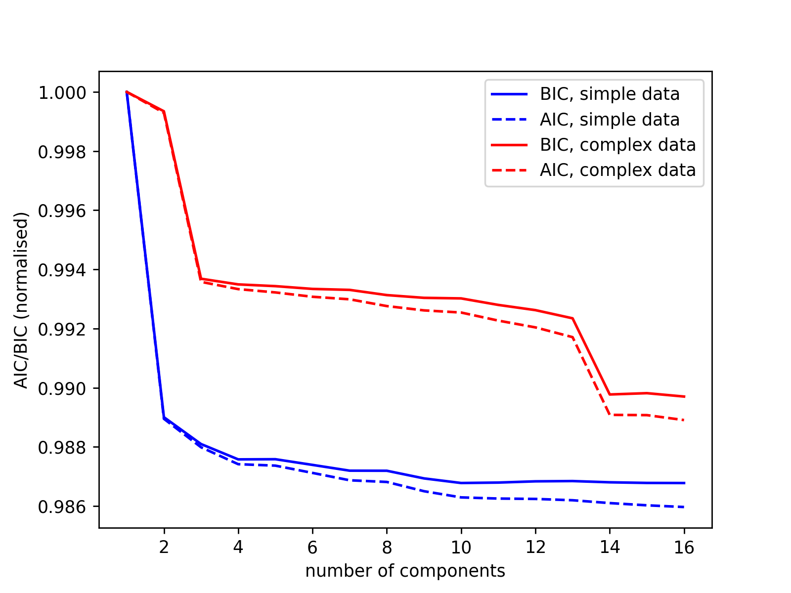

Slide 3
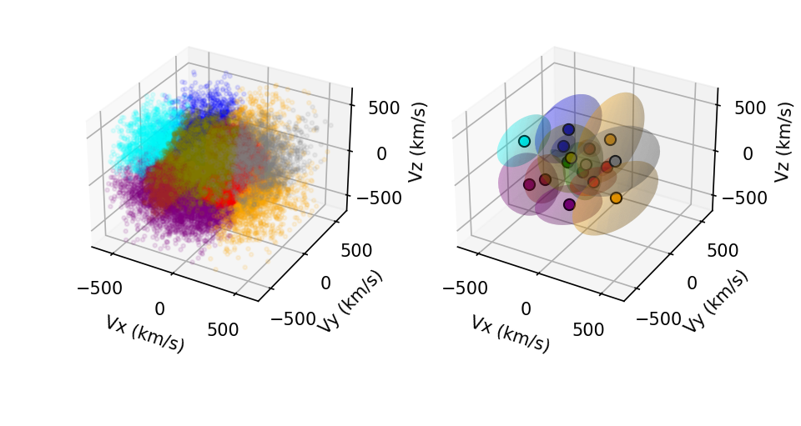
“complex data”

Slide 4
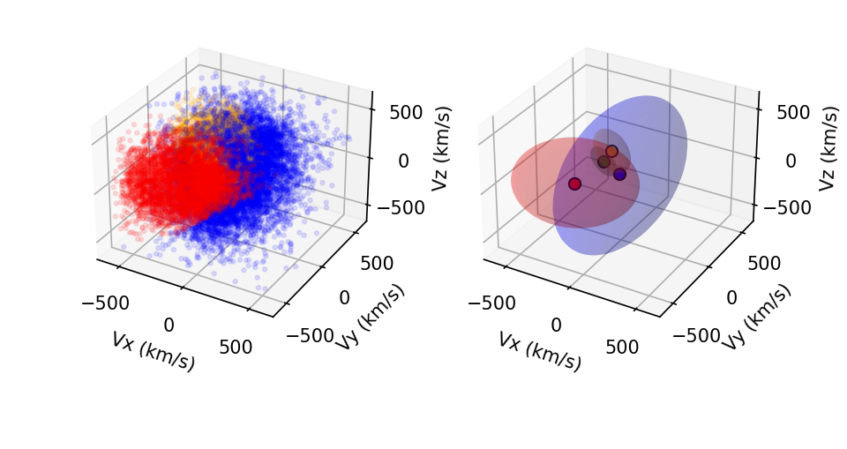
“simpler” distribution

Slide 5
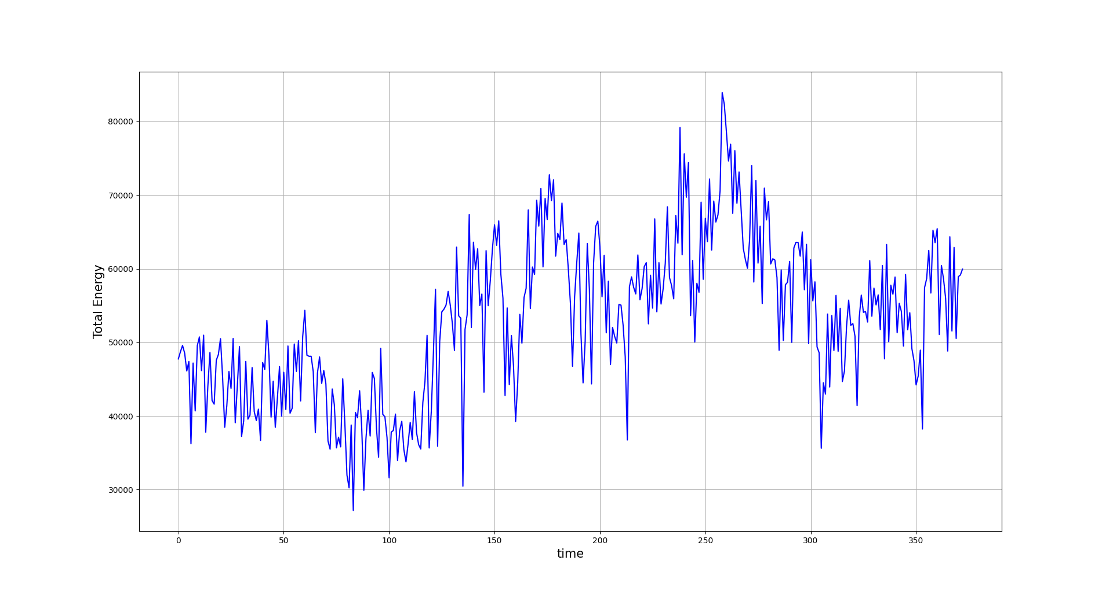
Kinetic energy
(per unit mass)
Interpretation?
Thermal energy ~kT? (per unit mass? To compare)
Where to find T?

Slide 6
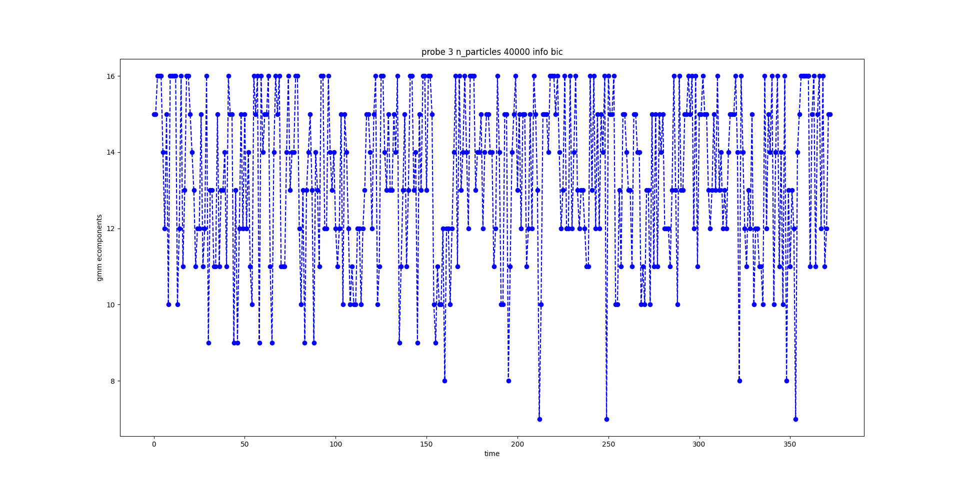
#components vs time

