Slide 1
Les 3
Divide-and-conquer : construction decision trees

Slide 2
Huiswerk vragen les 2 deel I
Wrong data?
What is a common solution for a missing value in a nominal dataset ?
Give at least 4 explanation of missing values (page 58)
Give at least 5 explanation of inaccurate values (page 59)

Slide 3
Huiswerk vragen les 2 deel II
Converting numeric valus to categories
How do you / should you convert numeric values into categories?
Simpel discretization method (page 87 and 88)
What are the steps to convert numeric to groups (catageries)?
How do you deal with multiple data values with the same numeric value.? Example (72 and 75) 70 71 72 72 73 75 75 80
no no no yes yes yes yes no
What are the pro and con if you make a group each time the traget value changes 64 | 65 68 69 | 70 71 | 83 | 85 no | yes yes yes | no no | yes | no … grp1 grp2 grp3 grp 4
Suppose minium limit is 3. What will be the result , give example below 30 32 33 35 36 37 40 41 50 51 53 60 61 62 63 64 65 66 yes no yes yes no no yes no yes yes no no yes no no yes yes yes
Is their a reason that the limit is odd? Is it allow that the limit is even ?

Slide 4
Huiswerk vragen les 2 deel II
Statistical modeling (par 4.2)
What are the two assumptions ?
Are they true?
What formula is use to calculate likelihood?
What do you get if you have calculate the likelihood?
What do you do with missing values (page 94) ?
Weka
How can you get the counts and probabilites of the data set?
Does the result differ form Witten? If so :
what is the reason ?
what can we do about it?

Slide 5
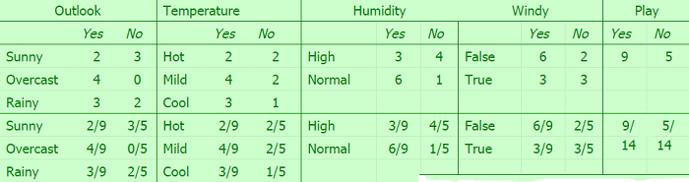
Huiswerk vragen les 2 deel III
Questions about the situation:
Outlook: rainy, temperature: mild, humidity: high, windy: no , play:yes
Statistical modeling
Caculate the likelihood :
Choose your answer(s)
3* 4*3*6*9
2*2*4*2*5
3* 4*3*6*9/(9*9*9*9*9)
2*2*4*2*5//(9*9*9*9*9)
3*5*3*6
2*2*4*2
3* 4*3*6/(9*9*9*9)
2*2*4*2//(9*9*9*9)
Answer 3 * 100%
Answer 4 * 100%
Answer 7 * 100%
Answer 8* 100%
3* 4*3*6*9/(5*5*5*5*5)
2*2*4*2*5//(5*5*5*5*5)
3* 4*3*6*9/(14*14*14*14*14)
2*2*4*2*5//(14*14*14*14*14)
3* 4*3*6*9/(9*9*9*9*14)
2*2*4*2*5//(9*9*9*9*5
There is no good anwswer
Explain your answer

Slide 6
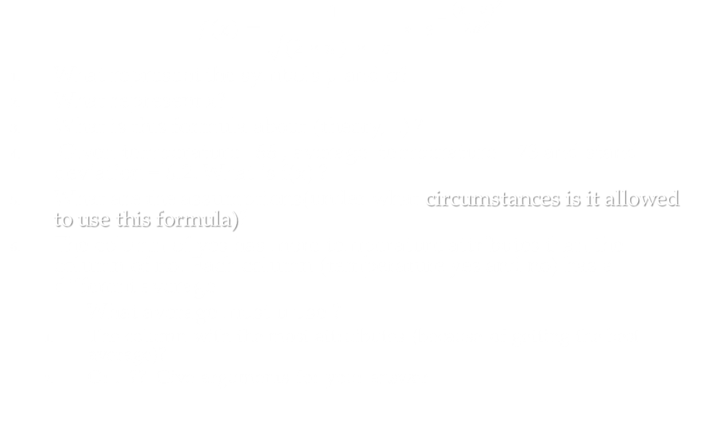
Huiswerk vragen les 2 deel IV
$$f\left(x\right)=\frac{1}{\sqrt{(2∗π}) ∗ σ }∗ e^{− \frac{{(x−μ)}^{2}}{2σ^{2}}}$$
What represent the symbols μ and σ?
What represent x?
What is this formula about (theory, ..) ?
Given temperature =66 , average temperature = 73 and stand deviation = 6.2. What is f(x) ?
What are the assumptions(under what circumstances is it allowed to use this formula)?
The column of yes has more temperature attributes than the column of no. Each column (temperature yes and no) has a different average
What average must u use ?
The column with the most attruibutes (because of getting the best average)?
Or .. ?? Give arguments for your answer

Slide 7
Huiswerk vragen les 2 deel V
Page 99
Naive Bayes questions:
Naive Bayes does not work well. What is the problem?
How do you discover this?
What is a solution ?
Normal distrubution questions:
How can i prove that the data in the predictor column is normal distributed?
What if the normal distribution does not fit the dataset ?
What can you do if you does not have any idea how the data is distributed?
What is a kernel density estimation?

Slide 8
Witten chapter: 4.2 statistical modelling Laplace estimator (page 93 and 94) 4.3 divide-and-conquer: construction decision trees
Huiswerk theorie

Slide 9
Huiswerk practicum
Statistic modeling afronden (numeric + nominal)
Decision trees I

Slide 10
Classification Process : Model Construction
Classification
Algorithms
Training
Data
Classifier
(Model)
IF rank = ‘professor’
OR years > 6
THEN tenured = ‘yes’
CSE634 course notes – Prof. Anita Wasilewska

Slide 11
Testing and Prediction (by a classifier)
IF rank = ‘professor’
OR years > 6
THEN tenured = ‘yes’
Classifier
Testing
Data
Unseen Data
(Jeff, Professor, 4)
Tenured?
CSE634 course notes – Prof. Anita Wasilewska

Slide 12
Classification by Decision Tree Induction
Decision tree generation consists of two phases
Tree construction
At start we choose one attribute as the root and put all its values as branches
We choose recursively internal nodes (attributes) with their proper values as branches.
We Stop when
all the samples (records) are of the same class, then the node becomes the leaf labeled with that class
or there is no more samples left
or there is no more new attributes to be put as the nodes. In this case we apply MAJORITY VOTING to classify the node.
Tree pruning
Identify and remove branches that reflect noise or outliers
CSE634 course notes – Prof. Anita Wasilewska

Slide 13
Les voorbeeld : maak een tree mbv Excel
age | income | student | credit_rating
young | high | no | fair
young | high | no | excellent
middle | high | no | fair
old | medium | no | fair
old | low | yes | fair
old | low | yes | excellent
middle | low | yes | excellent
young | medium | no | fair
young | medium | yes | fair
old | medium | yes | fair
young | medium | yes | excellent
middle | medium | no | excellent
middle | high | yes | fair
old | medium | no | excellent

Slide 14
In pseudocode, the general algorithm for building decision trees is:
Check for base cases
For each attribute a
Find the normalized information gain ratio from splitting on a
Let a_best be the attribute with the highest normalized information gain
Create a decision node that splits on a_best
Recur on the sublists obtained by splitting on a_best, and add those nodes as children of node
J48 is an open source Java implementation of the C4.5 algorithm in the weka data mining tool.

Slide 15
categorical
categorical
continuous
Refund
class
Yes
No
NO
MarSt
Single, Divorced
Married
TaxInc
NO
< 80K
> 80K
NO
YES
Test Data
Assign Cheat to ?

